Slide 1
Words Unlocked
Poetry Competition
Notes:
These lesson plans were designed for you, the instructor. The poems purposely introduce poetry through many peer-level authors to help inspire students to write poetry. It is a seven-day lesson plan with the goal in mind of all students producing poems they can enter into a school-wide poetry contest (of which the winner will be submitted to the BreakFree Poetry Contest). The due date for the BreakFree contest is at the end of April (check website for date), but we suggest teaching this unit as soon as possible to give students time to focus on the poem(s) they want to submit.

Slide 2
Day 1
Unit Launch and
Poetry Introduction
Notes:
Today is the first day of the poetry unit where we will be learning about the genre of writing called poetry
We will begin by introducing expectations of this unit: what we will be reading, what our focus will be, what our end goals are
As an entry point into the unit, we will break into small groups and participate in literature circles
In literature circles, students will work in groups where they each have an assigned role. As a group, students will complete the handout, which guides them in analyzing why poems are written and the many techniques that can be used in poetry
Once students complete their literature circle, they will move onto creating a poster with the key points of their reading to present to the class the next day

Slide 3
Do Now
Write a definition for poetry
Notes:
Teachers should provide a slip of paper or a writing journal for students to use throughout the unit’s Do Now activities. Some Do Now activities are included in the daily handouts.

Slide 4
Agenda
Do Now: poetry definition
Introduction to Poetry unit and focus poet
Group Literature circles & poem analysis
Group presentations
Exit Ticket

Slide 5
Objectives
Students will be able to:
Understand the purpose of this poetry unit and what we will be learning throughout it
Participate in small group literature circles to analyze different poems in order to answer the question, “What is poetry?”
Synthesize information from readings in literature circles and create posters to present findings from their texts and analysis to the class.

Slide 6
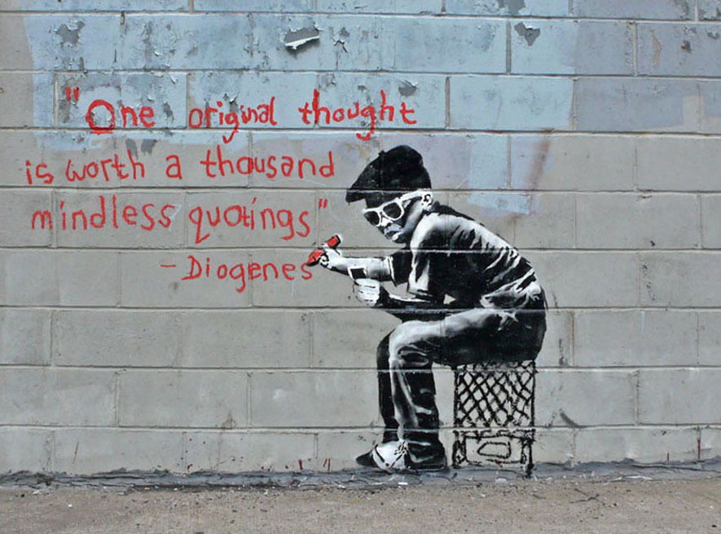
Introduction: What is Words Unlocked?
Throughout this month, we will be exploring the world of poetry. We will see how poetry can be used to communicate important messages and share important truths.
Don’t forget, there’s a competition too!
Notes:
Distribute the Note to Students
Explain to the students that by the end of this unit, they will be required to write a poem. As we go through our unit, they should keep that in mind as they learn more about poetry. Anytime something sparks their imagination, they should make a note of it (perhaps in their writer’s notebook). Explain BreakFree’s contest to them. Explain that they are going to be the poets. The BreakFree Contest is their chance to be an author. You may want to let them know that, though they only have one poem due at the end of this unit, they will hopefully be inspired to write many and choose their favorite and best for entry into the contest.
*reminder that only winning poems from school-wide contests will be eligible for submission to the Breakfree contest.

Slide 7
Introduction: 2023 Words Unlocked Theme
Shapeshift
To change one's shape or form or appearance through often magical means;
to undergo a noticeable change (for example, in character); to metamorphosize.
When writing your poetry this month, you are encouraged to share your truths and realities about this theme.
Notes:
1. Tell students that each year there is a theme to Words Unlocked, and they are encouraged to reflect on the theme when writing their poetry, especially their final poem that they will be submitting to your school-wide competition (of which the winning poem will be considered in BreakFree’s national poetry competition).
2. The theme for 2024 is Shapeshift. Spend a moment discussing what shapeshifting means with your students.

Slide 8
Introduction: What to expect
Throughout this unit we will
Learn what poetry is and the different poetic writing devices that authors use
Analyze poems to find and understand their deeper purpose and meaning
Write our own poems and have a poetry recital and competition!
Notes:
1. Introduce students to the expectations for what they will accomplish during this poetry unit.

Slide 9
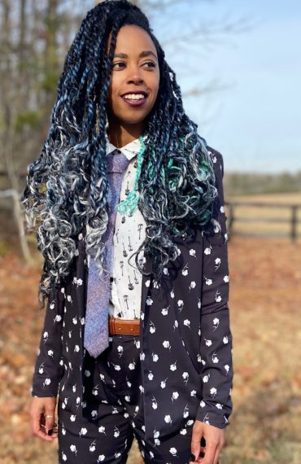
Our Focus Poet: Amber McBride
Amber McBride believes in magic, Hoodoo, ghosts and all the things she can’t see. The universe is, after all, 95% dark energy and dark matter; it would be strange to trust the 5% of reality. Amber’s parents blame her whimsy on the fact that she was born in the shadow of Heidelberg Castle in the middle of the night. Which is a fair assumption, all things considered.
Amber attended James Madison University and was a Pre-Med Major for two years before she decided to switch to English with a Creative Writing and African Studies minor. Switching majors was one of the best & most difficult choices she ever made.
Amber now teaches at the University of Virginia. Amber’s students call her Ms. Mermaid, because of her obsession with mermaids/medusa/mama wata. Her family calls her little wolf. Either way she is hardly ever called by her name. Why go by one name when you can have many?
Amber is also an avid reader—averaging around 100 books a year. She also enjoys searching for new music, cooking, writing poetry & novels, traveling and hanging out with her close friends and family in her spare time.
Notes:
1. Explain to students that each year, Words Unlocked selects a focus poet to highlight. A poet that is inspiring and will help us to launch the poetry unit. This year we have selected Amber McBride.
2. Read the Bio on Amber. Ask students to take think about their reactions to what Amber shares in her bio (anything that surprises them, sparks their interest, they can relate to).
3. Ask your students to share out some of their reactions.

Slide 10
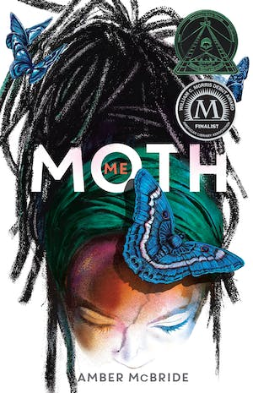
Our Focus Poet: Amber McBride
Amber’s debut YA novel-in-verse, Me (Moth) is about a teen girl who is grieving the deaths of her family, and a teen boy who crosses her path.
Here’s what she said when asked why she wrote Me (Moth) in verse:
Poetry has always been my first love—I started writing poetry in sixth grade. It was the format that made sense to me. I like the brevity and immediacy of poetry. I am mesmerized by the timelessness of poetry… I enjoy writing in all formats, but verse is where I feel at home.
Listen to the opening poem in the book here!
Notes:
1. Introduce Amber further and her book in verse, Me (Moth).

Slide 11
Our Focus Poet: Amber McBride
Watch the video created for Amber’s book being a finalist for the National Book Award. Read the excerpt on the next page and consider the questions after watching.
What are your thoughts about this poem?
What elements of ‘shapeshift’ do you hear in the poem?
What do you think is important when writing a poem?
Notes:
1. Tell students they will be watching a performance by our focus poet. Remind them to consider our theme of ‘shapeshift’ as they listen to the performance.
2. Watch the video and ask students to reflect on the questions on the next slide.

Slide 12
Our Focus Poet: Amber McBride
Excerpt from the poem “Moth”
Blossom in four stages because they are very good at poker
& don’t want to show all their cards at once.
egg (harden)
caterpillar (grow)
cocoon (rest)
moth (live)
This is how it goes.
Egg is nothing special–we are all an egg at one point.
Then caterpillar, spotted & furry like a mustache snatched
from a face.
Cocoon is the miracle.
When the caterpillar literally melts, sticky & soupy,
into slop & reassembles itself into a moth.
Imagine stepping out of the pot as Medusa.
Imagine your DNA holding the secret to snake hair & stone men.
Imagine being prepared to die
just to fly for a few weeks in the sky.
What are your thoughts about this poem?
What elements of ‘shapeshift’ do you see in the poem?
What do you think is important when writing a poem?
Notes:
1. Read the excerpt from the poem they watched in the previous video and ask students to reflect on the questions.
2. You can provide students with a written copy of the poem, located in Day 1 handouts.
3. For additional poems by Amber McBride consider the following:
Desecrate
For Colored Kids Building Up Their Bones
Black Witch Moth (Ascalapha odorata)
Slow Dance Furious

Slide 13
Thoughts to start the day
Who are some of your favorite poets? Why?
Do all poems rhyme?
Why do authors choose to write poems?

Slide 14
Literature Circles: Discover what poetry is
What will we do?
Each table will be assigned two different poems.
In your table groups each person will be assigned to a role (reader, discussion leader, summarizer, presenter).
As a group you will complete one analysis sheet and one group poster.
You will present your group poster to the class today.
Why are we doing this?
Before we begin reading and analyzing poems we need to understand what a poem is.
This poetry hunt will help us break down some of the stereotypes we may have learned about poetry.
Notes:
1. Explain the literature circle activity to students and go over the steps they will take in their groups to complete the task.
2. Break students up into their groups.

Slide 15
Literature Circles: Choose your role
Reader: Your job is to read the text aloud. You must read slowly and clearly and be sure that everyone is following along as you read.
Discussion Leader: Your job is to lead discussion once the reading is completed. You
will guide the group in responding to the questions that are asked and you will write
down the responses to the questions on the group handout.
Summarizer: Your job is to help your group summarize all that has just been read and learned and pick out 5 “must knows” from the text. You will write your group’s summary on the group handout. Additionally, you will lead your group in creating 2-3 “lingering questions” that you have after the reading.
Presenter: Your job is to lead your group in creating a group poster, which all group members must help to create, and then you will present your group poster to the class.
Notes:
1. With students divided and seated in their groups, have each group member choose the role they want to play. If a group does not have 4 members, some students may need to take on more than one role.
2. Distribute the Poems and handouts to each group. Note: Only one handout per group is necessary.

Slide 16
Literature Circles: Presentation Posters
What should be on the poster?
Your topic/subject
5 "takeaways" from your summary
Any important information about your topic you think the whole class needs to know
...remember, it doesn’t have to be pretty!

Slide 17
Literature Circles: Get started
The reader will read the text (you can take turns if you want!)
The discussion leader will then lead the group in answering the discussion questions and will write the group responses on the handout.
The summarizer will lead the group in summarizing the information by listing "5 takeaways" (the most important points from your packet) and 2-3 "lingering questions" (questions your group still has on your topic).
The presenter will lead the group in creating the group poster: it should include the topic, the most important information, and be very clear. (It does not have to be pretty!)
When steps 1-4 are complete we will present our literature circle findings!
Notes:
1. Teachers can leave this slide up while groups work to complete their literature circle task as a reminder of their roles within their group. You may also provide copies to students (located in day 1 handouts)
2. Teacher can rotate amongst groups to offer individualized support and facilitate the task

Slide 18
Exit Ticket
Make sure your literature circle group sheet is complete and turn it into the teacher.
*Don’t forget to fill in your Daily Learning Log
Notes:
1. Ask students to complete their literature circle group sheet and submit it before leaving class
2. Ask students to complete their Daily Learning Log

Slide 19
Day 2
Metaphor & Simile
Notes:
Today’s class will focus on similes and metaphors. A simile is a form of comparison that uses like or as. The author generally uses this comparison to create a mental picture for the reader or to exaggerate a certain trait
A metaphor is a form of comparison that calls on a thing by the name of another. Similar to the simile, by calling one thing another the author is highlighting a specific trait
In order to understand a poem, you can’t only know how to identify a simile or a metaphor. Good readers also know how to analyze them. Good readers ask themselves, “Why is this significant?” “What is the author trying to say?”

Slide 20
Do Now
Read the following sentences. Identify what two things are being compared Explain what the author means by the comparison My rhymes are shot clocks, interstate cops and blood clots, my point is your flow gets stopped. (Talib Kweli) Me without a mic is like a beat without a snare. (Lauryn Hill)
What two things are being compared? |  | Why does the author make this comparison?
Notes:
Distribute Day 2 handouts for the Do Now handout

Slide 21
Agenda
Do Now: Find the comparison
Learn about Metaphor & Simile
Identify and analyze metaphors and similes
Write your own poem!
Exit Ticket

Slide 22
Objectives
Students will be able to:
Identify, define, and differentiate between metaphors and similes.
Create original similes and metaphors.
write a poem that includes similes and/or metaphors

Slide 23
Thoughts to start the day
Why do you think poets might compare 2 things in their poems?
What are the different pieces of a poem?
Why do authors choose to write poems?

Slide 24
Cornell Notes
Key Words & Questions
Details
What is a metaphor?
Comparing a person, place, or thing to another person, place, or thing to show that even through they are different they still have some significant similarity.
Usually is a comparison with the word is.
Examples:
Life is a mountain.
America is a melting pot.
Pain is an ocean.
Notes:
1. Distribute the Cornell notes handout and walk students through completing.

Slide 25
Metaphors: Let’s create some!
Let’s create examples of metaphors with LOVE?
Love is __________________ Love is ___________________
Love is __________________ Love is ___________________
Love is __________________ Love is ___________________

Slide 26
Cornell Notes
Key Words & Questions
Details
What is a simile?
Comparing two or more nouns (person, place, or thing) using like or as.
Examples:
Life is like a mountain.
My pain is as deep as the ocean.
Her eyes are like the stars.

Slide 27
Similes: Let’s create some!
Let’s create examples of Similes with LOVE?
Love is __________________ Love is ___________________
Love is __________________ Love is ___________________
Love is __________________ Love is ___________________

Slide 28
Cornell Notes
Key Words & Questions
Details
What is the difference between a metaphor and a simile?

Slide 29
Analyzing Poetry
Read the poem Happiness.
Identify the similes and metaphors in the poem.
Then explain why the comparison was made.
Pre-reading questions:
What does the word "beacon" mean?
What does the word "elusive" mean?
Notes:
Remind your class that it’s not enough to just identify a simile or metaphor, to fully understand a poem you must also understand why the simile or metaphor is significant
As a class, read the poem Happiness in the handouts and complete the graphic organizer on the next page

Slide 30
Poetry Analysis: Happiness
What items are being compared? |  | Why does the author make this comparison?
Simile or Metaphor: ____________________
What items are being compared? |  | Why does the author make this comparison?
Simile or Metaphor: ____________________
What items are being compared? |  | Why does the author make this comparison?
Simile or Metaphor: ____________________
Notes:
Walk students through analyzing the poem Happiness on their handouts. Use the graphic organizers to not similes and metaphors the author uses.

Slide 31
Analyzing Poetry: Try it on your own!
Read the poem Harlem (A Dream Deferred).
Identify the similes and metaphors in the poem.
Explain why the comparisons were made.
Pre-reading questions:
What does the word "deferred" mean?
Notes:
2. The poem Harlem is in the student handouts

Slide 32
Poetry Analysis: A Dream Deferred
What items are being compared? |  | Why does the author make this comparison?
Simile or Metaphor: ____________________
What items are being compared? |  | Why does the author make this comparison?
Simile or Metaphor: ____________________
What items are being compared? |  | Why does the author make this comparison?
Simile or Metaphor: ____________________
Notes:
Walk students through analyzing the poem in their handouts. Use the graphic organizers to not similes and metaphors the author uses.

Slide 33
Write Your Own Poem
Create your own poem of at least 8 lines, using the metaphors and similes you created about LOVE at the beginning of class. You can add more to the poem, but the focus of this poem is to use metaphors and similes.
Go back to your notes and start with the similes and metaphors you created on love!
The theme of your poem is love.
You must use metaphors and similes in your poem.
Your poem must be at least 8 lines long.
After 10 minutes we will share out!

Slide 34
Exit Ticket
1. What is a metaphor? 2. What is a simile? 3. What is the main difference between a metaphor and a simile? 4. What is similar between a metaphor and a simile? 5. Why do poets use metaphors and similes?
*Don’t forget to fill in your Daily Learning Log
Notes:
1. Ask students to complete their Daily Learning Log

Slide 35
Day 3
Personification

Slide 36
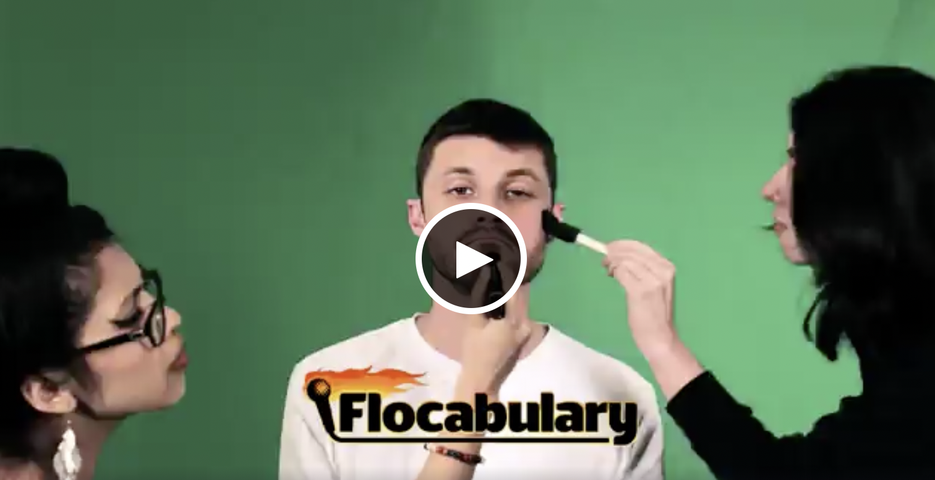
Do Now
Watch the video on Flocabulary to find out about personification and answer the following: What is personification? Give an example:
Notes:
1. Provide students with the do now handout

Slide 37
Agenda
Do Now: Flocabulary
Introduction to Personification
Glossary: Metaphor, Simile & Personification
Personification practice
Identify and analyze personification
Write your own poem!
Exit Ticket

Slide 38
Objectives
Students will be able to:
Define, identify, and analyze personification in poems through writing analysis paragraphs.
Write original poems about their neighborhood using personification.

Slide 39
Cornell Notes
Key Words & Questions
Details
What is personification?
Examples of personification:
Giving human qualities to non-human things.
What are some examples of non-human things?
What are some examples of human qualities?
My alarm clock screams.
This is an example of personification because
_____________________________________
The pencil cries when the eraser is thrown across the room.
This is an example of personification because
_____________________________________
Notes:
1. Students will complete the notes in the handout

Slide 40
Cornell Notes
Key Words & Questions
Details
Your turn! Create some examples of personification with these starters….
Why do you think poets may decide to use personification in their poems?
The sunshine ______________________________.
The rusty door hinge _______________________.
The culinary lunch _________________________.
The car ___________________________________.
My clothes ________________________________.

Slide 41
Glossary: Let’s add to it
Metaphor Definition: _____________________________________________________________ Example(s):
Simile Definition: _____________________________________________________________ Example(s):
Personification Definition: _____________________________________________________________ Example(s):
Notes:
Provide students with a copy of the glossary for them to complete throughout the unit

Slide 42
Personification: Class practice
Complete each sentence with a choice from the word box.
The clock _______________
My chair ________________
The water ______________
The pencil ______________
The book _______________
His shoe ________________
Word Box
shouts
is dancing
complains
cries
is tired
laughs

Slide 43
Personification: Independent practice
Come up with 6 things you encounter on a typical day in your neighborhood or your hometown in general and personify them!
1) ________________________________________________________
2) ________________________________________________________
3) ________________________________________________________
4) ________________________________________________________
5) ________________________________________________________
6) ________________________________________________________

Slide 44
Analyzing Personification: Group Practice
Let’s find examples of personification together. Identify any example of personification in the poems and we’ll complete the tables on the next slide.
The Rose That Grew From Concrete
by Tupac Shakur
Did you hear about the rose that grew from a crack in the concrete?
Proving nature's law is wrong, it learned to walk without having feet.
Funny it seems, but by keeping its dreams, it learned to breathe fresh air.
Long live the rose that grew from concrete when no one else ever cared.
Notes:
1. Poems and questions are located in the handouts

Slide 45
Analyzing Personification: Group Practice
What item is being personified? | How is the item being personified? (What human quality is given to the object?) | What does the personification do to the object?
What item is being personified? | How is the item being personified? (What human quality is given to the object?) | What does the personification do to the object?
What item is being personified? | How is the item being personified? (What human quality is given to the object?) | What does the personification do to the object?

Slide 46
Analyzing Personification: Group Practice
What is the effect of Tupac’s personification in the poem as a whole?

Slide 47
Analyzing Personification: Independent Practice
Underline the examples of personification in the poem and complete the table in your handout.
Song for Anacostia
by Fred Joiner
Notes:
1. Poems and questions are located in the handouts
2. The following slides can be used to discuss the poem after students read it independetly

Slide 48
Analyzing Personification: Independent Practice
What item is being personified? | How is the item being personified? (What human quality is given to the object?) | What does the personification do to the object?
#1
#2
1. What is the meaning of this poem?
2. What is the mood of this poem?
Notes:
If time permits, discuss the poem as a class and ask students to share what they wrote in their graphic organizer

Slide 49
Write Your Own Poem
Create your own poem of at least 8 lines, using the examples of personification you created about a typical day in your neighborhood or your hometown, plus at least 1 metaphor or simile.
The theme of your poem is, A Typical Day
You must use at least 4 examples of personification and at least 1 metaphor or simile
Your poem must be at least 8 lines long
After 10 minutes, we will share out!

Slide 50
Exit Ticket
1. What is the effect of personification? 2. Why might a poet use personification?
*Don’t forget to fill in your Daily Learning Log
Notes:
1. Ask students to complete their Daily Learning Log

Slide 51
Day 4
Alliteration & Symbolism

Slide 52
Do Now
Identify what the objects mean and write what they mean to you in the box below the image.
What does this object mean?
What does this object mean?
What does this object mean?
What does this object mean?
Notes:
1. Provide students with the do now handout

Slide 53
Agenda
Do Now: What do these images mean?
Introduction to Alliteration & Symbolism
Glossary: Alliteration & Symbolism
Identify and analyze poems
Write your own poem!
Exit Ticket

Slide 54
Objectives
Students will be able to:
Define, identify, and analyze alliteration and symbolism is poetry.
Create an original poem using alliteration and symbolism.

Slide 55
Before We Begin
Read the following poem excerpts, pair with a partner and share your answers to the questions.
While I nodded, nearly napping, suddenly there came a tapping,
As of someone gently rapping, rapping at my chamber door.
… from The Raven by Edgar Allan Poe
What do you notice about how Edgar Allen Poe creates the sound in these lines?
Two roads diverged in a yellow wood,
And sorry I could not travel both
And be one traveler, long I stood
And looked down one as far as I could
To where it bent in the undergrowth;
… from The Road not Taken by Robert Frost
What do you think the “roads” represent?
Notes:
1. Provide students with the handouts for today

Slide 56
Cornell Notes
Key Words & Questions
Details
What is alliteration?
Where is alliteration used in these lines?
Create a line of poetry that uses alliteration:
Alliteration is the repetition of a certain sound at the beginning of a set of words in the same line.
I’m trying to live it to the limit and love it a lot.
Where is the alliteration?
Peter piper picked a pickled pepper.
Where is the alliteration?

Slide 57
Cornell Notes
Key Words & Questions
Details
What is symbolism?
What are some examples of symbols?
Why do you think a poet might incorporate alliteration and/or symbolism into his or her poem?
Symbolism is an object or image that represents something other than its literal meaning.

Slide 58
Glossary: Let’s add to it
Alliteration Definition: _____________________________________________________________ Example(s):
Symbolism Definition: _____________________________________________________________ Example(s):
Notes:
1.Provide students with a copy of the glossary for them to complete throughout the unit

Slide 59
Analysis: Group practice
Let’s read the poem and answer the questions about the use of alliteration and/or symbolism by the poet.
Untitled
by Daniel S.
As I live in this life
Loving the long-lasting days
Looking in the sky at the sun’s amazing rays
Every moment, every minute, every month
must be a memory thought
that walks through the thin and thick
Two-sided path in your head.
My life has been reordered and
remembered by the recipients -
That remorse on the river of long-lasting pain
I’m like a grain of sand
There’s many like me
But my grain
Is mine.
Underline places where the poet uses alliteration.
What does the alliteration do to this poem?
The following line is an example of which poetic device?
I’m like a grain of sand
What does the sand represent to the poet?
What is this poem about? What is the meaning of this poem?

Slide 60
Analysis: Group practice
Got to Stop the Rain
by Daniel H.
I need to change so it won’t rain
If I’m doing the wrong thing it’s going to rain.
I don’t mean to do what I do, but it’s
In my brain. Mother asks me everyday to
Change ‘cause if I don’t it’s going to rain.
I don’t like the rain because it wants me to
Change. I am human but don’t like the rain.
When I’m ready to change that’s when it’s
Going to stop raining. Mother keeps telling
Me I’m making it rain but I don’t know
How, ‘cause I’m still the same. Little did
I know, I never saw the rain. Every time
She says it’s raining, I never saw it. Then
One day I walked in my house and saw
It raining. What I saw was my mother
Crying because I didn’t change but when
I changed it stopped raining.
Does the poet use alliteration in the poem? Yes/No
The “rain” is an example of which poetic device?
What does the rain represent?
What is this poem about? What is the meaning of this poem?

Slide 61
Analysis: Independent Practice
Read the poem “Caged Bird” and answer the questions about the use of alliteration and/or symbolism by the poet.
Notes:
Pass out student handouts for day 4

Slide 62
Write Your Own Poem
Create your own poem of at least 8 lines, using both alliteration and symbolism. The topic of today’s poem is YOU!
The theme of your poem is, you
You must use at least 1 example of alliteration and at least 1 symbol
Your poem must be at least 8 lines long
Remember, you can always use other poetic devices too!
After 10 minutes, we will share out!

Slide 63
Exit Ticket
1. What is alliteration? 2. Why might a poet use alliteration? 3. What is symbolism? 4. Why might a poet use symbolism?
*Don’t forget to fill in your Daily Learning Log
Notes:
1. Ask students to complete their Daily Learning Log

Slide 64
Day 5
Onomatopoeia and Imagery

Slide 65
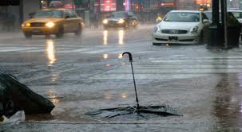
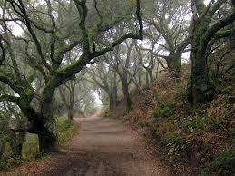
Do Now
Pick an image and imagine that you were standing in the middle of it. Describe the scene to someone who wasn’t there and include any sounds that you hear, things you see, and what you are thinking.

Slide 66
Agenda
Do Now: Describe a scene
Introduction to onomatopoeia & imagery
Glossary: onomatopoeia & imagery
Identify and analyze poems
Write your own poem!
Exit Ticket

Slide 67
Objectives
Students will be able to:
Define, identify, and analyze onomatopoeia and imagery in poetry.
Write original poems using poetic devices, specifically onomatopoeia and imagery

Slide 68
Thoughts to start the day
Name that poetic device! Read the lines of poetry and decide which poetic device is being used!
Personification
1. She is like a diamond.
2. The streets cry for the youth.
3. Money makes the world move.
4. Life is a roller coaster.
5. The caged bird sings for freedom.
Metaphor
Alliteration
Symbolism
Simile

Slide 69
Before We Begin
Crack an Egg
by Denise Rogers
Crack an egg.
Stir the butter.
Break the yolk.
Make it flutter.
Stoke the heat.
Here it sizzle.
Shake the salt,
Just a drizzle.
Flip it over,
Just like that.
Press it down.
Squeeze it flat.
Pop the toast.
Spread jam thin.
Say the word,
Breakfast’s in.
Let’s consider the following poem.
What sounds are in the poem?
What image comes to mind?

Slide 70
Cornell Notes
Key Words & Questions
Details
What is onomatopoeia?
What is imagery?
Why do you think a poet might use onomatopoeia or imagery in a poem?
The use of a word that sounds like an object or the sound that an object makes.
What sounds are in the previous poem?
The use of the 5 senses to create a mental image of an object, scene, event, or person.
What image did the previous poem create?
Notes:
1. Provide students with the notes handout and have them complete as you lead the lesson.

Slide 71
Glossary: Let’s add to it
Onomatopoeia Definition: _____________________________________________________________ Example(s):
Imagery Definition: _____________________________________________________________ Example(s):
Notes:
1.Provide students with a copy of the glossary for them to complete throughout the unit

Slide 72
Practice!
Identify the object that makes the sound in the left side of the table. Then create 4 sounds, using onomatopoeia, for sounds you hear every day.
Describe our school to someone who has never been here before in 3 lines. You must make the image come ALIVE!
What is the onomatopoeia? | Use onomatopoeia to come up with 4 sounds you hear everyday at school.
Oink =
Zip =
Click clack =
Tick tock =

Slide 73
Analysis: Group practice
Let’s read the poem and answer the questions.
Boss
by Dionte C.
I am a boss of basketball
Born to ball
I am like a ball that calls
For the hoop like “swish”
I am a captain on the court
Because I cook kids like cabbage.
1. What poetic devices does the poet use? Underline all examples of the poetic devices. Circle the poetic devices used.
Simile Metaphor Alliteration Imagery Onomatopoeia
2. What sound does the poet use to create onomatopoeia?
3. What does the poet mean when he says, “I am a boss of basketball”?
4. What is the meaning of this poem?

Slide 74
Analysis: Group practice
Let’s read the poem and answer the questions.
April Rain Song
by Langston Hughes
Let the rain kiss you
Let the rain beat upon your head with silver liquid drops
Let the rain sing you a lullaby
The rain makes still pools on the sidewalk
The rain makes running pools in the gutter
The rain plays a little sleep song on our roof at night
And I love the rain.
Notes:
Read the poem as a class or in small groups and answer the questions on the next page.

Slide 75
Analysis: Group practice
Questions for April Rain Song:
What poetic devices does the poet use? Underline all examples of the poetic devices. Circle the poetic devices used.
Simile Metaphor Alliteration Imagery Onomatopoeia Personification Symbolism
How does Langston Hughes personify the rain?
3. What image does Langston Hughes create and how?
4. What is the meaning of this poem?

Slide 76
Analysis: Independent practice
Read the poem below and then answer the questions in the table.
Thunder
by David S.
I’m like thunder that bring the boom, bang, and bumps to everyone
I roar unexpected like death
The lighting follows and the clouds darken
The rain falls, the pain washes away
Everything gets quiet and I still roar
Then people brace themselves for more,
but I roar no more
I keep everyone on edge like a mountain
But like thunder I’m unexpected, I roar.
Notes:
Pass out Handouts for students to complete the graphic organizer

Slide 77
Analysis: Independent practice
1. Underline all onomatopoeia. List the sounds that the poet creates.
2. When the poet writes “I’m like thunder” and “I keep everyone on edge like a mountain,” what poetic device is used?
3. What does the poet mean by the lines above?
4. What poetic device does the poet use in line 1 of the poem?
5. What image is the poet creating throughout the poem?
6. What does “thunder” represent? What is it’s symbolism?
7. What is the meaning of this poem? What is the poet saying?

Slide 78
Write Your Own Poem
Create your own poem of at least 8 lines, using both onomatopoeia and imagery. The theme of your poem is to describe one of the following places here:
Cafeteria
School building
Shop
Rec
Or some other location here
Remember, you can always use other poetic devices too!
After 10 minutes, we will share out!

Slide 79
Exit Ticket
Answer 3 of the following questions on your exit ticket. 1.What is onomatopoeia? 2. What is the effect of onomatopoeia? 3. Why might a poet use onomatopoeia? 4. What is imagery? 5. What is the effect of imagery? 6. Why might a poet use imagery?
*Don’t forget to fill in your Daily Learning Log
Notes:
1. Ask students to complete their Daily Learning Log

Slide 80
Day 6
Spoken Word

Slide 81
Do Now
Read the poem line and identify the poetic device used.
Line | Poetic Device
Sometimes, life can feel like the calm before the storm.
The book screamed for me to read it.
Pitter patter goes the rain.
He is a time bomb ticking.
My dreams tell me to go to sleep.
Simile
Metaphor
Imagery
Alliteration
Onomatopoeia
Personification
Symbolism

Slide 82
Agenda
Do Now: Name that device
Introduction to spoken word and slam poetry
Glossary: spoken word
Analyze poems
Write your own poem!
Exit Ticket

Slide 83
Objectives
Students will be able to:
Define spoken word and slam poetry.
Analyze spoken word poetry for its structure, use of poetic devices, and meaning.
Create an original spoken word piece of poetry

Slide 84
Thoughts to start the day
What is a poem?
What makes a poem a poem?
Can poetry be performed? If so, how?

Slide 85
Cornell Notes
Questions & Key Words
Details
What are social views and social commentary?
Social views are someone’s opinion about an issue in his or her culture or society
Social commentary is someone’s opinion in writing about a problem and asking for change.
What are YOUR views on current social issues?
Notes:
1. Provide students with the notes in the handouts and have them fill in the blanks as you teach.

Slide 86
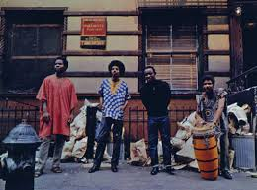
Cornell Notes
Questions & Key Words
Details
• A form of poetry that uses structured poems to express social views.
• Usually written in first person point of view and is themed in current events
• Spoken word poetry is performed in front of an audience
• Spoken word originated during the Harlem Renaissance and blues music
*Interesting fact: modern day
spoken word became popular
in the 1960s by a group called
“the Last Poets"
What is spoken word?

Slide 87
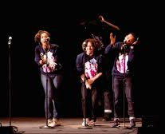
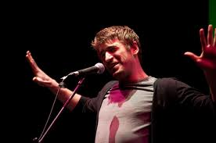
Cornell Notes
Questions & Key Words
Details
• Slam poetry is competition poetry.
• Poets perform structured poems about specific topics relating to their own personal lives.
• Slam became popular in the 1980s in New York and Chicago and San Francisco and then took hold throughout the US.
*Interesting fact: youth slam poetry is one of the most popular types of slam poetry
What is slam poetry?

Slide 88
Cornell Notes
Questions & Key Words
Details
Performance poetry is poetry that is composed for a performance before an audience.
Performance poetry is not intended for writing, but more so performed.
Spoken Word poetry took after performance poetry
*Interesting fact: performance poetry is not very “new” to our world because we have such a rich oral history (passing stories down through telling others
Give your poem a rhythm
Take specific pauses while reading your poem for a dramatic effect
Speed up or slow down your speaking rate at various points in your reading
What is performance poetry?
How do you perform poetry?

Slide 89
Glossary: Let’s add to it
Spoken Word/ Slam Poetry/ Performance Poetry Definition: _____________________________________________________________ Example(s):
Notes:
1.Provide students with a copy of the glossary for them to complete throughout the unit

Slide 90
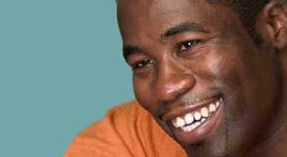
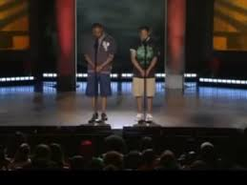
Analysis: Group practice
Together we are going to read the following performance poems and watch their videos. We will then analyze them.
Knock Knock
by Daniel Beaty
Lost Count: A Love Story
by Nate Marshall & Demetrius Amparan
Notes:
1. Divide students into groups (skip if you prefer to have students analyze the poems independently after listening to them as a class).
2. Distribute handout with written copy of the poems and analysis questions.
3. Watch one video at a time and ask students to answer the questions in the handout.

Slide 91
Analysis: Group practice - Knock Knock
What is the topic of this poem? What social problem is the author talking about? Underline a line in the poem that shows the author is talking about this topic.
What is the mood of this poem? How does the poet feel about this topic? Underline a line in the poem that shows the poet’s mood.
What poetic device does the poet continue to use throughout his poem?
What is symbolic about the knock of the dad on the son’s door/ What does this knock become?
What is the meaning of the last 10 lines of the poem?
What stood out to you about the poet’s performance? What did the poet do in his performance to get his point across?

Slide 92
Analysis: Group practice - A Love Story
What is the topic of this poem? What social problem are the poets talking about? Underline a line in the poem that shows the poets are talking about this topic.
What is the mood of this poem? How does the poet feel about this topic? Underline a line in the poem that shows the poets’ mood.
What poetic device do the poets use when they say, “Lives like these shouldn’t be shortened like/Sentence fragments of a future.” What does this mean?
The poets end their poem in a similar way. Why?
What stood out to you about the poets’ performance? What did the poets do in the performance to get their point across?

Slide 93
Write Your Own Poem
It’s time to write your own piece of spoken word or slam poetry! Follow the instructions to get you started:
Choose the social topic that you want to take stand on
Maybe something related to the Words Unlocked theme!
Write your poem
You must include at least 2 poetic devices in your poem.
Your poem must be at least 15 lines long
Remember, you will perform your poem
**You can work in pairs if you want to co-author a poem!
After 10 minutes, we will share out!

Slide 94
Exit Ticket
1. What is slam poetry/spoken word/performance poetry? 2. What does it mean that "spoken word poetry is based on a social view“ ? 3. How do you perform poetry?
Don’t forget about BreakFree’s Words Unlocked Poetry Competition!
(learn more in the following slides)
Notes:
1. Ask students to complete their Daily Learning Log

Slide 95
Words Unlocked Poetry Competition!
You will have the opportunity to write and share a poem that incorporates the theme.
Winners from our school will enter into the
nationwide competition!
Notes:
Remind students about the BreakFree Education Words Unlocked poetry competition
Tell students that the competition is nationwide and that winners will receive prizes
Explain that your class/school will have its own competition and the top three poems will be submitted to the national competition
Tell students the details of the speech
It will be 3-4 minutes long
It will be on a specific prompt (next slide)
They will submit both their written speech along with an audio recording of them presenting it
Our How-To guide also offers assistance in how to record students’ speeches
For additional competition information, view the guidelines here

Slide 96
Poetry Theme
When writing your poetry, you are encouraged to share your truths and realities about the following theme.
Shapeshift
To change one's shape or form or appearance through often magical means;
to undergo a noticeable change (for example, in character);
to metamorphosize.
Notes:
Read the prompt to students and answer any questions they have about it
Tell students this is the prompt they will be using for the competition
Remind students that this is an opportunity for not only their own voices to be heard, but for them to encourage people to listen to others’ voices as well

Slide 97
Focus Poet: Amber McBride
“As a child I was sure I was part wolf. Then there was the Slytherin Pride era. In my mid-twenties I shifted into a mermaid (I wanted to be liked). Turning 30 changed things; I am in my Mama Wata & Medusa (Wolf) era & that’s called leveling up.”
Amber McBride
on the importance of shapeshifting
Notes:
Read this quote about shapeshifting from our focus poet

Slide 98
Sample Poems
The following slides include sample poems around the theme of shapeshifting that may spark some inspiration!
Keep an open mind and notice the different interpretations of what shapeshifting means and represents.
Remember: your poems can be personal, universal, realistic, fantastical, etc!
Notes:
1. Tell students to look for the theme of shapeshifting as they read through the following poems. Remember that these poems are meant to inspire students, they do not need to be templates students follow. Encourage students to reflect on what shapeshifting means to them and write a poem that encapsulates that meaning.

Slide 99
The Light Streams In By Tomas Tranströmer
Outside the window, the long beast of spring
the transparent dragon of sunshine
rushes past like an endless
suburban train – we never got a glimpse of its head.
The shoreline villas shuffle sideways
they are as proud as crabs.
The sun makes the statues blink.
The raging sea of fire out in space
is transforming to a caress.
The countdown has begun.
Notes:
Source: https://pickmeuppoetry.org/the-light-streams-in-by-tomas-transtromer/

Slide 100
Metamorphosis By Ms Moem
I’m tired of waiting, being stuck on the verge.
Done being a caterpillar, I long to emerge
As a beautiful butterfly, flying free in the world;
It’s all that I’ve dreamt of since I was a girl.
Notes:
Source: https://pickmeuppoetry.org/the-light-streams-in-by-tomas-transtromer/

Slide 101
I wish I was a Bird by Marie Brousseau-Chauvet
I wish I was a bird,
to be able to fly
and call the sky home,
To live in the trees
And to call my domain,
To feel true freedom,
in tune with myself,
But then,
I wish I was a shapeshifter,
to swim in the waves
and fly in the sky,
And yet still call humans “family”
because I might be a bird and call trees my domain,
I want to keep living the life I have built here,
and live with my family
as well as my friends.
I wish I were human
now and again
Notes:
Source: https://www.writco.in/public/Poem/P62609272020004053

Slide 102
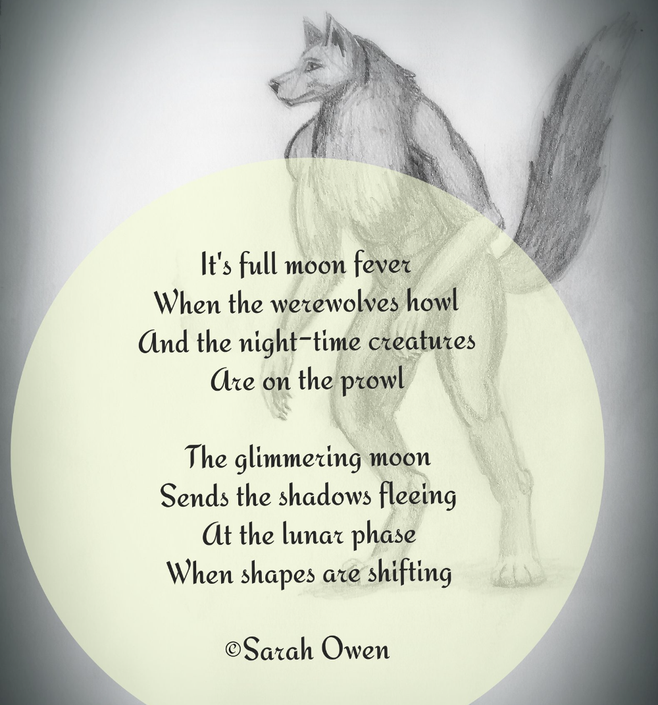
Werewolf by Sarah Owen
Notes:
Source: https://www.writco.in/public/Poem/P62609272020004053

Slide 103
From The Book of Taliesin
He transforms shape at his own will
Stag, boar, hare on the highest hill
Enchanted harp lays
Silver salmon plays
Yesterdays
Changing still
This poem is from the 1300’s and was written about a mythological poet in Wales who is said to have taken the form of many beings throughout his lifetime. The story goes that a witch accidentally gave Taliesin great knowledge and afterwards chased him to try and take back the knowledge. During the chase both of them shapeshifted (he to escape her, and she to hunt him)
Notes:
Source: https://medium.com/appalachian-tales-and-trails/taliesin-the-bard-d2b45f0ed0b9

Slide 104
"Shapeshifter" by Maureen McQuarry
There is a moment
when the creature seems to disappear.
Nothing remains, but a quivering
in the air, the invisible finger
that runs your ridge of spine
My students ask if it hurts
to become another. We’ve read
the stories of humans furred,
flesh erupting to wings, or scales,
gill-gasp of transformation.
I tell them some are stories of pursuit,
a dove answered with a hawk,
a hare with greyhound as reply.
Pursuer and pursued, their deft dance
that ended once with a grain of corn,
swallowed by a hen who birthed
the storyteller,Taliesin.
But what the students want to know is pain.
That remembered moment when
quills pierce skin, fingernails bleed
to claws. Beyond the window
winter’s first kiss startles the grass with frost.
I tell them yes,
there is always pain at birth or when,
our tent of flesh opens
like a door to the sky,
and something more, you must
lean close to hear
the single note of joy.
Notes:
Source:https://endicottstudio.typepad.com/poetrylist/shapeshifter-by-maureen-mcquarry.html

Slide 105
I Am Shapeshifting by Bernice B
I am shapeshifting
Stretching my personality to bend
To what is funny
What is trendy
What makes other people
Want to gravitate towards me
Like a magnet.
I am the belle of the ball
The smile permanently plastered on my face
But it barely conceals the desperate longing
To be liked.
I am still growing
And realizing
That the shapes I take on
Are not always the right fit
Like how a round peg
Can’t force its way through a square hole.
The malleability of my personality
Needs to take a chill pill
I need to build my identity in cement
Instead of stretching it like clay
Until it breaks.
I am shapeshifting
And finding
That I like myself best of all.
Notes:
Source: https://medium.com/the-brain-is-a-noodle/i-am-shapeshifting-339eafa16e54

Slide 106
Day 7
Poetry Recital / Poetry Slam
Notes:
Note to teachers: the following slides are to use when you carry-out the end-of-unit poetry cafe or recital. We recommend having several days of poetry workshops for students to write and revise their poems as well as practice delivering it.

Slide 107
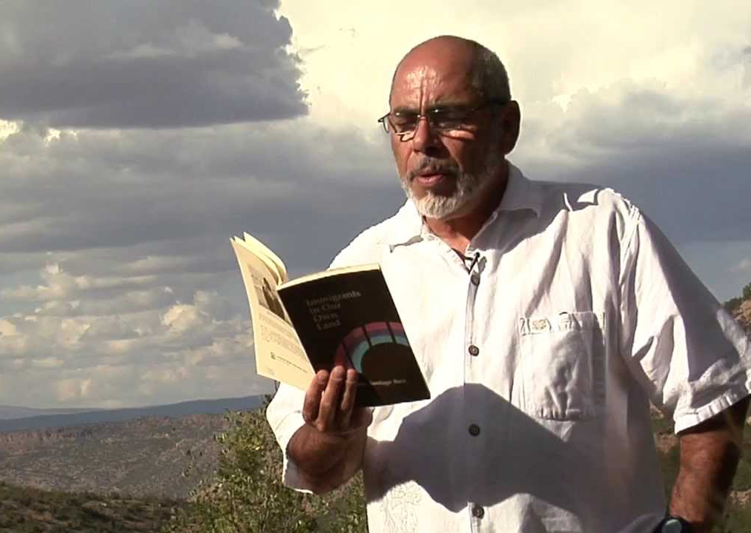
Do Now: Relaxation preparation
Watch the video and as you listen, allow the author’s words and voice calm you.
Notes:
1. Explain to students that they will be performing their poems today. It’s normal to feel nervous or anxious before a performance, but encourage your students to find their center. Have them watch the video and listen to Poet Jimmy Santiago Baca as he speaks about desire and overcoming fears to accomplish something.

Slide 108
Agenda
Do Now: Relaxation
Poetry Recital Expectations
One last example from our Focus poet
Poetry slam/recital!
Exit Ticket

Slide 109
Objectives
Students will be able to:
Share original works of poetry!

Slide 110
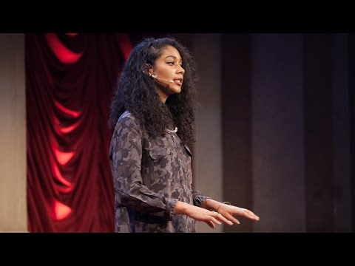
Bonus: Spoken word from our Focus Poet
Let’s look at one more example of spoken word from our Focus Poet!
Notes:
1. Watch one more spoken word piece from focus poet, Safia Elhillo. Remind them to consider our theme of ‘renewal’ as they listen to the performance.

Slide 111
Bonus: Spoken word from our Focus Poet
Consider these questions about our Focus Poet’s performance
What do you notice about how the poet presents their poem?
How do they speak?
Do they take dramatic pauses?
How do they change their speaking rate?
Does the poet use any hand gestures to emphasize their point?
How do the poets engage the audience?
Notes:
1. Ask students to reflect on these questions independently or as a group.

Slide 112
Poetry Slam: Rules
Read at least 1 poem aloud in the slam
“Present” or “perform” your poem, and not simply "read" it
One mic
Respect yourself, the audience, each other, and your writing

Slide 113
Poetry Slam: Group Review
Let’s share our feedback!
What is the Poem about?
How did the poet(s) use performance to get their message across to the audience?
What stood out most about the poem?
What feeling was evoked by the poem?
Notes:
1. As a class, you can have students offer feedback to the performing poet. Use these questions as a guide for offering feedback and providing a review of the poem and performance. Alternatively, you can ask students to write their responses to the questions and submit their reviews to be shared with poets at a later time. You can choose to conduct these reviews together, at the end of all performances, or after each one, individually.

Slide 114
Exit Ticket
How did your poetry develop over the course of this unit?
*Don’t forget to fill in your Daily Learning Log
Notes:
1. Ask students to complete their Daily Learning Log

Slide 115
Congrats on all your hard work throughout this poetry unit! You all did an amazing job in your writing and performance!

