Slide 1
Investors Club
Notes:
All lessons have been adapted from The Stock Market Game’s curriculum.

Slide 2
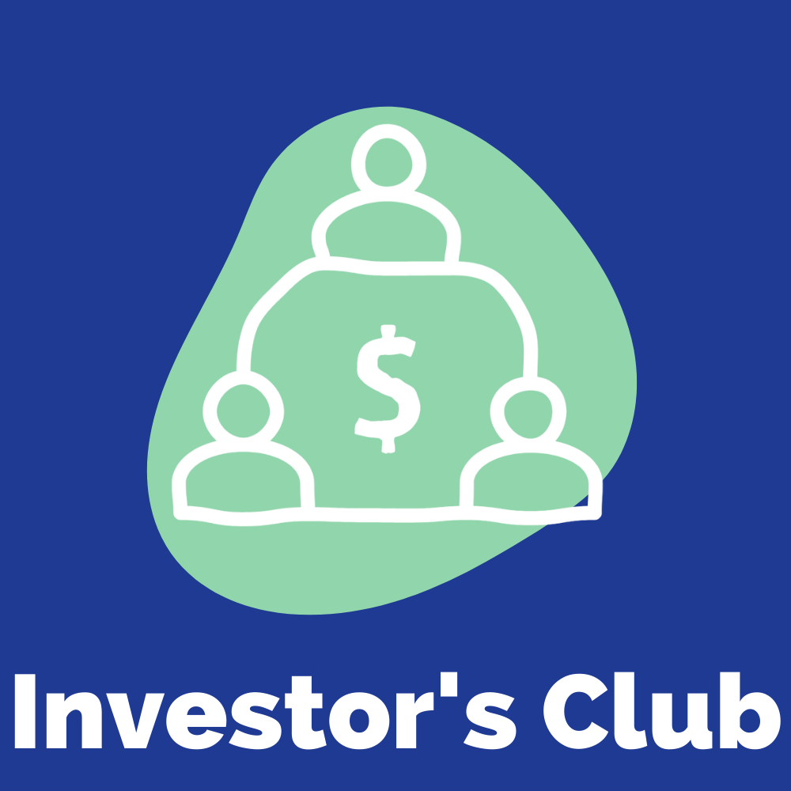
Lesson 1
Introduction to Investors’ Club and Stock Market Game
Notes:
View Lesson plan Here
Lessons adapted from The Stock Market Game

Slide 3
Do Now
What would you do with $100,000?
Notes:
As students enter classroom, have the Do Now prompt on the screen for them to respond to in their journals, handout, or piece of paper.
Lessons adapted from The Stock Market Game

Slide 4
Agenda
Do Now
What is the Investor’s Club?
What is $100,000 worth?
Team Rules and Roles
Exit Ticket
Notes:
Review the agenda for the day
Lessons adapted from The Stock Market Game

Slide 5
Objectives
Students will be able to
Understand the relative dollar value of $100,000
Understand the consensus building process
Cooperatively create rules for successful cooperation and consensus building
Identify key roles in managing a stock market portfolio
Notes:
Review the objectives for the day, so students know what is expected of their learning
Lessons adapted from The Stock Market Game

Slide 6
What is the Investors Club?
Our Focus: The stock market and gaining insight into the world of finance
What to Expect: Learning about investing money, playing the stock market, and pursuing careers in finance
Our Goal: Practice investing and to compete in a national competition!
Notes:
Introduce students to the Investors Club and explain what they can expect
Tell students that they will compete in BreakFree’s national competition to see what school can invest the smartest and increase their holdings
Lessons adapted from The Stock Market Game

Slide 7
What is the Stock Market Game?
In The Stock Market Game (SMG), students work together to create and manage a virtual investment portfolio of real world stocks, bonds, and mutual funds. Each team is responsible for researching and evaluating potential investments. Team members must also effectively come together on cooperative decisions on whether to buy, sell, or hold the stocks, funds, and bonds in their portfolio.
Notes:
Introduce students to the Stock Market Game and explain what they can expect
Tell students that they will be able to log into the game to research and make trades as a team
Lessons adapted from The Stock Market Game

Slide 8
Why is investing important?
Notes:
Watch the video as an introduction
Lessons adapted from The Stock Market Game

Slide 9
Revisiting the $100,000
Directions: With your $100,000 you can buy any of the following items (and multiple of each). You just have to spend your $100,000 completely. Write down the items and quantities you would purchase. Then pair off and determine the most popular items.
PS5
$500
Toyota Corolla
$20,000
Vacation to Caribbean for 1 person $5,000
Personal library
$2,000
French Bulldog
$1,500
Recording Studio
$30,000
Daily Starbucks
$1,500
1 Season Ticket
$10,000
Backyard Pool
$800
Electric Skateboard
$1,000
Notes:
Read the directions for students and allow time for them to complete the activity.
Instruct students to break into pairs and review the list of products they created. Have them number the items by popularity (with “1” being the product everyone might own). In their pairs, each member should share their lists and come to a consensus on the three most popular products.
Note: this can also be done as an entire class.
Lessons adapted from The Stock Market Game

Slide 10
$100,000 to Invest!
How far can
go in the stock market?
That’s our challenge!
$100,000
Notes:
Tell students that the goal of the activity was to give them a concrete sense of the “value” of $100,000. Inform them that as an investment team, they will be given a $100,000 in virtual cash to invest in companies they believe will make the most money over the coming weeks. They will also be able to buy bonds and mutual funds. Explain that each group will need to work as a team to make the purchases.
Explain to students that through BreakFree’s Investors Club Challenge, they will be competing against other schools to see who can increase the value of their holdings the most over the course of the school year.
Lessons adapted from The Stock Market Game

Slide 11
BreakFree Investors Challenge
A competition between schools to see who can increase the value of their portfolio the most!
Prizes:
Monthly winners
Overall winners in April
Our game runs October - April 15
Notes:
Explain to students that through BreakFree’s Investors Club Challenge, they will be competing against other schools to see who can increase the value of their holdings the most over the course of the school year.
Lessons adapted from The Stock Market Game

Slide 12
Our Investment Team
As an investment team, we will be making decisions as a group to build our team portfolio. Our success in part depends on our ability to compromise and cooperate.
Here are a few personal rules to follow:
Be responsible for your own learning.
Share your knowledge freely
Learn what you can from others
Foster interdependence by asking for and giving help
Express your ideas openly.
Listen carefully to feedback.
Be a good critical friend.
Share responsibility for decision-making.
Any other rules we want to add?
Notes:
Explain to students that they will be working as a team to compete against other investment clubs. As a team, there should be ground rules that
Lessons adapted from The Stock Market Game

Slide 13
Consensus Building
When you make a decision as a team it is called “consensus building”. The following are a few consensus building tips:
Listen. Be sure that each team member has a full understanding of what other team members are saying
Contribute. Share all relevant information even if it conflicts with personal interests
Include. Ensure that everyone is included in the decision-making process
Evaluate. Determine what points team members agree on and what points they disagree on. Spend time evaluating the differences
Time. Don’t waste time discussing those points that team members already agree on
Compromise. When used in consensus building, it means that the opinions of all team members are equally important, that each member will discuss an issue with an open mind, and is willing to fully support a decision made by the team.
Notes:
Review the different elements of consensus building and working as a team
Lessons adapted from The Stock Market Game

Slide 14
Let’s Come Up With Our Team Name!
Directions: Practice consensus building with this team naming activity:
Everyone list several ideas for the team name (everyone on your team must participate). Let your style show with the names you suggest! | Ask each person to give a pro and con for each of the top four names. Based on this, choose your top two. Do pros and cons on the top two names.
Each person chooses their first two choices for names. See if you have overlap. Reduce the list to four names or less. | If necessary, take a vote at this point to select the team name. Voting is only used when a team can't make it to consensus.
Notes:
Go through the steps to practice consensus building and come up with a team name.
Note: if your students are breaking into different teams, allow the teams to separate and go through the steps as individual teams
Please send your name(s) to Christina at ccampbell@breakfree-ed.org so she can update our SMG platform
Lessons adapted from The Stock Market Game

Slide 15
Team Roles
As a team, there are different roles that need to be filled:
Director. Coordinates the efforts of the entire team, ensures that activities are being completed successfully and that everyone on the team is being treated fairly. The Director is responsible for resolving disagreements among team members.
Head Researcher. Everyone on the team is responsible for gathering and sharing research on potential investments and trades. The Head Researcher is responsible for coordinating the team’s findings and summarizing them into a cohesive presentation that can be easily shared.
Portfolio Coordinator. Monitors the team’s portfolio transactions, records of all transactions the team makes, and ensures the portfolio data displayed is correct.
Notes:
Introduce students to the different roles that need to be filled on the team. If students are interested in taking on a specific role, discuss as a team how you will go about deciding team roles.
This process can be continued throughout the next few days as students become more familiar with the investors club
Lessons adapted from The Stock Market Game

Slide 16
Team Roles
Data Entry Coordinator. Ensures trades are entered and executed correctly. No member of the team, including the Director, should enter a trade without the Data Entry Coordinator knowing about it.
Lead Reporter. Maintains a current journal of the team’s activities and the status of their portfolio
Notes:
Introduce students to the different roles that need to be filled on the team. If students are interested in taking on a specific role, discuss as a team how you will go about deciding team roles.
This process can be continued throughout the next few days as students become more familiar with the investors club
Lessons adapted from The Stock Market Game

Slide 17
Exit Ticket:
What do you want to learn from our investors club?
Notes:
Before students leave class, ask them to complete the exit ticket on a piece of paper or submit one through your virtual classroom.
Lessons adapted from The Stock Market Game

Slide 18
Lesson 2
Before you invest
Notes:
View Lesson plan Here
Lessons adapted from The Stock Market Game

Slide 19
Do Now
Have you or someone you know ever: 1. Ordered from Amazon.com? 2. Bought something from The Body Shop? 3. Eaten at a Dunkin Donut?
Notes:
As students enter classroom, have the Do Now prompt on the screen for them to respond to in their journals, handout, or piece of paper.
Explain
Jeff Bezos, Amazon’s founder, Anita Roddick, founder of The Body Shop, and Dunkin Donuts founder, William Rosenberg, are examples of sole proprietorships that grew into internationally recognized companies and brands.
Explain to your students that there are different types of businesses. In addition to sole proprietorships there are partnerships like the group of former Paypal employees that founded YouTube. Have you or your students ever watched videos on YouTube?
There are also companies and corporations, which can be classified as private (companies that don’t sell stock) or public (companies that sell stock on the stock market).
Ask
Why do you think a company would change its ownership?
Why would a private company want to become a public corporation?
Lessons adapted from The Stock Market Game

Slide 20
Agenda
Do Now
What is a company?
What is a stock?
Exit Ticket
Notes:
Review the agenda for the day
Lessons adapted from The Stock Market Game

Slide 21
Objectives
Students will be able to
Identify and describe the terms: company, partnership, and corporation.
Explain the characteristics, advantages and disadvantages of various types of companies.
Explain why companies sell stock
Explain the differences between common stock and preferred stock.
Notes:
Review the objectives for the day, so students know what is expected of their learning
Lessons adapted from The Stock Market Game

Slide 22
What is a company?
A company is a business or association usually formed to manufacture or supply products or services for profit. A company can be a partnership, a limited liability partnership (LLP), a corporation, or owned by a single individual.
In a partnership the partners share the profits or losses of the business in which they have all invested; they are personally liable for the company’s debt.
A limited liability partnership (LLP) transfers much of the firm’s personal liability from the partners to the partnership, for example, accounting and law firms are generally set up as limited liability partnerships.
Notes:
Go over the different types of companies. As students to read the definitions from the board.
Lessons adapted from The Stock Market Game

Slide 23
What is a public corporation?
A public corporation is a company with publicly traded shares that anyone can buy in a stock market. A corporation offers these advantages:
Stockholders’ are not responsible for the company’s debt;
A corporation continues to exist even if its stockholders or managers change;
Stockholders can easily sell their ownership shares through the stock market.
A private corporation may be owned by an individual or privately sell stock to fund the business. The company does not sell shares to the public.
In the stock market, we focus on public corporations.
Can you think of any public corporations?
Notes:
Review what a public corporation is and explain to students that these are the types of companies they will be investing in
Ask students to call out any public corporations they may know
Lessons adapted from The Stock Market Game

Slide 24
Recap Video
Notes:
Watch the video
Lessons adapted from The Stock Market Game

Slide 25
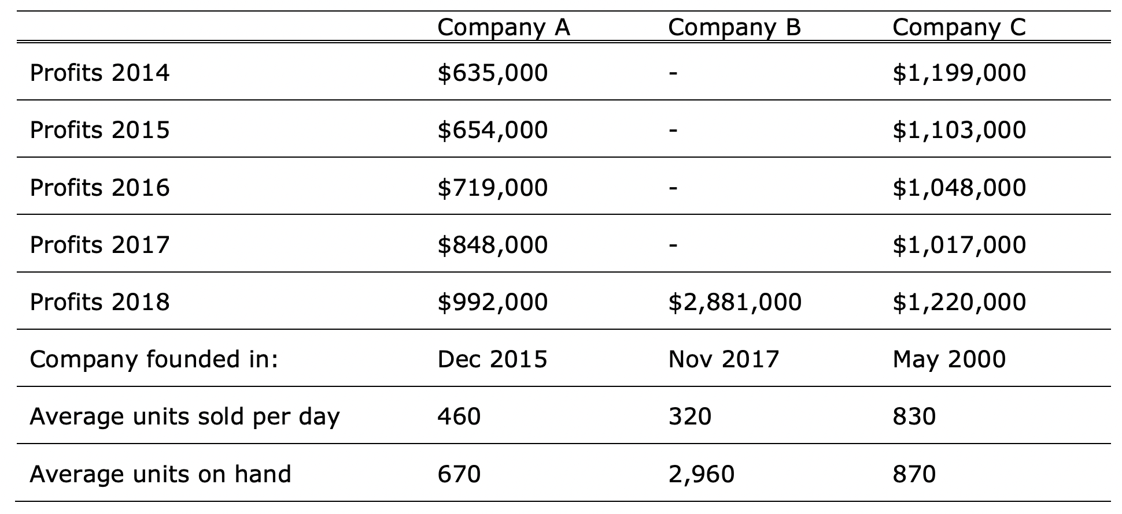
Which company would you invest in?
Consider the company information below:
Notes:
Review the information in the table with students
Explain that generally companies do not want to have too much inventory on hand. For each company, ask students express the number of units sold per day as a percentage of the number of units on hand.
Company A: 69%
Company B: 11%
Company C: 95%
Ask student what company they would invest in and why. Possible answers may include:
Co A. has had steady increases in profit last four years. Growth and expansion could help put this company ahead of the other two.
Co B. Huge profit in first year of business, but a lot of units on hand.
Co C. had a turnaround year in 2018. They did a great job managing inventory, which could indicate excellent managers for this company.
Lessons adapted from The Stock Market Game

Slide 26
What is a stock?
A public company issues stock for sale to the public.
It issues stock to raise money to develop new products and services and support the expansion of its current business.
When you purchase a company’s stock, you own part of the company that issued it.
A person who owns a company’s stock is also called a shareholder
Notes:
Explain to students what a stock is and why companies sell stock
The Hershey Company, the company that makes Hershey’s Kisses, Reese’s Peanut Butter Cups, and other famous candies, is an example of a public company. You can become a part owner of The Hershey Company by buying its stock.
Consider sharing with students the difference between public and private companies when it comes to stock:
A private company can be owned by an individual, a family, or a small group of investors. It does not raise money by selling stock to the public. A private company raises money through bank loans, venture capitalists and other sources of capital. Mars Incorporated, the maker M&M’s and other popular candies, is an example of a private company. It is owned by the Mars family.
Lessons adapted from The Stock Market Game

Slide 27
Why sell stock?
Most companies, including The Hershey Company, begin as small private companies.
However, as it grew and needed capital for expansion, its owners needed to make decisions on how it would raise money. The Hershey Company decided, instead of borrowing from banks or venture capitalists like private companies, they would “go public” and sell stock to the public to raise money for its growth.
In order to sell its stock, a company must also register its stock with the Securities and Exchange Commission (SEC) before “going public.”
Notes:
Read through the explanation on the slide to show students why companies choose to “go public” and sell stock
Lessons adapted from The Stock Market Game

Slide 28
Two types of stock...
Common stock entitles the owners (called shareholders) to collect dividends, if the company declares them. It also allows them to vote in company elections and proposals. Shareholders who purchase common stock share in most of a company’s profits and losses.
Preferred stock guarantees a dividend payment. This payment is made before any payments to common stock holders. If a company fails, preferred stock holders are repaid before common stock holders. Preferred stock holders do not share in most of a company’s profits or losses. Preferred stock holders also do not have any voting rights.
Dividend: Part of a company’s profits (earnings) that it pays as money to shareholders.
Notes:
Review the vocabulary with students
Lessons adapted from The Stock Market Game

Slide 29
Where are stocks sold?
Stocks are bought and sold on exchanges. The Stock Market Game™ program is an electronic platform on which you will buy and sell simulated shares of common stock listed on the two major U.S. stock exchanges: the New York Stock Exchange (NYSE) and the NASDAQ
Source: Scott Beale via wikimedia commons
Source: Kowloonese via wikimedia commons
Notes:
Tell students that there are two main stock exchanges in the U.S.
Lessons adapted from The Stock Market Game

Slide 30
When are stock investments successful?
$
$
If the company’s stock price rises above what you paid for it, your investment has earned money.
If the price falls below what you paid for it, your investment has lost money.
Let’s consider some sample investments and see if they were successful!
Notes:
If students want to dig deeper into stocks, why companies sell stock, and how companies “go public” via IPO’s, print and distribute this reading.
Lessons adapted from The Stock Market Game

Slide 31
Successful investment?
You purchase 723 shares of Nike at $47.75 per share and one year later you are ready to sell your 723 shares for the current market price of $62.25. Did you earn a profit or lose money from this stock sale? How much money did you make or lose?
During the year you own Nike stock you earn a dividend of $ 1.25 per share. You own 720 shares. How much did you earn in dividends?
Notes:
The profit from the sale of each share of stock is calculated by subtracting the cost per share which was $47.75 for the sale price of $62.25, equaling $14.50. Then you multiply the profit times the 723 shares which is $10,483.50.
You need to multiply the dividend of $1.25 per share times the number of shares which is 720. The result is an earning of $900
Lessons adapted from The Stock Market Game

Slide 32
Recap Video
Notes:
Watch the video
Lessons adapted from The Stock Market Game

Slide 33
Exit Ticket:
How do you know when an investment has been successful?
Notes:
Before students leave class, ask them to complete the exit ticket on a piece of paper or submit one through your virtual classroom.
Lessons adapted from The Stock Market Game

Slide 34
Lesson 3
Ticker Symbols & Stock Quotes
Notes:
View Lesson plan Here
Lessons adapted from The Stock Market Game

Slide 35
Do Now
Which of these companies would you invest in? Why?
Notes:
As students enter classroom, have the Do Now prompt on the screen for them to respond to in their journals, handout, or piece of paper.
Lessons adapted from The Stock Market Game

Slide 36
Agenda
Do Now
Identifying stock tickers
Interpreting stock quotes
Exit Ticket
Notes:
Review the agenda for the day
Lessons adapted from The Stock Market Game

Slide 37
Objectives
Students will be able to
Define the term ticker symbol
Look up ticker symbols in SMG portal
Interpret a stock quote
Enter a trade in their online Stock Market Game (SMG) portfolios
Notes:
Review the objectives for the day, so students know what is expected of their learning
Lessons adapted from The Stock Market Game

Slide 38
What is a ticker symbol?
Ticker symbols are what stock exchanges use to identify listed companies.
Typically, companies listed on the New York Stock Exchange (NYSE) have 1-3 letters in their ticker symbols. The NASDAQ Stock Market identifies companies and funds with symbols that maybe as long as 5 letters.
Notes:
Read the definition of a ticker symbol to students or ask someone to read out loud
Lessons adapted from The Stock Market Game

Slide 39
What is a ticker symbol?
Can you guess the companies these tickers belong to?
AAPL
GOOGL
WMT
AMZN
TSLA
IBM
NFLX
MCD
Notes:
Answers:
Apple
Google
Walmart
Amazon
Tesla
IBM
Netflix
MCD
Lessons adapted from The Stock Market Game

Slide 40
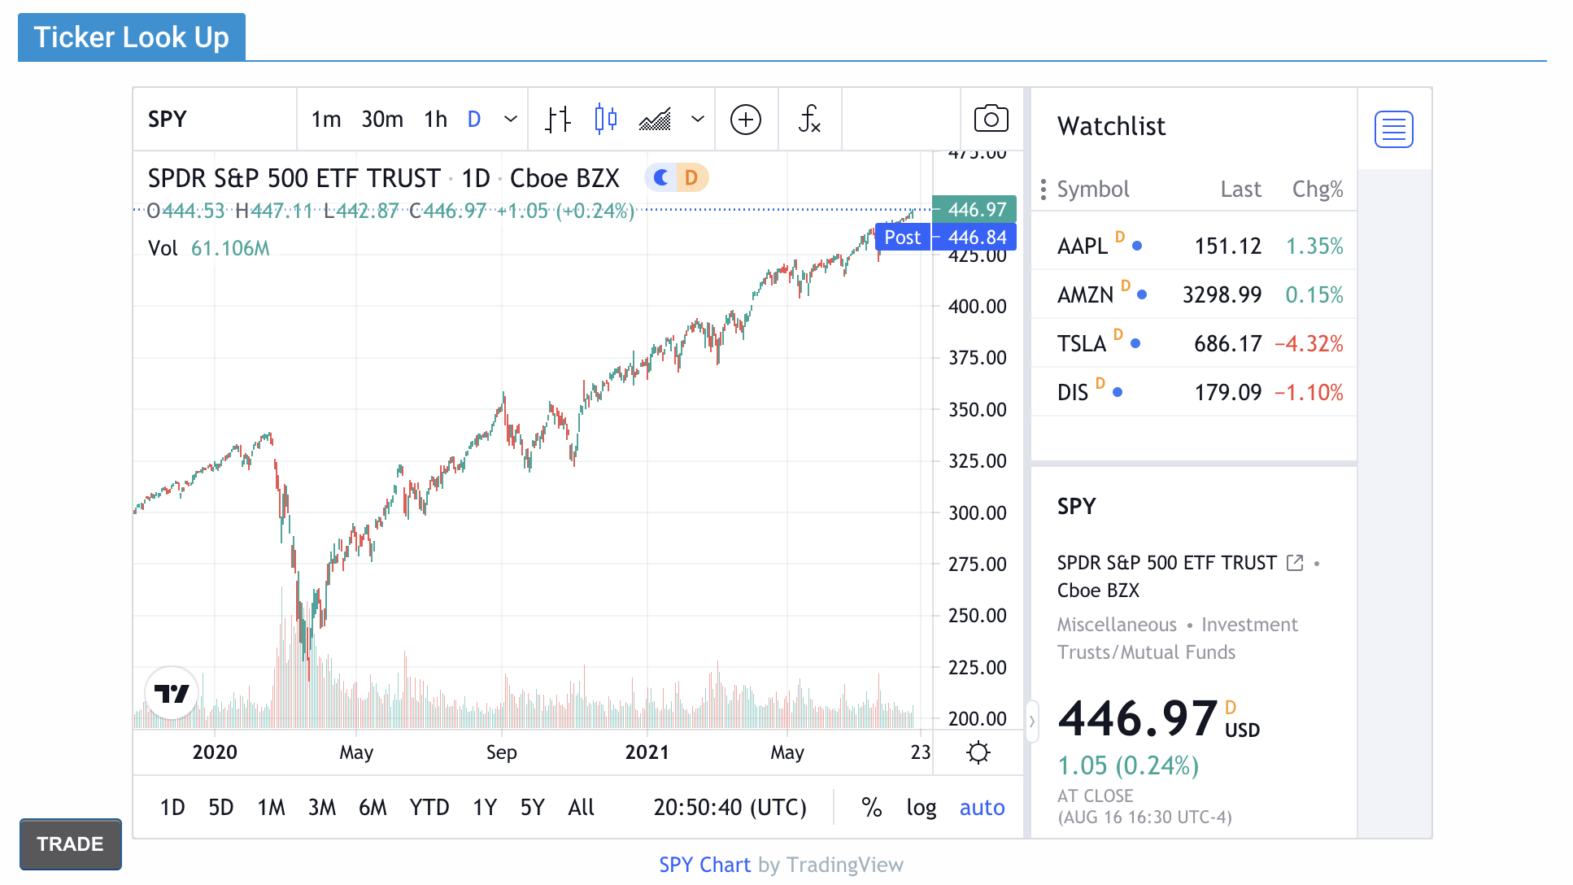
Ticker Symbols
The online SMG team portfolio has its own ticker lookup and quote tools.
Notes:
Explain to students that the SMG portal has an area that will allow them to look up stocks using tickers
Lessons adapted from The Stock Market Game

Slide 41
What is a Stock Quote?
A stock quote provides you with pricing information. This information helps you determine whether a stock is a good investment or not.
Company | The name of the company. | Symbol | A company’s stock symbol can be as short as one letter or as long as five.
Last Trade | The price of the stock when it was last sold. | Change | The increase or decrease in the stock’s price between the Last Trade price and the previous trading day’s closing price.
Volume | The total number of shares traded so far during the day. | Open | The price of the stock at the opening of the market day.
High | This entry shows the highest price the stock has traded at so far during the day. | Low | This entry shows the lowest price the stock has traded at so far during the day.
Close | The last price a stock sold for on the previous trading day. | P/E Ratio
52-Week High | This is the highest price of the stock within the last 52 weeks. | Low | This is the lowest price of the stock in the last 52 weeks
Notes:
Review the different aspects included in a stock quote and tell students that they will be analyzing stock quotes.
Lessons adapted from The Stock Market Game

Slide 42
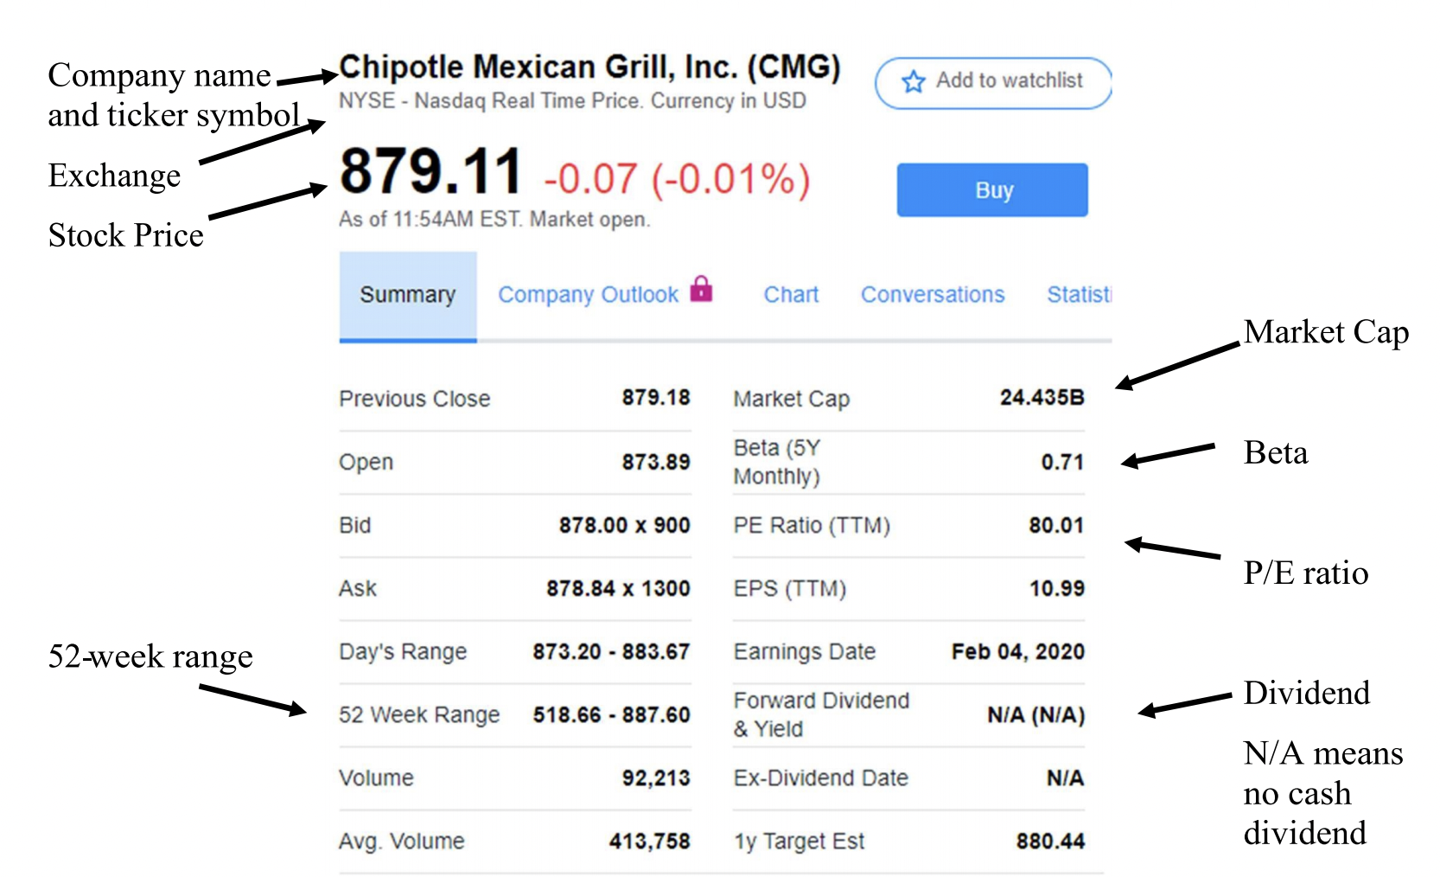
Stock Quote Example
Notes:
Show the example stock quote and point out the different key aspects
Lessons adapted from The Stock Market Game

Slide 43
Recap Video
Notes:
Before introducing the activity, watch the video
Lessons adapted from The Stock Market Game

Slide 44
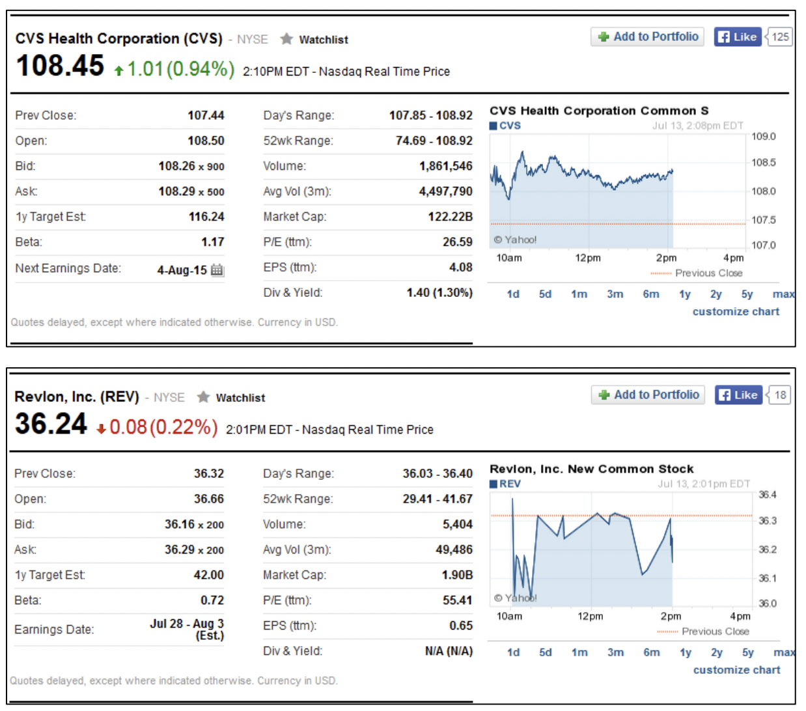
Reading a Stock Quote
Review the two stock quotes on the handout.
2. Answer the questions.
Is Revlon performing better or worse than it was the previous day? How do you know?
Is CVS nearer to its yearly high or low? Would this be a good time to purchase the stock?
Did either Revlon or CVS Caremark pay a dividend? What does that suggest about the company?
Based on the numbers in the charts and what you know about the companies, in which company would you invest?
Notes:
Distribute the handout to students and allow time for students to review the stock quotes.
Ask students to answer the questions on the handout or discuss the ones on the slide as a class.
Lessons adapted from The Stock Market Game

Slide 45
Practice in SMG Portal!
Notes:
After watching the video, pull up the Stock Market Game on the board and login to the team account.
Show students where they can find the ticker lookup and practice using it by having students call out companies they are interested in researching and then looking up their ticker.
Using a nominal amount of your $100,000, practice buying stock.
Lessons adapted from The Stock Market Game

Slide 46
Exit Ticket:
Make a list of 5 companies or types of companies you want us to research for potential investment.
Notes:
Before students leave class, ask them to complete the exit ticket on a piece of paper or submit one through your virtual classroom.
Lessons adapted from The Stock Market Game

Slide 47
Lesson 4
Selecting Your Investments
Notes:
View Lesson plan Here
Lessons adapted from The Stock Market Game

Slide 48
Do Now
What do you think the saying “Don’t put all your eggs in the same basket” means?
Notes:
As students enter classroom, have the Do Now prompt on the screen for them to respond to in their journals, handout, or piece of paper.
Lessons adapted from The Stock Market Game

Slide 49
Agenda
Do Now
Understanding Risk
Diversifying your portfolio
Exit Ticket
Notes:
Review the agenda for the day
Lessons adapted from The Stock Market Game

Slide 50
Objectives
Students will be able to
Define and illustrate the three major kinds of risk.
Examine companies and determine the risk involved in investing in these companies.
Interpret company and industry charts to determine which investments their SMG team should make
Define diversification, risk tolerance, industry, index
Notes:
Review the objectives for the day, so students know what is expected of their learning
Lessons adapted from The Stock Market Game

Slide 51
Which investment is best?
Jamie wanted advice about the best way to make money on money she received for her birthday.
Her brother told her, “Buy a lottery ticket. It may be risky but you could become a millionaire”
Her grandmother said, “Put it under your mattress and save it for a rainy day”
Her best friend advised her, “Buy stock in Chevron, gas prices are always in the news”
Her aunt said “Put it in a savings account and you can earn 1% interest a year for the next 20 years
What do you think is the best option?
Notes:
Ask students to work independently, or as a whole class to respond to the scenario and question on the slide
Lessons adapted from The Stock Market Game

Slide 52
What is Risk?
Definition: Risk is exposure to the chance of injury or loss.
How do you think risk applies to investing?
What does Jamie need to learn about investing to make the best decision?
Low risk = low return
High risk = high return, low return or loss
What does this mean?
Notes:
Define risk for students
Click to show students the equations.
Ask them what they think the equations mean.
Elicit from students the correlation that low risk usually means low profit; high risk may mean high profit or big losses.\
Lessons adapted from The Stock Market Game

Slide 53
3 Types of Risk
Conservative Risk (Low): Means taking limited risk on secure stocks and fixed income investments. Fixed Income stocks are generally low stocks that pay higher than average dividends (4% or higher). A dividend is money paid out to the owner of a stock based on the profit of a company. The value or price of the stock does not change quickly.
Moderate Risk: Growth stocks—stocks that grow faster and higher (value and price) than stocks of other companies with similar sales and earnings—are considered to be of moderate risk.
Speculative Risk (High): Stocks that carry major risks on investments with unpredictable results, but the potential to earn very high returns. When investing in speculative stocks, the investor must realize that while there is a chance of great returns, there is also the possibility for great loss.
Notes:
Click to review the different types of risk
Lessons adapted from The Stock Market Game

Slide 54
Conservative, Moderate, or Speculative?
Directions: Consider the following scenario and decide if the investment is conservative, moderate, or speculative risk.
Company Clockwork makes clocks. Compared with other clock making companies, Company Clock has the highest revenue and earnings, but low profits. Company Clock’s earnings have grown 15 percent over the past 5 years. The average earnings of other clock companies, in the past five years, have been at 10 percent.
Based on this scenario, if you invested in Company Clock, what type of risk are you taking?
Notes:
As a class, read through the scenario and answer the question.
Lessons adapted from The Stock Market Game

Slide 55
Conservative, Moderate, or Speculative?
Directions: Consider the following scenario and decide if the investment is conservative, moderate, or speculative risk.
Jax Company provides gas and electric to your area. The stock pays an annual dividend of $4 per share per year. You own 200 shares, so the company pays you a yearly dividend of $800. This is a fixed income stock. What type of risk are you taking by investing in Jax Company?
Notes:
As a class, read through the scenario and answer the question.
Lessons adapted from The Stock Market Game

Slide 56
Conservative, Moderate, or Speculative?
Directions: Consider the following scenario and decide if the investment is conservative, moderate, or speculative risk.
Watching the news, you learn about a new drug that supposedly makes children smarter. You’ve never heard of the drug manufacturer, but you decide to invest in this company. Why wouldn’t we want our children smarter? If you have no other information and plan to invest in this drug company, what kind of risk are you taking?
Notes:
As a class, read through the scenario and answer the question.
Lessons adapted from The Stock Market Game

Slide 57
Optional: To risk or not to risk?
Risk tolerance is personal.
Based on factors such as age, salary, financial obligations, and family situation, people’s risk tolerances vary greatly
Directions: Consider the scenarios on the handout and decide if the investment is low, moderate, or high risk for the individual person.
Notes:
If students want to learn more about risk, distribute the optional activity handout and have them determine each investment risk for the individual investor.
Lessons adapted from The Stock Market Game

Slide 58
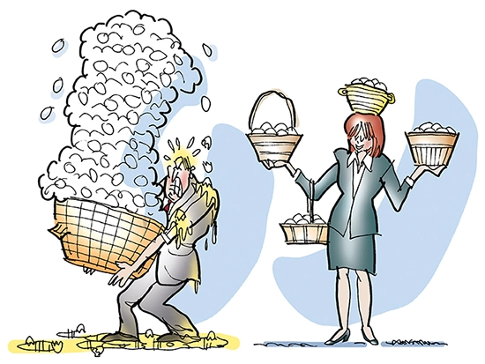
What is Diversification?
Because it is difficult to predict how any one company will perform over time, diversification is a strategy that helps to protect your portfolio.
It is a widely used and highly successful way to reduce risk. By investing in different types of stocks, bonds, and/or mutual funds, the value of your entire portfolio should not be wiped out if one investment fails.
Where are you diversified in your own life?
Notes:
Explain what diversification means
Ask: Where are you diversified in your own life?
What about the clothes you wear, the classes you take, the food you eat, etc.?
All of your clothes don’t look the same, you don’t take all English classes or all math classes and you don’t eat only pizza. Why do you diversify in these areas?
Lessons adapted from The Stock Market Game

Slide 59
Recap Video
Notes:
Watch the video
Lessons adapted from The Stock Market Game

Slide 60
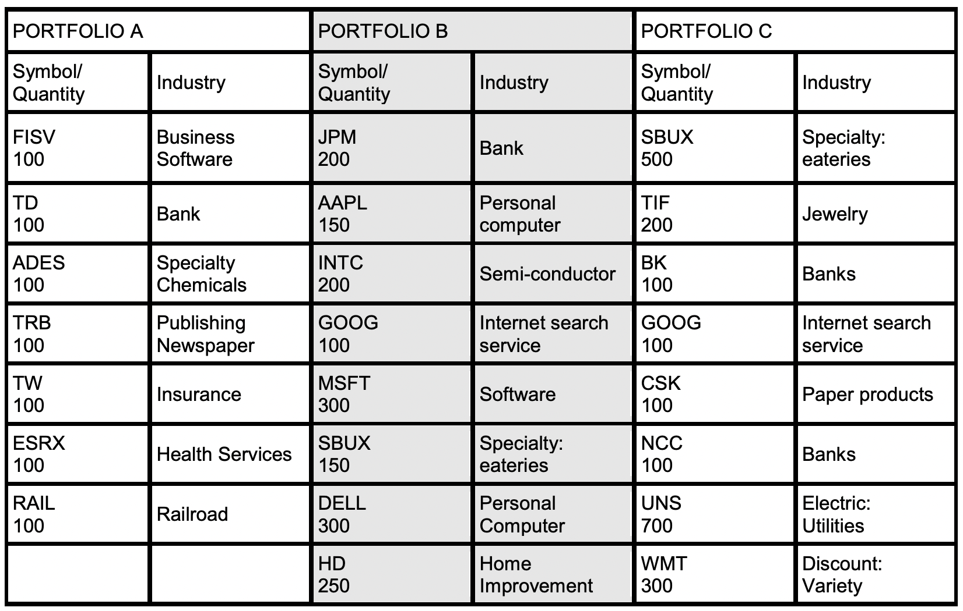
How diversified are these portfolios?
How many different industries are represented in each portfolio?
Can a portfolio be diversified based on the quantity of shares?
What do you notice about the portfolios? Are any “heavy” with one particular industry?
Notes:
Show students the table with the three portfolios. Allow them time to read and review.
Ask students:
Which portfolio is the most diversified?
How could you make the other portfolios more diversified?
Lessons adapted from The Stock Market Game

Slide 61
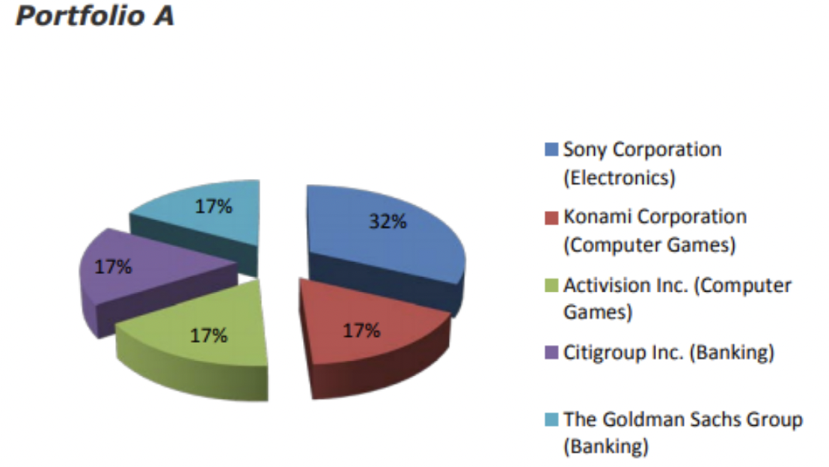
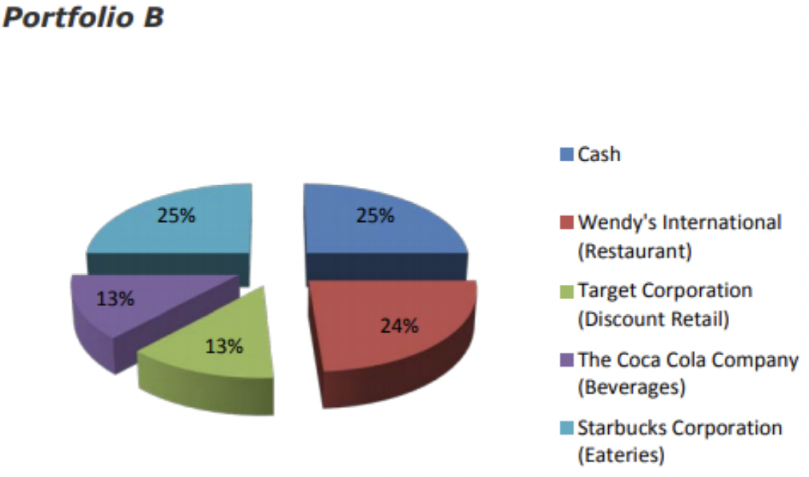
How diversified are these portfolios?
Notes:
Show students the graphs and explain that diversification can be shown this way as well.
Ask: Which portfolio is more diversified?
Lessons adapted from The Stock Market Game

Slide 62
Diversification Rules
How will we, as an investment team, avoid risk and diversify our portfolio?
What diversification rules do we want to establish for our investments?
Notes:
work as a class to develop a set of “Rules for Diversification.”
Elicit rules such as:
Select investments from at least three industries;
Buy different financial products such as common stocks and preferred stocks;
Diversify holdings even within an industry. (This means that if investing in the entertainment industry, for example, invest in the stock of high cap company such as Disney to balance an investment in a start-up, low cap, animation company that appears to have potential for growth.)
Lessons adapted from The Stock Market Game

Slide 63
Time to research!
It’s time for us to start thinking about what companies we want to invest in and what stocks we’re going to buy!
What industries do you want to research?
What companies are you interested in?
Industries to consider:
Energy
Financial
Healthcare
Industrial
Technology
Utilities
Retail
Notes:
As a class or individually, begin researching stocks. Some helpful websites are listed below (they can be whitelisted or pulled up on a teacher computer for the class to view together)
http://finance.yahoo.com – Students can learn about different industries and explore the top industries to help them select stocks for their teams’ portfolio at the Yahoo! Finance homepage. The web page provides data on best and worst performing industries.
If you need an introduction on how to conduct research using Yahoo Finance, this video created by SMG is very helpful
http://biz.yahoo.com/ic/ind_index.html - Students interested in learning about different industries may find the Yahoo! Finance Industry Index of interest.
www.thestreet.com – Students can learn about various stocks and their performance.
In addition, within the SMG portal, students can use the ticker search tool to look up individual company stocks
Lessons adapted from The Stock Market Game

Slide 64
Exit Ticket:
What advice would you give someone who tells you that they’re thinking about using all their savings to buy Target stock?
Notes:
Before students leave class, ask them to complete the exit ticket on a piece of paper or submit one through your virtual classroom.
Lessons adapted from The Stock Market Game

Slide 65
Lesson 5
Tracking Your Investments
Notes:
View Lesson plan Here
Lessons adapted from The Stock Market Game

Slide 66
Do Now
Do you think these headlines are real? If they were real, do you think they could affect stock prices? “Avocado shortage fuels crime wave in New Zealand” “Avocados and the Mexican Drug Cartels” “About 1,000 avocados stolen from Renmark”
Notes:
As students enter classroom, have the Do Now prompt on the screen for them to respond to in their journals, handout, or piece of paper.
Ask students to share their responses and discuss what they think is happening (there’s a shortage for avocados and therefore the demand for avocados has risen). When the demand for avocados increases, the price of avocados also increases
Ask students if they think now would be a good time to invest in a company that sells avocados (yes!)
If you want to read the articles
“Avocado shortage fuels crime wave in New Zealand”(New Zealand) http://bit.ly/1OonGus
“Avocados and the Mexican Drug Cartels”(US) http://bit.ly/2iZJy1r
“About 1000 avocados stolen from Renmark” (Australia) http://bit.ly/2iNm5kt
Lessons adapted from The Stock Market Game

Slide 67
Agenda
Do Now
What causes stock prices to change
Buy, Sell, or Hold
Exit Ticket
Notes:
Review the agenda for the day
Lessons adapted from The Stock Market Game

Slide 68
Objectives
Students will be able to
Analyze and interpret market indices, which influence changes of the overall stock market.
Discuss the various ways stock prices are influenced
Evaluate the ways investors can be affected by the change in market prices when choosing to buy, sell or hold.
Interpret charts and graphs to better understand the growth and change in stock prices
Notes:
Review the objectives for the day, so students know what is expected of their learning
Lessons adapted from The Stock Market Game

Slide 69
How can current events/news impact stocks?
Can you think of any recent news stories that might impact a company’s stock?
BP Oil Spill
Pandemic
McDonald’s Hot Coffee Lawsuit
Notes:
Ask students the question on the board and allow them to brainstorm out loud.
Click through the pictures and ask students how each of the current events could have impacted specific stocks or the stock market as a whole
Answers will vary
Oil spill: BP stock decrease, overall gas prices increase so stock prices increase
Covid-19: overall the stock market crashed, throughout quarantine some stocks were successful (like peloton, Zoom, and TeleDoc) because the demand for those products increased
Coffee Lawsuit: MCD stock went down, maybe other fast food stocks went up in price, once the lawsuit was over MCD stock steadily increased
Lessons adapted from The Stock Market Game
Image Source: https://commons.wikimedia.org/wiki/File:Flickr_-_DVIDSHUB_-_Oil_Spill.jpg

Slide 70
What else might impact stocks?
Supply & Demand: If more people want to buy a stock (demand) than sell it (supply), then the price goes up. Conversely, if more people wanted to sell a stock than buy it, supply exceeds demand and the price falls.
Reports on internal corporate activity: For example, if a company makes a huge charitable donation and the public likes that they did that, price goes up.
Public Earnings Reports: Public companies must report their earnings four times a year. “Wall Street” carefully watches earnings results. Analysts base their opinions about future value of a company on its earnings projections. If a company's results are better than analysts expected, the stock price rises. If a company's results are worse than expected the stock price falls.
Notes:
Review the list of items that can impact a stock price
Lessons adapted from The Stock Market Game

Slide 71
Recap Video
Notes:
Watch the video as a review
Lessons adapted from The Stock Market Game

Slide 72
Buy, Sell or Hold
Why would someone...
Buy
Sell
Hold
How do you know the “right” action to take?
Notes:
1. Ask students to brainstorm why someone might buy, sell, or hold a stock. Write answers on board as students talk.
Examples:
People buy to make a future profit.
People buy to save for retirement.
People sell to collect their profits, or protect against further loss because the stock price is dropping.
People hold because historical trends suggest that over the long-term stocks have the greatest return
Lessons adapted from The Stock Market Game

Slide 73
Buy, Sell or Hold Video
Watch the video and answer the questions in it!
Notes:
Show students the video, pausing to allow them time to think.
Have them complete the exit ticket question at the end of the video
Lessons adapted from The Stock Market Game

Slide 74
Time to research!
It’s time for us to start thinking about what companies we want to invest in and what stocks we’re going to buy!
Choose two companies in a sector
Research the companies through a financial engine
Compare information from company websites and annual reports
Vs.
Vs.
Vs.
Notes:
As a class or individually, choose two companies in the same sector/industry and compare them to decide which one you will invest in.
http://finance.yahoo.com – Students can learn about different industries and explore the top industries to help them select stocks for their teams’ portfolio at the Yahoo! Finance homepage. The web page provides data on best and worst performing industries.
http://biz.yahoo.com/ic/ind_index.html - Students interested in learning about different industries may find the Yahoo! Finance Industry Index of interest.
www.thestreet.com – Students can learn about various stocks and their performance.
In addition, within the SMG portal, students can use the ticker search tool to look up individual company stocks
Lessons adapted from The Stock Market Game

Slide 75
BreakFree Investors Challenge
Now it’s time to invest!
Remember, we’re competing against other schools, so we have to be smart and patient with our decisions. We also need to monitor our investment portfolio and make trades (sell and buy) as we go!
BreakFree Prizes:
Monthly winners
Overall winners at end of school year
Notes:
Tell students that they will now begin the work of managing their team portfolio and competing in the nationwide competition!
Lessons adapted from The Stock Market Game

