Slide 1
Unheard
Speechwriting Unit &
Competition
Notes:
Access information on the 2022 Speech Competition here
*The lesson plans were designed, in large part, by teachers at the Maya Angelou Academy

Slide 2
Day 1
Launch
Notes:
View Day 1 Lesson plan here
View Day 1 handouts here

Slide 3
Do Now
What makes you want to listen to somebody when they are talking? Give an example of a speech you heard that made you feel something.
Notes:
As students enter classroom, have the Do Now prompt on the screen for them to respond to in their journals, handout, or piece of paper.

Slide 4
Agenda
Do Now
Introduction to Unheard
Cornell Notes: Elements of a Speech
Guided Practice: Naomi Wadler Speech
Independent Practice: Dalton Sherman Speech
Exit Ticket
Notes:
Review the agenda for the day

Slide 5
Objectives
Students will be able to
Define and analyze the key elements of a speech: purpose, message, audience and context
Define context clues and use context clues to determine the meaning of unknown words
Examine the impact of student activism
Notes:
Review the objectives for the day, so students know what is expected of their learning

Slide 6
What is Unheard?
Our Focus: Speeches! (reading, writing, analyzing, and giving powerful speeches)
What to expect: Learning about a wide variety of speakers and speeches and determining what makes a good speech and why.
Our Goal: At the end of the unit, there will be a speech competition!
Who do you know?!
Notes:
Introduce students to the Unheard speechwriting unit and explain what they can expect
Tell students that the unit will culminate with a speech competition (either class-wide or school-wide) and that winners will have the opportunity to submit their speech to BreakFree’s national competition.
Distribute the Note to students and allow them to tread through it to better understand the speechwriting competition
Ask students if they are familiar with any of the speakers on the slide. What do they know about their speeches or their speaking ability?

Slide 7
Cornell Notes
Key Words & Questions
What are the key elements of a speech?
Details
Audience
The people who the speech is intended to speak to; who is listening?
Context
The background, which provides a reason for the speaker to give the speech.
Purpose
typically what you are trying to accomplish with the speech. The general purpose of any speech will be either to Inform; Motivate/Persuade; or Entertain your audience
Message
The central idea that the speaker is trying to communicate to the listener
Notes:
Instruct students to take Cornell notes as you review the key words and questions of the day.
Context is closely related to purpose.
Purpose: In this unit, we will primarily be focusing on persuasion
Message: the message of a speech is the central idea that the speaker is trying to communicate to the listener

Slide 8
Cornell Notes
Key Words & Questions
What are the key non-verbal aspects of a speech?
Details
Hand Gestures
pointing, lifting arms and calling people to rise, putting a fist in the air to show power, etc
Inflection
Don’t be monotone! With inflections a speaker can highlight what is most important and cause the listener to listen deeper
Physical Aspects
Posture, clothing, etc
Eye Contact
Don’t just stare at the paper in front of you. Look to the person you are speaking to
Notes:
Instruct students to take Cornell notes as you review the key words and questions of the day.
Non-verbal aspects can help a speaker communicate to the listeners just as much as the words that are being spoken. Through non-verbal aspects, the speaker can show emotion and feeling.
Hand gestures: pointing, lifting arms and calling people to rise, putting a fist in the air to show power, etc
inflection : it’s important to not be monotone, by using inflections in voice, a speaker can highlight what is most important and bring in the listener to listen deeper
Physical aspects: posture, clothing, etc
Eye Contact: it’s important to not only stare at the paper in front of them, to be dynamic by looking to the person you are speaking to

Slide 9
Cornell Notes
Key Words & Questions
What are context clues?
Details
Context clues are clues in the text that help you determine the meaning of new or unfamiliar words.
Example: He loves to talk, in fact some call him garrulous, but his friend on the other hand is taciturn.
Example: They walked down the corridor to get to the other classroom.
Notes:
Instruct students to take Cornell notes as you review the key words and questions of the day.
Explain why it’s important to both use context clues and be able to analyze a speech for its key components and how the key components of a speech form the foundation of a speech. Make connections between speeches and our lives today.

Slide 10
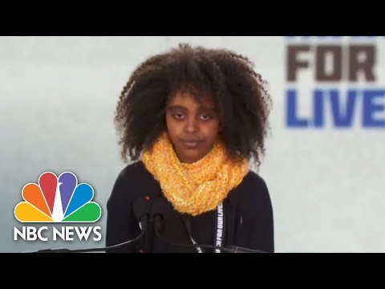
Let’s Consider a Speech!
Who was the audience?
What was the purpose?
What was the context?
What was the message?
Notes:
Play video of speech for students. You can also print out the text of the speech and have students follow along as they listen.
As a class, discuss the questions to analyze the speech

Slide 11
Independent Work
Complete the “before reading” side of the anticipation guide | Complete the "Speech Analysis" graphic organizer
Read the speech (Use your context clues to help determine the meaning of any new words) | Go back to the anticipation guide and complete the “after reading” side
“Do You Believe in Me” by Dalton Sherman
Notes:
Walk thru the students steps for reading and analyzing the assigned speech
Keep this slide on the screen as students work through their handouts so they can keep track of what steps are next
Click to the next page to show students the anticipation guide before they begin

Slide 12
A Closer Look: Anticipation Guide
Before Reading Agree or disagree? |  | After Reading Agree or disagree?
 | 1. A 10-year old student can inspire 1,000s of teachers.
 | 2. A 10-year old student can give an incredibly motivating and inspirational speech.
 | 3. All speeches have one main purpose and one main message.
 | 4. All strong speeches are well written and well presented.
Notes:
Walk thru the students steps for reading and analyzing the assigned speech
Keep this slide on the screen as students work through their handouts so they can keep track of what steps are next
Click to the next page to show students the anticipation guide before they begin

Slide 13
Exit Ticket:
What did you learn today?
*Don’t forget to fill in your Daily Learning Log!
Notes:
Before students leave class, ask them to complete the exit ticket on a piece of paper or submit one through your virtual classroom.
Ask students to fill out their Daily Learning Log

Slide 14
Day 2
Mini Speech
Notes:
View Day 2 Lesson plan here
View Day 2 handouts here

Slide 15
Do Now
Describe a time in your life where you had to take responsibility for something. How did you feel? How did you know this was "taking responsibility"?
Notes:
As students enter classroom, have the Do Now prompt on the screen for them to respond to in their journals, handout, or piece of paper.

Slide 16
Agenda
Do Now
Mini Lesson: Capitalization
Mini Lesson: Student Activism
Guided Practice: Writing Prompts
Independent Practice: Mini Speech
Exit Ticket
Notes:
Review the agenda for the day

Slide 17
Objectives
Students will be able to
Develop the key elements of a speech: purpose or message, audience, and context in order to write a mini-speech.
Use correct capitalization and punctuation in a mini-speech.
Analyze the role of students in affecting change in the U.S.
Notes:
Review the objectives for the day, so students know what is expected of their learning

Slide 18
Quick Review
What are the key elements of a speech?
What are the key nonverbal aspects of a speech?
Notes:
Ask students to review what they have learned in previous classes using the questions on the board
If using an interactive board, teacher can ask student volunteers to write answers on the board

Slide 19
Capitalization
The first word of a sentence | Thank you for the letter.
The first word in a quotation | She said, “Today is beautiful.”
The greeting and closing in a letter | Dear John Sincerely, Sherry
The names of days, months, and holidays | Thursday November Thanksgiving
People’s first & last names, their initials, and their titles | Mrs. Smith and Phil were seen by Dr. Lee
The word that names yourself - I | My friend and I love horses
The names of streets, cities, and states | Palm Avenue Mesa, Arizona
The names of specific buildings and monuments | Statue of Liberty Empire State Building
The titles of stories, movies, TV shows, video games, etc. | Night at the Museum
Notes:
Instruct students on proper uses of capital letters
Extension: consider creating a handout with more practice or including this concept in an upcoming quiz or test.

Slide 20
Student Activism
Explanation of initiative
See-Think-Wonder
What do you see in this image?
What do you think is happening in this image?
What are you wondering about this image?
Notes:
In her speech from Day 1’s lesson, Naomi Wadler talked about how she and her peers will be voting in just a few short years. Take students through a See-Think-Wonder thinking routine to begin thinking about how voting laws have changed in the US for young people. This can be done as a whole class discussion or students working in small groups or partners.
See- Show students this image and ask them to identify only what they see. (ex. Posters, young white men and women)
Think- Ask students what they think is happening in the photo. (ex. protest)
Wonder- Students ask questions about the image. (ex. I wonder why the sign is encouraging support for 18 as the voting age, isn’t that already the voting age? I wonder if it always has been? Or I wonder why there are only white people in this photo? I wonder when/where it was taken?)
Image- https://www.smithsonianmag.com/history/how-young-activists-got-18-year-olds-right-vote-record-time-180976261/

Slide 21
Student Activism
Did you know that the voting age used to be 21?
This is an image of a march in support of the Vote 18 movement in Seattle in 1969. The buttons around the photo are advocating for changing the voting age to 18.
What was happening in 1969?
There were many anti-war and civil rights protests in the 1960’s organized in large part by young people. Young people had been drafted for Vietnam and other wars at the age of 18, but they couldn’t vote until 21.
Notes:
Questions for Discussion:
Why do you think it took so long for the voting age to change?
Do you think 18 is the right age for voting?
What role did young people play in the 26th amendment?
For more information or to extend this mini-lesson further: https://www.smithsonianmag.com/history/how-young-activists-got-18-year-olds-right-vote-record-time-180976261/

Slide 22
Student Activism
“But the decades-long push to lower the voting age from 21 to 18, which culminated in the 1971 ratification of the 26th Amendment, came about because young Americans of different races, genders and political persuasions came together, taking on an ambivalent and resistant government, to gain the right to vote”
-(Smithsonian Magazine).
Did You Know?
Once it was passed by congress and ratified by the states, it only took 100 days for the 26th amendment to become law.
Notes:
Discuss the quote in the third bullet point- explain how the government would have been ambivalent and resistant to changing the voting age.
What is an example of an issue today that could also be described in this way?
What connections can you make between Naomi Wadler’s speech and the 26th amendment?
For more information or to extend this mini-lesson further: https://www.smithsonianmag.com/history/how-young-activists-got-18-year-olds-right-vote-record-time-180976261/

Slide 23
Components of a Speech
Welcome the audience (Who is your audience?)
“Good afternoon Congress and members of the parties…”
“Hello Americans, fellow world leaders, and those who are tuned in…”
“Thank you for inviting me to speak today and good afternoon to the Class of 2012…”
“Welcome students, parents, faculty, family and friends…”
State your purpose for speaking (Why are you here to speak?)
“Today I’m here to speak to you about…”
“I want you to remember that…”
“I have been asked to speak about…”
Make your message loud and clear (What is your point to the audience?)
“What I’m here to tell you is…”
“If you don’t remember anything at all, remember…”
“The point of this is…”
Notes:
Instruct students on the 3 key components of a speech. Remind them that they will need to focus on these components as they write their mini-speech and as they prepare their speech for the final competition.

Slide 24
Mini Speech
Directions: You are going to write a “mini speech” on a given topic. Before you write your speech, you must identify the key elements of your speech, keeping in mind your audience and purpose. Your mini speech should be a minimum of 2 paragraphs and should answer the prompt you have selected.
Prompt 1
Imagine you have been approached by a local news station to give a speech about your thoughts on whether or not the voting age should be changed to 16. In your mini speech explain your position (for or against) and reasons why you feel that way.
Prompt 2
Imagine you are the director of your state’s juvenile justice department and you are giving a speech to other directors about changes you are making to your facilities. In your mini speech explain your changes and explain why you are making those changes.
Notes:
Explain the directions for the mini-speech
Ask volunteer students to read the two writing prompts for today

Slide 25
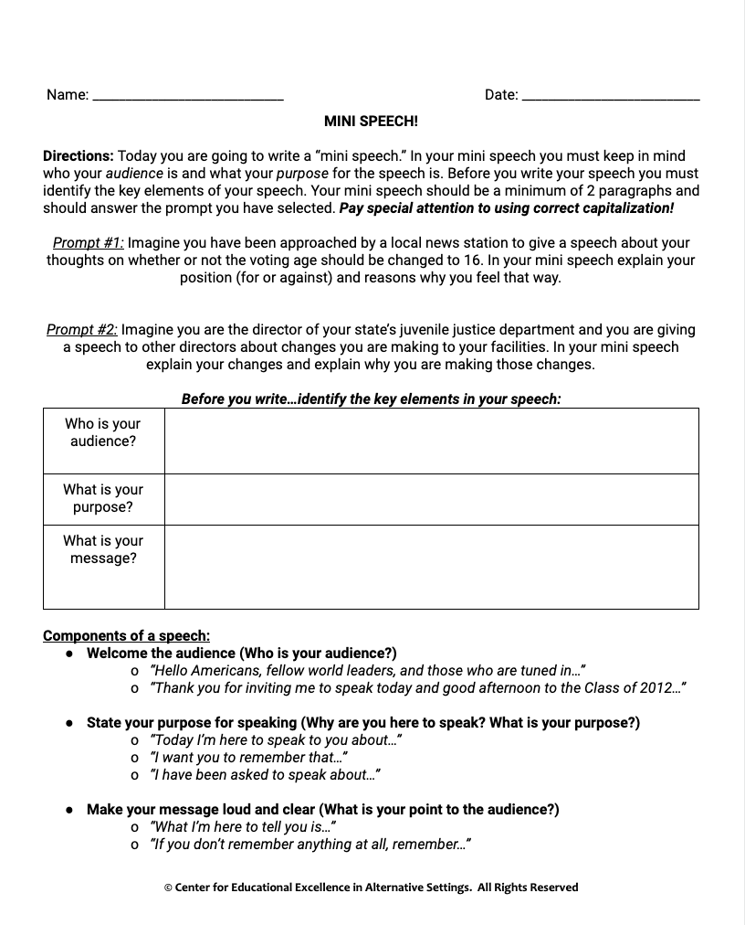
Mini Speech
Choose your prompt
Identify your audience, purpose, and message using the organizer in your handout
Write your speech
Share your speech
Notes:
Walk thru the steps students will take to complete their assignment.
Once students have completed their mini-speech, remind them that they will share their speech and use the rubric to offer feedback to a peer.

Slide 26
Mini Speech
Rubric
The speech has a clear message | 3 [Excellent, on point!] | 2 [Approaching, okay!] | 1 [Needs some work!]
The speech welcomes the audience | 3 [Excellent, on point!] | 2 [Approaching, okay!] | 1 [Needs some work!]
The speech makes sense & answers the prompt | 3 [Excellent, on point!] | 2 [Approaching, okay!] | 1 [Needs some work!]
The speaker presented the speech well (using HIPE) | 3 [Excellent, on point!] | 2 [Approaching, okay!] | 1 [Needs some work!]
The speech uses correct capitalization and punctuation | 3 [Excellent, on point!] | 2 [Approaching, okay!] | 1 [Needs some work!]
Notes:
Present the rubric on the board while students either work in small groups, pairs, or as a class with volunteer students presenting their speech.
Students should use the rubric in their handouts to offer feedback to a peer.

Slide 27
Exit Ticket:
What is an example of a non-verbal aspect of a speech you would feel comfortable using in your own speech?
*Don’t forget to fill in your Daily Learning Log!
Notes:
Before students leave class, ask them to complete the exit ticket on a piece of paper or submit one through your virtual classroom.
Ask students to fill out their Daily Learning Log

Slide 28
Day 3
Speech Analysis and Comprehension
Notes:
View Day 3 Lesson plan here
View Day 3 handouts here

Slide 29
Do Now
Discuss this prompt with a partner and come up with an answer together. What does it mean to persuade?
Notes:
As students enter classroom, have the Do Now prompt on the screen for them to respond to in their journals, handout, or piece of paper.

Slide 30
Agenda
Do Now
Notes: Modes of Persuasion
Guided Practice: Nelson Mandela
Independent Practice: Colin Kapernick
Exit Ticket
Notes:
Review the agenda for the day

Slide 31
Objectives
Students will be able to
Define the modes of persuasion used in a message of a speech (ethos, pathos, logos)
Analyze a speech for its use of ethos, pathos, and logos to get a message across to the audience
Use context clues to determine the meaning of unknown words
Notes:
Review the objectives for the day, so students know what is expected of their learning

Slide 32
Quick Review
What are the key elements of a speech?
What are the key nonverbal aspects of a speech?
What are context clues?
Notes:
Ask students to review what they have learned in previous classes using the questions on the board
If using an interactive board, teacher can ask student volunteers to write answers on the board

Slide 33
Modes of Persuasion
When authors are trying to persuade an audience, they use three main strategies:
Ethos
Pathos
Logos
Notes:
Tell students there are three modes of persuasion that speakers use. Remind students that persuasive speech is one type of speeches.

Slide 34
Cornell Notes
Key Words & Questions
Ethos
Pathos
Details
Showing that the speaker is someone worth trusting
Example: I am a doctor and I have seen many patients rapidly decline from their smoking habits.
Trying to make the listener feel strong emotions
Example: Just imagine your poor old grandmother sitting alone in her room coughing and hacking after a cigarette.
Notes:
Explain to students the definitions of ethos and pathos
Ethos is about establishing your authority to speak on the subject
Pathos is your attempt to sway an audience emotionally.

Slide 35
Cornell Notes
Key Words & Questions
Logos
Details
The facts or logic that support a speaker’s message.
Example: A doctor recently stated that smokers are 65% more likely to have lung cancer than people who do not smoke.
Notes:
Explain to students the definitions of ethos and pathos
Logos is your logical argument for your point

Slide 36
Ethos? Pathos? Or Logos?
Ethos
Pathos
Logos
The algorithms have been run in a thousand different ways, and the math continues to check out.
You'll make the right decision because you have something that not many people do: you have heart.
If my years as a Marine taught me anything, it's that caution is the best policy in this sort of situation."
"If we don't move soon, we're all going to die! Can't you see how dangerous it would be to stay?
History has shown time and again that absolute power corrupts absolutely.
Notes:
Facilitate a review activity. Click through the sentences on the slide and as you go through them one by one, have student raise the number of fingers for they type of persuasion they think is being used in the sentence.

Slide 37
Cornell Notes
Key Words & Questions
Message Analysis
Details
What are the main elements of the speech?
What is speaker saying?
How is the speaker persuading the audience? (ethos, pathos, logos)
Do you agree or disagree with the message?
Notes:
Explain to students the four questions to ask when analyzing the message of a speech.

Slide 38
Let’s Consider a Speech!
“Above all, My Lord, we want equal political rights, because without them our disabilities will be permanent. I know this sounds revolutionary to the whites in this country, because the majority of voters will be Africans. This makes the white man fear democracy.
But this fear cannot be allowed to stand in the way of the only solution which will guarantee racial harmony and freedom for all. It is not true that the ability to vote, or enfranchisement, of all will result in racial domination. Political division, based on colour, is entirely artificial and, when it disappears, so will the domination of one colour group by another. The ANC has spent half a century fighting against racialism. When it triumphs as it certainly must, it will not change that policy...
I am Prepared to Die
-By Nelson Mandela
Nelson Mandela was a South African anti-apartheid revolutionary. He was the president of the African National Congress (ANC), a political organization that worked to end apartheid. He was imprisoned for 27 years for “conspiring to overthrow the government.” He later became South Africa’s first Black president.
Notes:
Introduce students to the speech you will be reading together by reviewing the context of the speech written in white
As a class, read the speech out loud

Slide 39
Let’s Consider a Speech!
“This then is what the ANC is fighting. Our struggle is a truly national one. It is a struggle of the African people, inspired by our own suffering and our own experience. It is a struggle for the right to live.
During my lifetime I have dedicated my life to this struggle of the African people. I have fought against white domination, and I have fought against black domination. I have cherished the ideal of a democratic and free society in which all persons will live together in harmony and with equal opportunities. It is an ideal for which I hope to live for and to see realised. But, My Lord, if it needs be, it is an ideal for which I am prepared to die.”
What is the purpose of this speech? What is he trying to persuade the listener of?
Where does Mandela use ethos?
Where does he use Pathos?
Where does he use logos?
Notes:
Read the speech.
After completing the speech, click back to the previous slide to determine meaning of bolded words via context clues

Slide 40
Independent Work
Complete the “before reading” side of the anticipation guide | Complete the "Speech Analysis" graphic organizer
Read the speech (Use your context clues to help determine the meaning of any new words) | Go back to the anticipation guide and complete the “after reading” side
“Amnesty International’s Ambassador of Conscience Award Speech”
by Colin Kaepernick
Notes:
Walk thru the students steps for reading and analyzing the assigned speech
Keep this slide on the screen as students work through their handouts so they can keep track of what steps are next
Click to the next page to show students the anticipation guide before they begin

Slide 41
A Closer Look: Anticipation Guide
Before Reading Agree or disagree? |  | After Reading Agree or disagree?
 | 1. Giving an acceptance speech is an appropriate platform to speak about social justice issues.
 | 2. In order to get a clear message across to the audience, the speaker should use ethos, pathos, and logos.
 | 3. An award acceptance speech should use a lot of ethos in order to really move the audience.
Notes:
Review the anticipation guide with students
You can also show a video of this speech https://www.youtube.com/watch?v=5B8VU3JykvI&ab_channel=AmnestyInternational

Slide 42
Exit Ticket:
What strategies do speakers use to persuade their audience? What are the steps in analyzing the message of a speech? Why is it important to use context clues when you come across words that are unfamiliar?
*Don’t forget to fill in your Daily Learning Log!
Notes:
Before students leave class, ask them to complete the exit ticket on a piece of paper or submit one through your virtual classroom.
Ask students to fill out their Daily Learning Log

Slide 43
Day 4
Mini Speech
Notes:
View Day 4 Lesson plan here
View Day 4 handouts here

Slide 44
Do Now
What does it mean for a voice to go unheard? If a voice is unheard, how can things change for it to be heard?
Notes:
As students enter classroom, have the Do Now prompt on the screen for them to respond to in their journals, handout, or piece of paper.

Slide 45
Agenda
Do Now
Mini Lesson: Punctuation
Mini Lesson: Free Speech
Guided Practice: Writing Prompts
Independent Practice: Mini Speech
Exit Ticket
Notes:
Review the agenda for the day

Slide 46
Objectives
Students will be able to
Develop the key elements of a speech: purpose or message, audience, and context in order to write a mini-speech.
Use correct capitalization and punctuation in a mini-speech.
Analyze and evaluate the freedoms and limitations of rights from two primary source documents.
Notes:
Review the objectives for the day, so students know what is expected of their learning

Slide 47
Quick Review
What are the key elements of a speech?
What are the key nonverbal aspects of a speech?
What do speakers use to persuade their audience?
Notes:
Ask students to review what they have learned in previous classes using the questions on the board
If using an interactive board, teacher can ask student volunteers to write answers on the board

Slide 48
Punctuation: Commas
Always use a comma to separate...
A city and state | Miami, Florida
The date from the year | December 25, 2018
The greeting and closing of a letter | Dear Jane, Sincerely, John
Two adjectives that tell about the same noun | Shawn is a clever, smart boy.
Use a comma to show a pause...
Between three or more items in a series | Jim likes pizza, spaghetti, and lasagna.
Between the words spoken by someone and the rest of the sentence | “I know,” answered Mary.
After a short introductory phrase | After all that candy, nobody was hungry for cake
Notes:
Instruct students on proper uses of commas
Extension: consider creating a handout with more practice or including this concept in an upcoming quiz or test.

Slide 49
Punctuation: Commas
Add an apostrophe...
When there is one owner, add an apostrophe first, and then add an S | The cat’s dish is empty
When there is more than one owner, add as S first and then an apostrophe | All of the cats’ dishes were empty.
When you put two words together to make a contraction | Now he’s on the table.
Notes:
Instruct students on proper uses of apostrophes
Extension: consider creating a handout with more practice or including this concept in an upcoming quiz or test.

Slide 50
Free Speech
What is Freedom of Speech?
Amendment 1 of the US Constitution: “Congress shall make no law respecting an establishment of religion, or prohibiting the free exercise thereof; or abridging the freedom of speech, or of the press, or the right of the people peaceably to assemble, and to petition the Government for a redress of grievances.”
Article 19 of the Universal Declaration of Human Rights: “Everyone has the right to freedom of opinion and expression; this right includes freedom to hold opinions without interference and to seek, receive and impart information and ideas through any media and regardless of frontiers.”
Notes:
Read through the quotes and remind students that Colin Kaepernick and Nelson Mandela both exercised their right to free speech in different ways.
Lead a brief discussion using the questions below:
What does freedom of speech mean?
Are there any situations in which freedom of speech should not be protected? Encourage students to support their claims with evidence.
Have students read Articles 28-30 in the handout.
Discuss: What do these articles mean (in your own words)?
Had your opinion changed about what freedom of speech is or should be?
How does personal responsibility connect to freedom of speech?
Full text of the Constitution can be found here: https://constitutioncenter.org/media/files/constitution.pdf
Full text of the Universal Declaration of Human Rights can be found here: https://www.un.org/sites/un2.un.org/files/udhr.pdf

Slide 51
Free Speech
Article 28 Everyone is entitled to a social and international order in which the rights and freedoms set forth in this Declaration can be fully realized.
Article 29 1. Everyone has duties to the community in which alone the free and full development of his personality is possible. 2. In the exercise of his rights and freedoms, everyone shall be subject only to such limitations as are determined by law solely for the purpose of securing due recognition and respect for the rights and freedoms of others and of meeting the just requirements of morality, public order and the general welfare in a democratic society.
Article 30 Nothing in this Declaration may be interpreted as implying for any State, group or person any right to engage in any activity or to perform any act aimed at the destruction of any of the rights and freedoms set forth herein.
Did You Know?
The Universal Declaration of Human Rights is an international document adopted by the United Nations General Assembly that enshrines the rights and freedoms of all human beings
Notes:
Have students read Articles 28-30 from the Universal Declaration of Human Rights
Discuss:
What do these articles mean (in your own words)?
How does personal responsibility connect to freedom of speech?
Who decides if someone’s right to free speech is infringing on someone else’s rights?
Has your opinion changed about what freedom of speech is or should be?

Slide 52
Components of a Speech
Welcome the audience (Who is your audience?)
“Good afternoon Congress and members of the parties…”
“Hello Americans, fellow world leaders, and those who are tuned in…”
“Thank you for inviting me to speak today and good afternoon to the Class of 2012…”
“Welcome students, parents, faculty, family and friends…”
State your purpose for speaking (Why are you here to speak?)
“Today I’m here to speak to you about…”
“I want you to remember that…”
“I have been asked to speak about…”
Make your message loud and clear (What is your point to the audience?)
“What I’m here to tell you is…”
“If you don’t remember anything at all, remember…”
“The point of this is…”
Notes:
Instruct students on the 3 key components of a speech. Remind them that they will need to focus on these components as they write their mini-speech and as they prepare their speech for the final competition.

Slide 53
Mini Speech
Directions: You are going to write a “mini speech” on a given topic. Before you write your speech, you must identify the key elements of your speech, keeping in mind your audience and purpose. Your mini speech should be a minimum of 2 paragraphs and should answer the prompt you have selected.
Prompt 1
Imagine you are the commissioner of the NFL. Given the current state of affairs regarding kneeling during the national anthem, what would your message to NFL viewers be? As the commissioner of the NFL, what is your standpoint going to be? What steps will you take to ensure viewers understand your standpoint?
Prompt 2
Imagine Nike has decided to stop making their shoes due to criticism they have received. You want Nike to continue making shoes and you’ve been hired as a consultant to persuade Nike to ignore the criticism and produce their shoes. Write a persuasive mini speech that will make Nike believe they must continue their shoe making.
Notes:
Explain the directions for the mini-speech
Ask volunteer students to read the two writing prompts for today

Slide 54
Mini Speech
Choose your prompt
Identify your audience, purpose, and message using the organizer in your handout
Write your speech
Share your speech
Notes:
Walk thru the steps students will take to complete their assignment.
Once students have completed their mini-speech, remind them that they will share their speech and use the rubric to offer feedback to a peer.

Slide 55
Mini Speech
Rubric
The speech has a clear message | 3 [Excellent, on point!] | 2 [Approaching, okay!] | 1 [Needs some work!]
The speech welcomes the audience | 3 [Excellent, on point!] | 2 [Approaching, okay!] | 1 [Needs some work!]
The speech makes sense & answers the prompt | 3 [Excellent, on point!] | 2 [Approaching, okay!] | 1 [Needs some work!]
The speaker presented the speech well (using HIPE) | 3 [Excellent, on point!] | 2 [Approaching, okay!] | 1 [Needs some work!]
The speech uses correct capitalization and punctuation | 3 [Excellent, on point!] | 2 [Approaching, okay!] | 1 [Needs some work!]
Notes:
Present the rubric on the board while students either work in small groups, pairs, or as a class with volunteer students presenting their speech.
Students should use the rubric in their handouts to offer feedback to a peer.

Slide 56
Exit Ticket:
What are three things you learned today?
*Don’t forget to fill in your Daily Learning Log!
Notes:
Before students leave class, ask them to complete the exit ticket on a piece of paper or submit one through your virtual classroom.
Ask students to fill out their Daily Learning Log

Slide 57
Day 5
Speech Analysis and Comprehension
Notes:
View Day 5 Lesson plan here
View Day 5 handouts here

Slide 58
Do Now
Think back to a time when you helped change somebody’s mind or when somebody helped change your mind. Why were you (or the other person) successful in helping change a person’s mind?
Notes:
As students enter classroom, have the Do Now prompt on the screen for them to respond to in their journals, handout, or piece of paper.

Slide 59
Agenda
Do Now
Notes: Rhetorical Devices
Guided Practice: Lucretia Mott
Independent Practice: Stacey Abrams
Exit Ticket
Notes:
Review the agenda for the day

Slide 60
Objectives
Students will be able to
Define and analyze the use of the rhetorical devices hyperbole and hypophora and repetition in speeches by reading the speech in order to understand how to craft a persuasive speech.
Notes:
Review the objectives for the day, so students know what is expected of their learning

Slide 61
Quick Review
What are the basic elements of a speech?
What 3 modes of persuasion do speakers use convince the audience of their point or message?
Notes:
Ask students to review what they have learned in previous classes using the questions on the board
If using an interactive board, teacher can ask student volunteers to write answers on the board
Tell students “today, we’re going to talk about other tools speech writers use and how they are able to make their messages so powerful.”

Slide 62
Cornell Notes
Key Words & Questions
What tools do authors use to help make their message powerful and heard by the audience?
Hypophora
Details
Rhetorical Devices
(Rhetoric means speech-making.)
Hypophora is when the speaker asks a question, and then answers the question
Example: Do you know what it means to have power? What it means to have power that you can influence others around you to do good.
Notes:
Instruct students to take Cornell notes as you review the key words and questions for today

Slide 63
Cornell Notes
Key Words & Questions
Hyperbole
Repetition
Details
Hyperbole is when the speaker uses exaggeration to emphasize a certain point
Example: I’m so tired that I could sleep for a million years
Repetition is when the speaker repeats a certain word or phrase multiple times in his or her speech.
Example: Power is authority. Power is control. Power is a mental mindset.
Notes:
Instruct students to take Cornell notes as you review the key words and questions for today

Slide 64
Let’s Consider a Speech!
The question that is often asked is, “What does woman want more than she enjoys? What is she seeking to obtain or get? What rights does she not have? What privileges is she not allowed to have?”
I answer, she asks nothing as a favor, but as a right; she wants to be acknowledged as an equal and responsible being. She is seeking not be governed by laws in the making of which she has no voice. She is deprived of and not given almost every right in society.
Yet, women are symbols in this nation. Women represent, care and nurture. Women clean, cook, furnish, dress, and hold the household together. I mean women run the household.
Lucretia Mott gave this speech on October 18, 1854 at the 5th National Women’s Rights Convention in Philadelphia.
Notes:
Introduce students to the speech you will be reading together by reviewing the context of the speech written in white
As a class, read the speech out loud

Slide 65
Let’s Consider a Speech!
But, in marriage there is assumed a greater power on the part the husband and therefore a lower position of the wife. The laws in which they stand now are those from the darker ages and those customs are no longer present in today’s society.
There is no longer time to wait for a change in the rights for women. If we wait any longer we will all be dead! I have said it a million times and I will say it a million times more; a woman should no longer stand outside of the light. Women need political rights. Women need rights. Women need the chance to stand on the same level as men. Women need equal rights.
Women need what they deserve. It is a disgrace that women cannot vote. It is truly distasteful that women are looked at as below the men.
Where does Ms. Mott use repetition? What does the line mean?
Where does she use hypophora? What does the line mean?
Where does she use hyperbole? What does the line mean?
Notes:
Read the speech
Discuss the questions as a class

Slide 66
Independent Work
Read the speech (Use your context clues to help determine the meaning of any new words) | Complete the "Speech Analysis" graphic organizer
"3 Questions to Ask Yourself About Everything You Do"
by Stacey Abrams
Notes:
Walk thru the students steps for reading and analyzing the assigned speech
Keep this slide on the screen as students work through their handouts so they can keep track of what steps are next
The full speech can be found here: https://www.ted.com/talks/stacey_abrams_3_questions_to_ask_yourself_about_everything_you_do/transcript?language=en

Slide 67
Exit Ticket:
What are rhetorical devices? Give an example of how a speaker can use one of the following in a speech: hypophora, hyperbole, repetition Why do speakers use rhetorical devices?
*Don’t forget to fill in your Daily Learning Log!
Notes:
Before students leave class, ask them to complete the exit ticket on a piece of paper or submit one through your virtual classroom.
Ask students to fill out their Daily Learning Log

Slide 68
Day 6
Mini Speech
Notes:
View Day 6 Lesson plan here
View Day 6 handouts here

Slide 69
Do Now
Write down three ways you can use your voice to do good.
Notes:
As students enter classroom, have the Do Now prompt on the screen for them to respond to in their journals, handout, or piece of paper.

Slide 70
Agenda
Do Now
Mini Lesson: Word Choice and Clarity
Mini Lesson: Voting Rights
Guided Practice: Writing Prompts
Independent Practice: Write Your Own Speech!
Exit Ticket
Notes:
Review the agenda for the day

Slide 71
Objectives
Students will be able to
Develop a message using hyperbole, hypophora, and repetition in order to write a mini-speech.
Use correct word choice and clarity in a mini-speech.
Examine the progression of voting rights in the U.S. and evaluate the role of citizens and government in this process.
Notes:
Review the objectives for the day, so students know what is expected of their learning

Slide 72
Word Choice and Clarity
Skill | What is it and why is it important | How do I improve it?
Clarity | Excessive wordiness can confuse readers and require them to spend more time trying to understand your sentences, rather than your ideas. | Be specific Be active Don’t just be, do! Be positive Avoid repetition
Word Choice | Word choice is the use of rich, colorful, precise language that communicated not just in a functional way, but also in a way that moves and enlightens the reader | Eliminate redundancy Ask yourself, “How else can I say it?” Learn to use resources Build new vocabulary through reading List words you love
Notes:
Instruct students on the importance of remembering both clarity and word choice when writing and speaking
Extension: consider creating a handout with more practice or including this concept in an upcoming quiz or test.

Slide 73
Word Choice & Clarity
Words affect tone, attitude, imagery, and voice. They can also reveal emotion.
Read the following two ways a father asks his daughter about a boy he saw her walking with.
“Who was that fool I saw you sneaking around with on the street?”
“Was that your new Prince Charming I saw you with?”
Let’s consider some different words!
1¢ Words | 5¢ Words | 10¢ Words | 50¢ Words
bad | evil | malicious | heinous
big | large | gigantic | titanic
loud | showy | gaudy | ostentatious
kind | giving | generous | philanthropic
fun | ____________ | ____________ | ____________
Notes:
Instruct students on to consider word choice further
Lead students through the exercise of progressing from a 1 cent word to a 50 cent word, using “fun”
Extension: consider creating a handout with more practice or including this concept in an upcoming quiz or test.

Slide 74
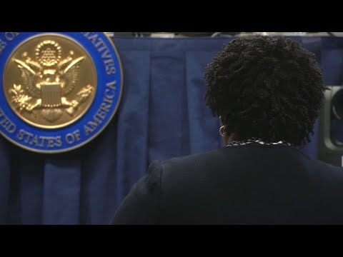
Voting Rights
Why do you think voting rights are being challenged right now?
How can voices be heard through voting?
Notes:
Introduce the video: This video will give more context to the excerpt of Stacey Abrams’ speech from the previous lesson.
Show the video.
Discuss:
Why do you think voting rights are being challenged right now?
How can voices be heard through voting?
The next slide will show the evolution of voting rights in the constitution.

Slide 75
Voting Rights: Historical Context - The Constitution
Article 1, Section 4
“The Times, Places and Manner of holding Elections for Senators and Representatives, shall be prescribed in each State by the Legislature thereof; but the Congress may at any time by Law make or alter such Regulations, except as to the Places of choosing Senators.”
Amendment 19
“The right of citizens of the United States to vote shall not be denied or abridged by the United States or by any State on account of sex.”
What’s happening now?
States across the nation are passing bills to both limit and expand voting rights. The federal government gets involved.
1951
1971
1947
1920
2023
Amendment 15
“The right of citizens of the United States to vote shall not be denied or abridged by the United States or by any State on account of race, color, or previous condition of servitude.”
Amendment 26
“The right of citizens of the United States, who are eighteen years of age or older, to vote shall not be denied or abridged by the United States or by any State on account of age.”
Notes:
Teacher notes:
Walk students through the timeline, which provides historical context for voting rights in the constitution.
It is important to note- although the 15th Amendment extended the right to vote to all citizens regardless of race, Native American people born in the United States were not recognized as full American citizens until the Snyder Act and therefore did not have the right to vote until 1924.
Discuss briefly what has been happening recently- laws that limit voting access relate to changing polling locations, changing how people can vote by mail which affects students who live away from home, stricter regulations on acceptable ID’s to vote in person, among others. WA and NY recently restored voting rights to people with past convictions, and other states have made it easier to vote by mail.
The important thing to note here is that the country has become polarized. Because the constitution allows a great deal of power to the states, they can still maintain autonomy in how they run elections. The amendments protect voting to citizens regardless of race, religion, sex, or age, but as we have seen, there are many other ways to restrict voter access or at least make it very difficult for people to navigate the system.
Discuss: What do you notice?
What do you wonder?
Who or what is missing in the article or amendments?
More specific information about 2021 voting laws and updates on the For the People Act: https://www.brennancenter.org/our-work/research-reports/voting-laws-roundup-may-2021

Slide 76
Components of a Speech
Welcome the audience (Who is your audience?)
“Good afternoon Congress and members of the parties…”
“Hello Americans, fellow world leaders, and those who are tuned in…”
“Thank you for inviting me to speak today and good afternoon to the Class of 2012…”
“Welcome students, parents, faculty, family and friends…”
State your purpose for speaking (Why are you here to speak?)
“Today I’m here to speak to you about…”
“I want you to remember that…”
“I have been asked to speak about…”
Make your message loud and clear (What is your point to the audience?)
“What I’m here to tell you is…”
“If you don’t remember anything at all, remember…”
“The point of this is…”
Notes:
Instruct students on the 3 key components of a speech. Remind them that they will need to focus on these components as they write their mini-speech and as they prepare their speech for the final competition.

Slide 77
Mini Speech
Directions: You are going to write a “mini speech” on a given topic. Before you write your speech, you must identify the key elements of your speech, keeping in mind your audience and purpose. Your mini speech should be a minimum of 2 paragraphs and should answer the prompt you have selected.
Prompt 1
Imagine you are going before your social worker to make your case for going straight home, as opposed to going to a group home when leaving detention. Why should he/she send you home? Make your case.
Prompt 2
You have just turned 18, and an election is coming up. You have been informed, however, that a law was passed in your state that will prevent you and many others in your community from voting. You have been asked to speak at a town meeting to represent your community to state officials. Write a speech to make your case.
Notes:
Explain the directions for the mini-speech
Ask volunteer students to read the two writing prompts for today

Slide 78
Mini Speech
Choose your prompt
Identify your audience, purpose, and message using the organizer in your handout
Write your speech
Share your speech
Notes:
Walk thru the steps students will take to complete their assignment.
Once students have completed their mini-speech, remind them that they will share their speech and use the rubric to offer feedback to a peer.

Slide 79
Mini Speech
Rubric
The speech has a clear message | 3 [Excellent, on point!] | 2 [Approaching, okay!] | 1 [Needs some work!]
The speech welcomes the audience | 3 [Excellent, on point!] | 2 [Approaching, okay!] | 1 [Needs some work!]
The speech makes sense & answers the prompt | 3 [Excellent, on point!] | 2 [Approaching, okay!] | 1 [Needs some work!]
The speaker presented the speech well (using HIPE) | 3 [Excellent, on point!] | 2 [Approaching, okay!] | 1 [Needs some work!]
The speech uses correct capitalization and punctuation | 3 [Excellent, on point!] | 2 [Approaching, okay!] | 1 [Needs some work!]
Notes:
Present the rubric on the board while students either work in small groups, pairs, or as a class with volunteer students presenting their speech.
Students should use the rubric in their handouts to offer feedback to a peer.

Slide 80
Exit Ticket:
What are the three components of a speech?
*Don’t forget to fill in your Daily Learning Log!
Notes:
Before students leave class, ask them to complete the exit ticket on a piece of paper or submit one through your virtual classroom.
Ask students to fill out their Daily Learning Log

Slide 81
Day 7
Speech Analysis and Comprehension
Notes:
View Day 7 Lesson plan here
View Day 7 handouts here

Slide 82
Do Now
Think about a time you heard a story and it made an impact on you. What was the story about? Who told it? Why did it impact you?
Notes:
As students enter classroom, have the Do Now prompt on the screen for them to respond to in their journals, handout, or piece of paper.

Slide 83
Agenda
Do Now
Notes: Rhetorical Devices
Guided Practice & independent Practice: Michelle Obama
Exit Ticket
Notes:
Review the agenda for the day

Slide 84
Objectives
Students will be able to
Analyze speeches for their use of the rhetorical device anecdote, and determine how it adds to the overall message of the speech.
Notes:
Review the objectives for the day, so students know what is expected of their learning

Slide 85
Quick Review
What rhetorical devices have we learned about so far?
Hyperbole
Hypophora
Repetition
Notes:
Ask students to review what they have learned in previous classes using the questions on the board
If using an interactive board, teacher can ask student volunteers to write answers on the board

Slide 86
Cornell Notes
Key Words & Questions
Anecdote
Details
An anecdote is a personal story that helps connect with the audience and make the message stronger.
Let’s look at an example...
Notes:
Instruct students to complete Cornell notes as you review the key words and questions for today
Click to next slide to review an example together

Slide 87
Cornell Notes
Example: Steve Jobs Speech
“Today I want to tell you three stories from my life. That's it. No big deal. Just three stories.
I was lucky — I found what I loved to do early in life. A friend and I started Apple in my parent’s garage when I was 20. We worked hard, and in 10 years Apple had grown from just the two of us in a garage into a $2 billion company with over 4000 employees. We had just released our finest creation — the Macintosh — a year earlier and I had just turned 30. And then I got fired. How can you get fired from a company you started?”
How is this an anecdote?
What is Steve Jobs talking about?
Notes:
Read the example excerpt together
Discuss the questions

Slide 88
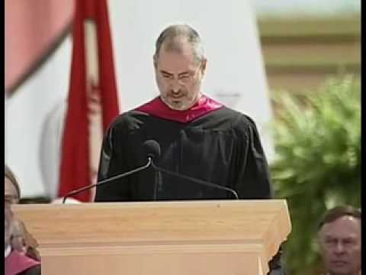
Steve Jobs Speech
Notes:
Show students the full Steve Jobs Speech, if time permits.

Slide 89
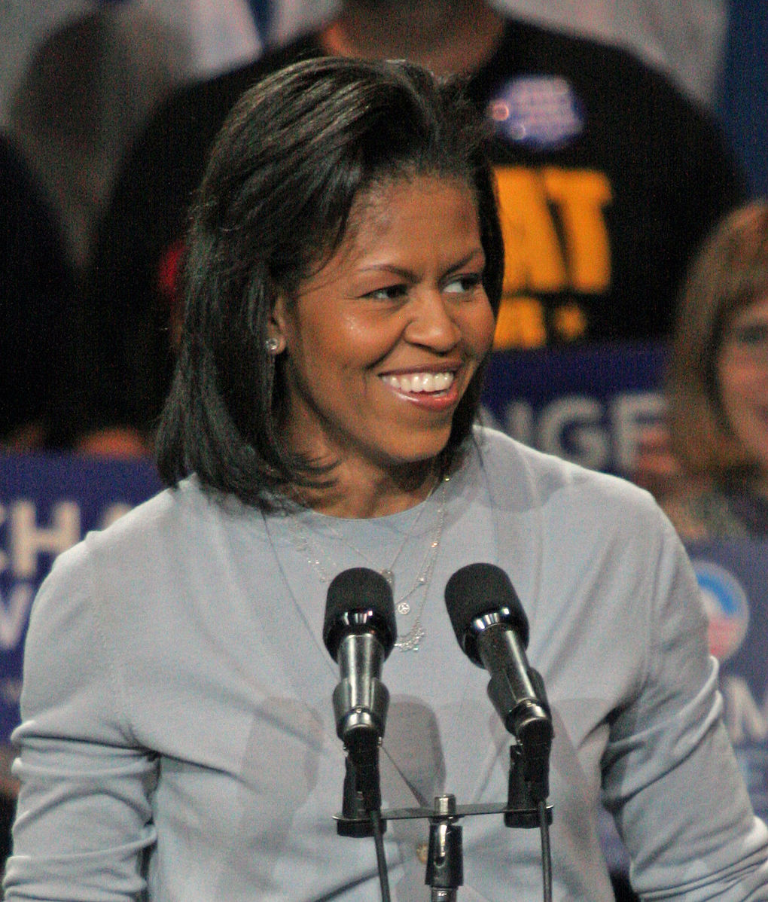
Let’s Consider a Speech!
“…to me, he was still the guy who’d picked me up for our dates in a car that was so rusted out, I could actually see the pavement going by through a hole in the passenger side door…he was the guy whose proudest possession was a coffee table he’d found in a dumpster, and whose only pair of decent shoes was half a size too small.”
"That's the man who sits down with me and our girls for dinner nearly every night, patiently answering their questions about issues in the news, and strategizing about middle school friendships."
These are excerpts from Michelle Obama’s Speech to the DNC in Sept 2012
Notes:
Tell students that you will be considering a couple excerpts from a Michelle Obama speech where she uses anecdotes. Tell students that after we read the quotes, they will analyze them for their meaning in their handouts
Read through the quotes
Image Source: https://commons.wikimedia.org/wiki/File:Michelle_Obama_2008-10-22_%281%29_cropped.jpg

Slide 90
Let’s Consider a Speech!
Anecdote in Your Own Words | The Point of the Story
Notes:
Instruct to complete the graphic organizer in their handouts by writing down the anecdote story in their own words and then providing an explanation for why Michelle Obama told the story (the point of the story)

Slide 91
Independent Practice
Together we will read the speech excerpt from Michelle Obama’s Speech to the DNC in Sept 2012.
You will identify one of the anecdotes used by her speech and write it in the organizer below.
Anecdote in Your Own Words | The Point of the Story
Notes:
Walk thru the students steps for reading and analyzing the assigned speech. They will now read through more of Michelle Obama’s speech and identify an anecdote to analyze.
Keep this slide on the screen as students work through their handouts so they can keep track of what steps are next
Image Source: https://commons.wikimedia.org/wiki/File:Michelle_Obama_2008-10-22_%281%29_cropped.jpg

Slide 92
Exit Ticket:
How can a speaker use anecdotes in his or her speech? Why might a speaker want to use anecdotes?
*Don’t forget to fill in your Daily Learning Log!
Notes:
Before students leave class, ask them to complete the exit ticket on a piece of paper or submit one through your virtual classroom.
Ask students to fill out their Daily Learning Log

Slide 93
Day 8
Speech Preparation
Notes:
View Day 8 Lesson plan here
View Day 8 handouts here

Slide 94
Do Now
What are 5 social issues that you care about?
Notes:
As students enter classroom, have the Do Now prompt on the screen for them to respond to in their journals, handout, or piece of paper.

Slide 95
Agenda
Do Now
Introduction to Speech Contest
Speech Planning: Empathy Map
Begin Drafting Speech!
Exit Ticket
Notes:
Review the agenda for the day

Slide 96
Objectives
Students will be able to
Develop a topic for a speech using empathy mapping and brainstorming
Develop a message for a speech using rhetorical devices
Notes:
Review the objectives for the day, so students know what is expected of their learning

Slide 97
Unheard Speech Competition!
You will have the opportunity to write and deliver a 3-4 minute speech about the given topic!
Winners from our school will enter into the
nationwide competition!
Don’t let your voice go unheard!
Notes:
Introduce the BreakFree Education Unheard speech competition
Tell students that the competition is nationwide and that winners will receive prizes
Explain that you class/school will have its own competition and the top three speeches will be submitted to the national competition
If you need ideas on how to host an in-person or virtual speech contest, please view our How-To Guide
Tell students the details of the speech
It will be 3-4 minutes long
It will be on a specific prompt (next slide)
They will submit both their written speech along with an audio recording of them presenting it
Our How-To guide also offers assistance in how to record students’ speeches
For additional competition information, view the guidelines here

Slide 98
Speech Prompt
Stories get told every day, but only some voices get heard.
Whose voices are going unheard in your community? The U.S.? The world? What is missing as a result of their voices not being heard? Why should we listen to their voices?
Choose a local, national, or global group of voices that you care about and believe are not being heard. Write a persuasive speech that outlines (1) the importance of hearing those voices and (2) proposes how we can work to hear those voices and listen to what they are asking for.
*Examples of unheard voices may include the homeless, the disabled,
prisoners, or those of a minority background (race, culture, religion).
Notes:
Read the prompt to students and answer any questions they have about it
Tell students this is the prompt they will be using for the competition
Remind students that this is an opportunity for not only their own voices to be heard, but for them to encourage people to listen to others’ voices as well

Slide 99
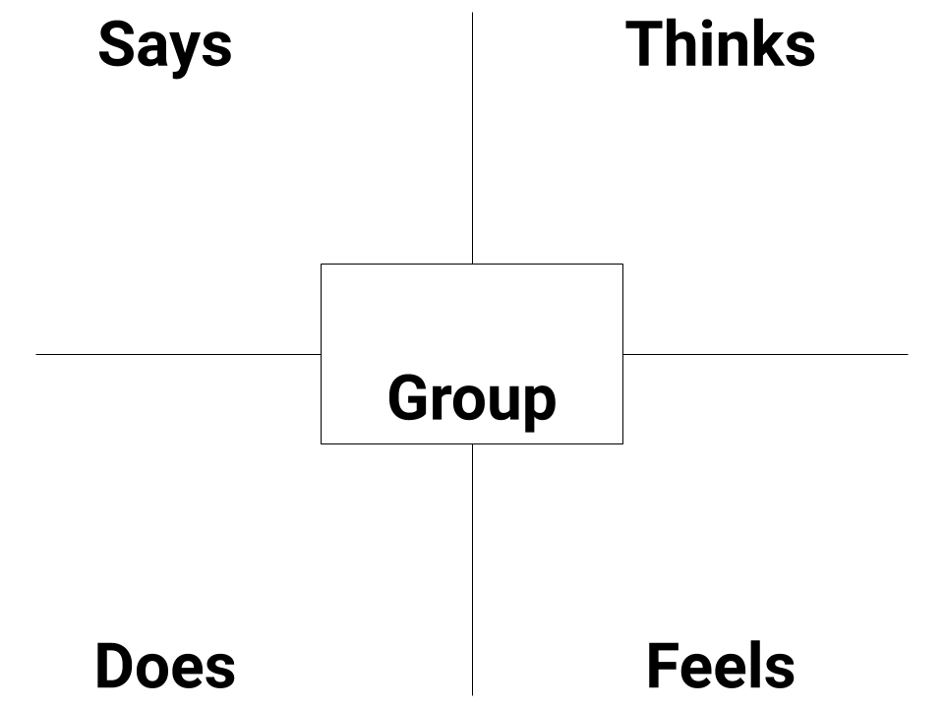
Choose Your Group of Voices!
What voices do you want to be heard?
Let’s use the empathy
graphic to start brainstorming
about your group?
Notes:
Introduce students to the empathy map. Typically empathy maps are used in design thinking to help you grow closer to and better understand an individual or group. For this exercise, it will help students to think about the group of voices they want to advocate for in their speech and begin thinking about the unique perspective that their chosen group of voices have. After completing this exercise, students will have a better grasp of their focus group and will be better prepared to write their speech as to why it is important this group of voices is heard.

Slide 100
Choose Your Group of Voices!
Choose your group
Identify your audience, purpose, and message using the organizer in your handout
Begin to write your speech making sure to use the rhetorical devices we’ve discussed
Share your speech
We’ll have more time to continue working on your speeches, editing them, and making them stronger!
Notes:
Walk thru the steps students will take to complete their assignment.
Remind students that they will have more time to work on their speech draft and prepare for the speech competition.

Slide 101
Exit Ticket:
What are your goals for crafting your speech?
*Don’t forget to fill in your Daily Learning Log!
Notes:
Before students leave class, ask them to complete the exit ticket on a piece of paper or submit one through your virtual classroom.
Ask students to fill out their Daily Learning Log

