Slide 1
Uncharted
Pythagorean and
Coordinate Geometry
Notes:
In this 3-day+ initiative, students will use their knowledge of the pythagorean theorem and the distance formula to chart the path of the superthief Carmen Sandiego and discover her hideout--along the way, they'll learn about the world sites where Carmen has been spotted. Uncharted culminates with students helping others to learn about the mathematic formulas they've mastered by creating their own children’s storybook. The math in this initiative is roughly at the level of Geometry.
Access the Teacher Lesson Plans
Day 1
Day 2
Day 3
Day 4+
Access to printable versions of the student handouts here
Day 1
Day 2
Where in the World is Carmen Sandiego Game Worksheet
Day 4+

Slide 2
Day 1
Pythagorean Theorem
Notes:
This lesson introduces students to the fundamental concept of the Pythagorean Theorem.

Slide 3
Do Now:
What do you know about right-angle triangles? Can you draw one?
Notes:
As students enter classroom, have the Do Now prompt on the screen for them to respond to in their journals, handout, or piece of paper.

Slide 4
Agenda
Do Now: Right Triangles
Introduction to Uncharted
Lesson: Pythagorean Theorem
Activity: Practice Worksheet
Lesson: Practical Applications
Exit Ticket
Notes:
Review the agenda for the day

Slide 5
Objectives
Students will be able to:
Define a right triangle and its parts
Understand the Pythagorean Theorem and apply it
See how the Pythagorean Theorem can be used practically in everyday life
Notes:
Review the objectives for the day, so students know what is expected of their learning

Slide 6
Introduction: What is Uncharted?
Over the next few days, we will explore the mathematical concepts of the Pythagorean Theorem and Distance Formula. We will practice to gain mastery, and in the process play a game and learn about countries around the world.
Don’t forget, there’s a competition too!
Notes:
Explain to the students that by the end of this unit, they will be asked to create an original children’s book to help explain a mathematical concept of their choosing. As we go through our mini-unit, they should keep that in mind as they learn about the different mathematical concept, and how they learn the concepts best. Anytime something sparks their imagination, they should make a note of it (perhaps in their writer’s notebook). Explain BreakFree’s contest to them and pass out the Student Note.
The BreakFree Contest is their chance to be an author!

Slide 7
Discussion
What do you know about right triangles?
What makes it a right triangle?
How many degrees is a right-angle?
What is the hypotenuse?
Hypotenuse
Opposite the right angle
Longest of the 3 sides
c
a
90º
b
Legs
Notes:
Pose the question at the top to students and ask a few students to share their answers from the Do Now activity
If the Theorem comes up, use it to introduce the next subtask. If it does not come up, introduce the Pythagorean Theorem
(a2+ b2= c2) and that we will be exploring the theorem

Slide 8
Pythagorean Theorem
Pythagorean Theorem is used for right triangles and allows us to find the length of one side of the triangle, when the other two side lengths are known.
a² + b² = c²
c
a
b
DID YOU KNOW: Pythagoras lived during the 6th century B.C. on the island of Samos in the Aegean Sea. He also lived in Egypt, Babylon, and southern Italy. He was a philosopher and a teacher.

Slide 9
Pythagorean Theorem - Let’s Practice!
Finding a leg
Steps
Write equation
Substitute numbers
Square numbers
Subtract
Find the square root
Label answer
a² + b² = c²
5² + b² = 15²
25 + b² = 225
-25 -25
b² = 200
b = 14.14
15
5
b

Slide 10
Pythagorean Theorem - Let’s Practice!
Finding the hypotenuse
Steps
Write equation
Substitute numbers
Square numbers
Add
Find the square root
Label answer
a² + b² = c²
7² + 4² = c²
49 + 16 = c²
65 = c²
√65 = c
c = 8.06
c
7 in
4 in

Slide 11
Pythagorean Theorem - Pythagorean Triples
Pythagorean Triples
There are combinations of whole numbers that work in the Pythagorean Theorem. These sets of numbers are known as Pythagorean Triples.
3-4-5 is the most famous of the triples. Try it out!
3² + 4² = 5²
9 + 16 = 25
If you recognize the sides of the triangle as being a triple (or multiple of one), you won't need a calculator!
5 in
4 in
3 in

Slide 12
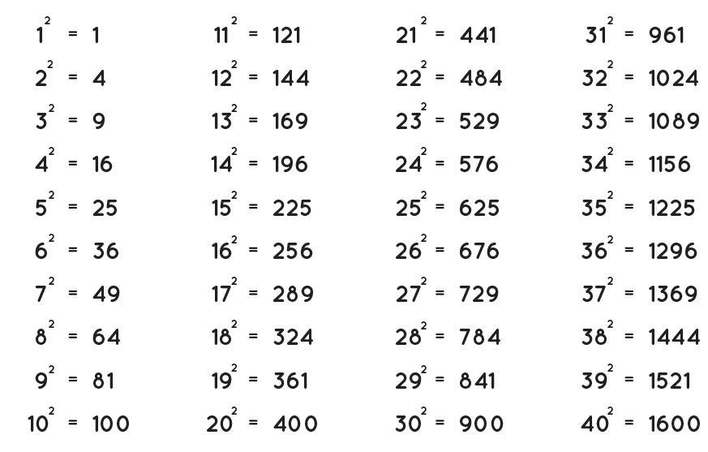
Pythagorean Theorem - Pythagorean Triples
Pythagorean Triples
Can you use the table of squares to identify any other Pythagorean Triples?
More Triples
5 - 12 - 13
7 - 24 - 25
8 - 15 - 17
Notes:
Give students a couple minutes to work independently or on their own to practice adding some squares together to see if they can discover another Pythagorean Triple.
Click to show some additional answers.

Slide 13
Pythagorean Theorem - Pythagorean Triples
Pythagorean Triples
Multiples of Pythagorean Triples work, too! Find the missing side lengths below, given what you know about triples.
15 in
24 in
15 in
18 in
48 ft
50 ft
36 in
9 in
30 in
39 in
12 in
14 ft
3x 3 - 4 - 5
6x 3 - 4 - 5
2x 7 - 24 - 25
3x 5 - 12 - 13

Slide 14
Pythagorean Theorem - Independent Practice!
Complete the following problems on your worksheet
1. 2.
a² + b² = c²
15² + 41² = c²
225 + 1,681 = c²
1,906 = c²
√1,906 = c
c = 43.66
a² + b² = c²
a² + 4² = 5²
a² + 16 = 25
- 16 -16
a² = 9
a = 3
c
41 ft
5 in
a
15 ft
4 in
Notes:
Pass out the handout and allow students to work independently or in groups. You can have students complete the worksheet entirely and then review, or go question by question.
Note: Answers are provided step-by-step by clicking through the slide

Slide 15
Pythagorean Theorem - Independent Practice!
Complete the following problems on your worksheet
3. 4.
The legs of a right triangle are 2 and 12, what is the length of the hypotenuse?
The hypotenuse of a right triangle has a length of 9 and one of its legs has a length of 4. What is the length of the other leg?
a² + b² = c²
2² + 12² = c²
4 + 144 = c²
148 = c²
√146 = c
c = 12.17
a² + b² = c²
a² + 4² = 9²
a² + 16 = 81
- 16 -16
a² = 65
a = 8.06
2 in
c
9 in
a
12 in
4 in
Notes:
Pass out the handout and allow students to work independently or in groups. You can have students complete the worksheet entirely and then review, or go question by question.
Note: Answers are provided step-by-step by clicking through the slide

Slide 16
Pythagorean Theorem - Independent Practice!
Complete the following problem on your worksheet with a partner!
5.
In ΔABC, BD is perpendicular to AC. The dimensions are shown in centimeters.
What is the length of AC?
Is there anything special about this triangle?
First, we solve for DC! (DC is the same as side “b”)
a² + b² = c²
6² + b² = 10²
36 + b² = 100
-36 -36
b² = 64
b = 8 → DC = 8
B
10
10
Then we solve for AC
AC = 2 * DC
AC = 2 * 8
AC = 16
6
A
C
D
Notes:
Pass out the handout and allow students to work independently or in groups. You can have students complete the worksheet entirely and then review, or go question by question.
Note: Answers are provided step-by-step by clicking through the slide
Tell students that this triangle is special, because the smaller triangles within it are Pythagorean triples!

Slide 17
Converse of the Pythagorean Theorem
Pythagorean Theorem is used for right triangles.
a² + b² = c²
If, however,
a² + b² ≠ c²
Then it is NOT a right triangle
(In other words, you can check if a triangle is a right triangle by seeing if the Pythagorean Theorem is true)
Is this a right triangle?
36 ft
30 ft
24 ft
Notes:
Discuss the converse of the Pythagorean Theorem

Slide 18
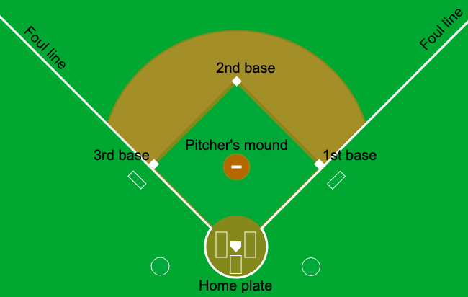
Applications of Pythagorean Theorem
A baseball field is made up of a square with 90 ft sides.
If a catcher throws to second base, how far does he throw?
90
90
a² + b² = c²
90² + 90² = c²
8,100 + 8,100 = c²
16,200 = c²
√16,200 = c
c = 127.28 → The catcher would need to
throw 127.28 ft to reach second base
90
Notes:
As a class, read the question and work through the problem together

Slide 19
Applications of Pythagorean Theorem
You're locked out of your house and the only open window is on the second floor, 25 feet above ground. There are bushes along the edge of your house, so you'll have to place a ladder 10 feet from the house. What length of ladder do you need to reach the window?
(round to the nearest foot)
25 ft
a² + b² = c²
10² + 25² = c²
100 + 625 = c²
725 = c²
√725 = c
c = 26.93 → The ladder needs to be at least 27 ft. long
x
10 ft
Notes:
As a class, read the question and work through the problem together

Slide 20
Where in the World is Carmen Sandiego?!?
Throughout this geometry unit, we’ll be working toward locating the world’s greatest thief, Carmen Sandiego! Our last day of the unit, will be a super-hunt to determine her hideout. Save the answers to your exit tickets, for clues on her whereabouts!
DID YOU KNOW:
Where in the World is Carmen Sandiego was an educational video game first released in 1985! The franchise expanded to include a TV game show in 1991. Netflix revived the popular superthief in 2019 with a cartoon that follows her new international capers.
There’s also a book series!
Image Source: The Kats Cafe
Notes:
Introduce Where in the World is Carmen Sandiego and tell students that throughout this 3-day unit they will be working toward an international scavenger hunt where they will track down Carmen Sandiego

Slide 21
Exit Ticket: Carmen’s River Escape
Carmen Sandiego recently escaped on a river boat after stealing precious artifacts. Solve the problem below to get a clue as to which River she traveled on! How long is the river between point x and point y? (round to the nearest whole number)
Y
Answer | Clue
37 | The Danube
47 | The Nile
45 | The Thames
35 | The Colorado
20 miles
X
42 miles
Notes:
Before students leave class, ask them to complete the exit ticket on the handout, a piece of paper or submit one through your virtual classroom.
Answer
47 - The Nile
Ask students to fill in their Daily Learning Logs

Slide 22
Day 2
Distance Formula
Notes:
In this lesson, Students will learn the concept of the Distance Formula and understand it as a derivative of the Pythagorean Theorem.

Slide 23
Do Now
How far does Jamal have to walk to get from his house to the grocery store? Bonus question: If Jamal can walk 5 miles per hour, how long will it take him to walk to the grocery store?
c
0.3 miles
0.9 miles
Notes:
As students enter classroom, have the Do Now prompt on the screen for them to respond to in their journals, handout, or piece of paper.
Answer: 0.95 miles
Bonus: 11.4 minutes OR .19 hours

Slide 24
Agenda
Do Now: Jamal’s walk to the grocery store
Review Pythagorean Theorem
Lesson: The Distance Formula
Activity: Practice Worksheet
Exit Ticket
Notes:
Review the agenda for the day

Slide 25
Objectives
Students will be able to:
Recognize the aspects of a coordinate plane and solve for lengths between points using the Pythagorean Theorem
Understand the Distance Formula as a derivative of the Pythagorean Theorem
Solve for distances using the Distance Formula and coordinates
Notes:
Review the objectives for the day, so students know what is expected of their learning

Slide 26
Review of Pythagorean Theorem
Pythagorean Theorem is used for right triangles and allows us to find the length of one side of the triangle, when the other two side lengths are known.
a² + b² = c²
Hypotenuse
Opposite the right angle
Longest of the 3 sides
c
a
b
Legs
Notes:
Briefly review the key concepts that students learned about in the last lesson

Slide 27
Pythagorean Theorem & Distance
Let’s apply the Pythagorean Theorem to finding distances once again!
To get from his high school to his home, Michael travels 5.0 miles east and then 4.0 miles north. When Sheila goes to her home from the same high school, she travels 6.0 miles west and 2.0 miles south. What is the measure of the shortest distance, to the nearest tenth of a mile, between Michael’s home and Sheila's home?
5
c
-5
5
-5
Can we make this into a right triangle and use the Pythagorean Theorem?
Notes:
Walk students through the word problem and how to graph points on a chart

Slide 28
Pythagorean Theorem & Distance
Let’s apply the Pythagorean Theorem to finding distances once again!
Turn this into a right Triangle!
What is the length of a?
11
5
What is the length of b?
6
c
b
What is the length of c?
a²+b²=c²
11²+6²=c²
121 + 36 = c²
√157 = c → c = 12.53
-5
5
a
-5
Notes:
Walk through solving the problem by counting the squares on the graph to determine the legs of the triangle and then applying the pythagorean theorem to find the hypotenuse

Slide 29
Pythagorean Theorem & Distance
Review of x- and y-axis
y-axis
Where is the x-axis?
x-axis
5
m
Where is the y-axis?
A point’s coordinates are written: (x, y)
What are the coordinates of point m?
(5, 4)
What are the coordinates of point s?
(-6, -2)
-5
5
s
-5
Notes:
Briefly review the key terms associated with a coordinate plane

Slide 30
Pythagorean Theorem & Distance
Finding the distance of side a and side b…
Before, we simply counted the units on the graph
Another approach is to use the point coordinates
(5, 4) and (-6, -2)
a = |x₂- x₁| and b = |y₂- y₁|
a = |-6 - 5| and b = |-2 - 4|
a = |-11| and b = |-6|
a = 11 and b = 6
5
m
c
b
-5
5
s
a
-5
Notes:
Show students how the length of a vertical or horizontal line can be calculated using endpoints

Slide 31
Pythagorean Theorem & Distance
So, another way of using the Pythagorean Theorem
a² + b² = c²
But with coordinate points, is the Distance Formula
d = (x2 - x1)² + (y2 - y1)²
5
m
c
b
-5
5
s
a
-5
√
c
Here “c” is called “d” for “distance”
a
b
Notes:
Introduce the Distance Formula and show students that it is simply another way of using the pythagorean theorem!

Slide 32
Distance Formula
Distance Formula
d = (x₂ - x₁)² + (y₂ - y₁)²
√
d = √(-6 - 2)² + (2 - 5)²
d = √(-8)² + (-3)²
d = √64 + 9
d = √73
d = 8.54
(2, 5)
c
5
b
(-6, 2)
a
-5
5
-5
Notes:
Lead students through this practice problem for using the distance formula

Slide 33
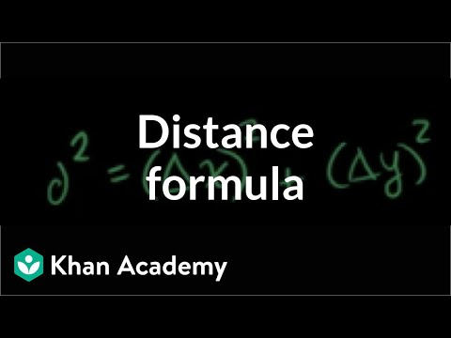
Distance Formula
Notes:
Watch the Khan Academy video for further review of the distance formula and pythagorean theorem

Slide 34
Distance Formula - Independent Practice!
Complete the following problems on your worksheet
1. 2.
Point 1 (-4, -7) Point 1 (2, 3)
Point 2 (-5, -2) Point 2 (6, 8)
√(-5 - -4)² + (-2 - -7)²
√(-5 + 4)² + (-2 + 7)²
√(-1)² + (5)²
√1 + 25
√26
d = 5.1
√(6 - 2)² + (8 - 3)²
√(4)² + (5)²
√16 + 25
√41
d = 6.4
Notes:
Pass out the handout and allow students to work independently or in groups. You can have students complete the worksheet entirely and then review, or go question by question.
Note: Answers are provided step-by-step by clicking through the slide

Slide 35
Distance Formula - Independent Practice!
Complete the following problems on your worksheet
3. 4.
Point 1 (-7, -2) Point 1 (4, 6)
Point 2 (11, 3) Point 2 (1, 5)
√(11 - -7)² + (3 - -2)²
√(11 + 7)² + (3 + 2)²
√(18)² + (5)²
√324 + 25
√349
d = 18.7
√(1 - 4)² + (5 - 6)²
√(-3)² + (-1)²
√9 + 1
√10
d = 3.2
Notes:
Pass out the handout and allow students to work independently or in groups. You can have students complete the worksheet entirely and then review, or go question by question.
Note: Answers are provided step-by-step by clicking through the slide

Slide 36
Distance Formula - Independent Practice!
Complete the following problems on your worksheet
5.
A horizontal line segment has a length of 6 units and one endpoint is (-4, 5). Which could be the other endpoint?
(2, 5)
(2, 1)
(-4, 11)
(10, 13)
6 =√(-4 - 2)² + (5 - 5)²
6 = √(6)² + (0)²
6 = √36 + 0
6 = √36
Answer: (2,5)
Notes:
Pass out the handout and allow students to work independently or in groups. You can have students complete the worksheet entirely and then review, or go question by question.
Note: Answers are provided step-by-step by clicking through the slide

Slide 37
Distance Formula - Independent Practice!
Complete the following problem on your worksheet with a partner!
6.
Find the perimeter of ΔEFG. Round the answer to the nearest tenth.
EF = √(3 - 7)² + (4 - -1)²
EF = √(16 + 25) = √41
FG = √(1-3)² + (1-4)²
FG = √4 + 9 = √13
GE = √(7-1)² + (-1 - 1)²
GE = √36 + 4 = √40
5
F
√41 + √13 + √40 = 16.3
G
5
E
Notes:
Pass out the handout and allow students to work independently or in groups. You can have students complete the worksheet entirely and then review, or go question by question.
Note: Answers are provided step-by-step by clicking through the slide

Slide 38
Activity: Worksheet
Let’s review our answers!
Notes:
If time permits, bring the class back together to review their answers

Slide 39
Exit Ticket: Carmen’s River Escape
Carmen was recently spotted taking foreign language lessons, likely to aid in her upcoming caper. Solve the equation below to discover what language she was learning. If (13, 6) is one endpoint and (-3, k) is the other, what is k if the distance is √260?
Answer | Clue
6 | Mandarin
16 | Tagalog
-4 | French
4 | Arabic
Notes:
Before students leave class, ask them to complete the exit ticket on the handout, a piece of paper or submit one through your virtual classroom.
Answer
4 - Arabic
Ask students to fill in their Daily Learning Logs

Slide 40
Day 3
Where in the World is Carmen Sandiego
Notes:
In this lesson, students will play the Where in the World is Carmen Sandiego to make hunt down the superthief by solving equations using the distance formula. Throughout the course of the game, students will “visit” several countries and keep a passport with details about where they go and what they learn.

Slide 41
Do Now
For one last clue on Carmen’s recent whereabouts, solve the following: Find the distance between (3, 5) and (3, -2).
Answer | Clue
7 | Pyramids
√7 | The Great Wall
-7 | Hockey Games
49 | Castles
Notes:
As students enter classroom, have the Do Now prompt on the screen for them to respond to in their journals, handout, or piece of paper.
Answer: 7 - Pyramids

Slide 42
Agenda
Do Now
Where in the World is Carmen Sandiego Game
Class Discussion
Notes:
Review the agenda for the day

Slide 43
Objectives
Students will be able to:
Apply the distance formula
Use logic and reasoning to solve puzzles
Notes:
Review the objectives for the day, so students know what is expected of their learning

Slide 44
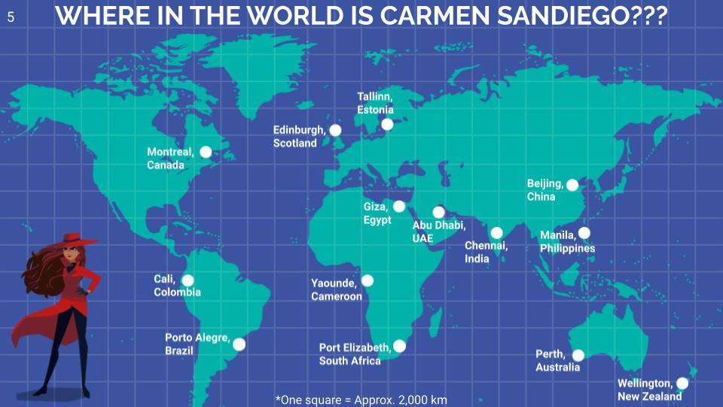
Activity: Worksheet
Time to Play Where in the World is Carmen Sandiego!
As you play the game, follow along on the passport worksheet to keep track of your travel locations!
Notes:
Students will play the game independently or as a class and complete the worksheet as they go through each step of the game.
Game link
Game Worksheet
Worksheet can be printed OR if students are using their own computers, a copy can be made for each of them to complete
Completion Certificate
Note for teachers and students:
For the purposes of keeping track of Carmen Sandiego, distances between cities are calculated assuming a flat grid where the lines of longitude run parallel to each other (instead of joining at the north and south poles and then ‘spreading’ across the globe).
Further, we have created a unit of distance which we have termed “hops” for the finding Carmen Sandiego exercises.
We note that calculating the distance between locations, based on their latitude and longitude does not directly correlate mathematically to the distance that will be calculated using the pythagorean theorem (or the distance formula). This is because the earth is a sphere so the actual distance between longitudinal points varies based on how far the points are from the equator.

Slide 45
Exit Ticket:
What are three things you’ve learned from playing Where in the World is Carmen Sandiego?
Notes:
Before students leave class, ask them to complete the exit ticket on a piece of paper or submit one through your virtual classroom.
Ask students to fill in their Daily Learning Logs

Slide 46
Day 4+
Making a Children’s Book
Notes:
For the rest of the lessons, students will work creatively on building a children’s storybook to explain a mathematical concept of their choosing

Slide 47
Do Now:
Chat with a partner: What were your favorite children’s books? Why did you like them? What did they teach you?
Notes:
As students enter classroom, have the Do Now prompt on the screen for them to respond to with a partner.

Slide 48
Agenda
Do Now: Favorite Children’s Books
Activity: Children’s Book Design
Notes:
Review the agenda for the day

Slide 49
Objectives
Students will be able to:
Explain a mathematical concept using straightforward language and visuals
Think creatively to develop a story
Notes:
Review the objectives for the day, so students know what is expected of their learning

Slide 50
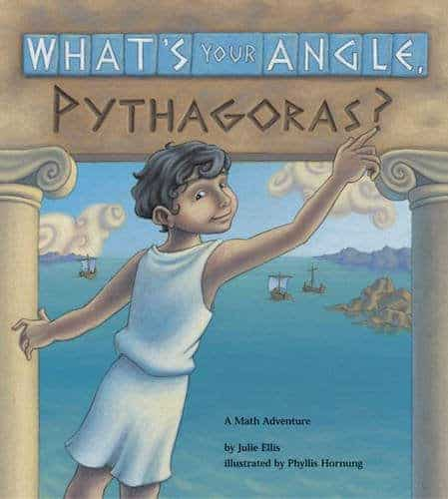
Activity: Make a Children’s Book!
Many of us grew up either having children’s books read to us or reading them ourselves. Combining artwork and simple sentences, children’s books help explain new and complex topics for young learners, introducing them to a concept and then illustrating it with fun, colorful, and interesting imagery.
You’ve just mastered the mathematical concepts of the Pythagorean Theorem and the Distance Formula, so now you can help others learn about them by creating your own children’s storybook.
Notes:
Introduce the activity to students. Show examples of books that explain mathematical concepts if you can.
Note: Students may work together to create a storybook

Slide 51
Activity: Make a Children’s Book!
Let’s get started!
Complete the graphic organizer to help you conceptualize your book!
Parameters for your book:
Must choose at least one mathematical concept to explain
Must use at least three examples
Must incorporate images/visuals
Must incorporate a story
Notes:
Passout the Children’s book graphic organizer
If students have access to complete the assignment on the computer using google slides, you can choose to share the following templates to help spark their creativity
Picture book template
Storybook template
Detailed Fish Storybook template
Printable Book Template (pdf version)

Slide 52
Submit Your Work!
Chance to win a Chromebook!
Submit your children’s book to BreakFree for a chance to win a Chromebook!
Notes:
Tell students about the chance to win a Chromebook by completing and submitting their work to BreakFree
Collect and submit your students’ children’s books through our portal by February 24, 2023. The first place student win a Chromebook!
At the end of the day, ask students to fill in their Daily Learning Logs

