Slide 1
Words Unlocked
Optional Lessons
Notes:
These lessons are meant to be optional, additional lessons to use with the core Words Unlocked lessons.

Slide 2
Optional Lesson 1
Metaphors & Similes 2.0

Slide 3
Do Now
Read the two sets of lyrics and complete the graphic organizer for each to tell us what the author means.
One You’re like 31 flavors you’re oh so cold Feels like 30 straight days of falling snow I’m so cold and alone, alone You're cold as ice | Two Yeah I’m sorry, I can’t afford a Ferrari, but that don’t mean I cant get you there. I guess he’s an X-Box and I’m more an Atari, but the way you play your game ain’t fair.
What two items are being compared? |  | What does the author mean?
Simile or metaphor?

Slide 4
Agenda
Do Now: Lyrics
Identify and analyze the metaphors and similes
Write your own poem!
Exit Ticket

Slide 5
Objectives
Students will be able to:
Identify similes and metaphors within a poem and analyze the significance of their use.
Analyze how poets use figurative language to enhance their message by reading poems that use simile and metaphor.
Write original poems about family using metaphors and similes.

Slide 6
Thoughts to start the day
What is the difference between a simile and a metaphor?
Why does an author use these types of figurative language in their writing?

Slide 7
Guided Practice: Still I Rise by Maya Angelou
You may write me down in history
With your bitter, twisted lies,
You may trod me in the very dirt
But still, like dust, I'll rise.
Does my sassiness upset you?
Why are you beset with gloom?
'Cause I walk like I've got oil wells
Pumping in my living room.
Just like moons and like suns,
With the certainty of tides,
Just like hopes springing high,
Still I'll rise.
Did you want to see me broken?
Bowed head and lowered eyes?
Shoulders falling down like teardrops,
Weakened by my soulful cries?
What two items are being compared? |  | What does the author mean?
What two items are being compared? |  | What does the author mean?
What two items are being compared? |  | What does the author mean?
What two items are being compared? |  | What does the author mean?

Slide 8
Guided Practice: Still I Rise by Maya Angelou
You may shoot me with your words,
You may cut me with your eyes,
You may kill me with your hatefulness,
But still, like air, I'll rise.
Out of the huts of history's shame
I rise
Up from a past that's rooted in pain
I rise
I'm a black ocean, leaping and wide,
Welling and swelling I bear in the tide.
Leaving behind nights of terror and fear
I rise
Into a daybreak that's wondrously clear
I rise
Bringing the gifts that my ancestors gave,
I am the dream and the hope of the slave.
I rise I rise I rise.
What two items are being compared? |  | What does the author mean?
What two items are being compared? |  | What does the author mean?
What two items are being compared? |  | What does the author mean?

Slide 9
Guided Practice: Still I Rise by Maya Angelou
What is this poem about?
What is the mood of the poem?
How does the poet feel?

Slide 10
Independent Practice
Caged Bird by Adrian A free bird just goes around taking life for granted, While a caged bird wishes it can be free like the free bird, And never take freedom for granted. Sometimes I feel like a caged bird, Because I have been in the same spot for so long, Seeing the same people, Same places, Hearing the same voices. Sometimes I even come down on myself asking, How did I get here? What can I do? What am I doing? Can I do it better? I just want to be free, Like the free bird, And never take life for granted, If I am not physically free, all I want is just to be free of mind.
What is the poem about?
What is the mood of the poem?
Does the poet use metaphors, similes, or both?
Give 1 example of a metaphor or simile that the poet uses in the poem.

Slide 11
Write Your Own Poem
Create your own original poem of at least 8 lines, using the metaphors and similes.
The theme of your poem is, Family
You must use at least 4 examples of personification and at least 1 metaphor or simile
Your poem must be at least 8 lines long
After 10 minutes, we will share out!

Slide 12
Exit Ticket
What is a metaphor? What is a simile? What is the main difference between a metaphor and a simile? What is similar between a metaphor and a simile? Why do poets use metaphors and similes? How do you determine the significance of a metaphor or simile?

Slide 13
Optional Lesson 2
Poem Structure

Slide 14
Do Now
Write a short poem that uses a rhyming pattern. For Example: Roses are red, violets are blue, sugar is sweet, and so are you

Slide 15
Agenda
Do Now: Rhymes
Poem structure: Cornell Notes
Identify and analyze the poems
Write your own poem!
Exit Ticket

Slide 16
Objectives
Students will be able to:
Identify, define, and analyze the use of rhyme scheme and poetic structure
Write their own original poems using poetic devices and following a specific structure.

Slide 17
Cornell Notes
Key Words & Questions
Details
How are poems typically organized?
Quick review:
What is a stanza?
Quick review:
What is a line?
In stanzas and lines.
Each stanza can be about a different topic that relates to the overall meaning of the poem.

Slide 18
Cornell Notes
Key Words & Questions
Details
What is a poem structure?
What is a haiku?
Why is it important for poems to have a structure?
Poem structure is a poem’s organization
Poems can have many different types of organizational patterns
A haiku is a specific type of poem with a certain structure
Each line is organized by a certain number of syllables
5-7-5 structure
A syllable is a beat

Slide 19
Practice: Write your own haiku
Write your own haiku using a 5-7-5 syllable format.
_________________________________________
_____________________________________________________
_________________________________________

Slide 20
Group Practice
Let’s read the poem by Maya Angelou together and analyze each stanza to see how she organized her poem.
Woman Work
by Maya Angelou
I've got the children to tend The clothes to mend The floor to mop The food to shop Then the chicken to fry The baby to dry I got company to feed The garden to weed I've got shirts to press The tots to dress The can to be cut I gotta clean up this hut Then see about the sick And the cotton to pick.
Shine on me, sunshine
Rain on me, rain
Fall softly, dewdrops
And cool my brow again.
Storm, blow me from here
With your fiercest wind
Let me float across the sky
'Til I can rest again.
Fall gently, snowflakes
Cover me with white
Cold icy kisses and
Let me rest tonight.
Sun, rain, curving sky
Mountain, oceans,
leaf and stone
Star shine, moon glow
You're all that I can call my own.

Slide 21
Group Practice: Analysis
Woman Work
by Maya Angelou
I've got the children to tend The clothes to mend The floor to mop The food to shop Then the chicken to fry The baby to dry I got company to feed The garden to weed I've got shirts to press The tots to dress The can to be cut I gotta clean up this hut Then see about the sick And the cotton to pick.
What is stanza 1 about?

Slide 22
Group Practice: Analysis
Shine on me, sunshine
Rain on me, rain
Fall softly, dewdrops
And cool my brow again.
Storm, blow me from here
With your fiercest wind
Let me float across the sky
'Til I can rest again.
Fall gently, snowflakes
Cover me with white
Cold icy kisses and
Let me rest tonight.
Sun, rain, curving sky
Mountain, oceans,
leaf and stone
Star shine, moon glow
You're all that I can call my own.
What is stanza 2 about?
What is stanza 3 about?
What is stanza 4 about?
What is stanza 5 about?

Slide 23
Group Practice: Analysis
What is the overall meaning of the poem?

Slide 24
Independent Practice
Read the poem and identify the topic of each stanza.
Past, Present, and Future
by Sean G.
Being left alone,
free to do whatever I want at an early age,
life was interesting but scary,
back in these days.
Depending on my wants,
instead of my needs,
come bad deeds, guns, and weed.
Once being left alone now has me
suffering on my own.
But growing up will be different,
for the simple fact that I’m grown,
I will still be on my own
But never left alone.
I see a successful old man,
that turned an inch to a mile,
and the experiences I had as a child,
had me on trial and had me going wild,
but I’m more of a man to the next man,
because I gained growth through experience.

Slide 25
Write Your Own Poem
Organize your poem today by idea. Each of the following must be at least one stanza, so your poem will have at least 4 stanzas.
1st part: about baby/childhood
2nd part: about being a teenager
3rd part: about being an adult
4th part: about old age
The theme of your poem is your life through various stages!
You must include at least one of the poetic devices we have learned so far this unit! (metaphor/simile, imagery, personification, etc.)
After 10 minutes, we will share out!

Slide 26
Exit Ticket
How are poems usually organized? Why do poems need structure? What is a haiku? How can you analyze a poem by looking at its structure?

Slide 27
Optional Lesson 3
Rhyme Scheme

Slide 28
Do Now: Rhyme Time
Write words that rhyme with the following: Look Man

Slide 29
Agenda
Do Now: Rhyme time
Rhyme Scheme: Cornell Notes
Glossary: Rhyme Scheme
Identify and analyze the poems
Write your own poem!
Exit Ticket

Slide 30
Objectives
Students will be able to:
Identify, define, and analyze the use of rhyme scheme and poetic structure
Write their own original poems using poetic devices and following a specific structure.

Slide 31
Thoughts to start the day
Name that poetic device! Read the lines of poetry and decide which poetic device is being used!
1. He is as loud as a lion.
2. Hope is a dove.
3. Thump, thump goes my heart.
4. Lunch speaks to me as my stomach growls.
5. Beep, beep, my alarm clock speaks!
Personification
Metaphor
Alliteration
Symbolism
Simile

Slide 32
Cornell Notes
Key Words & Questions
Details
What is rhyme?
Rhyme is when there is a correspondence of sound between words or the ending of words, especially when used at the ends of lines of poetry.
Example:
-Balloon rhymes with moon
-Cool rhymes with school
YOUR TURN!
Late rhymes with _______________________
Mood rhymes with ______________________

Slide 33
Cornell Notes
Key Words & Questions
Details
What is a “scheme”?
What is rhyme scheme?
How do you figure out
the rhyme scheme of a
poem?
A scheme is a plan.
Rhyme scheme is the ordered pattern of rhymes at the ends of the lines of a poem or verse.
Read the poem.
Start with the letter “A” and assign the sound of the first line the letter “A”.
Read the next line; if the last word of the second line
rhymes with the last word of the first line then it will also be assigned the letter “A”. But, if it’s a different sound it will get the letter “B”
Keep going down the lines of the poems and for each sound that matches give it the same letter, if it’s different assign it a new letter.

Slide 34
Thoughts to start the day
Read the following poem and identify the rhyme scheme by writing the rhyme scheme next to each line.
Roses are red, ___
Violets are blue, ___
Sugar is sweet, ___
And so are you. ___
The rhyme scheme of this poem is
________________________________
Now let’s rewrite it using ABAB:
Roses are red,
Violets are blue,
__________________________,
And so are you.
Now YOU rewrite it using ABBA:
Roses are red,
Violets are blue,
__________________________,
__________________________.

Slide 35
Glossary: Let’s add to it
Rhyme Scheme Definition: _____________________________________________________________ Example(s):
Notes:
1.Provide students with a copy of the glossary for them to complete throughout the unit

Slide 36
Group Practice: Analysis
Identify the rhyme scheme by writing letters at the end of each line
We Real Cool
by Gwendolyn Brooks
The Pool Players.
Seven at the Golden Shovel.
We real cool. We
Left school.
We lurk late. We
Strike straight. We
Sing sin. We
Thin gin. We
Jazz June. We
Die soon.
What is the meaning of this poem?
The rhyme scheme of this poem is: __________________________________
How would the rhyme scheme change if each line ended at the period?

Slide 37
Group Practice: Analysis
Let America be America Again By Langston Hughes
Let America be America again. Let it be the dream it used to be. Let it be the pioneer on the plain Seeking a home where he himself is free.
(America was never America to me.)
Let America be the dream the dreamers dreamed— Let it be that great strong land of love Where never kings connive nor tyrants scheme That any man be crushed by one above.
(America was never America to me.)
O, let my land be a land where Liberty Is crowned with no false patriotic wreath, But opportunity is real, and life is free,
Equality is in the air we breathe.
Identify the rhyme scheme by writing letters at the end of each line.
What is the meaning of this poem?
The rhyme scheme of this poem is: __________________________________
How would the rhyme scheme change if each line ended at the period?

Slide 38
Write Your Own Poem
Create your own poem using rhyme scheme!
The theme for today’s poem is…freedom.
Your poem today must have at least 3 stanzas.
Each stanza must have at least 4 lines.
FIRST: Plan the rhyme scheme of your first stanza. Repeat that rhyme scheme for each stanza!
Your poem must include at least one poetic device.
You can always include other poetic devices!
After 10 minutes, we will share out!

Slide 39
Exit Ticket
1. What is rhyme scheme? 2. How do you identify the rhyme scheme? 3. Why might a poet use a rhyme scheme?

Slide 40
Optional Lesson 4
Elegy

Slide 41
Do Now
Read the poem and answer the questions
Forever by Makel Really, there is no secret to it. Live your life like you live your day, each one, one after the other, dodging bullets. Empty the chamber so you are not tempted to fire back. He is gone— to be remembered. Forever. RIP. We Love You. | The poem is ________________ stanzas long. What is the poem about? Who do you think the poem is written for? When the poet says, “Empty the chamber so you are not tempted to fire back” what ?does he mean? What is the mood of this poem?

Slide 42
Agenda
Do Now: Read & Respond
Elegy: Cornell Notes
Glossary: Elegy
Identify and analyze the poems
Write your own elegy!
Exit Ticket

Slide 43
Objectives
Students will be able to:
Identify and define the elements of an elegy.
Analyze an elegy for its structure and use of poetic devices.
Create original elegies.

Slide 44
Thoughts to start the day
Name that poetic device! Read the lines of poetry and decide which poetic device is being used!
1. The click clack of her heels.
2. Life is like a river.
3. Life lives longer later.
4. The water screamed for me to drink it!
5. He is a lion.
Personification
Metaphor
Alliteration
Symbolism
Simile

Slide 45
Cornell Notes
Key Words & Questions
Details
What is a poem form?
What is an elegy?
What is the structure of an elegy?
A poem form is a type of poem with a specific layout or about a specific topic.
An elegy is specific poem form written in remembrance for a person or a group of people who have passed away.
There are 3 pieces of an elegy.
Pain: which is where the speaker expresses grief and sorrow.
Praise: which is where the speaker admires and honors the dead.
Relief: which is where the speaker finds peace of mind with the death.

Slide 46
Group Practice: Analysis
Is this an elegy? How do we know?
Forever
by Makel M.
Really, there is no secret to it.
Live your life like you live
your day, each one,
one after the other,
dodging bullets.
Empty the chamber
so you are not tempted
to fire
back.
He is gone—
to be remembered. Forever. RIP. We Love You.
Can you identify the 3 pieces of the elegy and mark where each part is.

Slide 47
Glossary: Let’s add to it
Elegy Definition: _____________________________________________________________ Example(s):
Notes:
1.Provide students with a copy of the glossary for them to complete throughout the unit

Slide 48
Group Practice: Analysis
DL
by Markel
You shined like the sun on a sunny day
There is no one who could fill your place.
You keep the streets alive,
Even when it was dead outside.
You were a man that held his pride.
I remember the days we were straight trappin.
And when we went in the house,
We went straight to snackin.
The night I heard that thing clappin,
The same night the sky spoke to me and told
me what happened.
I didn’t know what the hell happened.
We will always remember you for everything
you did.
Now all I got to say is Rest in Peace kid…
How do you know this is an elegy?
Does the elegy include the three parts: pain, praise, and relief? Put a star next each of the places in the poem where these parts are shown.
The poet uses both a simile and personification in his poem. Underline these two lines.
What mood does the poet create in this poem?
What image does the poet create in the poem?

Slide 49
Group Practice: Analysis
Fallen Star (4 Huey P. Newton)
by Tupac
They could never understand
what u set out 2 do
instead they chose 2
ridicule u
when u got weak
they loved the sight
of your dimming
and flickering starlight
How could they understand what was so intricate
2 be loved by so many, so intimate
they wanted 2 c your lifeless corpse
this way u could not alter the course
of ignorance that they have set
2 make my people forget
what they have done for much 2 long
2 just forget and carry on
I had loved u forever because of who u r
and now I mourn our fallen star
How do you know this is an elegy?
What is the rhyme scheme of this poem?
How is the “fallen star” used as a symbol? What does it represent?
What is the mood of the poem?

Slide 50
Independent Practice: Analysis
Rest In Peace
by Reggie C.
Rest in peace to my opportunity of seeing my
son’s 1st step
Rest in peace to my opportunity of seeing my
son’s 1st word
Rest in peace…
Rest in peace to my chance of seeing 2011
summer time
Rest in peace to my chance of taking pictures
with my son at a young age,
For him to see when he gets older
Rest in peace…
Rest in peace to my opportunity of being with
my son his first time at Chuckey Cheese
Rest in peace to my opportunity of my son
really getting to know me
Rest in peace.
How does the poet use the elegy form here? What is this elegy about?
What is the mood of this poem?
What image does the poet create in the poem?

Slide 51
Write Your Own Poem
Before writing, brainstorm!
The person (or group of people) I am writing about is:______________________
Things I remember the person saying
What this person looked like
Symbols (objects, places, colors, sights…) that remind me of this person and/or represent this person
What I learned from this person
After 10 minutes, we will share out!

Slide 52
Write Your Own Poem
Create your own elegy!
Your elegy must be at least 10 lines long (you can choose the number of stanzas!)
Your elegy should include the 3 pieces of an elegy: pain, praise, and relief
Try and use at least 2 different poetic devices in your elegy
After 10 minutes, we will share out!

Slide 53
Exit Ticket
What is an elegy? What is the structure of an elegy? Why do poets write elegies?

Slide 54
Optional Lesson 5
Odes

Slide 55
Do Now
O beautiful books sitting around waiting to be picked up, Your pages flowing like waves moving from side to side. Oh, great mighty book, your cover is your shield, it protects you from the deadly reader. When I flip you, you do this little dance. To me, you sound like a motor about to run. You're like a hand-out, when I'm finished with you
you go to another home.
Read the poem and answer the questions. 1. What is this poem about? 2. If you had to give this poem a title, what would it be? 3. When the poet says, “Your pages flowing like waves moving from side to side.” What poetic device is used and what does this mean?

Slide 56
Agenda
Do Now: Read & Respond
Odes: Cornell Notes
Glossary: Ode
Identify and analyze poems
Write your own ode
Exit Ticket

Slide 57
Objectives
Students will be able to:
Identify and define the elements of an ode.
Analyze an ode for its structure and use of poetic devices in a poetry paragraph analysis.
Create original odes

Slide 58
Thoughts to start the day
Name that poetic device! Read the lines of poetry and decide which poetic device is being used!
1. Love is like a roller coaster.
2. Pitter patter goes the rain.
3. Sally sells seashells by the seashore.
4. The table cries out to be cleaned!
5. I am a grain of sand
Personification
Metaphor
Alliteration
Symbolism
Simile

Slide 59
Cornell Notes
Key Words & Questions
Details
What type of poem forms and structures have we learned about so far?
What is an ode?
An ode is a specific poem form written to praise or commemorate a person, group of people, or an object.
It is written to express a sincere appreciation for someone or something.
Odes are usually sung!
Usually the title of an ode is “Ode to ___________”

Slide 60
Cornell Notes
Key Words & Questions
Details
How is this an example
of an ode?
Ode to My Hair
by Martiqe
My hair is my hat, keeps
The shade from the sun
My hair is my pet
At least I take care of it like one
You keep my scalp warm
You are my umbrella when the suns out there
You relax me when you’re being done
And being with you all the time is so much fun.
What is the topic of this ode?
How does the poet praise his topic?

Slide 61
Cornell Notes
Key Words & Questions
Details
What is a poem analysis?
The reader’s analysis or interpretation of a poem written in paragraph.
The pieces of a poem analysis paragraph are:
1. Topic sentence that includes the title of the poem, the poet’s name, and a short explanation of the meaning of the poem.
2. The remainder of the paragraph includes identifying at least 2 poetic devices that the poet used (if there are 2) and giving an example of the device.
3. Explaining the mood of the poem.
4. Identifying the type of poem if applicable (elegy, ode…)
5. Conclusion sentence that summarizes your points.

Slide 62
Glossary: Let’s add to it
Ode Definition: _____________________________________________________________ Example(s):
Notes:
1.Provide students with a copy of the glossary for them to complete throughout the unit

Slide 63
Group Practice: Analysis
Read the poem and answer the questions on your handout.
If one day
A bullet
From the enemy
Might leave a spot of my blood on you
And then
You would die with me
Or maybe
It won’t all be
So dramatic
But simple
And you’ll just get weak,
Clothing,
With me
Growing old
With me, with my body
And together
We will enter
The earth.
That’s why
Every day
I greet you
With respect and then
You embrace me and I forget you.
Ode to Clothing
by Pablo Neruda
Each morning you’re waiting
My clothing, on a chair
For me to fill you
With my vanity, my love
My hope, my body
I hardly
Have gotten out of sleep
I say goodbye to the water
I enter into your sleeves
My legs look for
The hollowness of your legs
And so embraced
By your tireless faithfulness
You are like the sun in the sky

Slide 64
Write Your Own Poem
Before writing, brainstorm!
The subject of my ode:______________________
The best things or your favorite things about this subject
A symbol representing your subject
Metaphor comparing your subject to something
Simile comparing your subject to something (comparison using like or as)
Simile comparing your subject to something (comparison using like or as)
Simile comparing your subject to something (comparison using like or as)
After 10 minutes, we will share out!

Slide 65
Write Your Own Poem
Create your own ode!
Your ode must be at least 10 lines long and follow the structure of an ode.
You must use at least 2 poetic devices!
Use your brainstorm sheet to help you write your ode!
After 10 minutes, we will share out!

Slide 66
Exit Ticket
What is an ode? Why do poets write odes? What is a poem paragraph analysis? What should be included in your paragraph analysis of a poem?

Slide 67
Optional Lesson 6
Concrete Poems

Slide 68
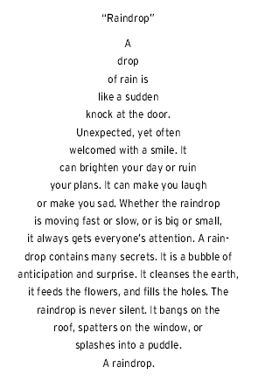
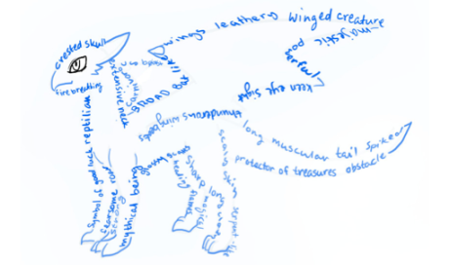
Do Now
Read the poem and answer the questions. What is this poem about? What shape(s) are in the poem? How do they relate to the topic of the poem?

Slide 69
Agenda
Do Now: Read & Respond
Concrete poems: Cornell Notes
Glossary: Concrete poem
Identify and analyze the poems
Write your own concrete poem
Exit Ticket

Slide 70
Objectives
Students will be able to:
Identify and define the elements of a concrete poem.
Analyze concrete poems for their meaning and form by writing a paragraph analysis.
Create original concrete poems

Slide 71
Thoughts to start the day
Name that poetic device! Read the lines of poetry and decide which poetic device is being used!
Personification
1. Sometimes life is like a merry-go-round.
2. Bam, bang, boom--thunder.
3. My heart screamed for you.
4. Totally truthful truth.
5. Freedom speaks to me.
Metaphor
Alliteration
Symbolism
Simile

Slide 72
Ode: Cornell Notes
Key Words & Questions
Details
What is a concrete poem?
Check this out!
A concrete poem is one that takes the shape of what it’s describing.
It is often called visual poetry or shape poetry.
The arrangement of the letters and words are important to the overall meaning and message of the poem.
A sputter, a click,
A whoosh to roar,
A shudder, a flick,
A push to soar,
The wings steady,
The nose held high,
The plane is ready,
The touch the sky.

Slide 73
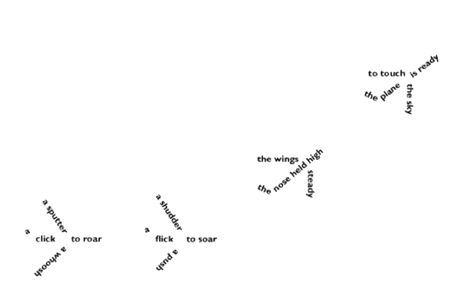
Now, the same poem as a CONCRETE POEM:

Slide 74
Questions to consider:
How is the original version of the poem different from the concrete poetry version?
How is the experience of reading the first poem different from the experience of reading the second version of the poem?
What shape does the concrete poem take? How does the shape help convey the poem's message?

Slide 75
Glossary: Let’s add to it
Concrete Poem Definition: _____________________________________________________________ Example(s):
Notes:
1.Provide students with a copy of the glossary for them to complete throughout the unit

Slide 76
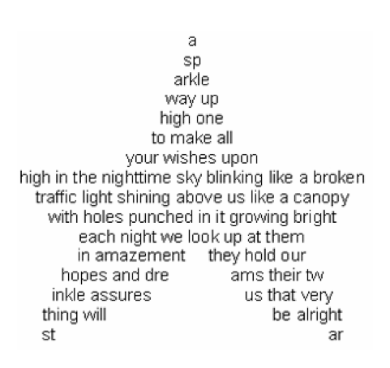
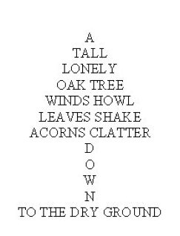
Group Practice: Analysis
Let’s read the poems and complete the questions.
1
2

Slide 77
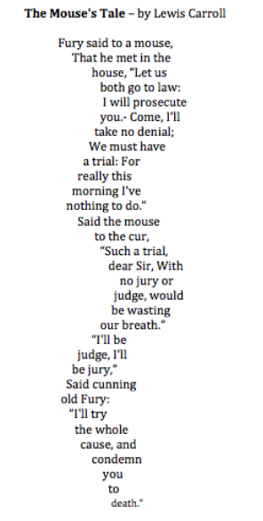
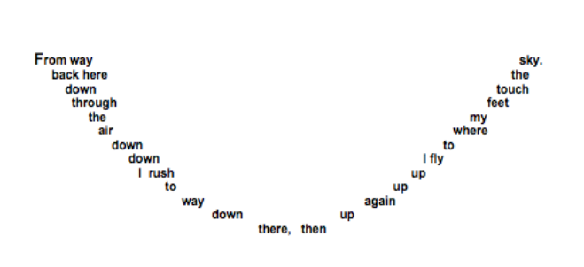
Group Practice: Analysis
Let’s read the poems and complete the questions.
3
4

Slide 78
Questions about Concrete Poems
Topic of the poem:
What does this poet do with certain words that is very unusual?
Topic of the poem:
One word is written differently from all the others. What word is it and why is it written this way?
Topic of the poem:
What is the double meaning of the title of this poem?
Topic of the poem:
How does this poem make your eyes EXPERIENCE what the poem is about?

Slide 79
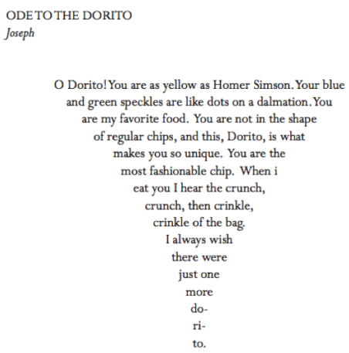
Independent Practice: Analysis
Let’s read the poems and complete the questions.

Slide 80
Independent Practice: Analysis
Topic Sentence (title, author, meaning): ________________________________________________________________________
________________________________________________________________________
2 poetic devices the author uses, example, and meaning:
________________________________________________________________________
________________________________________________________________________
________________________________________________________________________
________________________________________________________________________
________________________________________________________________________
Is the poem a specific form? (ode, elegy, concrete poem…): ________________________________________________________________________
Conclusion Sentence (summarize your points): ________________________________________________________________________
________________________________________________________________________

Slide 81
Write Your Own Poem
Create your own concrete poems!
The only requirements for these poems are that you must use IMAGERY and each poem must be in the FORM OF ITS SUBJECT!
After 10 minutes, we will share out!

Slide 82
Exit Ticket
What is a concrete poem? What makes concrete poems ?unique? What is a poem paragraph analysis? What should be included in your paragraph analysis of a poem?

