Slide 1
UNKNOWN

Slide 2
Day 1
THE IMPORTANCE OF CELLS
Notes:
Unknown Day 1:
Today students will be introduced to human cells and understand the importance of human cells to living healthy lives so our bodies can function properly. Students will take notes on the lesson on cells and then complete a reinforcement activity focused on the functions of cells.

Slide 3
DO NOW
Question:
What do you know about cells?
Notes:
Teacher notes:
Discuss as a class and/or have students keep a learning journal throughout this initiative
At first glance, this may be difficult for students. You can help struggling students by asking some guiding questions such as: Are cells living? Are there more than one type of cell? Can we see cells with the naked eye or do we need to use a microscope. Encourage students to realize that they know something about cells to ensure student engagement.

Slide 4
OBJECTIVE
Students will be able to:
Explain the importance of human cells
Identify the functions of the cell
Students will be able to explain how/why cells are used in research
Notes:
Teacher notes:
Review the objectives for the day, so students know what is expected of their learning

Slide 5
AGENDA
Do Now
Mini lesson: What are cells?
Activity: What do cells do?
Exit Ticket
Notes:
Teacher notes:
Review the agenda for the day

Slide 6
Introduction
Through Unknown, students will learn about HeLa cells and the story of Henrietta Lacks. Students will also dive into the ethics behind using humans in research, patient rights, and informed consent. Students will utilize their artistic skills by completing both a self-portrait and a 3D model of a cell structure.
Don’t forget, there’s a competition too!
Notes:
Explain to students that by the end of this unit, they will be asked to create an artifact for a living museum. Anytime something sparks their imagination, they should make a note of it. Explain BreakFree’s monthly contest and pass out the Note to Students.

Slide 7
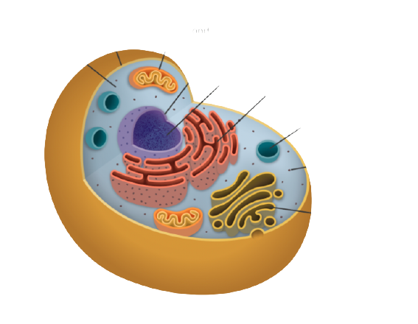
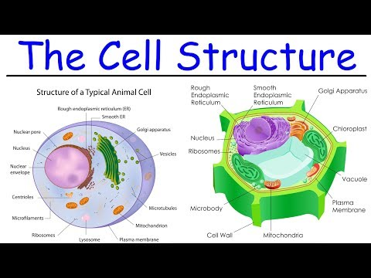
What is a cell?
Cells are the basic building blocks of living things. The human body is composed of trillions of cells, all with their own specialized function.
Cells are the basic structures of all living organisms.
Cells provide structure for the body, take in nutrients from food and carry out important functions.
Cells group together to form tissues, which in turn group together to form organs, such as the heart and brain.
cell membrane
mitochondrion
cytoplasm
nucleus
DNA
endoplasmic reticulum
lysosome
ribosome
Golgi apparatus
source
Notes:
Teacher notes:
Begin lesson by reviewing with students what a cell is. Read the information on the slide as a class (invite a student to the board to read, call on students from their seats, or read aloud to the class).
Students can use this digital handout to take notes on the slides. Here is the pdf for paper based. Encourage students to resist the inclination to copy the slide word for word and focus on paraphrasing the important information that is highlighted.
You can also play the provided video for a deeper explanation of the cell structure and its purpose.

Slide 8
Why is Cell Division Essential to Life?
Humans need cell division to grow and to replace dead or damaged cells. For example, repeated divisions allow a single fertilized egg cell to develop into an adult with more than 37 trillion cells.
After growth, division remains important in normal cell turnover, such as in our skin and gut, where cells are continuously renewed. Other cells have to divide to heal wounds like skin cuts or broken bones.
To remain healthy, it's critical for an organism to maintain the right number of cells.
source
Notes:
Teacher notes:
Read the information on the slide as a class (invite a student to the board to read, call on students from their seats, or read aloud to the class).
Watch the video provided to discuss the purpose of cell division called Mitosis.

Slide 9
Cells Divide, Differentiate, or Die
Cells divide in response to molecular regulators that send signals to cells.
Cells divide to produce two identical daughter cells. Cells stop dividing to specialize in structure and function, a process called differentiation. Once differentiated, some cells may divide again under certain conditions.
Cells can also undergo cell death, or apoptosis, a process that eliminates unnecessary cells during development and removes unhealthy or damaged cells in the mature organism.
source
Notes:
Teacher notes:
Read the information on the slide as a class (invite a student to the board to read, call on students from their seats, or read aloud to the class).
Before clicking to the next slide, check students’ understanding by asking them to distinguish between “dividing,” “differentiating,” and “dying” of cells in their own words.

Slide 10
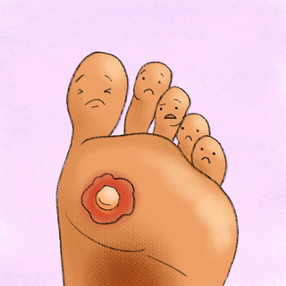
Why is Cell Division Essential to Life?
If regulators don’t function properly, an organism may end up with too few or too many cells. This can cause problems of varying severity—from harmless hair loss or the growth of warts to the development of life-threatening tumors.
Too Few Cells
Hair Loss
Too Many Cells
Warts & Tumors
source
Did You Know? The human body loses approximately 50 million cells per day. Skin cells reproduce constantly at a rate of 30,000 to 40,000 cells per day as do hair cells due to the daily loss of these types of cells. Just the act of showering and brushing your hair allows old skin cells to be removed to make room for new healthy cells
Notes:
Teacher notes:
Read the information on the slide as a class (invite a student to the board to read, call on students from their seats, or read aloud to the class).

Slide 11
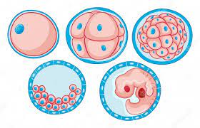
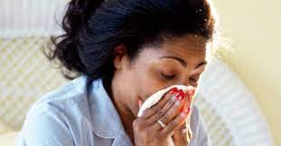
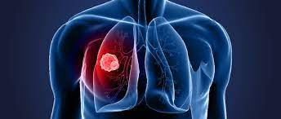
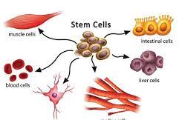
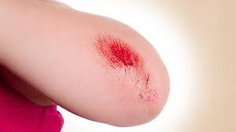
Activity: Cells Divide, Differentiate, or Die
On your handout, look at the image and label the cell process as either:
cell division, cell differentiation, or cell death
Growing Embryo
Body Fighting COVID-19
Lung Cancer
EXAMPLE
Process: Cell division
Process:
Process:
Wound Healing
Stem Cells
Process:
Process:
Notes:
Teacher notes:
This activity can be completed individually or as a class. Use this digital handout to take notes on the slides. Here is the pdf for paper based. Click here for the answer key. This activity should be used to reinforce the many functions and the importance of cells. This is a great way to ensure that when you discuss HeLa cells, students will understand the many functions that HeLa cells are used for.
The growing embryo is an example. (Note: Cell differentiation is a correct answer as well, if any students mention it.)

Slide 12
How/Why are Cells used in research
Today, thousands of human cell cultures called cell lines are used in medical research. Some of the most important cells in research are called immortal cells. What are immortal cells?
01
BUT, immortal cells, divide and grow forever!!
Typically, human cells can divide about 50 xs before they self-destruct
02
Notes:
Teacher notes:
Read the information on the slide as a class (invite a student to the board to read, call on students from their seats, or read aloud to the class).
More context: Immortalized cell lines are cells that have been manipulated to proliferate indefinitely and can thus be cultured for long periods of time. Immortalized cell lines are derived from a variety of sources that have chromosomal abnormalities or mutations that permit them to continually divide, such as tumors (like Henrietta Lacks’).

Slide 13
How/Why are Cells used in research
The discovery of immortal cells occurred 70 years ago with the identification of a cell line called HeLa. The HeLa cell line still lives today and is serving as a tool to uncover crucial information about the novel coronavirus.
Did You Know? HeLa cells came from a woman named Henrietta Lacks. Henrietta Lacks represents the mother of HeLa cells. As the first and, for many years, only cell line able to divide indefinitely out of the body.
Notes:
Teacher notes:
Introduce students to HeLa cells as the first immortal cells discovered by reading the large text
Read the “did you know” box to introduce students to Henrietta Lacks

Slide 14
Exit Ticket
Don’t forget to complete your daily learning log!!
Questions to consider:
Why is cell division essential to life?
Notes:
Teacher notes:
Pause with students to consider the questions as a class. Depending on timing, raise the questions to students and allow for a short discussion.
Remind students to complete Daily Learning Log.

Slide 15
Day 2
Henrietta Lacks and Her Cells
Notes:
Unknown Day 2:
In this lesson, students will learn about immortal cells, how they are different from typical human cells, and why they are important for medical research. Students will discover who Henrietta Lacks was and how her cells have been used in some of science’s biggest and most important discoveries. Students will also be introduced to the moral/ethical concerns around the collection and use of HeLa cells.

Slide 16
DO NOW
Question:
Can you think of anything that is immortal? How would you define an immortal cell?
Notes:
Teacher notes:
Discuss as a class and/or have students keep a learning journal throughout this initiative

Slide 17
OBJECTIVE
Students will be able to:
Students will be able to infer what an immortal cell is
Students will be able to describe who Henrietta Lacks is and why her HeLa cells are significant
Notes:
Teacher notes:
Review the objectives for the day, so students know what is expected of their learning

Slide 18
AGENDA
Do Now
Mini lesson: Who was Henrietta Lacks?
Activity: Article Analysis
Exit Ticket
Notes:
Teacher notes:
Review the agenda for the day

Slide 19
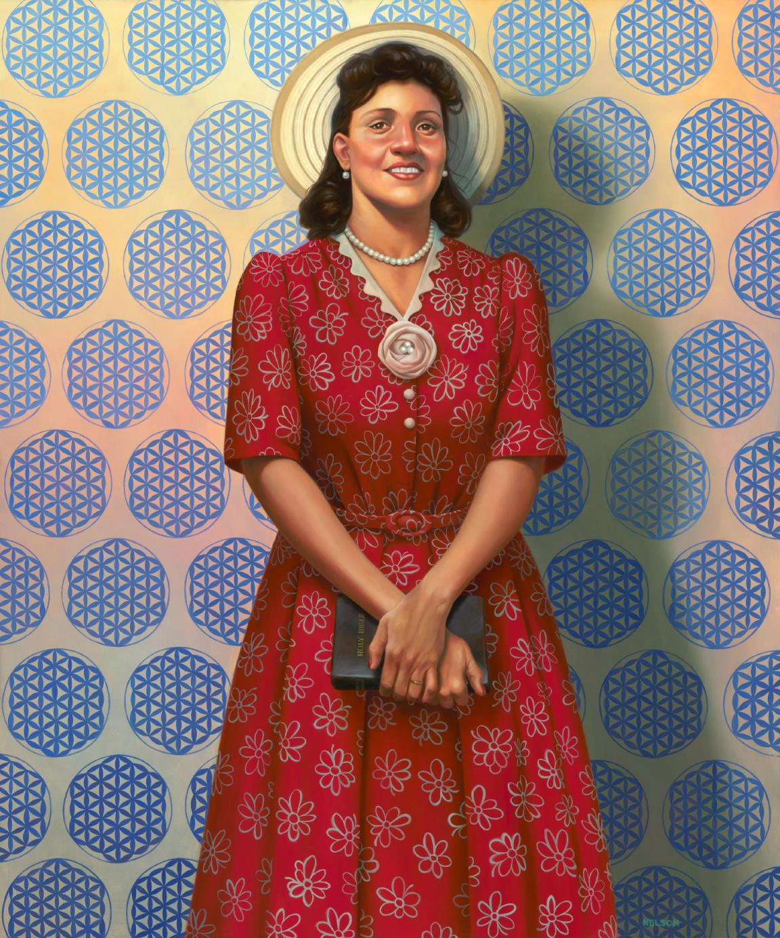
How/Why are Cells used in research
Henrietta Lacks
source
Notes:
Teacher notes:
Show students the picture of Henrietta Lacks

Slide 20
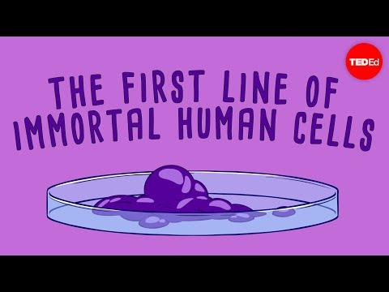
What are HeLa Cells?
Watch this video!
Notes:
Teacher notes:
Watch the short video on HeLa cells

Slide 21
What More Do We Know About Henrietta Lacks?
Why did Henrietta Lacks go to John Hopkins?
What was Henrietta Lacks’ cancer treatment?
Did Henrietta Lacks give consent for her cells to be used for research?
Though 20 miles away from where Henrietta Lacks lives, it was the only option in the area for African Americans seeking medical treatment.
The treatment Henrietta Lacks underwent for her cancer left her infertile, something she was not made aware of before beginning the treatment.
No! HeLa cells were later sold for profit and shared all around the world!
Notes:
Teacher notes:
Share the additional information about Henrietta Lacks by reading the information on the slides
Additional notes
Note: This was during the Jim Crow era when segregation was common)
Note: It was common practice in those days for doctors to do any treatment they thought best for their patients and patient merely trusted doctors to help them)
Note: Consent was not expected back then. Later, medical researchers set up a large-scale cell culture factory in a former Fritos factory in Bethesda, Maryland to begin mass-producing HeLa cells for global distribution, simultaneously ushering in a multibillion-dollar industry for the selling of biomedical specimens.

Slide 22
What More Do We Know About Henrietta Lacks?
Questions to consider...
Do you think Henrietta Lacks would have consented to the treatment? To her cells being used for research? | Do you think it’s fair that other people profited from using/selling HeLa cell?
Notes:
Teacher notes:
Pause with students to consider the questions as a class. Depending on timing, raise the questions to students and allow for a short discussion.

Slide 23
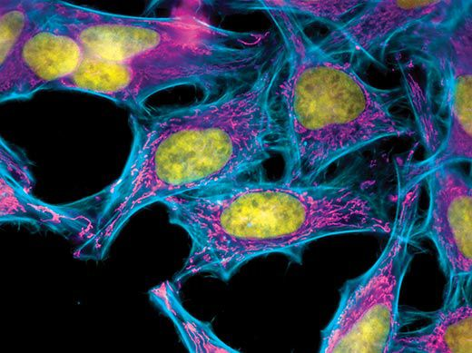
What More Do We Know About Henrietta Lacks?
These HeLa cells were stained with special dyes that highlight specific parts of each cell. The DNA in the nucleus is yellow, the actin filaments are blue and the mitochondria- the cells power generators- are pink.
source
Notes:
Teacher notes:
Show students the picture of dyed HeLa cells. Explain that when using HeLa cells in research, scientists dye the cells in order to watch the different parts of the cells to see how they are affected when manipulated.

Slide 24
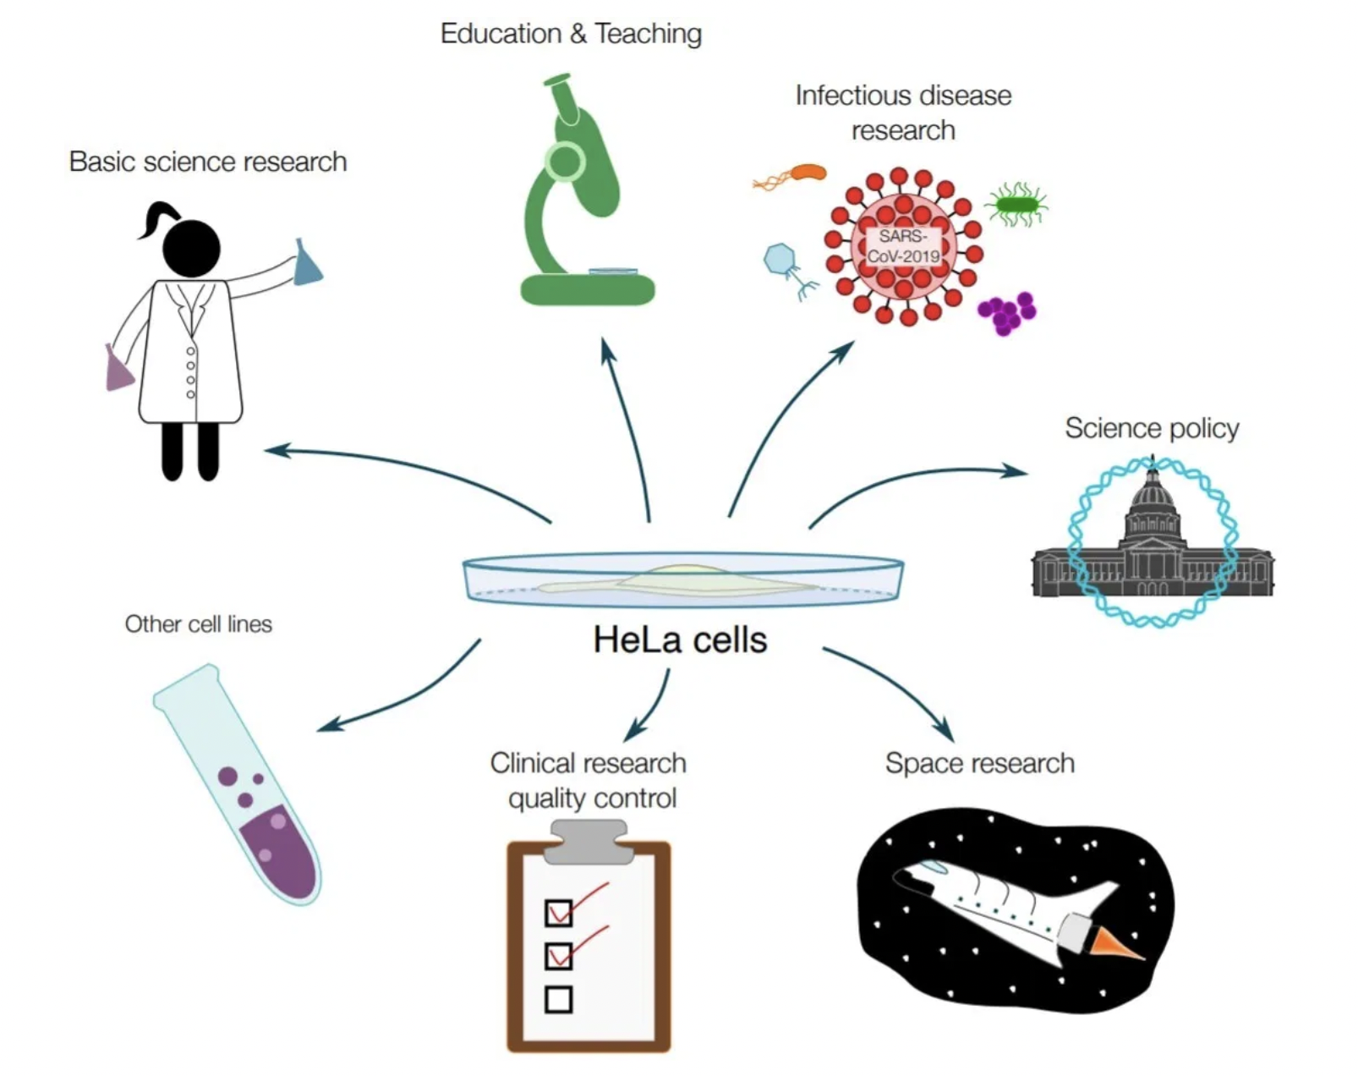
How Have HeLa Cells Been Used?
Polio vaccine
HPV Vaccine
Mapping the human genome
Develop In-Vitro Fertilization
They went to space
Discoveries that have merited three Nobel prizes
Covid-19 research
source
Notes:
Teacher notes:
Show students the slide and explain how HeLa cells have been used in some of the most important scientific discoveries!
Additional context: The Immortal Life of Henrietta Lacks allows us to see the history of cell culture and genetics. It explains how science has been so successful in treating and finding cures for different diseases. It also informs us on how chromosomes, cloning, and gene mapping were able to be discovered. The key factor in the discovery and successful implication of the science and technology we have today is HeLa, cancerous cells of the immortal Henrietta Lacks.
Note on Covid research: HeLa cells are paving the way for COVID-19 research breakthroughs. The groundbreaking study that identified the infectivity of the virus in humans did so using the cells that were isolated from Henrietta Lacks.

Slide 25
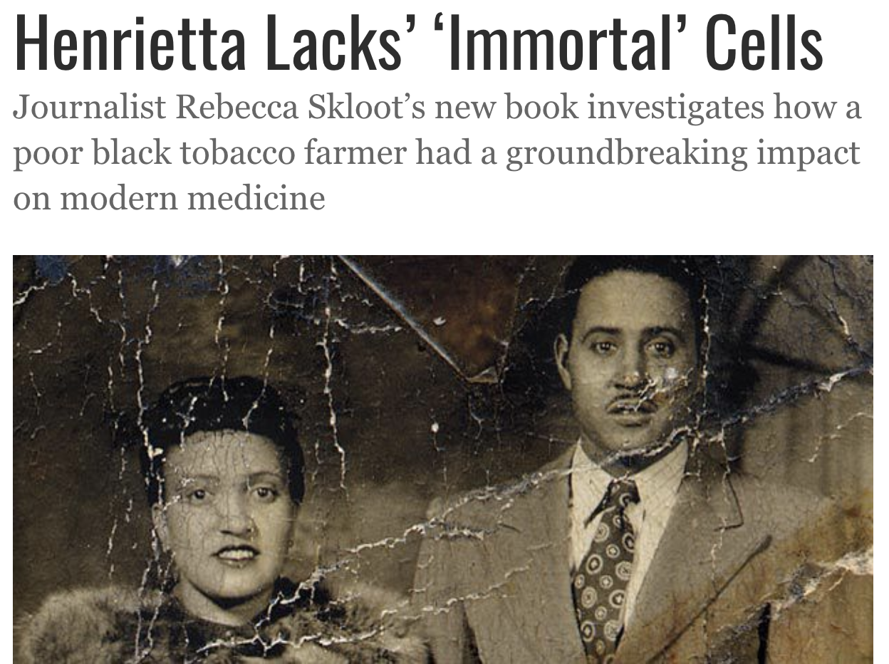
ACTIVITY
Read this Article
Click here to complete the
KWL activity!
Notes:
Teacher notes:
Distribute the KWL handout to students. Ask students to complete the K and W sections of the handout before reading. After reading, they will complete the L section.
Handout link - google slide or pdf
Have students read the article on Henrietta’s immortal cells
Students can read independently, in pairs or groups, or you can read aloud as a class
Access the article here

Slide 26
Class Discussion
Questions to consider...
What differentiates HeLa cells from other human cells? | Henrietta’s doctor removed her cancer tissue during an autopsy and didn’t tell her family. Do you think he should have asked her and her family for permission and why?
If you go to the dermatologist and he or she removes a mole, what do you think is done with that tissue sample?
Notes:
Teacher notes:
Facilitate a class discussion after completing the reading.
Ask students to share what they learned and wrote on the KWL handout
Ask students to consider the three questions on the slide
Students can discuss in pairs, in small groups, or as an entire class

Slide 27
EXIT TICKET
Don’t forget to complete your daily learning log!!
Question
Answer a question asked by one of Henrietta’s children: “Can you tell me what my mama’s cells really did? I know they did something important, but nobody tells us nothing.”
Notes:
Teacher notes:
discuss as a class and/or have students keep a learning journal throughout this initiative
Quote Source
Remind students to complete Daily Learning Log.

Slide 28
Day 3
INFORMED CONSENT
Notes:
Unknown Day 3:
In this lesson, students will be introduced to human subjects in medical research. Students will learn about the importance for protecting humans in research and understand the historical context for establishing ethical codes of conduct in research. Students will focus in on the ethical protection of informed consent and discover what is required for consent to be “informed.” Students will consider the consent Henrietta Lacks provided and learn that it would not be considered informed consent today. Students will then carry out an activity, applying what they know about informed consent to hypothetical scenarios.

Slide 29
DO NOW
Question: Which option would you choose? Why?
You go to the doctor and have blood drawn for your check-up. The paperwork you have to sign provides the two options below:
Option 1 “I grant permission for any remaining blood to be used in medical research, so long as all personal information is removed and the sample is anonymous.” | Option 2 “I do not want my blood used for research purposes.”
Notes:
Teacher notes:
discuss as a class and/or have students keep a learning journal throughout this initiative

Slide 30
OBJECTIVE
Students will be able to:
Understand the importance of protecting human subjects in research
Identify the key components to informed consent
Apply their understanding of informed
consent to determine patient’s rights
violations
Notes:
Teacher notes:
Review the objectives for the day, so students know what is expected of their learning

Slide 31
AGENDA
Do Now
Mini lesson: Human Subjects in Research & Informed Consent
Activity: Ethics: Is this informed consent?
Exit Ticket
Notes:
Teacher notes:
Review the agenda for the day

Slide 32
What are Human Subjects in Medical Research?
In scientific research, any time an experiment involves humans, researchers need to get special permission and ensure that the research will not cause any harm. Government agencies have developed guidelines to make sure human subjects are protected during the research process.
Why might this be important?
Notes:
Teacher notes:
Introduce students to the concept of human subjects in medical research. Read the information on the slide as a class (invite a student to the board to read, call on students from their seats, or read aloud to the class).
Before clicking to the next slide, ask students to consider why it might be important to protect human subjects in research

Slide 33
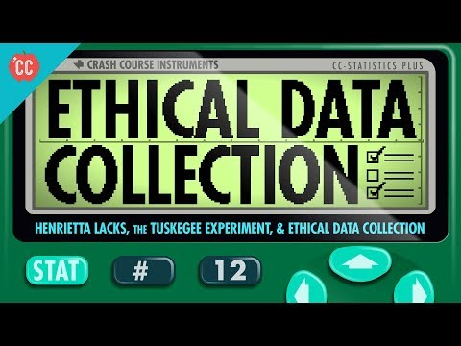
Using Humans in Research
Why might this information be important?
Notes:
Teacher notes:
Show students the video discussing the ethics behind using humans in research.

Slide 34
Historical Context
Nuremberg Code
Evolved from the Nuremberg trials where Nazis tried for experiments conducted at concentration camps. The code states, “The voluntary consent of the human subject is absolutely essential.”
Declaration of Helsinki
Established an international standard that informed consent is a right for any human subject participating in clinical research.
Common Rule Established
Informed consent becomes a requirement in the United States.
1951
1972
1947
1964
1991
Henrietta Lacks
Tumor tissue cells were taken and used in research without her consent.
One researcher injected HeLa cells into human subjects to see if they would get cancer. Those subjects were not told of the risks.
Tuskegee Experiment Shuts Down
A study on African-American men with syphilis who were not told by researchers there was a cure for the disease. Shut down after concerns over ethical violations grew.
Notes:
Teacher notes:
Walk students through the timeline, which provides historical context as to why humans should be protected in medical research
Nuremberg Code: During WWII Nazis used Jewish people for harmful, painful, and dangerous experiments. After the war, during the Nuremberg Trials when Nazis were held accountable for their war crimes, the Nuremberg code was established to protect humans in research: it required all research participants to volunteer for the research (no more could people be forced to participate in studies or be studied unknowingly)
Henrietta Lacks: Not long after the Nuremberg code was established, Henrietta Lacks’ tumor cells were taken and used in research without her consent. Her cells were also used by Dr. Chester Southam to conduct experiments without patient consent to see whether or not injections of HeLa cells could cause cancer.
Declaration of Helsinki: The Declaration of Helsinki is a set of ethical principles regarding human experimentation developed for the medical community by the World Medical Association (WMA). It is regarded as the cornerstone document on human research ethics.
Tuskegee Experiments: In these experiments, African American males with syphilis were studied and not given proper treatment for their illness. As more people in the medical community learned about this, they called for the study to be stopped.
Common Rule: The Common Rule is a 1981 rule of ethics in the United States regarding biomedical and behavioral research involving human subjects.
It took over 50 years after the Nuremberg Code for the USA to establish the common rule. Maybe ask students why they think it took so long?

Slide 35
What is informed consent?
What must be included for it to be informed consent:
What the research is
How long the research will last
Any potential risks
Any compensation
Did You Know? Informed consent means that prospective research participants must be fully informed about the procedures and risks involved in research and must give their signed consent to participate.
Notes:
Teacher notes:
Review with students what informed consent is and what is required to be included for consent to be “informed”
Read the information on the slide as a class (invite a student to the board to read, call on students from their seats, or read aloud to the class).

Slide 36
What is informed consent?
Is this informed consent?
Why or why not?
OPERATION PERMIT: I hereby give consent to the staff of The Johns Hopkins Hospital to perform any operative procedures and under any anaesthetic either local or general that they may deem necessary in the proper surgical care and treatment of: ______________________________.
*this is the consent form that Henrietta Lacks signed in 1951!
Notes:
Teacher notes:
Ask students to read the consent paragraph and consider whether is it informed consent.
Ask students to share out and explain their reasoning behind thinking it is or is not informed consent
Note: this is the exact language used on the consent form Henrietta Lacks signed. It is not informed consent, as informed consent was not used or required in 1951

Slide 37
What is informed consent?
Is this informed consent?
Why or why not?
A physician has provided the following information to me: the nature and benefits of the proposed procedure treatments; the consequences of non-treatment; the significant alternative treatments; the possible significant complications of the proposed procedures.
I voluntarily consent to the procedure as discussed with my physicians. I understand that associates, residents or assistants may participate in my case.
I realize that tissue samples taken from this procedure may be used for research and will be stored at [name] hospital.
Notes:
Teacher notes:
Ask students to read the consent paragraph and consider whether is it informed consent.
Ask students to share out and explain their reasoning behind thinking it is or is not informed consent. How is this different from what Henrietta signed?
Note: The most glaring difference is that Henrietta’s document requires nothing from the health care providers, at least not explicitly. It is probably implied that they will give the best care that they can, but that is tied up in the context and the times. The second form lays out explicitly some of the responsibilities of the physicians and explicitly calls on the patient to provide questions about their own care. The second form also addresses potential use of the patient’s cells/tissue in research, where the first makes no mention of this.

Slide 38
ACTIVITY: Is this informed consent?
Directions: In the following examples, determine if the patient’s rights are being violated using these three levels:
RED: The patient rights are definitely being violated. The patient doesn’t have enough information to be fully informed.
YELLOW: It is unclear if the patient rights are being violated. More information should be provided.
GREEN: The patient rights are not being violated because enough information is provided.
Notes:
Teacher notes:
Tell students that for the next several slides, they will be applying what they know about informed consent to several scenarios. In the activity, they will need to determine if the patient’s rights are being violated. They will have three options to choose from.
Explain the options between red, yellow, and green. When showing the next few slides remind students of the three options to determine if the examples are considered informed consent.
Note: distribute colored index cards, have students color in three index cards red, yellow, and green, or students can hold up fingers associated with the colors (for example, 1= red, 2=yellow, 3=green)

Slide 39
Is this informed consent?
Paul walks into a medical lab and when giving blood, the technician asks if she can use paul’s blood in her research on cancer. Paul tells her “sure.”
Notes:
Teacher notes:
Read the scenario out loud
Ask students to hold up/show their selection by determining if this is red, yellow, or green
Ask students to share out and explain their reasoning
Note:
This is clearly a red. Paul’s rights are being violated because the technician hasn’t provided enough information for Paul to be fully informed when giving his consent. If the technician were to use Paul’s blood in her research, that would be an ethical and legal violation because no informed consent was obtained. For this to be informed consent, Paul would need to understand what the research is, how long it would last, any potential risks associated with the research, and whether or not he would be compensated.

Slide 40
Is this informed consent?
Cindy learns about a vaccine trial and goes to sign up for it. She meets with clinic staff who tell her
the study will last for 3 months
there are potential side effects of fever and disorientation
she will be compensated $100 for her participation
Cindy signs paperwork and starts in the trial
Notes:
Teacher notes:
Read the scenario out loud
Ask students to hold up/show their selection by determining if this is red, yellow, or green
Ask students to share out and explain their reasoning
Note:
This is a green light! Cindy was informed when signing the paperwork and provided informed consent.

Slide 41
Is this informed consent?
Carol provides informed consent to Dr. James to use her tissue specimen for research on lung cancer. Dr. James has leftover tissue at the end of his research. Not wanting to waste the tissue, Dr. James gives it to Dr. Lim. Dr. Lim uses Carol’s tissue to study bronchitis.
Notes:
Teacher notes:
Read the scenario out loud
Ask students to hold up/show their selection by determining if this is red, yellow, or green
Ask students to share out and explain their reasoning
Note:
This is a red light. There is a clear violation of Carol’s rights because she only gave consent for Dr. James to use her tissues for lung cancer research. She was not told that her tissues would be used by Dr. Lim to study bronchitis, therefore she could not have provided informed consent for her tissues to be used in that way. In order for Dr. Lim to use Carol’s tissues, he would need to obtain separate informed consent from her.
Some students may see this as a yellow light: Dr. James didn’t want to waste the tissues and knew that Dr. Lim could use them to do good. Morally, there is some grey area here, however, legal ethical standards require informed consent and that is not present.

Slide 42
Is this informed consent?
A group of people volunteer for a study for a rare disease: they were told
how long the study would last,
the risks associated with the treatment, and
that they would not receive compensation.
The researchers did not tell the volunteers about an existing cure to the disease (the cure is a different treatment than that being used in the trial).
Notes:
Teacher notes:
Read the scenario out loud
Ask students to hold up/show their selection by determining if this is red, yellow, or green
Ask students to share out and explain their reasoning
Note:
This is a red light. The patient’s rights are being violated because they were not fully informed when they gave consent. The researchers checked most of the required boxes to establish informed consent, but they left out a very important aspect: they did not tell the volunteers that a cure existed… one that they could likely receive if they didn’t participate in the study. As such, there is no informed consent.
Some students may feel this is a yellow… they might not think that the researcher’s omission is critical, but it is.

Slide 43
Is this informed consent?
John provides informed consent for Dr. Golde to use his bone marrow for research of leukemia. Dr. Golde then patents John’s bone marrow cells and sells them to labs across the world. The consent form stated John would not be compensated for this research, but didn’t say Dr. Golde would sell the tissue.
Dr. Golde earns millions of dollars through the sales, but John is not compensated.
Notes:
Teacher notes:
Read the scenario out loud
Ask students to hold up/show their selection by determining if this is red, yellow, or green
Ask students to share out and explain their reasoning
Note:
This is a tricky scenario and one that is currently being considered by courts around the country. This is a real-life scenario about John Moore (more information on the next slide). Some students may see issued with this because although John knew he would not be compensated, he was not informed about the extent to which Dr. Golde would use his cells for profit. With this reasoning, it is unfair that John did not receive compensation and his rights were violated.
Alternatively, some students may consider this to be a green light-- John’s rights were not violated because all aspects of informed consent were present and John agreed to not being compensated
Click to the next slide to explain the real-life case to students

Slide 44
John Moore
In 1976, John Moore was suffering from leukemia and went to see Dr. Golde at UCLA, who removed his spleen
Like Lacks’s doctors, Golde realized there was money in Moore’s cells. (they were overproducing lymphokines, small proteins that are vital to the immune system)
For the next seven years, Golde asked Moore to return to the hospital to give blood, skin and bone marrow samples.
Later, Moore learned that Golde had patented his cells into the “Mo” line, with a potential value of 3 billion dollars.
Moore filed a lawsuit against Golde, but the CA supreme court ruled in favor of Golde, saying that once his spleen was removed from his body, Moore did not have any rights to it and therefore he did not have any rights to the profits Golde made
Notes:
Teacher notes:
Walk through the bullet points on the slide to share the true story of John Moore. Tell students if they selected a green light on the previous slide, they would have been correct… the Supreme Court of California ruled that Moore’s rights were not violated.

Slide 45
Did the Court Get It Wrong?
Should John Moore be compensated? | Should the Lacks family be compensated?
Notes:
Teacher notes:
Pose the question to students as to whether they think the California Supreme Court got it wrong. Should John Moore be compensated? Should Henrietta Lacks’ family be compensated?
Explain to students that this is one of the most discussed issues in medical research today, along with keeping cell lines anonymous!

Slide 46
EXIT TICKET
Don’t forget to complete your daily learning log!!
Question
How would you define “informed consent”?
Did You Know? In 2021, the family of Henrietta Lacks sued a pharmaceutical company named Thermo Fisher Scientific Inc. for compensation of using the HeLa cells since they have continued to benefit financially from the HeLa cell line. To date, no decision has been made.
Notes:
Teacher notes:
discuss as a class and/or have students keep a learning journal throughout this initiative
Optional: read more about the Hela lawsuit by accessing this article.
Remind students to complete Daily Learning Log.

Slide 47
Day 4
HUMANS IN RESEARCH
Notes:
Unknown Day 4:
Today’s lesson builds on the lesson from Day 3 about patient rights and informed consent by presenting four historical case studies and allowing students to dive into the ethical issues of using humans in research.

Slide 48
DO NOW
Question:
Do you have a problem with using humans in scientific research?
Notes:
Teacher notes:
discuss as a class and/or have students keep a learning journal throughout this initiative

Slide 49
OBJECTIVE
Students will
understand that ethical judgements are required when research is done with human participation
learn that researchers must follow ethical guidelines that result in the consideration of populations that are used for research
analyze and discuss the ethical use of human participants in historical research cases, select the principle that was most violated, and defend their choice
Notes:
Teacher notes:
Review the objectives for the day, so students know what is expected of their learning

Slide 50
AGENDA
Do Now
Introduction of Human Ethics in Research
Activity: Case Studies
Exit Ticket
Notes:
Teacher notes:
Review the agenda for the day

Slide 51
Humans in Research
During the upcoming activity, you will each read two of four case studies to learn more about using humans in research.
A
Henrietta Lacks HeLa cells
B
The Havasupai Indians
C
The Tuskegee Study
D
The Willowbrook Study
Did You Know? The historical case studies used in this lesson are U.S. cases and span a time period from the 1030s to the 1970s. However, the issues surrounding each case continue to be discussed today.
Notes:
Teacher notes:
In this activity students will use case studies to explore the ethical implications of humans in research. Explain to students that the case study stories are real historical situations where researchers involved human participants in their studies. Stress that these particular cases are included because they illustrate questionable practices involving humans in research. Though the methods may (or may not) have been acceptable at the time, they do not represent current ethical practices.

Slide 52
Guiding Questions
01
02
03
What good came out of the research? What was the importance of the study?
What things were not fair or are questionable about the research or its process?
Who was involved in the case? Directly? Indirectly?
04
05
06
07
Was everyone involved fully aware of and did they agree to be part of all aspects of the research?
What was society’s role in the case?
How did social issues (e.g. poverty, education, religion) influence the case?
What core values were in conflict in this case?
Notes:
Teacher notes:
review the guiding questions with the class and ensure students understand the questions and what they are supposed to look for.
Students will use the digital or paper version of the Guiding Questions to take their own notes. Click here to make a copy of the Google Doc for the Guiding Questions. Click here to access a PDF of the Guiding Questions to print.

Slide 53
ACTIVITY
THINK
Read TWO of the four case studies provided!
A
Henrietta Lacks HeLa cells
B
The Havasupai Indians
C
The Tuskegee Study
D
The Willowbrook Study
Notes:
Teacher notes:
Have students select two of the case studies shown on the slide - make sure that all four studies are selected
Students will use the digital or paper version of the Guiding Questions to take notes on their two selected case studies.
This portion of the activity should be completed individually.
Click here to make a copy of the Google Doc for the Guiding Questions. Click here to access a PDF of the Guiding Questions to print.
The case studies are linked below:
Case Study A: Henrietta Lacks HeLa Cells
Case Study B: The Havasupai Indians
Case Study C: The Tuskegee Study
Case Study D: The WIllowbrook Study

Slide 54
ACTIVITY
PAIR
Rotate through groups discussing what you learned about your two chosen case studies. Make sure to discuss all four case studies in each group.
(1) COUNT AWAY
(2) ODDS VERSUS EVENS
1
2
3
4
(3) NUMBERS UNITES
EXAMPLES
Notes:
Teacher notes:
assign a number to students 1, 2, 3, and 4.
Students will rotate through the groups sharing what they found in their case studies in the following order:
Count Away (each group has a 1, 2, 3, and 4 represented)
Odds versus Evens: odds & evens together (one group has two 1s and two 3s, another group has two 2s and two 4s, etc)
Numbers Unite: All same numbers together (all 1s, all 2s, all 3s, all 4s)
Students can spend any length of time in each group. The teacher should rotate through the groups to ensure students are on topic. If you do not have enough students for four groups, you can split students into any number of groups that works best. The goal is to have students discussing what they found several times with different students.

Slide 55
ACTIVITY
SHARE
Let’s hear what you learned?
While sharing, make a list of any common themes that have emerged from sharing about each case study.
Notes:
Teacher notes:
students should end the “pair” section in their numbered groups (all 1s, all 2s, etc).
Have one group share about one case study until you have discussed all four of the cases. Group 1 share about HeLa, Group 2 share about the Tuskegee Study, etc.
While students are sharing begin writing a list of common themes on the board, on paper, or digitally. You will need this list for Day 4.

Slide 56
EXIT TICKET
Don’t forget to complete your daily learning log!!
Question
Do you have a problem with using humans in scientific research? Has your opinion changed since the beginning of this lesson?
Notes:
Teacher notes:
discuss as a class and/or have students keep a learning journal throughout this initiative
Remind students to complete Daily Learning Log.

Slide 57
Day 5
CELLS & DNA
Content for this lesson from BreakFree Teacher Fellow
Valerie Hurt from Georgia DJJ.
Notes:
Unknown Day 5:
Today’s lesson builds on the learned knowledge of cells and introduces DNA.

Slide 58
DO NOW
Question:
What do you know about DNA?
Notes:
Teacher notes:
discuss as a class and/or have students keep a learning journal throughout this initiative

Slide 59
OBJECTIVE
Students will
Be able to define DNA
Be able to explain the function of DNA
Be able to extract DNA from a strawberry
Notes:
Teacher notes:
Review the objectives for the day, so students know what is expected of their learning

Slide 60
AGENDA
Do Now
Introduction of DNA
Activity: Strawberry DNA Extraction
Exit Ticket
Notes:
Teacher notes:
Review the agenda for the day

Slide 61
LESSON
What is DNA?
DNA is made up of chains of individual nucleotides on two strands hydrogen bonded to each other down the middle.
Notes:
Teacher notes:
Review list from the brainstorming activity on day 4 of common themes from the four case studies

Slide 62
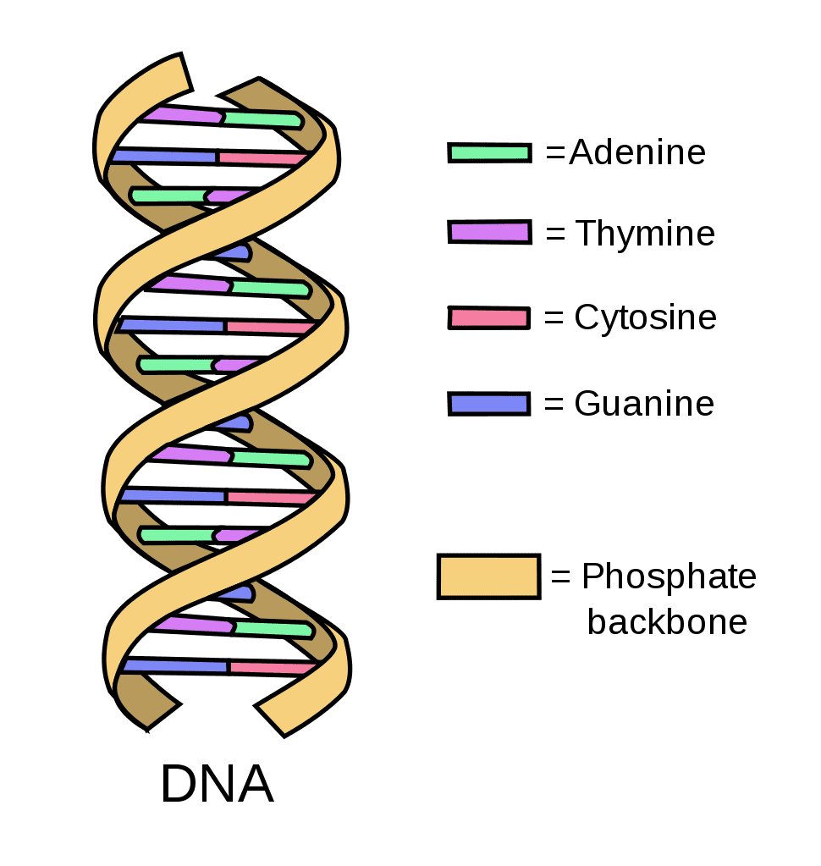
LESSON
DNA is…
arranged like two intertwined ropes, in a structure called a double helix.
Each strand of DNA is made of four types of molecules, also called bases, attached to a sugar-phosphate backbone. The four bases are adenine (A), guanine (G), cytosine (C), and thymine (T) (source).
Notes:
Teacher notes:
Review list from the brainstorming activity on day 4 of common themes from the four case studies

Slide 63
LESSON
DNA Stores Information
DNA stores genetic information. Genes are an individual’s characteristics that are determined by factors that are passed down from parent to child. Genes (for example blood type & eye color) must have necessary information needed for their specific jobs.
Genes control development and contain information that causes a single cell to develop. All cells must be CODED in DNA.
Notes:
Teacher notes:
Review list from the brainstorming activity on day 4 of common themes from the four case studies

Slide 64
LESSON
DNA Copies Itself
Before a cell divides it MUST make a COPY of itself (GENES).
DNA copying is an important process that ensures that when cell multiplies, through the mechanisms of mitosis or meiosis, the equal amount of DNA (genetic material) passes in to the new cell. The DNA replicates so that there will be an extra copy of DNA when the cell multiplies (source).
Notes:
Teacher notes:
Review list from the brainstorming activity on day 4 of common themes from the four case studies

Slide 65
ACTIVITY: Strawberry DNA Extraction
Let’s see how this works!
Gather the Materials Needed:
Notes:
Teacher notes:
Gather the necessary materials - if certain materials aren’t allowed by students, you, the teacher, should manage those materials
A PDF version of the ten steps for this activity is available here.

Slide 66
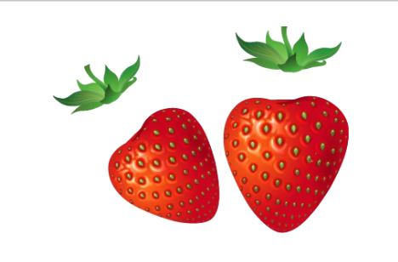
ACTIVITY: Experiment
Step 1
Pull off any green leaves on the strawberries.
Notes:
Teacher notes:
Students can use the basic elements of sketchnoting to help with ideas!
Remind students they are creating a sketchnote based on the common themes found in the historical case studies

Slide 67
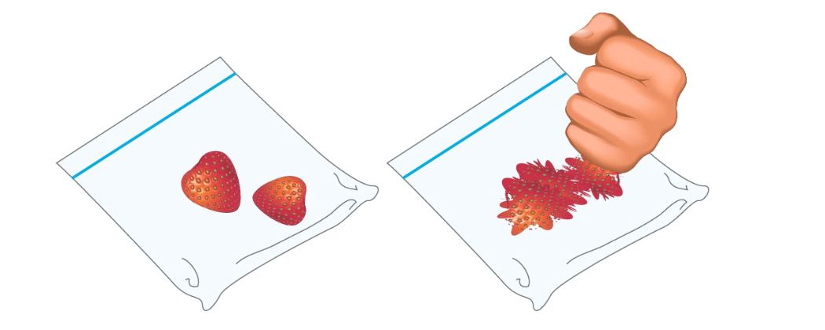
ACTIVITY: Experiment
Step 2
Put the strawberries into the plastic bag, seal it and gently smash the strawberries for about two minutes. This starts to break open the cells and release the DNA.
Notes:
Teacher notes:
Students can use the basic elements of sketchnoting to help with ideas!
Remind students they are creating a sketchnote based on the common themes found in the historical case studies

Slide 68
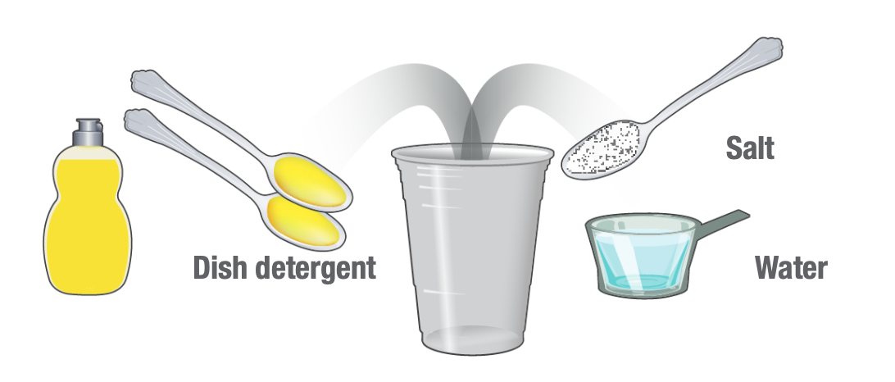
ACTIVITY: Experiment
Step 3
Mix together 2 teaspoons of detergent,
1 teaspoon of salt and 1/2 cup of water in a plastic cup. This will be your DNA extraction liquid.
Notes:
Teacher notes:
Students can use the basic elements of sketchnoting to help with ideas!
Remind students they are creating a sketchnote based on the common themes found in the historical case studies

Slide 69
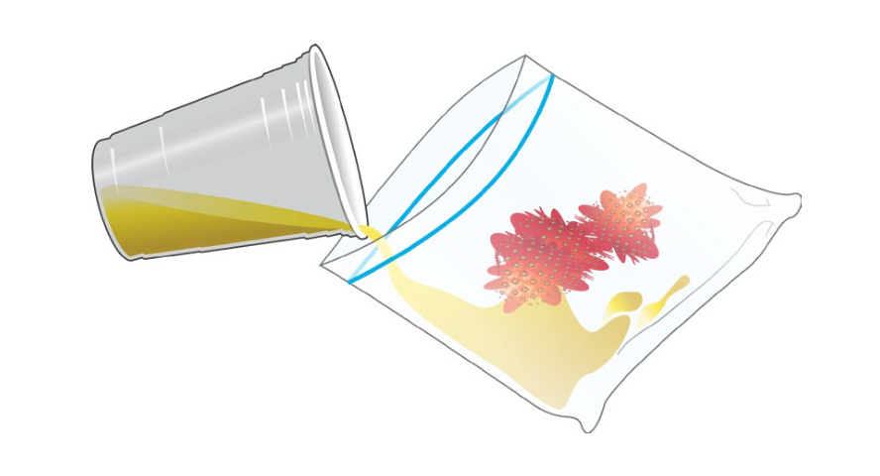
ACTIVITY: Experiment
Step 4
Pour the DNA extraction liquid into the bag with the strawberries (make sure the bag is big enough; quart-sized works well!). This will further break open the cells.
Notes:
Teacher notes:
Students can use the basic elements of sketchnoting to help with ideas!
Remind students they are creating a sketchnote based on the common themes found in the historical case studies

Slide 70
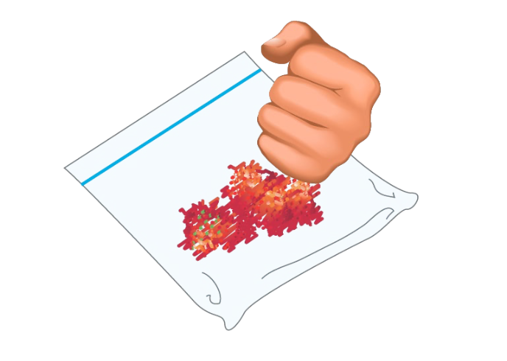
ACTIVITY: Experiment
Step 5
Reseal the bag and gently smash for another minute. Avoid making too many soap bubbles.
Notes:
Teacher notes:
Students can use the basic elements of sketchnoting to help with ideas!
Remind students they are creating a sketchnote based on the common themes found in the historical case studies

Slide 71
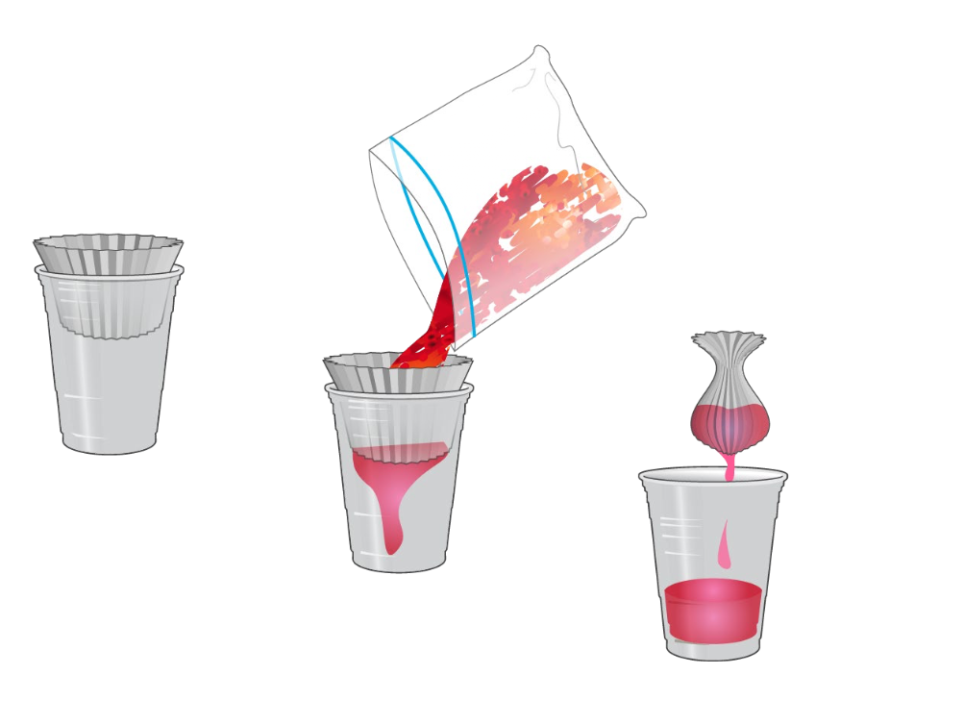
ACTIVITY: Experiment
Steps 6 & 7
Place the coffee filter inside the other plastic cup.
Open the bag and pour the strawberry liquid into the filter.
Twist the filter just above the liquid and gently squeeze the remaining liquid into the cup.
Notes:
Teacher notes:
Students can use the basic elements of sketchnoting to help with ideas!
Remind students they are creating a sketchnote based on the common themes found in the historical case studies

Slide 72
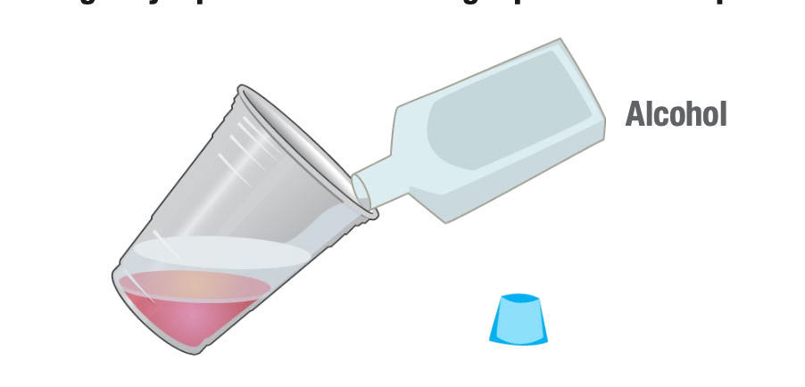
ACTIVITY: Experiment
Step 8
Pour an equal amount of rubbing alcohol as there is strawberry liquid down the side of the cup. Do not mix or stir.
Notes:
Teacher notes:
Students can use the basic elements of sketchnoting to help with ideas!
Remind students they are creating a sketchnote based on the common themes found in the historical case studies

Slide 73
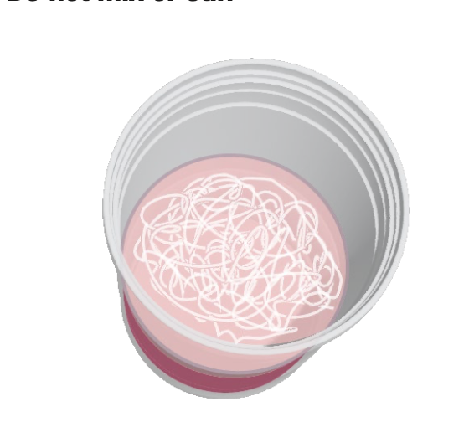
ACTIVITY: Experiment
Step 9
Within a few seconds, watch for a white cloudy substance (DNA) to develop in the top layer. You have just isolated the DNA from the rest of the material contained in the cells of the strawberry.
Notes:
Teacher notes:
Students can use the basic elements of sketchnoting to help with ideas!
Remind students they are creating a sketchnote based on the common themes found in the historical case studies

Slide 74
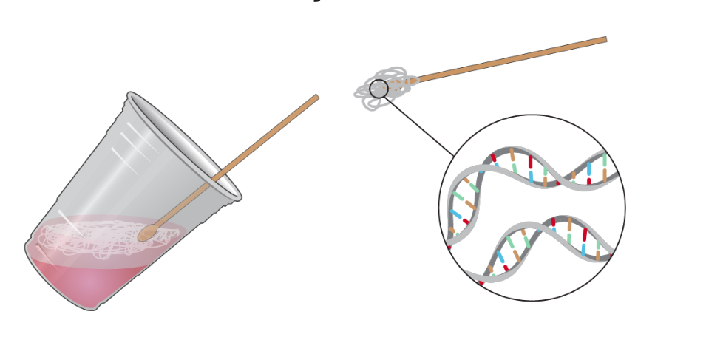
ACTIVITY: Experiment
Step 10
Tilt the cup and pick up the DNA using a coffee stirrer.
Notes:
Teacher notes:
Students can use the basic elements of sketchnoting to help with ideas!
Remind students they are creating a sketchnote based on the common themes found in the historical case studies

Slide 75
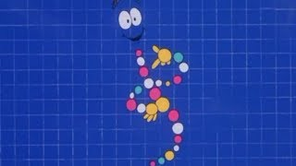
EXIT TICKET
Don’t forget to complete your daily learning log!!
WATCH & SHARE
Watch this clip from Jurassic Park to learn more about DNA! Share which of your DNA genes you are the most proud of (eye color, hair color, etc)!
Notes:
Teacher notes:
Watch the clip from Jurassic Park and ask students to share which traits/genes of themselves they are most proud of.
Remind students to complete Daily Learning Log.

Slide 76
Days 6+
SELF-PORTRAIT &
CELL DESIGN
Notes:
Unknown Days 6+:
Utilizing all of the knowledge learned through the previous lessons, the culminating activity begins today. Students will choose between creating a self-portrait or creating a 3D model of a cell.

Slide 77
DO NOW
Question:
How would you react if someone used your cells without your permission?
Notes:
Teacher notes:
discuss as a class and/or have students keep a learning journal throughout this initiative

Slide 78
OBJECTIVE
Students will
understand that ethical judgements are required when research is done with human participation
create a self-portrait and/or a model of a cell
Notes:
Teacher notes:
Review the objectives for the day, so students know what is expected of their learning

Slide 79
AGENDA
Do Now
Introduction: Review
Activity: Create a Self-Portrait and/or model of a cell
Exit Ticket
Notes:
Teacher notes:
Review the agenda for the day

Slide 80
LESSON
Henrietta Lacks
source
Notes:
Teacher notes:
Review who was Henrietta Lacks be reviewing the content learned over the last few days.

Slide 81
Henrietta Lacks
"Henrietta Lacks died of cervical cancer on October 4, 1951 at the age of 31. During an examination, cells were taken from her body without her knowledge or consent by a doctor at Johns Hopkins Hospital, and were subsequently used to produce the world’s first immortal cell line, called HeLa. Henrietta’s cells were paramount to some of the most important advances and research in modern medicine, including the polio vaccine, chemotherapy, gene mapping, and in-vitro fertilization. Henrietta’s unique cells continue to be used extensively for medical research and development to this day.
I elected to paint a prideful and glowing portrait of Henrietta lacks who is often referred to as, "The Mother of Modern Medicine," visually juxtaposing faith and science. Lacks smiles innocently. She stands with her beautifully manicured hands crossed, covering her womb (the birthplace of the immortal cell line) while cradling her beloved Bible (a symbol of her strong faith). Her deep red dress is covered with a vibrant floral pattern that recalls images of cell structure and division, while two of the four dime-sized buttons on her dress are noticeably missing (a reference to the cells that were taken from her body without her knowledge). Her bright yellow hat functions as a halo (recalling Renaissance paintings of the Madonna), while pearls (a symbol of the aggressive cancer that took her life) hang from her neck. The decorative wallpaper behind her forms a repeated hexagonal pattern, a design containing the "flower of life", an ancient symbol of immortality and exponential growth - two distinctive qualities of her rare and incredibly durable cells."
Kadir Nelson, 2017
source
Notes:
Teacher notes:
Kadir Nelson painted this work of art in 2017. Read the caption on the slide. This is a quote directly from K. Nelson discussing why & how he painted her portrait.
The description of the painting is below and can be read to students.
Oil painting of Henrietta Lacks by Kadir Nelson. Lacks, smiling, is depicted standing in the center of the image. She is facing forward with her hands clasped in front of her body, holding a black book with gold-colored text [HOLY BIBLE]. Lacks is wearing a red dress with a white flower pattern and small belt. The dress has central buttons, with two (2) missing. There is a flower accessory with three (3) pearls in the center above the buttons. Lacks is wearing a wedding ring and a pearl necklaces and earrings. She has a cream and tan hat, the circular brim of which acts like a halo behind her head. Lacks is standing in front of a cream wall with a blue geometric "Flower of Life" motif. The work is signed in the lower right.

Slide 82
ACTIVITY
So far, you have learned about...
HeLa Cells
Cell Structures
Humans in Research
Henrietta Lacks
Notes:
Teacher notes:
Introduce the activity to students and show examples on the next few slides.

Slide 83
ACTIVITY
Now, let’s look at what makes you...you
Your task is to create one (or both) of the following items:
a self-portrait | a model of a cell (either as a 3D model or hand drawn)
Notes:
Teacher notes:
Show students these examples in preparation for them to create their own self-portrait and/or a model (drawn of built) of a cell.

Slide 84
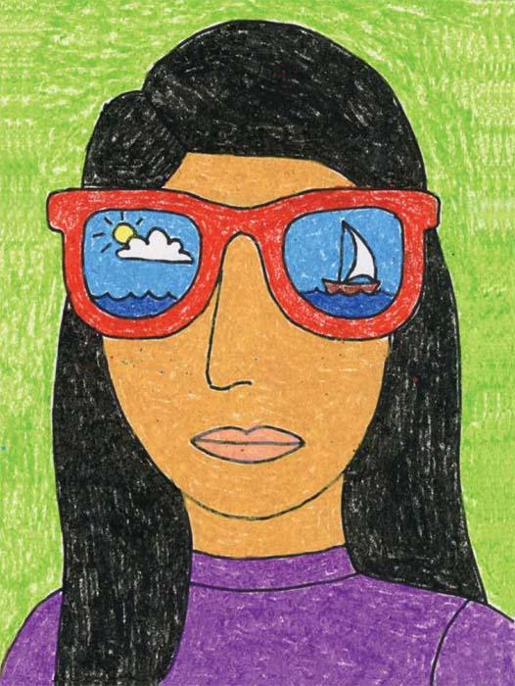
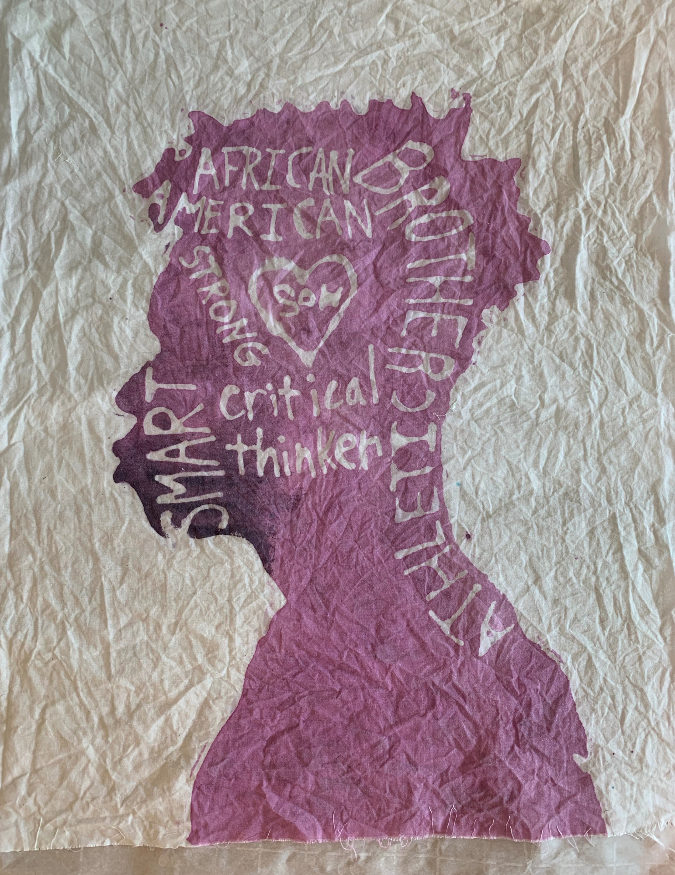
Self-Portrait Examples
Notes:
Teacher notes:
This examples shows self-portraits.
Portrait 1 source
Portrait 2 source: drawn by a student at Travis Hill Schools

Slide 85
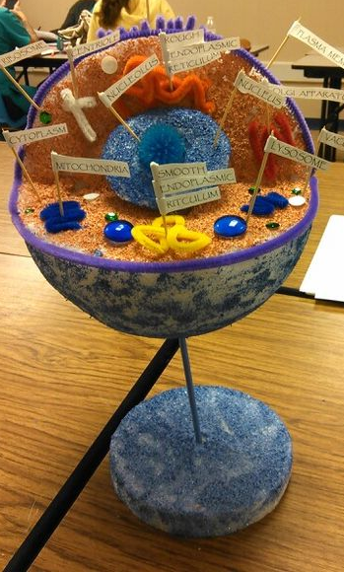
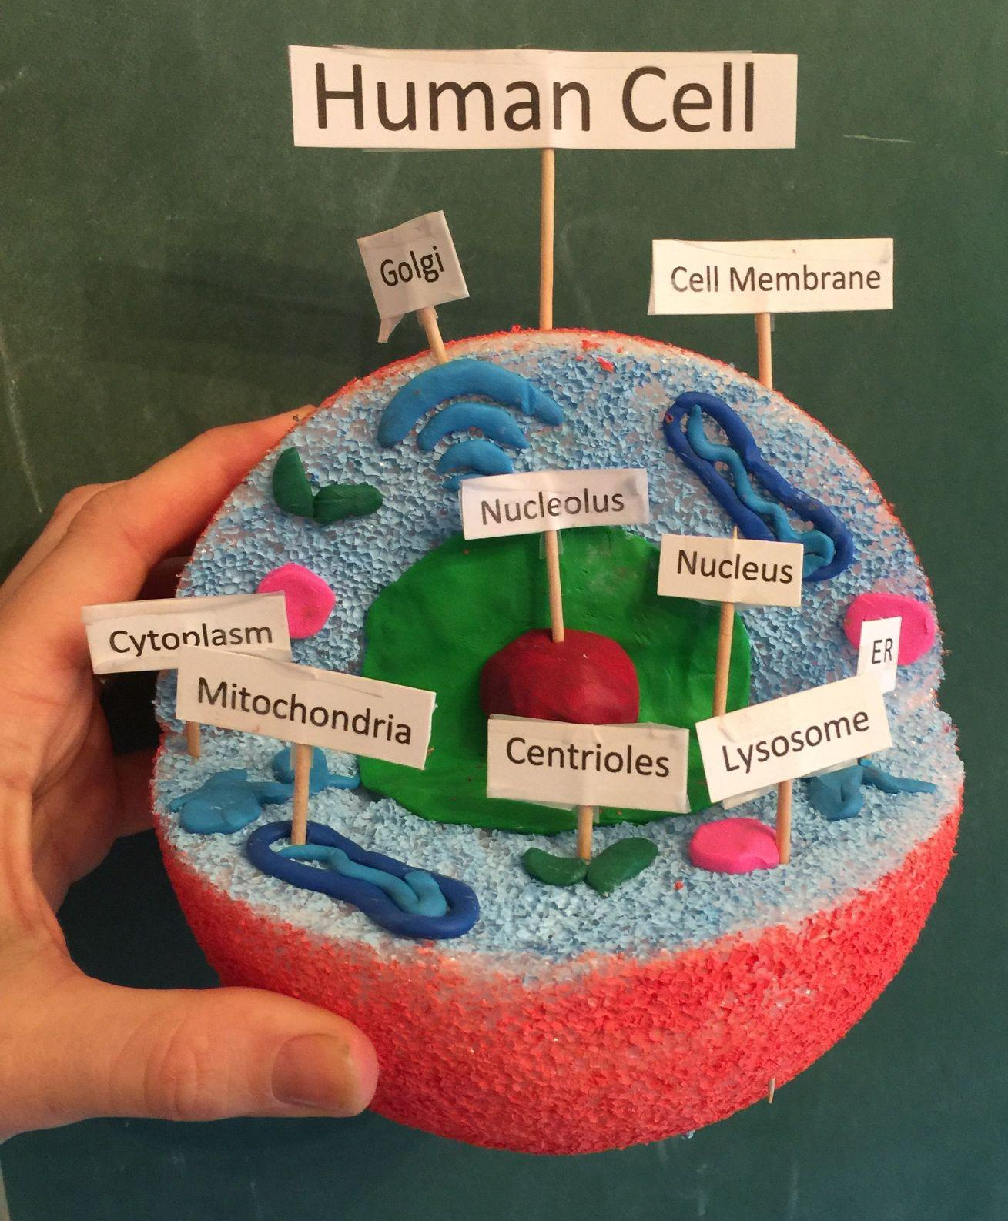
Example of a Cell model
Notes:
Click here for other ways you can create a 3D model of a cell.
Teacher notes:
This example shows a completed model of a cell.
Example 1 source
Example 2 source

Slide 86
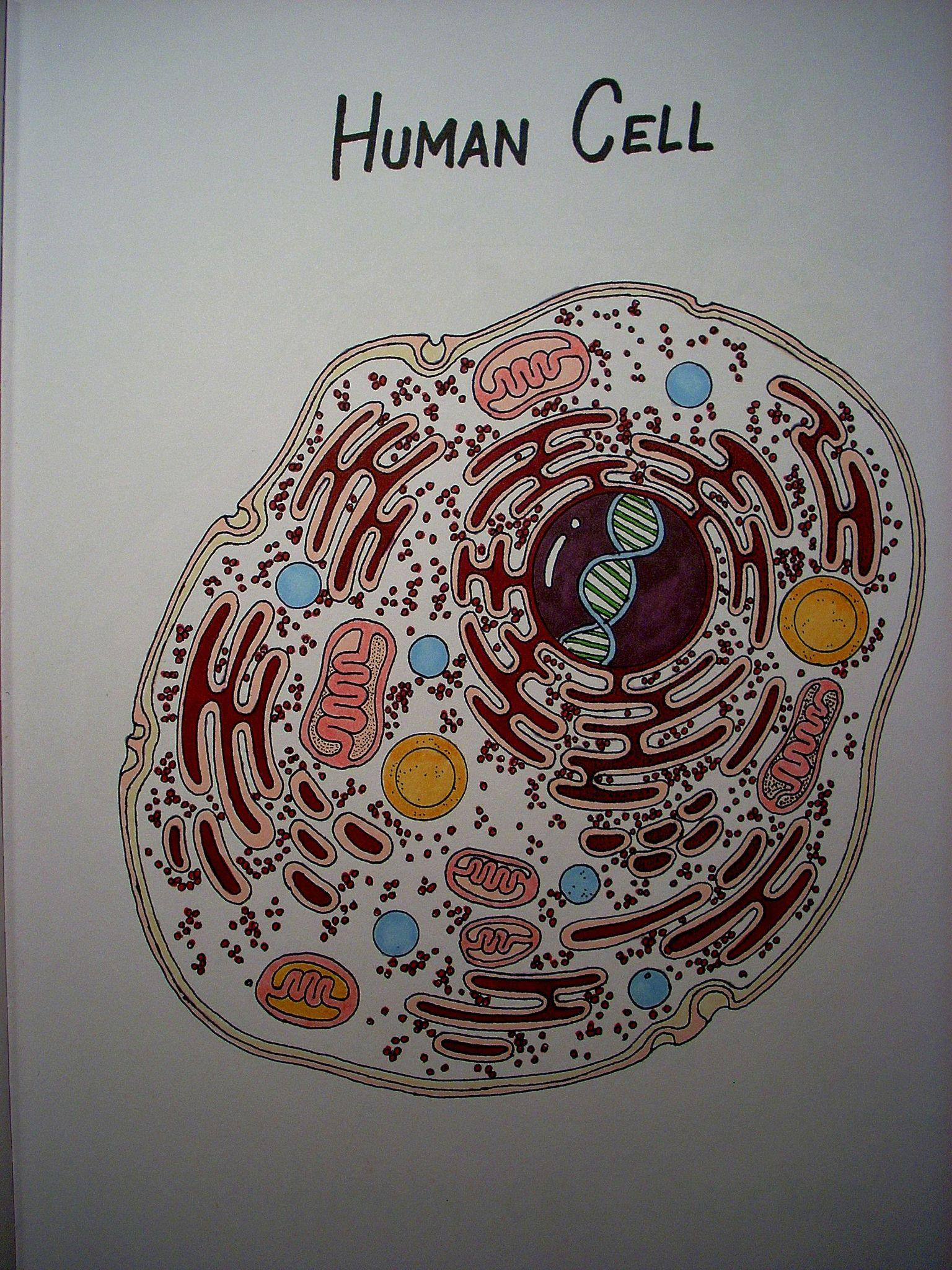
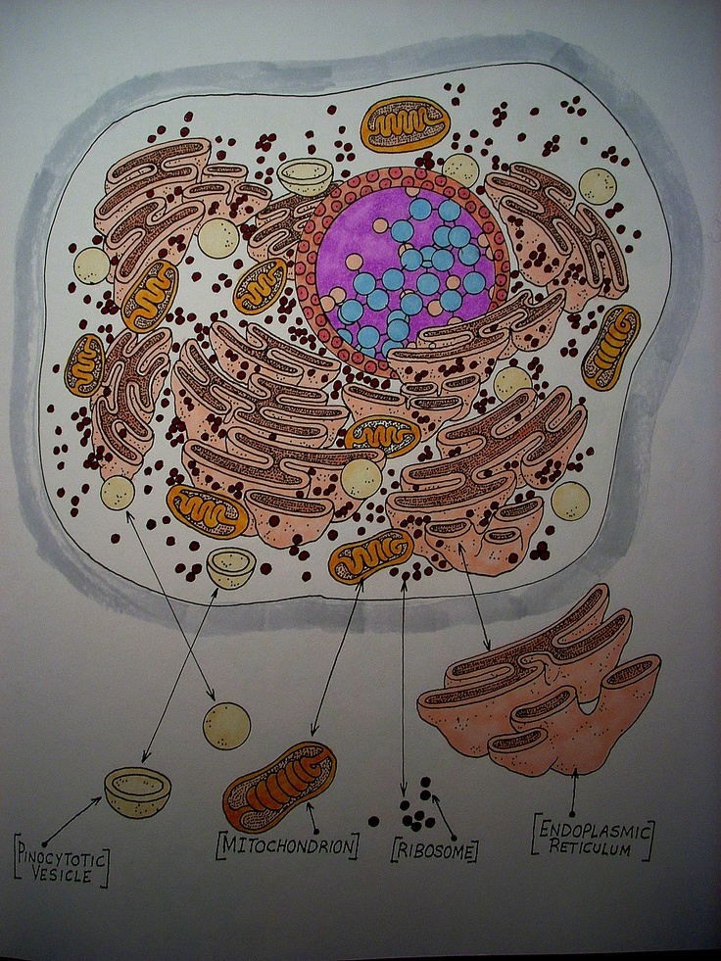
Example of a Hand Drawn Cell
Notes:
Teacher notes:
Click here for other ways you can create a 3D model of a cell.
This example shows a completed hand drawn cell.
Example 1 source
Example 2 source

Slide 87
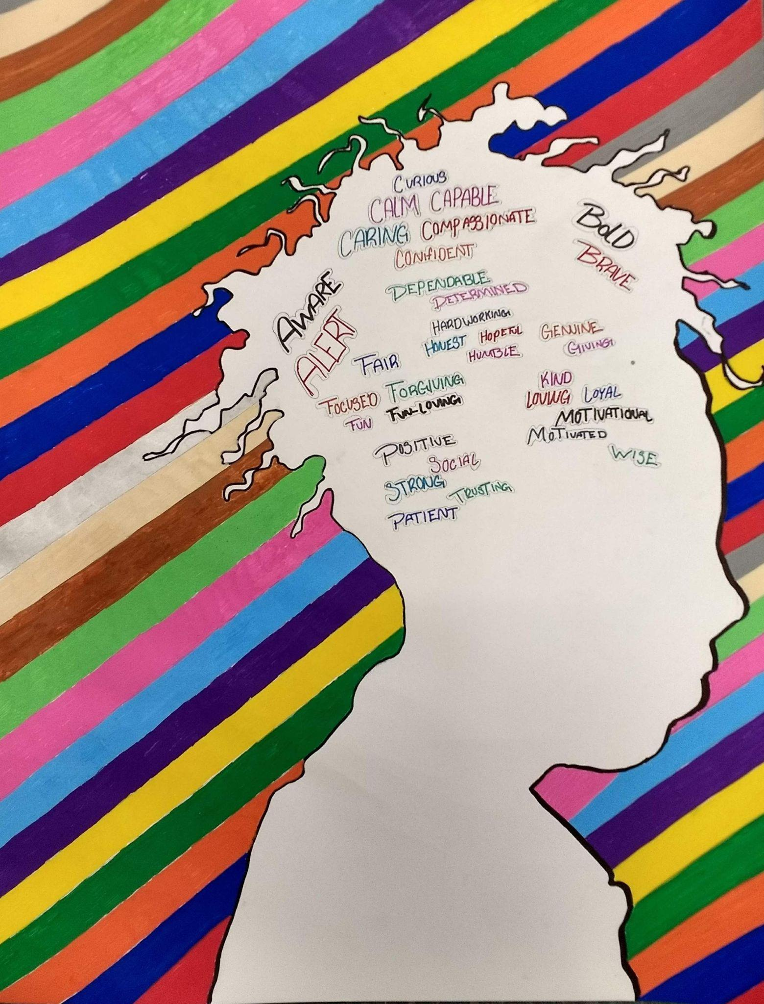
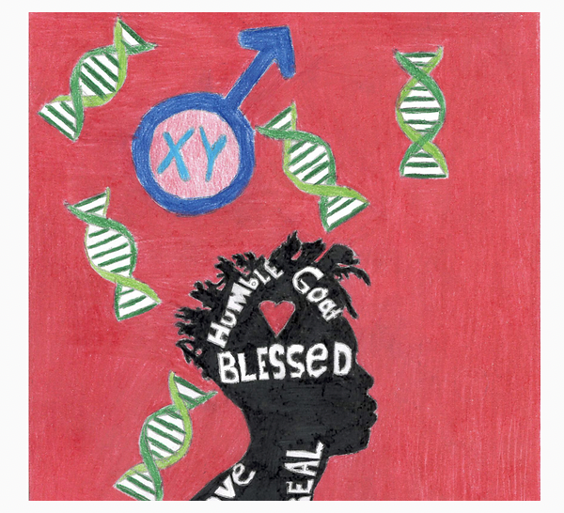
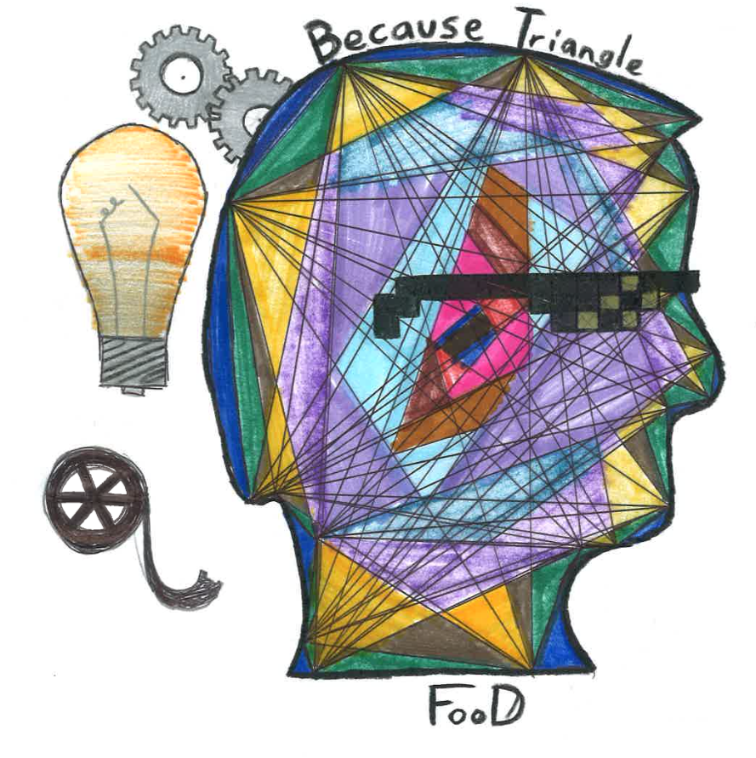
Past Winners - Self Portrait
Notes:
Teacher notes:
This examples show the blending of a self-portrait with a quote that is unique to the student.
Photo #1 20-21 Unknown Winner
Photo #2 21-22 Unknown Winner

Slide 88
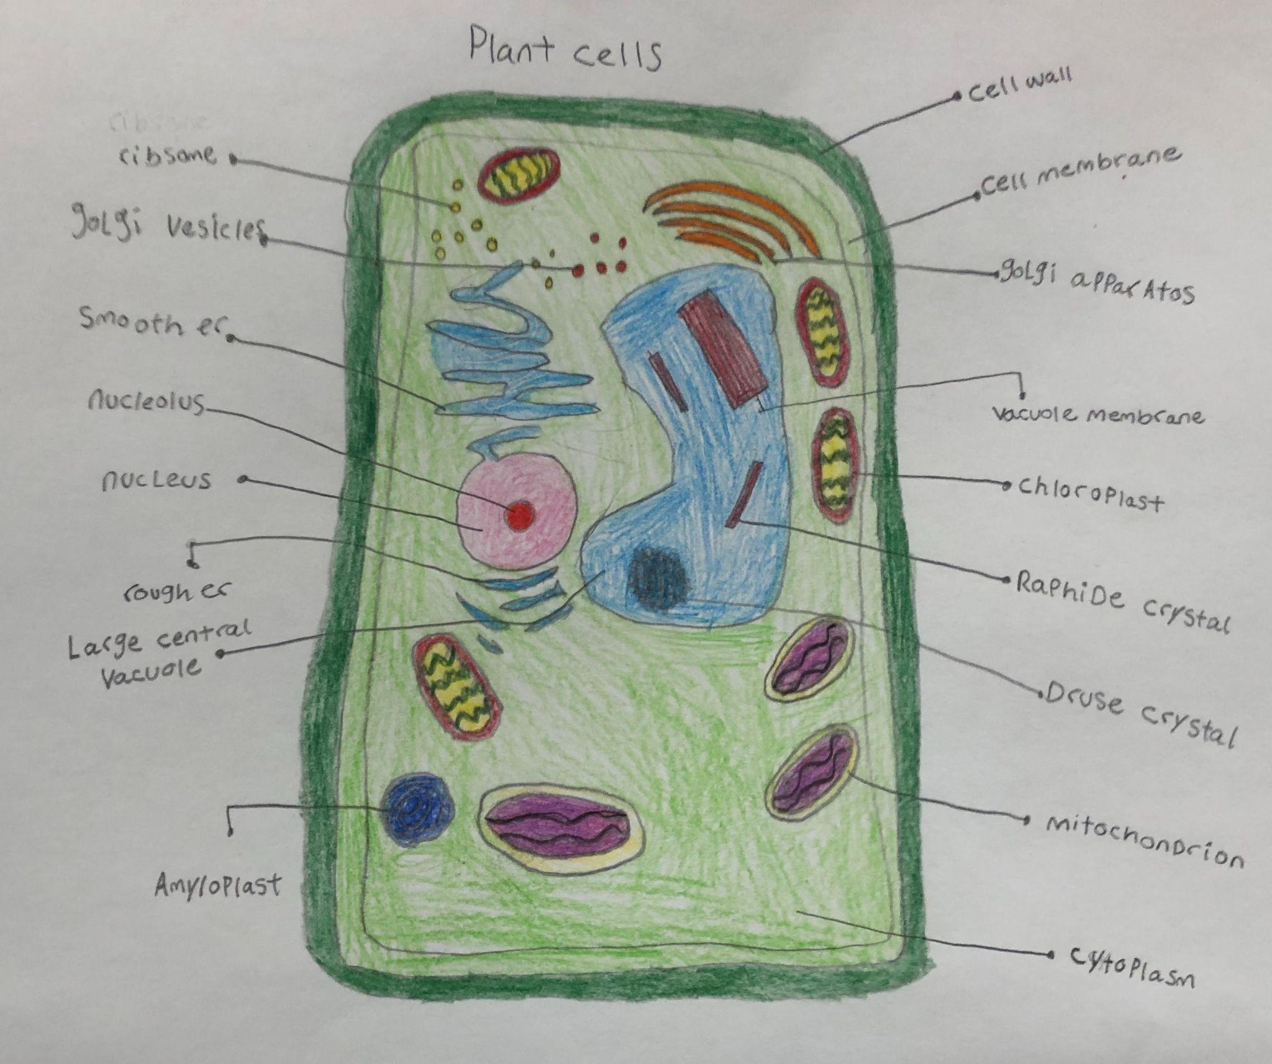
Past Winners
Notes:
Teacher notes:
Click here for other ways you can create a 3D model of a cell.
This example shows a completed hand drawn cell.
Example 1 source
Example 2 source

Slide 89
Your Turn
Choose…
01
02
03
a self-portrait, and/or
a model of a cell either 3D model or hand drawn
be creative and show your unique self
Notes:
Teacher notes:
Have students create either a (1) self portrait or a (2) a cell either as a 3D model or hand drawn. Students can and should be as creative as possible! We cannot wait to see their submissions! Students can create and submit both. There will be a winner in each category!

Slide 90
EXIT TICKET
Don’t forget to complete your daily learning log!!
SUBMIT your artwork to the BreakFree Education competition!
Notes:
Teacher notes:
collect student artwork and submit them to the portal!!
Remind students to complete Daily Learning Log.

Slide 91
UNKNOWN

