Slide 1
Unspent
Wealth v. Cash
Notes:
In this 3-day initiative, students will differentiate between wealth and cash in terms of financial well-being. They will then delve into real-world problems around net-wealth, giving them an understanding of essential financial literacy topics and associated mathematical concepts. The initiative culminates in a contest. The math in this initiative is roughly at the level of Algebra I.
Access the Teacher Lesson Plans
Day 1
Day 2
Day 3
Access to printable versions of the student handouts here
Day 1
Day 2
Unspent Game of Life Worksheet

Slide 2
Day 1
Four Key Concepts
Notes:
This lesson introduces students to the fundamental concepts in finance, teaching them to understand financial wellbeing in terms of wealth, rather than simply cash. In addition, the lesson uses the accounting equations to get a precise mathematical model of these concepts, and students must critically apply them in context to deepen their understanding.

Slide 3
Do Now: Theo & Shannon
Thrifty Theo Theo keeps all of his money in an eggo box in his freezer: He lives in a tiny apartment and shares wifi with a neighbor to spend the least amount of money He eats canned soup and cereal for meals He saves the rest of his money | Showy Shannon Shannon does not save her cash: She spends away all of her earned money on purses, clothes, and cars
Both Theo and Shannon are 28 years old. Theo has $100,000 in cash and Shannon has $500 in her wallet. Who do you think is in the better financial position? Why?
Notes:
As students enter classroom, have the Do Now prompt on the screen for them to respond to in their journals, handout, or piece of paper.

Slide 4
Agenda
Do Now: Theo & Shannon
Cornell Notes: Key Concepts
Consumption, Wealth, Income, Expense, Asset, Liabilities
Activity: Partner Worksheet
Exit Ticket
Notes:
Review the agenda for the day

Slide 5
Objectives
Students will be able to:
Understand how their financial choices can lead to achieving long-term wealth
Describe why wealth is a better measurement of financial well-being than cash balance
Use accounting equations, and the concepts of income, expense, asset and liability, to help measure and better understand their wealth
Notes:
Review the objectives for the day, so students know what is expected of their learning

Slide 6
Theo & Shannon: Continued...
Thrifty Theo (Continued) Theo borrowed $40,000 from crooked Carl. Carl demands $65,000 by the end of the month for repayment + interest. Theo’s tiny apartment is in disrepair because he rented one in an old building and his car broke down because he bought a very cheap one that was 15 years old. | Showy Shannon (Continued) Shannon took out loans to pay for med school, but she just graduated The condo she bought has increased in value by $100,000 The electric car she bought gets great gas mileage and the purses she owns will stay valuable for years.
Notes:
Tell students there’s more to the story from the Do Now prompt…
Ask a student to read the continuation of Theo and Shannon’s story

Slide 7
Theo & Shannon: Continued...
In summary:
Thrifty Theo Likes having cash, so he saves his money Has more cash than Shannon Has loans that create extra debt Spent his money on cheap things that fall apart | Showy Shannon Invested in items that are increasing value and will last a long time Has less cash than Theo Has loans that she’ll be able to pay off with the higher salary she’ll earn with a medical degree
Notes:
Give students a few moments to read the summary to themselves and consider all the facts about both Theo and Shannon before clicking to the next slide

Slide 8
Discussion
Is Theo or Shannon in a better financial position?
Is cash a good marker of someone’s wealth?
What do you miss by only looking at someone’s amount of cash to determine their financial position?
Does this surprise you?
Notes:
Pose the question in blue to students and ask a few students to share their answers (or have students raise their hands to vote on who is in the better financial decision)
Ask students if their opinions changed from the Do Now activity
Click through to ask the following questions in black to students
Note: Cash does not tell the whole story. There are many other aspects of a person’s finances that can indicate their overall wealth and financial position.
Note: A person’s wealth is not solely reflected by their cash savings. You can be cash poor, but still be in a very good financial position.

Slide 9
Discussion
If you want to know if someone is in a good financial position,
Simply looking at how much cash they have is not enough.
What else should you consider?
Notes:
Read the text from the slide to review what they just discovered
Point out that the icons in turquoise are examples of the different types of assets one may have that factor into their overall financial wealth (cash, real estate, cars, jewelry/clothing)

Slide 10
Wealth or Cash?
Cash is important when assessing your current financial situation (can I buy this car right now? Can I afford to go out to the movies?)
Wealth is important when assessing your long-term
financial situation
So, if you want to be wealthy when you get older,
should you save or spend your money?
Notes:
As a class, read the statement on the slide and identify the key terms in yellow

Slide 11
Cornell Notes
Key Words & Questions
Consumption
Details
Definition: The purchase and use of goods and services
Our ability to purchase (or consume) goods and services is determined by our financial position
Whether we can buy food, live in a particular neighborhood, drive a certain car, all depends on how much money we have.
Sometimes we choose to save our money for future consumption
Example of consumption:
Buying a pair of shoes and wearing them to school is consumption
Notes:
Distribute the Day 1 Cornell Notes Handout and guide students through filling it out

Slide 12
Activity: Consumption or not?
Which of the following activities do you think are examples of consumption? Give reasons that relate to the definition you’ve been given of ‘consumption’.
Sleeping in new pajamas
Drinking a milkshake from a diner
Birdwatching at your local park
Going to a theme park
Listening to your neighbor play the piano
Watching a movie at the theater
Notes:
Read the instructions on the slide. Explain that you will be showing different activities on the board and students will be asked to identify whether it is considered consumption or not. Click through the items and ask for student to respond (as a group or call on students individually)
Answers:
Yes
Yes
No
Yes
No
Yes

Slide 13
Cornell Notes
Key Words & Questions
Wealth
Details
Definition: Measures your ability to consume. The more wealth you have, the more you can consume.
You can use cash to purchase goods, so having cash does increase your wealth, but it’s not the whole story:
Other items can be used to consume, like trading items, gold, or jewels
If you owe money from loans, the amount of cash you have needs to be used toward those loan payments, rather than consuming new goods or services..
Notes:
Distribute the Day 1 Cornell Notes Handout and guide students through filling it out

Slide 14
Activity: Consumption or not?
Given what you know about Theo and Shannon, list some things that are good and bad for their wealth:
Thrifty Theo | Showy Shannon
Notes:
Ask students to brainstorm about Steve and Fiona. If using a smartboard, ask a student to write on the board while others call out answers
Potential answers
Theo
+ Lots of cash
- Owes money
- Has no valuable possessions
Shannon
- Not much cash
+ Valuable investments
+ Owns property which will last a long time
+ In a good position to earn money as a lawyer

Slide 15
The Four Key Concepts
We know from Theo and Shannon that cash is not enough to understand someone’s wealth. There are four concepts that we need to understand to assess someone’s wealth:
Income
Expense
Asset
Liability
Notes:
Introduce students to the Four Key concepts

Slide 16
Cornell Notes
Key Words & Questions
Income
What are some other forms of income?
Details
Definition: Money received that leads to an increase in wealth.
When you receive income, your ability to consume increases.
Note 1: The most common form of income is a salary earned for the work you complete.
When your job pays you, you receive income.
Notes:
Distribute the Day 1 Cornell Notes Handout and guide students through filling it out
Other forms of income may include
Earning interest on an investment
Receiving money for a birthday or graduation
Finding money on the street

Slide 17
Cornell Notes
Key Words & Questions
Expense
What are some other examples of expenses?
Details
Definition: The money spent on something (cost), which leads to a decrease in wealth
When you incur (are subject to) expenses, your ability to consume decreases.
Note 1: The most common kind of expense is when you spend cash to consume.
When you pay $10 to see a movie in a theater, you incur an expense.
Notes:
Distribute the Day 1 Cornell Notes Handout and guide students through filling it out
Other forms of expenses
Rent
Gas
Taxes

Slide 18
Income & Expense involve changes in wealth
Income and expenses both lead to a change in wealth. They allow us to track whether your wealth is going up or down.
But what if we want to measure your wealth at a fixed point in time?
For that, we need to understand assets and liabilities
Notes:
Review income and expenses and introduce the next two key concepts

Slide 19
Cornell Notes
Key Words & Questions
Assets
Details
Definition: Anything that holds value and can be converted into cash. (The more assets you have, the greater your wealth)
1) The most common kind of asset is an item that can be sold in the future.
For example real estate, a car, or stocks
Owning these items increases wealth, since you can sell them and use the cash for consumption
2) Cash itself is an asset
What are some more examples of assets?
Notes:
Distribute the Day 1 Cornell Notes Handout and guide students through filling it out

Slide 20
Cornell Notes
Key Words & Questions
Assets
Details
3) Fixed assets: personal property can also be an asset if it retains its value over an extended period of time, even if you can’t sell it
For example, a computer is a fixed asset; while it can’t be resold for much, it retains its value to you because it can be used in your daily life for several years.
If an object is useful for an extended period of time, this reduces your expenses, since you don’t have to buy another one during that time.
Notes:
Distribute the Day 1 Cornell Notes Handout and guide students through filling it out

Slide 21
Cornell Notes
Key Words & Questions
Liabilities
Details
Definition: Liabilities are something you owe. They are your debts.
1) The greater your liabilities, the less your wealth, since the money you have will need to go toward paying off those liabilities rather than consumption.
2) Liabilities typically come from borrowing cash.
For example, you take out a loan to pay for your college tuition.
3) Unpaid liabilities typically increase over time due to interest.
What are some more examples of liabilities?
Notes:
Distribute the Day 1 Cornell Notes Handout and guide students through filling it out
Note: Your liabilities are things you owe, such as unpaid bills, a mortgage, a car loan, or unpaid taxes.

Slide 22
Activity: Worksheet
Liabilities ___________ your wealth
Assets ___________ your wealth
Notes:
If time permits, bring the class back together to review their answers
Review answer key for answers

Slide 23
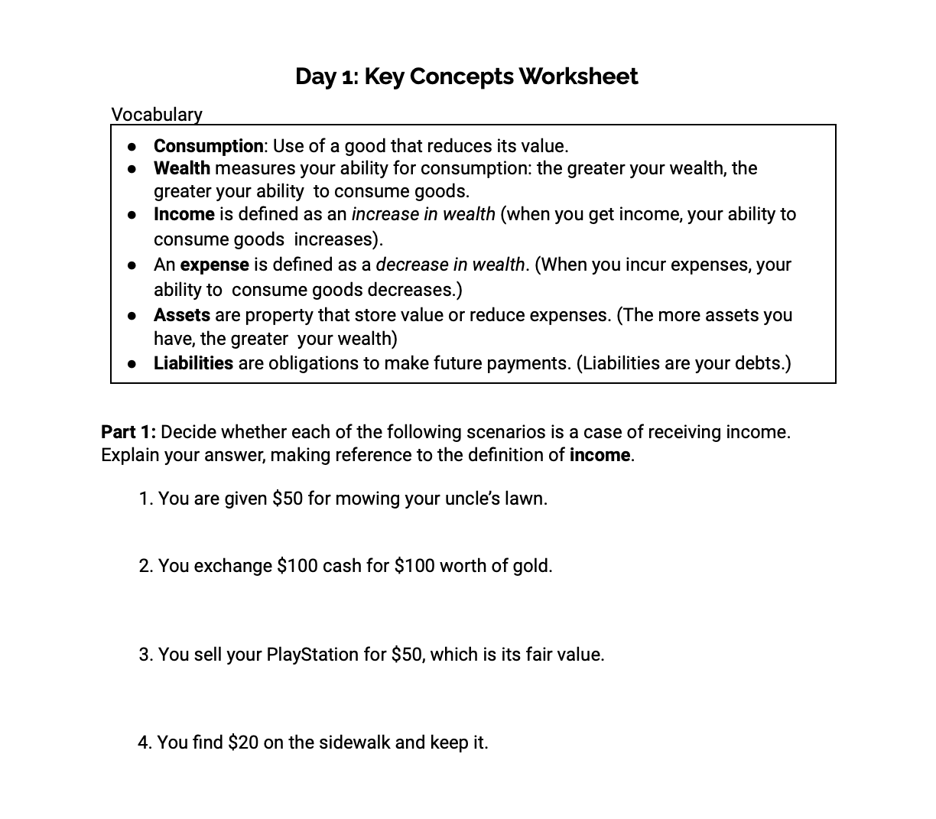
Activity: Worksheet
Independently or with a partner, complete the worksheet on the four key concepts!
Notes:
Distribute the Day 1 Activity Handout and instruct students to complete the activity

Slide 24
Activity: Worksheet
Let’s review our answers!
Notes:
If time permits, bring the class back together to review their answers
Review answer key for answers

Slide 25
Exit Ticket: LeBron James Sneakers
Answer the following questions: You buy the new limited edition “LeBron James” sneakers... You go to the local carry-out and buy a meal You purchase gas to fill up your car You bought a condo and have plans to sell it in the future Your aunt gave you $50 for your graduation You borrowed money from your mom to go to the movies Word Bank: Asset Expense Consumption Liability Income
Notes:
Before students leave class, ask them to complete the exit ticket on the handout, a piece of paper or submit one through your virtual classroom.
Answers
Consumption
Expense
Asset
Income
Liability

Slide 26
Day 2
Net Worth & Cash Flow
Notes:
In this lesson, Students will learn the concepts of assets and liabilities and the flow (an amount per unit of time) concepts of income and expenses. Students use this distinction to determine net worth, cash flow, and the relationship between them.

Slide 27
Do Now
Write a definition for “wealth”
Notes:
As students enter classroom, have the Do Now prompt on the screen for them to respond to in their journals, handout, or piece of paper.

Slide 28
Agenda
Do Now:
Review Four Key Concepts: A-L-I-E activity
Lesson: Net Worth
Activity
Exit Ticket
Notes:
Review the agenda for the day

Slide 29
Objectives
Students will be able to:
Understand how their financial choices can lead to achieving wealth in the long term
Describe net worth as the value of a person’s assets minus the value of the individual’s liabilities at a point in time
Notes:
Review the objectives for the day, so students know what is expected of their learning

Slide 30
Review of Key Concepts
Consumption: The purchase and use of goods and services.
Wealth: Measures your ability to consume. The more wealth you have, the more you can consume.
Income: Money received that leads to an increase in wealth.
Expense: money spent on something (cost), which leads to a decrease in wealth.
Assets: property that store value or reduce expenses.
Liabilities: obligations to make future payments.
Notes:
Briefly review the key concepts that students learned about in the last lesson

Slide 31
Activity: A-L-I-E
You will be given a scenario...
For each scenario, first decide if your cash balance goes UP, DOWN, or stays the SAME
Decide what kind of transaction it is, and hold up your card to show your vote
Asset, Liability, Income, Expense
A
L
I
E
Notes:
Introduce the ALIE activity by explaining the directions on the slide
Ask students to take a piece of paper and fold it in half twice. Have them cut or tear across the folds. Now, with their four pieces, have them write an A, L, I, and E on separate pieces to use for the game. Alternatively, you can have cards already made for students to use.

Slide 32
Activity: A-L-I-E
Situation | Cash Balance | Earning income | Acquiring (non-cash) asset | Incurring expense | Increasing liabilities | None
1. You are paid $15/hr for working at a restaurant | U / D / S
2. You buy a new pair of shoes and wear them the next day | U / D / S
3. You buy a bus pass for $75 and use it to get to work | U / D / S
4. You sell your car for a fair price | U / D / S
5. Your borrow $25 from your grandma | U / D / S
6. You find $5 on the street | U / D / S
X
X
X
X
X
X
Notes:
Click through the slide to show the different scenarios and then pause before clicking to view the answers for each scenario. Continue through all six scenarios.

Slide 33
The Net Worth Equation
In personal finance, it is important to know your financial situation. The two basic measures of your financial situation are your net worth and cash flow.
Net worth is another term for wealth.
Remember our previous definition of wealth: your ability to consume
Net worth captures how much you would have left over to use for consumption if you paid off all your debt.
Notes:
Introduce the concept of net worth by reading the slide to students or asking for a volunteer to read

Slide 34
Cornell Notes
Key Words & Questions
Net Worth
Details
Definition: the value of your assets minus the value of your liabilities
Accounting Equation:
Total Assets - Total Liabilities = Net Worth
A - L = NW
Formula Key:
NW = Net Worth
A=Assets
L=Liabilities
Notes:
Distribute the Day 2 Cornell Notes Handout and guide students through filling it out

Slide 35
Net Worth Example 1
Joe has $1200 in assets and $350 in liabilities, let’s calculate his net worth
We know A - L = NW
A =
L =
Substituting in the values for variables:
Therefore, Joe’s net worth is...
1,200
350
NW = 1,200 - 350
$850
Notes:
Distribute the Day 2 Cornell Notes Handout and guide students through filling it out
Click through the slide to make the answers appear

Slide 36
Net Worth Example 2
Emily has $340 in cash, and she owns a car worth $2500; she owes her brother $100, and her mother $220. Let’s calculate her net worth.
We know A - L = NW
A =
L =
Substituting in the values for variables:
Therefore, Emily’s net worth is...
340 + 2,500 = 2,840
100 + 220 = 320
NW = 2,840 - 320
$2,520
Notes:
Distribute the Day 2 Cornell Notes Handout and guide students through filling it out
Click through the slide to make the answers appear

Slide 37
Net Worth Example 3
Reggie has a Net worth of $3,000, and liabilities of $1,100. How can calculate the value of his assets?
Substitute the values into the accounting equation
This gives us…
A - 1,100 = 3,000
Now we solve for “A”
A = 3,000 + 1,100 = $4,100
Notes:
Distribute the Day 2 Cornell Notes Handout and guide students through filling it out
Click through the slide to make the answers appear

Slide 38
Cash Flow & Net Income
In personal finance, it is important to know your financial situation. The two basic measures of your financial situation are your net worth and cash flow.
Your cash flow is a measure that gives you a good indication of how your net worth is likely to change over time.
If your inflow (your income) exceeds your outflow (your expenses), your net worth is likely to rise over time.
If your outflow (your expenses) exceeds your inflow (your income), your net worth is likely to fall over time.
Another way of talking about cash flow is net income
Notes:
Introduce the concept of cash flow by reading the slide to students or asking for a volunteer to read

Slide 39
Cornell Notes
Key Words & Questions
Cash Flow / Net Income
Details
Definition: the difference between gross (total) income and expenses.
Net Income Equation:
NI = I – E
Formula Key
NI = Net Income (or cash flow)
I = Gross income
E = Expenses
Notes:
Distribute the Day 2 Cornell Notes Handout and guide students through filling it out

Slide 40
Cash Flow Example 1
Jack has gross income of $2,200 and expenses of $850, what is his net income?
We know NI = I – E
I =
E =
Substituting in the values for variables:
Therefore, Jack’s net income is...
2,200
850
NI = 2,200 - 850
$1,350
Notes:
Distribute the Day 2 Cornell Notes Handout and guide students through filling it out
Click through the slide to make the answers appear

Slide 41
Cash Flow Example 2
Mary earns $2,100 in monthly salary and receives $175 in cash as a birthday present. She spends $600 on food and $320 on clothes. What is Mary’s net income?
We know NI = I – E
I =
E =
Substituting in the values for variables:
Therefore, Ian’s net income is...
2,100 + 175 = 2,275
600 + 320 = 920
NI = 2,275 - 920
$1,355
Notes:
Distribute the Day 2 Cornell Notes Handout and guide students through filling it out
Click through the slide to make the answers appear

Slide 42
Cash Flow Example 3
Example 3: Mark has gross income of $35,200 and a net income of $17,520, what is the value of her expenses?
We know NI = I – E
I =
NI =
Substituting in the values for variables:
Therefore, Mark’s expenses are...
35,200
17,520
17,520 = 35,200 - E E = 35,200 - 17, 520
$17,680
Notes:
Distribute the Day 2 Cornell Notes Handout and guide students through filling it out
Click through the slide to make the answers appear

Slide 43
Activity: Net Worth Increase or Decrease?
For each scenario, give a thumbs up if you think the net worth will INCREASE over time, or a thumbs down if you think the net worth will DECREASE over time
Sam has a part-time job earning $75 dollars after taxes each week. Sam spends $30 a week on gas, food, and entertainment.
Madison has a part time job during the school year. She earns $200 per month. Her cell phone bill is $75 per month, and she spends $50 per week on snacks, movies, and having fun with friends.
Emma’s summer job pays her $200 per week. Her monthly expenses are a $250 car payment, a $100 car insurance payment, a $75 cell phone bill, and $100 for living expenses.
Notes:
Read the instructions for the short activity and click through the three scenarios, pausing to ask students to give a thumbs up or thumbs down. Review answers.
Answers
Thumbs up
Thumbs down
Thumbs up

Slide 44
Activity: Net Worth and Cash Flow
Work through the Net Worth and Cash Flow Worksheet
Classify each of the following as an asset (write “A”), liability (“L”), income (“I”), or expense (“E”).
Given the information in Part A, what is this person’s net worth? Explain your answer.
Given the information in Part A, explain whether this person’s net worth is likely to grow or decrease over time if things remain the same.
(Hint: Convert all income and expense flows into monthly figures and compare them.)
1
2
3
Notes:
Distribute a copy of the Day 2 Handout to each student and allow time for students to work (in groups or independently)

Slide 45
Activity: Net Worth and Cash Flow
Consumption: Use of a good that reduces its value.
Wealth measures your ability for consumption: the greater your wealth, the greater your ability to consume goods.
Income is defined as an increase in wealth (when you get income, your ability to consume goods increases).
An expense is defined as a decrease in wealth. (When you incur expenses, your ability to consume goods decreases.)
Assets are property that store value or reduce expenses. (The more assets you have, the greater your wealth)
Liabilities are obligations to make future payments. (Liabilities are your debts.)
Gross income is the sum of all sources of income
Net Income is the difference between gross income and expenses
Net worth is the value of your assets minus the value of your liabilities
Notes:
If helpful, leave these vocabulary definitions up while students work through the worksheet

Slide 46
Activity: Worksheet
Let’s review our answers!
Notes:
If time permits, bring the class back together to review their answers
Review answer key for answers

Slide 47
Exit Ticket:
Write a response to the following questions that includes specific suggestions and calculations. How would you help this person change his or her inflow (income) and outflow (expenses) to improve his or her financial health? Recommend ways for this person to increase his or her income or decrease expenses. How would your plan change this person’s net worth over time?
Notes:
Before students leave class, ask them to complete the exit ticket on the handout, a piece of paper or submit one through your virtual classroom.
Review answer key for sample answers

Slide 48
Day 3
Unspent Game of Life
Notes:
In this lesson, students will play the Unspent Game of Life to make financial choices that are common in life. As they make choices, students will keep track of them on the worksheet and see how the choices affect their monthly budget. At the end of the game, students will see how their choices add up… will their net worth be likely to increase or decrease?

Slide 49
Do Now
What are your financial goals for the future?
Notes:
As students enter classroom, have the Do Now prompt on the screen for them to respond to in their journals, handout, or piece of paper.

Slide 50
Agenda
Do Now
Unspent Game of Life
Class Discussion
Notes:
Review the agenda for the day

Slide 51
Objectives
Students will be able to:
Understand the basics of having a budget
Spend and save thoughtfully
Manage money and understand the relationship between saving and spending apply their knowledge with direct, real-world applications
Notes:
Review the objectives for the day, so students know what is expected of their learning

Slide 52
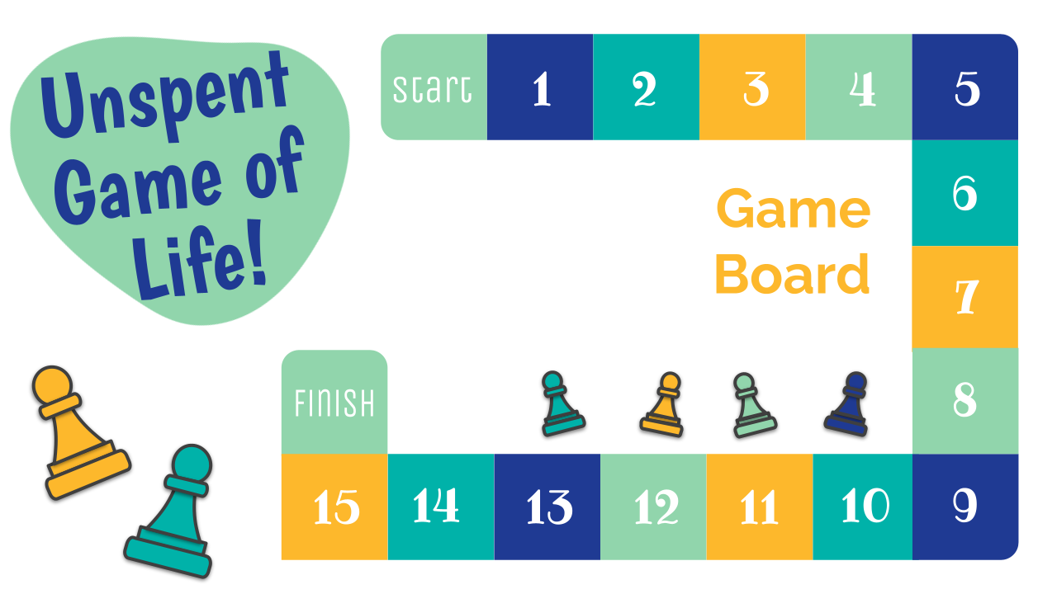
Activity: Worksheet
Time to Play the Unspent Game of Life!
As you play the game, follow along on the worksheet to keep track of your choices and budget!
Notes:
Students will play the game independently and complete the worksheet as they go through each step of the game.
Game link
Game Worksheet
Google sheet can be printed OR if students are using their own computers, a copy can be made for each of them to complete

Slide 53
Submit Your Work!
Chance to win a Chromebook!
BreakFree will choose one lucky student to win a Chromebook. Just submit your Unspent Game of Life worksheet and you could be the lucky winner!
Notes:
Collect and submit your students’ Unspent Game of Life worksheet through our portal by August 27, 2021. Each student will be entered into our lottery for the chance to win a Chromebook.

Slide 54
Exit Ticket:
What are three things you’ve learned from playing the Unspent Game of Life?
Notes:
Before students leave class, ask them to complete the exit ticket on a piece of paper or submit one through your virtual classroom.

