Slide 1
UNLEASHED

Slide 2
Day 1
MOTION
Notes:
Unleashed Day 1:

Slide 3
DO NOW
Question:
What is motion?
Notes:
Teacher notes:
discuss as a class and/or have students keep a learning journal throughout this initiative
This question acts as a period knowledge check to see what students already know about motion.

Slide 4
OBJECTIVE
Students will
Define motion
Understand the importance of motion
Explain why motion is important in everyday life
Notes:
Teacher notes:
Review the objectives for the day, so students know what is expected of their learning

Slide 5
AGENDA
Do Now
Introduction of Motion (& class experiment)
Activity: Think - Pair - Share
Exit Ticket
Notes:
Teacher notes:
Review the agenda for the day

Slide 6
Introduction
Students will study the concepts of force and motion and the life of Granville T. Woods, the inventor of the Figure Eight roller coaster. The Unleashed initiative will showcase student knowledge through building a paper roller coaster. Unleashed includes 6 days of curriculum with the rest of the month spent on building paper roller coasters.
Don’t forget, there’s a competition too!
Notes:
Explain to students that by the end of this unit, they will be asked to create an artifact for a living museum. Anytime something sparks their imagination, they should make a note of it. Explain BreakFree’s monthly contest and pass out the Note to Students.

Slide 7
What is Motion?
MOTION is the change of position. Motion is everywhere you look - the earth revolving around the sun, closing a door, running or walking, air coming in and out of our lungs is all motion.
DID YOU KNOW: Any time your position changes, YOU are in motion.
Notes:
Teacher notes:
Explain the definition of motion and discuss other possibilities for what could be motion.
Other examples: running, cycling, jumping, swimming, eating, drinking, playing, writing, typing, moving cars, throwing ball, breathing, ticking of a clock, etc

Slide 8
Relative Motion
If you see a truck driving at 50 miles an hour, to you, the truck appears to be moving. However, if you were in a car also driving 50 miles an hour next to the truck, the same truck wouldn’t seem to move at all.
DID YOU KNOW: Motion is relative. It is always described in relation to a reference point.
Notes:
Teacher notes:
Explain relative motion and discuss what a reference point could be? Ask students if they can come up with another example.

Slide 9
Reference Point
The object that appears to not be moving (mailboxes, bikes, driveways, etc) is what is known as a reference point.
When you were in the hallway today, how did you know that you were moving?
You compared yourself to the walls, tiles, and even other classmates. Those were all reference points. They helped you to determine that you were in fact moving.
Notes:
Teacher notes:
Discuss what the references point might have been on their way to class.

Slide 10
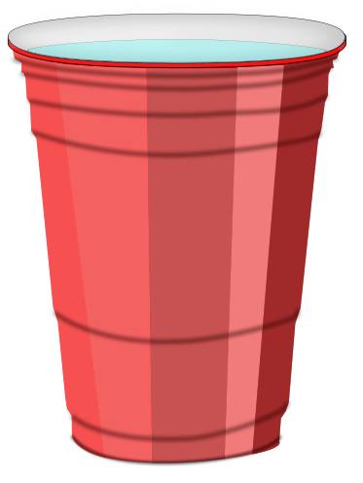
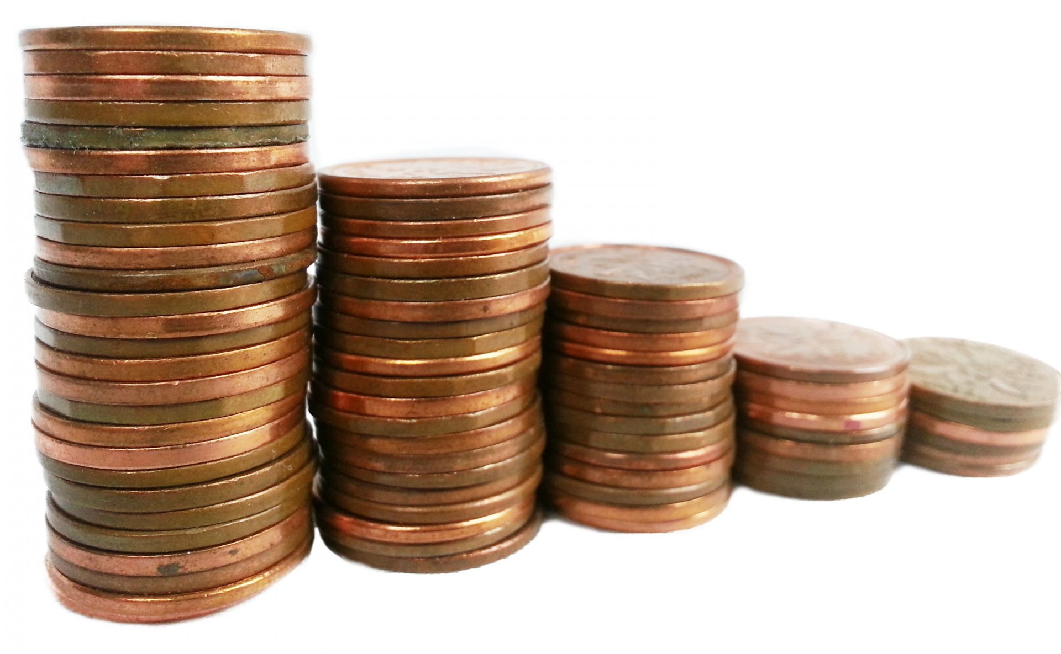
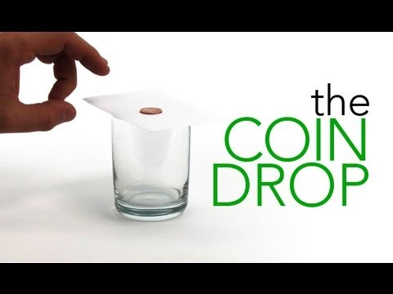
Experiment!
1. Gather the materials!
2. Watch this video!
3. Try it out then answer these questions!
A
Which object is not in motion?
B
What causes the penny to fall?
C
What is the reference point?
Notes:
Teacher notes:
Experiment: “Sir Isaac Newton has had a lock on this outcome since the 17th Century. The First Law of Motion (there are three) says something like this: “An object at rest stays at rest unless an outside force is strong enough to make it move. An object that is moving, will continue moving at the same speed in a straight line unless an outside force is strong enough to speed it up, slow it down, stop it, or cause it to change direction.” In the case of the Coin Drop activity, the penny is at rest sitting on top of the card. Watch it as long as you like but, on it’s own, the penny will not move from that spot. When you flick the card out from under the penny, you allow gravity (an outside force) to act on it and drop it into the glass. The bottom of the glass stops the penny from falling. However, if the penny were a lot heavier (had more mass) and were falling much faster, it could go right through the glass (and probably the table supporting it, too). So, why doesn’t the penny take off when the card is flicked? If you flick the card correctly, it simply slides out from between the glass and the penny. There’s not enough friction from the card to take the penny with it” (source).
Watch the video on the slide (also linked here).
Have students attempt the activity with one penny/coin then challenge themselves to see who can get the most pennies successfully in the jar.
Debrief the activity by asking students the following questions:
Which object is not in motion? Answer - penny, jar, index card
What causes the penny to fall? - gravity from the movement of the index card
What is the reference point? - the jar

Slide 11
ACTIVITY
THINK - PAIR - SHARE
THINK: think about motion and how it is used in everyday life. Come up with at least two examples on your own.
PAIR: Rotate through groups (as shown) discussing what you learned about motion and how motion is used in everyday life.
SHARE: share what you learned with the class.
(1) COUNT AWAY
(2) ODDS VERSUS EVENS
1
2
3
4
(3) NUMBERS UNITES
EXAMPLES
Notes:
Teacher notes:
assign a number to students 1, 2, 3, and 4.
Students will rotate through the groups sharing what they learned about motion in the following order:
Count Away (each group has a 1, 2, 3, and 4 represented)
Odds versus Evens: odds & evens together (one group has two 1s and two 3s, another group has two 2s and two 4s, etc)
Numbers Unite: All same numbers together (all 1s, all 2s, all 3s, all 4s)
Students can spend any length of time in each group. The teacher should rotate through the groups to ensure students are on topic. If you do not have enough students for four groups, you can split students into any number of groups that works best. The goal is to have students discussing what they found several times with different students.

Slide 12
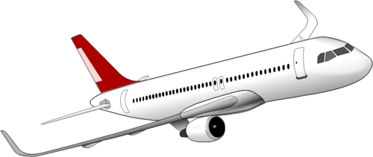
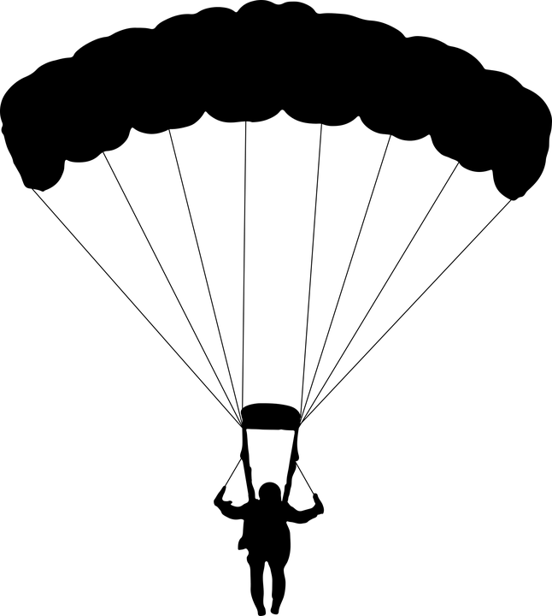
EXIT TICKET
Don’t forget to complete your daily learning log!!
Look at the image below, what is the reference point? Who appears to be moving, not moving, moving closer, moving farther away from the reference point.
Notes:
Teacher notes:
discuss as a class and/or have students keep a learning journal throughout this initiative
Ask students: what is the reference point? Remember, a reference point appears to not be moving.
Who is moving, not moving, moving closer to the reference point?
If the building is the reference point then the plane, people in the plane, person parachuting, two people on the ground are all moving in some from with closer to or farther away from the reference point (building)
Remind students to complete Daily Learning Log.

Slide 13
Day 2
SPEED
Notes:
Unleashed Day 2:

Slide 14
DO NOW
Question:
How do you determine the speed of an object?
Notes:
Teacher notes:
discuss as a class and/or have students keep a learning journal throughout this initiative
This question acts as a period knowledge check to see what students already know about motion.

Slide 15
OBJECTIVE
Students will
Define speed and velocity
Understand how to determine the speed of an object
Understand how to read a graph to determine the speed of an object
Notes:
Teacher notes:
Review the objectives for the day, so students know what is expected of their learning

Slide 16
AGENDA
Do Now
Introduction of Speed & Velocity
Activity: How fast is too fast?
Exit Ticket
Notes:
Teacher notes:
Review the agenda for the day

Slide 17
What is Speed?
SPEED is the distance something travels in a certain amount of time:
{
}
change in distance
change in time
speed =
DID YOU KNOW: Distance is measured in METERS, time is measured in SECONDS...so speed is measured in METERS PER SECONDS.
Notes:
Teacher notes:
Explain the definition of speed
Ask students if you can run 100 meters in ten seconds - what is your speed? Answer 10 meters per second
Tell students: this would be the runner’s AVERAGE speed. When something is in motion, it doesn't necessarily stay at the same speed the entire time. It can change speeds and move faster or slower between its stopping & starting points. The average speed is the total distance something has traveled divided by the total time it traveled. For example, an Olympic runner who completed the 100 meter dash in 10 seconds might have an average speed of 10 meters per second but that is her average speed. I’m sure she was going much faster near the finish line!

Slide 18
What is Velocity?
VELOCITY is just like speed except that it includes direction.
2 meters/second
2 meters/second
SPEED
VELOCITY
-2 meters/second
+2 meters/second
DID YOU KNOW: VELOCITY is speed in a certain direction so a change in velocity mean either a change in speed or direction.
Notes:
Teacher notes:
Explain the definition of velocity
Tell students: If you were jogging at 2 meters per second and all of a sudden you turned and jogged 2 meters per second in the opposite direction, your speed before and after would stay the same but your velocity would be different. You would be jogging 2 meters per second first, then negative 2 meters per second after turning around. The velocity would be equal in magnitude but opposite in direction.

Slide 19
Acceleration and Deceleration
ACCELERATION is the rate at which something changes directions. Whenever an object changes velocity, it is accelerating either by speeding up, slowing down, or changing direction. Positive acceleration is when an object is speeding up. Negative acceleration is when an object is slowing down because the velocity is in the opposite direction of the object's motion. Think of it like a gas pedal and break. Gas mean accelerating/gaining speed. Brake means decelerating/slowing down.
BRAKE
(decelerator)
GAS
(accelerator)
Notes:
Teacher notes:
Explain the definition of acceleration and deceleration
Tell students: Because velocity takes direction into account, so does acceleration. When your car goes around a corner (even if it keeps the same speed), you feel the acceleration as a force that seems to push you toward the outside corner.
Image:
gas and brakes by tezar tantular from the Noun Project

Slide 20
ACTIVITY: Graphing
Scientists have to graph the data they find in order to make sure the information is correct. Over the next few slides, you will learn how to read a graph AND how to create your own graphs. The following graphs have the distance along the left side vertically and the time along the bottom horizontally because we are learning about speed and velocity. BUT, graphs can include any information that needs to be studied.
REMEMBER: to calculate average speed, divide the total distance by the total time.
Notes:
Teacher notes:
Scientist all need to know how to graph the data they find.

Slide 21
ACTIVITY
1800
1600
1400
1200
1000
800
600
400
200
 | 0 | 20 | 40 | 60 | 80 | 100 | 120
This runner covered 1200 meters in 80 seconds.
What is their average speed?
Distance/Meters
Time/Seconds
Notes:
Teacher notes:
students will learn how to read a graph and graph on their own
Answer: 1200 / 80 = 15 meters per second

Slide 22
ACTIVITY
1800
1600
1400
1200
1000
800
600
400
200
 | 0 | 20 | 40 | 60 | 80 | 100 | 120
A
What distance did the runner cover?
Distance/Meters
B
How long did it take?
C
What is the average speed?
Time/Seconds
Notes:
Teacher notes:
students will learn how to read a graph and graph on their own
Answer: 1000 meters / 120 seconds - 8.33 meters per second

Slide 23
ACTIVITY
1800
1600
1400
1200
1000
800
600
400
200
 | 0 | 20 | 40 | 60 | 80 | 100 | 120
A
What distance did the runner cover?
Distance/Meters
B
How long did it take?
C
What is the average speed?
Time/Seconds
Notes:
Teacher notes:
students will learn how to read a graph and graph on their own
Answer: 1800 meters / 120 seconds - 15 meters per second

Slide 24
ACTIVITY
1800
1600
1400
1200
1000
800
600
400
200
 | 0 | 20 | 40 | 60 | 80 | 100 | 120
A
What distance did the runner cover?
Distance/Meters
B
How long did it take?
C
What is the average speed?
Time/Seconds
Notes:
Teacher notes:
students will learn how to read a graph and graph on their own
Answer: 600 meters / 80 seconds - 7.5 meters per second

Slide 25
ACTIVITY: Draw your own graph!
Draw a graph for the following: A runner ran 1400 meters in 300 seconds. A runner ran 800 meters in 120 seconds. A runner ran 1000 meters in 80 seconds.
REMEMBER: distance/meters goes along the left vertical side and time/seconds goes along the bottom horizontal side
Notes:
Teacher notes:
Have students draw one or three separate graphs to indication the running examples above. If drawing one graph, have students use a different color for each example to show the difference.

Slide 26
EXIT TICKET
Don’t forget to complete your daily learning log!!
Question
What is the average speed for a runner who covers 400 meters in 2 minutes?
Bonus points for creating your own graph to show your answer!
Notes:
Teacher notes:
discuss as a class and/or have students keep a learning journal throughout this initiative
Answer: 400 meters / 120 seconds = 3.33 meters per second
Remind students to complete Daily Learning Log

Slide 27
Day 3
FORCE
Notes:
Unleashed Day 3:

Slide 28
DO NOW
Question:
What makes the wheels on a bike turn?
Notes:
Teacher notes:
discuss as a class and/or have students keep a learning journal throughout this initiative

Slide 29
OBJECTIVE
Students will
Define force and gravity
Understand balanced and unbalanced forces
Understand the relationship between the pull from two objects
Notes:
Teacher notes:
Review the objectives for the day, so students know what is expected of their learning

Slide 30
AGENDA
Do Now
Introduction of Force
Activity: Tug of War
Exit Ticket
Notes:
Teacher notes:
Review the agenda for the day

Slide 31
What is Force?
FORCE is what makes something move. What makes a car speed up or a bike move - force! Force is a push or pull that changes the motion of an object. You apply force to the bike pedals in order to make it move.
DID YOU KNOW: The force powering a car to move is the engine.
Notes:
Teacher notes:
Explain the definition of force
Tell students: a force always has magnitude (size) and direction. Forces can set an object in motion or change the speed and direction. Movement doesn’t have to be moving from one location to another; it can also change the shape of something. Think about squeezing an empty soda can until it crumbles. You did not throw it into the garbage can but you did cause motion by changing its shape.

Slide 32
Net Force
Sometimes there is more than one force working on an object. The combination of forces on an object is called Net Force. For example, if you pull a magnet off of the fridge there are two forces working, the magnetic force holding the magnet to the fridge and your force pulling it away.
DID YOU KNOW: Force, like velocity and acceleration, has direction. To calculate the net force of an object, you need to take in to account the direction. If the forces are in the same direction - add. If the forces are in opposite directions - subtract.
Notes:
Teacher notes:
Explain the definition of net force
Ask students for other examples of net force on objects

Slide 33
Inertia
Matter/an object doesn’t like change. If an object is in motion - it likes to stay in motion. If an object is at rest - it likes to stay at rest. INERTIA is an object/matter’s resistance to change in motion.
DID YOU KNOW: Sir Isaac Newton created three laws of motion to describe the motion of all objects in the universe. The first law states that “an object in motion will remain in motion and on object at rest will remain at rest unless there is net force acting on the object”.
Notes:
Teacher notes:
Explain the definition of Inertia
Tell students: for example, a soccer ball is lying in an open field. It will remain sitting there (at rest) until an outside force acts on the object (wind, foot kicking it, etc). Once the ball is in motion, it will remain in motion unless an outside force acts on it (like the friction between the ball and the grass, air resistance, gravity, orr it hits something - another player’s foot, the net, etc).

Slide 34
Momentum
Momentum is a measure of how difficult it is to change the inertia of an object. Objects with more mass have more inertia. Think about catching a tennis ball versus catching a basketball. If they have the same velocity (direction & speed), it will be easier to stop the tennis ball because the tennis ball has less mass than the basketball.
Notes:
Teacher notes:
Explain the definition of Inertia
Tell students: think about pushing a shopping cart and pushing a car. If you apply the same amount of momentum/force to both, the shopping cart will zoom off, but the car won’t budge. So a larger mass will accelerate less if the same amount of momentum is applied.

Slide 35
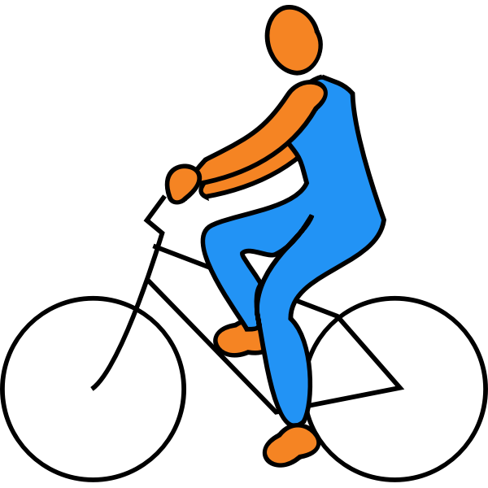
Balanced & Unbalanced Forces
Balanced Forces cancel each other out so there is no acting force. Unbalanced Forces has a net force in one direction.
Unbalanced Forces
Balanced Forces
Notes:
Teacher notes:
Explain the definition of balanced & unbalanced forces
Explain the images
When you are coasting on a bike with the wind at your back, the net force is in the same direction, so you accelerate forward (speed up!). This is unbalanced force
When you are coasting on a bike against the wind, the net force is pushing in the opposite direction, so you decelerate (slow down!) This is balanced force

Slide 36
Unbalanced Force
Matter/an object doesn’t like change. If an object is in motion - it likes to stay in motion. If an object is at rest - it likes to stay at rest. INERTIA is an object/matter’s resistance to change in motion.
DID YOU KNOW: Sir Isaac Newton created three laws of motion to describe the motion of all objects in the universe. The first law states that “an object in motion will remain in motion and on object at rest will remain at rest unless there is net force acting on the object”.
Notes:
Teacher notes:
Explain the definition of Inertia
Tell students: for example, a soccer ball is lying in an open field. It will remain sitting there (at rest) until an outside force acts on the object (wind, foot kicking it, etc). Once the ball is in motion, it will remain in motion unless an outside force acts on it (like the friction between the ball and the grass, air resistance, gravity, orr it hits something - another player’s foot, the net, etc).

Slide 37
Vocabulary
Can you define the following terms?
Force
D
Unbalanced Forces
A
Net Force
E
Balanced Forces
B
C
Inertia
F
Momentum
Notes:
Teacher notes:
Discuss these vocabulary words and ensure that students understand and can define them

Slide 38
ACTIVITY: Tug of War
Balanced versus Unbalanced Forces
Notes:
Teacher notes:
Tug-of-war is a great way to demonstrate balanced and unbalanced forces. There are two ways to facilitate this activity:
Using an actual rope: Group students for each round. Some examples are: Girls vs. Boys, Tall vs. Short, and an Uneven # of students for each side. 3. Have students compete using traditional Tug of War rules. Compete multiple times if needed. 4. Pass out printable and use the discussion questions to review how each round illustrated the concepts of balanced and unbalanced forces.
Using a whiteboard: Place a line across the middle of your desk or table to represent a tug-of-war rope. Working with a dilemma that can be considered from multiple perspectives or stances, such as should women in the WNBA be paid as much as men in the NBA? Identify the two opposing sides of the dilemma you are exploring (e.g. Yes and No). Use these to label each end of the “tug-of-war rope”. Generate as many tugs, or reasons that pull you toward each side of the dilemma. Write these on individual sticky notes. Each sticky note would represent a person. Once all students have submitted their answers, examine the scenario on the board and discuss how the concepts of balanced and unbalanced forces are represented.

Slide 39
EXIT TICKET
Don’t forget to complete your daily learning log!!
Question
When you jump, why do you move but the Earth doesn’t?
Notes:
Teacher notes:
discuss as a class and/or have students keep a learning journal throughout this initiative
Answer: While the force you apply to the Earth is equal to the force Earth applies to you, you have different accelerations because your mass is different. The force Earth applies on you is large enough to send you into the air, but the force you apply to the Earth is not big enough to send Earth moving away in the other direction. Short answer - because your mass does not Earth’s mass.
Remind students to complete Daily Learning Log

Slide 40
Day 4
FRICTION
Notes:
Unleashed Day 4:

Slide 41
DO NOW
Question:
If you kick a soccer ball down a field, why does it stop rolling?
Notes:
Teacher notes:
discuss as a class and/or have students keep a learning journal throughout this initiative

Slide 42
OBJECTIVE
Students will
Define friction
Understand all types of friction
Discover and label the types of friction
Notes:
Teacher notes:
Review the objectives for the day, so students know what is expected of their learning

Slide 43
AGENDA
Do Now
Introduction of friction
Activity: Ok Go - Rube Goldberg
Exit Ticket
Notes:
Teacher notes:
Review the agenda for the day

Slide 44
Friction
Newton’s first law of motion says that an object in motion will stay in motion unless stopped by a force. If you slide a notebook across the table, it eventually slows down and stops. Why? Friction! Friction is the force that opposes the movement between touching surfaces and always goes against the direction of motion.
DID YOU KNOW: We have in our own bodies - where are joints connect.
Notes:
Teacher notes:
Explain the definition of friction
Tell students: rougher surfaces have more friction. Sandpaper is harder to slide than normal paper because it has a rough surface and thus more friction. We can also help things move easier by minimizing the friction by greasing things down. Our bodies produce fluid around our joints to lower the friction when moving.

Slide 45
Static Friction
Static Friction is the force of friction between surfaces not in motion. Static friction is the result of molecules on one surface adhering to another surface.
For example, a concrete block on the sidewalk - two unmoving surfaces.
Notes:
Teacher notes:
Explain the definition of net force
Ask students for other examples of static friction

Slide 46
Sliding Friction
Sliding Friction is also known as Kinetic Friction! It is the force that affects surfaces in motion. Because the surfaces are not always bonded like they are in static friction, sliding friction is less powerful than static friction.
For example: pushing a box creates a resistance to motion that is sliding friction
Notes:
Teacher notes:
Explain the definition of net force
Ask students for other examples sliding friction

Slide 47
Rolling Friction
Rolling Friction is when the friction between surfaces rolls freely like a wheel or a ball. Rolling friction is weaker than sliding friction which is why it is easier to move something on wheels!
For example, the friction between the wheels of a skateboard and the sidewalk is rolling friction.
Notes:
Teacher notes:
Explain the definition of net force
Ask students for other examples of rolling friction

Slide 48
Magnetic Forces
Magnetic force is a material that is either attracted to or repelled by iron, steel, or other magnets. Magnets have a positive and negative charge.
+
-
+
+
-
+
-
-
DID YOU KNOW: Opposite charges attract (pull together)- like charges repel (push away).
Notes:
Teacher notes:
Explain the definition of net force
Ask students for other examples of net force on objects

Slide 49
Centripetal Forces
Centripetal Force is the force that causes an object to follow a curved of circular path and is directed inward toward the center of rotation. The moon moves in a circular path around the earth and is affected by the centripetal force of gravity.
DID YOU KNOW: If you swing a yo-yo around in a circle, tension from the string is the centripetal force that keeps the yo-yo in circular motion. This is also what helps keep the roller coaster on the track!
Notes:
Teacher notes:
Explain the definition of net force
Ask students for other examples of centripetal force

Slide 50
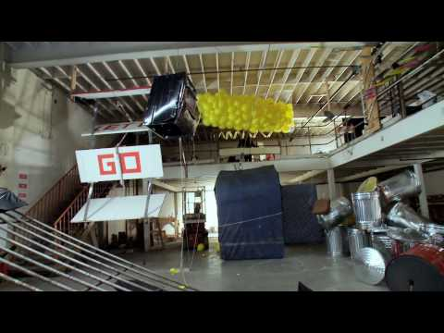
ACTIVITY: Ok Go!
Watch this video and label the types of friction you see being used? How many can you find?
Notes:
Teacher notes:
students will watch this video (perhaps several times) and label all the types of friction they can find
You can watch the youtube link on the slide or you can access the same video in Google Drive linked here
There are numerous examples of friction shown in the video and students can find them all if they want (frame by frame)! Just make sure that each answer is linked to a type of friction - static (unmoving), sliding, and rolling or force - magnetic or centripetal. Students can complete a handout (access a pdf copy or make a copy of the digital version).

Slide 51
ACTIVITY
THINK - PAIR - SHARE
THINK: think about the video - how many types of friction can you find?
PAIR: Rotate through groups (as shown) discussing the types of friction you found
SHARE: share what you learned with the class.
(1) COUNT AWAY
(2) ODDS VERSUS EVENS
1
2
3
4
(3) NUMBERS UNITES
EXAMPLES
Notes:
Teacher notes:
assign a number to students 1, 2, 3, and 4.
Students will rotate through the groups sharing what they learned about friction from the video - how many types of friction can they find?
Count Away (each group has a 1, 2, 3, and 4 represented)
Odds versus Evens: odds & evens together (one group has two 1s and two 3s, another group has two 2s and two 4s, etc)
Numbers Unite: All same numbers together (all 1s, all 2s, all 3s, all 4s)
Students can spend any length of time in each group. The teacher should rotate through the groups to ensure students are on topic. If you do not have enough students for four groups, you can split students into any number of groups that works best. The goal is to have students discussing what they found several times with different students.

Slide 52
EXIT TICKET
Don’t forget to complete your daily learning log!!
Question
Which force causes objects to have a circular motion?
Notes:
Teacher notes:
discuss as a class and/or have students keep a learning journal throughout this initiative
Answer: centripetal force
Remind students to complete Daily Learning Log

Slide 53
Days 5
LIFE IN MOTION
Notes:
Unleashed Day 5:

Slide 54
DO NOW
Question:
What would you invent to improve something that already exists?
Notes:
Teacher notes:
discuss as a class and/or have students keep a learning journal throughout this initiative

Slide 55
OBJECTIVE
Students will
Understand the life of Granville T Woods
Apply the knowledge to creating a plan for a roller coaster
Notes:
Teacher notes:
Review the objectives for the day, so students know what is expected of their learning

Slide 56
AGENDA
Do Now
Introduction to Granville T Woods
Activity: Plan your build
Exit Ticket
Notes:
Teacher notes:
Review the agenda for the day

Slide 57
The life of
Granville T. Woods

Slide 58
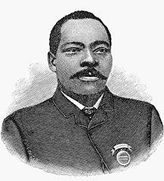
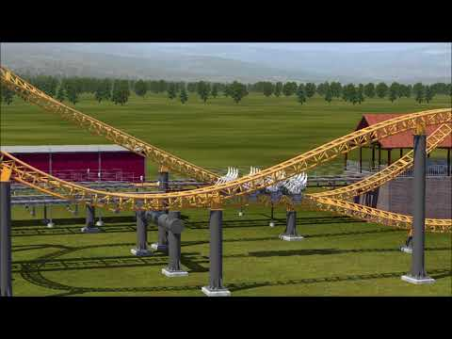
Granville T. Woods
Granville T Woods is a notable inventor.
He invented the figure eight
roller coaster! He used the
same technology to help keep
subways moving!
Notes:
Teacher notes:
Click the image from the slide of a Figure eight roller coaster - link is also below https://www.youtube.com/watch?v=g7PCSiVdFME&ab_channel=CoastingtheCountry

Slide 59
The Life of Granville T. Woods
Watch this video:
Notes:
Teacher notes:
Watch this brief video about the life of Granville T. Woods
Video link: https://www.youtube.com/watch?v=rfQhfJXtc64&t=1s&ab_channel=TheWiseChannel

Slide 60
The Life of Granville T. Woods
Watch this video:
Notes:
Teacher notes:
Watch this brief video about Granville T. Woods and his invention of the figure eight roller coaster
Video link: https://www.youtube.com/watch?v=M4LJ1-R7WOM&t=1s&ab_channel=LaurelCable

Slide 61
Notable Facts
1880
1887
1878
1910
1876
1856
Notes:
Teacher notes:
This slide is best used in present mode - click on the hands under each year to learn more facts about Granville T. Woods’ life.

Slide 62
1856
Born in Columbus, Ohio, on April 23, 1856, Woods received little schooling as a young man and, in his early teens, took up a variety of jobs, including as a railroad engineer in a railroad machine shop, as an engineer on a British ship, in a steel mill, and as a railroad worker.
Notes:
Biography of Granville T Woods from Biography.com

Slide 63
1876
From 1876 to 1878, Woods lived in New York City, taking courses in engineering and electricity — a subject that he realized, early on, held the key to the future.

Slide 64
1878
Back in Ohio in the summer of 1878, Woods was employed for eight months by the Springfield, Jackson and Pomeroy Railroad Company to work at the pumping stations and the shifting of cars in the city of Washington Court House, Ohio. He was then employed by the Dayton and Southeastern Railway Company as an engineer for 13 months. During this period, while traveling between Washington Court House and Dayton, Woods began to form ideas for what would later be credited as his most important invention: the "inductor telegraph." He worked in the area until the spring of 1880 and then moved to Cincinnati.

Slide 65
1880
Living in Cincinnati, Woods eventually set up his own company to develop, manufacture and sell electrical apparatus, and in 1889, he filed his first patent for an improved steam boiler furnace. His later patents were mainly for electrical devices, including his second invention, an improved telephone transmitter. The patent for his device, which combined the telephone and telegraph, was bought by Alexander Graham Bell, and the payment freed Woods to devote himself to his own research. One of his most important inventions was the "troller," a grooved metal wheel that allowed street cars (later known as "trolleys") to collect electric power from overhead wires.

Slide 66
1887
Woods's most important invention was the multiplex telegraph, also known as the "induction telegraph," or block system, in 1887. The device allowed men to communicate by voice over telegraph wires, ultimately helping to speed up important communications and, subsequently, preventing crucial errors such as train accidents. Woods defeated Edison's lawsuit that challenged his patent, and turned down Edison's offer to make him a partner. Thereafter, Woods was often known as "Black Edison." After receiving the patent for the multiplex telegraph, Woods reorganized his Cincinnati company as the Woods Electric Co. In 1890, he moved his own research operations to New York City, where he was joined by a brother, Lyates Woods, who also had several inventions of his own. Woods's next most important invention was the power pick-up device in 1901, which is the basis of the so-called "third rail" currently used by electric-powered transit systems. From 1902 to 1905, he received patents for an improved air-brake system.

Slide 67
1910
Following the Great Blizzard of 1888, New York City Mayor Hugh J. Grant declared that all wires, many of which powered the above ground rail system, had to be removed and buried, emphasizing the need for an underground system. Woods' patent built upon previous third rail systems which were used for light rails and increased the power for use on underground trains. His system relied on wire brushes to make connections with metallic terminal heads without exposing wires by installing electrical contactor rails. Once the train car had passed over, the wires were no longer live reducing the risk of injury. It was successfully tested in February 1892 in Coney Island on the Figure Eight Roller Coaster. By the time of his death, on January 30, 1910, in New York City, Woods had invented 15 appliances for electric railways. received nearly 60 patents, many of which were assigned to the major manufacturers of electrical equipment that are a part of today's daily life.
NEXT
Notes:
Biography from Biography.com & Wikipedia

Slide 68
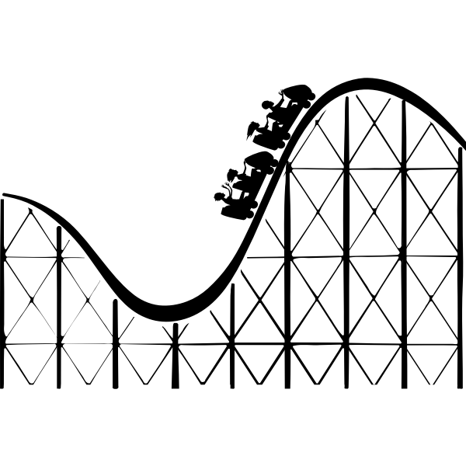
Roller Coasters
Like Granville T Woods, you are going to build a roller coaster! The next several days you will complete a cycle of planning, designing, timing runs, reiterating, and timing runs again!
Let’s start with planning!
Notes:
Teacher notes:
In this lesson, students will learn about paper roller coasters and plan how to build one!

Slide 69
Roller Coasters
Roller coasters can include the following items:
A
Straight Tracks
D
Columns
B
Braces
E
Beams
C
Loops
F
Curves
G
Funnels
Notes:
Teacher notes:
students will build a paper roller coaster. The following slides details how to use the provided templates and gives examples.

Slide 70
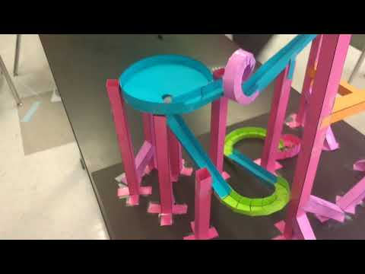
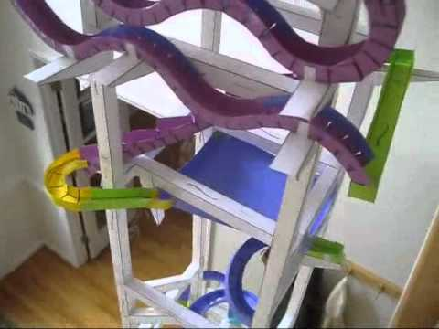
Roller Coasters - Examples
Watch these videos:
Notes:
Teacher notes:
students will watch these two videos for lots of examples of paper roller coasters
Left video: https://www.youtube.com/watch?v=cDgJB0VtJMI&t=2s&ab_channel=topsailscience
Right video: https://www.youtube.com/watch?v=UByZhF7siLo&t=1s&ab_channel=AndrewGatt

Slide 71
ACTIVITY
PLAN
Complete a drawing of your plan for your roller coaster!
Notes:
Teacher notes:
students will draw a plan for their paper roller coaster - this can be very informal as more requirements will be shared in tomorrow’s lesson

Slide 72
EXIT TICKET
Don’t forget to complete your daily learning log!!
Submission
Submit your plan for the roller coaster design
Notes:
Teacher notes:
discuss as a class and/or have students keep a learning journal throughout this initiative
Remind students to complete Daily Learning Log

Slide 73
Days 6+
ROLLER COASTERS
Notes:
Unleashed Day 6+:
In this lesson, students will plan, design, and build a paper roller coaster. Students can work independently or in a group. Students can submit completed roller coasters (including designs) to the BreakFree contest.
Roller Coasters
Plan - give templates & examples (from Roller Coaster slide deck) - themes??
Build
Record
Reiterate
Record
Submit

Slide 74
DO NOW
Plan:
Improve your roller coaster design
Notes:
Teacher notes:
Have students begin class by improving their roller coaster plan/design

Slide 75
OBJECTIVE
Students will
Apply the knowledge gained to build a roller coaster
Notes:
Teacher notes:
Review the objectives for the day, so students know what is expected of their learning

Slide 76
AGENDA
Do Now
Introduction of Contest
Activity: Build a Roller Coaster
Exit Ticket
Notes:
Teacher notes:
Review the agenda for the day

Slide 77
Let’s get started...
So far, you have learned about...
Motion
Speed
Forces
Friction
Notes:
Teacher notes:
Introduce the activity to students and show examples on the next few slides.

Slide 78
Build
The local amusement park has issued a challenge to designers to create an exciting roller coaster that meets the following criteria while spending as little “money” as possible.
height between 30 cm and 100 cm
track length must be at least 150cm
at least one minute in run length
at least one loop & six turns
something at the end to catch the marble
theme/decorations
Don’t forget to log your run trials on your build sheet!
Notes:
Teacher notes:
students will build a paper roller coaster. Ensure that each student or group of students completes a build sheet to ensure they are meeting all requirements of the build. The build sheet will be submitted to the contest along with a video and/or pictures of the roller coaster.
Print the build sheet (linked here as a pdf; linked here as a google doc) so students can complete it as they build.
You can also print the roller coaster instructions & enough templates for each student and/or group to have them (hint: print each template on a unique color if possible to make it easier to know which template is what when building - for example, straight track is pink, loops are blue, etc).

Slide 79
Cost
Each item in the roller coaster costs “money”. Your challenge is to build an exciting and reliable roller coaster while spending as little money as possible**!
Column $0.50 | Sharp Curve $1.25
Beam $0.50 | Wide Curve $1.25
Support $0.10 | Funnel $2.50
Bracket $0.05 | Loop $1.50
Straight Track $1.00 | Theme $1.50
Don’t forget to log your run trials on your build sheet!
**The money mentioned is completely fictional. No money is required to build and/or submit this roller coaster to the contest.
Notes:
Teacher notes:
students will build a paper roller coaster. Ensure that each student or group of students completes a build sheet to ensure they are meeting all requirements of the build. The build sheet will be submitted to the contest along with a video and/or pictures of the roller coaster.

Slide 80
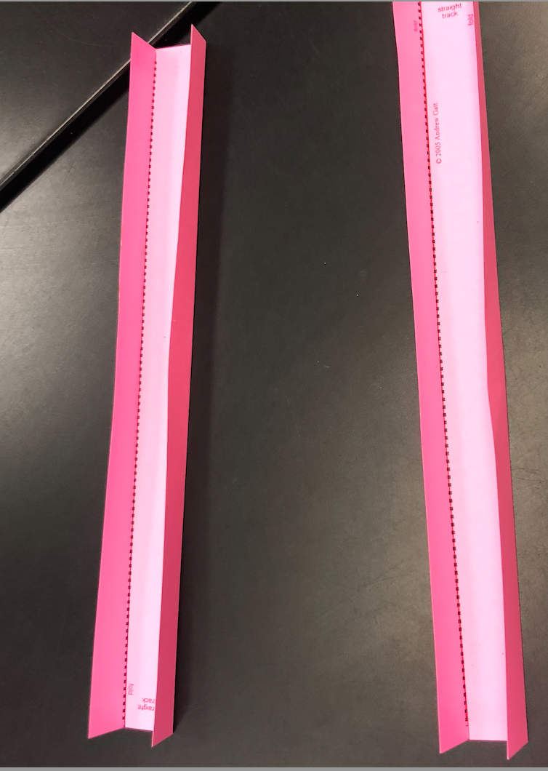
Straight Track
Notes:
Teacher notes:
Show students these examples to help them visualize their roller coaster

Slide 81
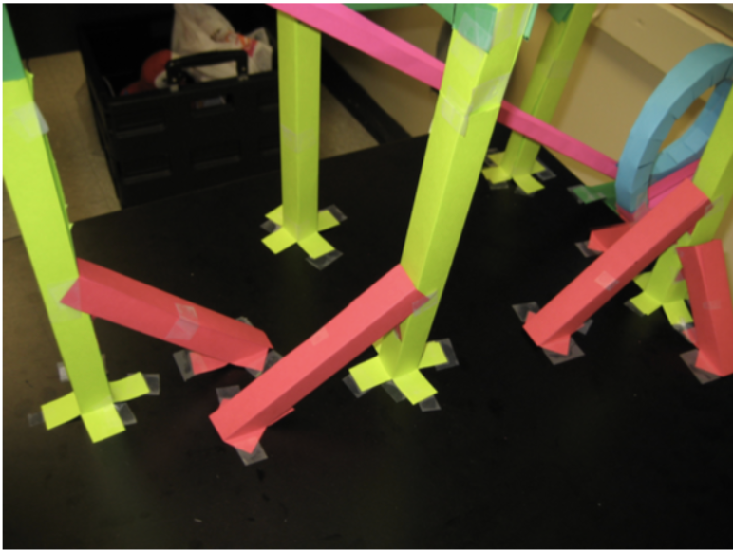
Supports
Notes:
Teacher notes:
Show students these examples to help them visualize their roller coaster

Slide 82
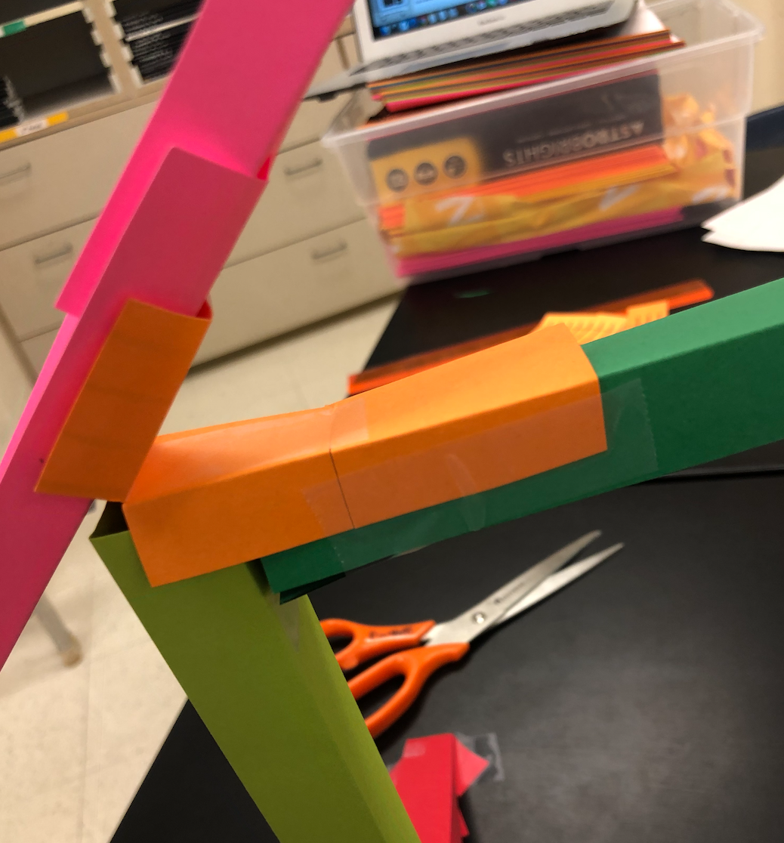
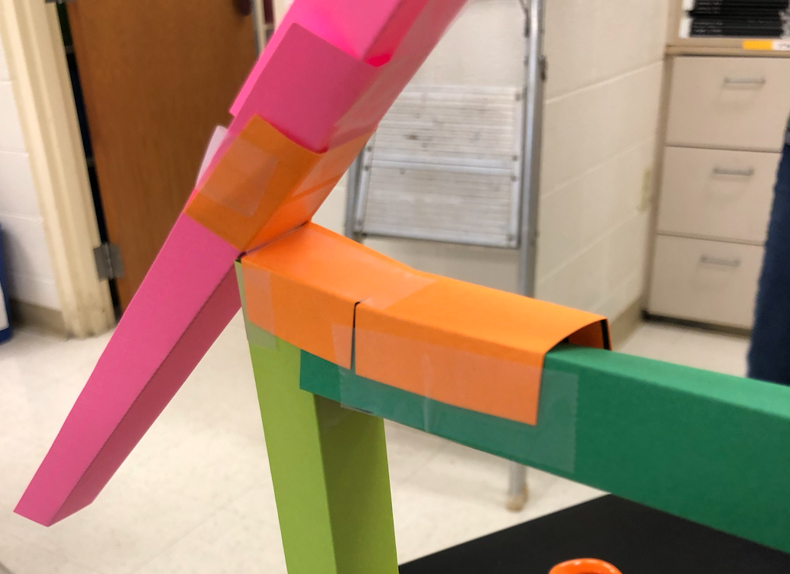
Brackets
Notes:
Teacher notes:
Show students these examples to help them visualize their roller coaster

Slide 83
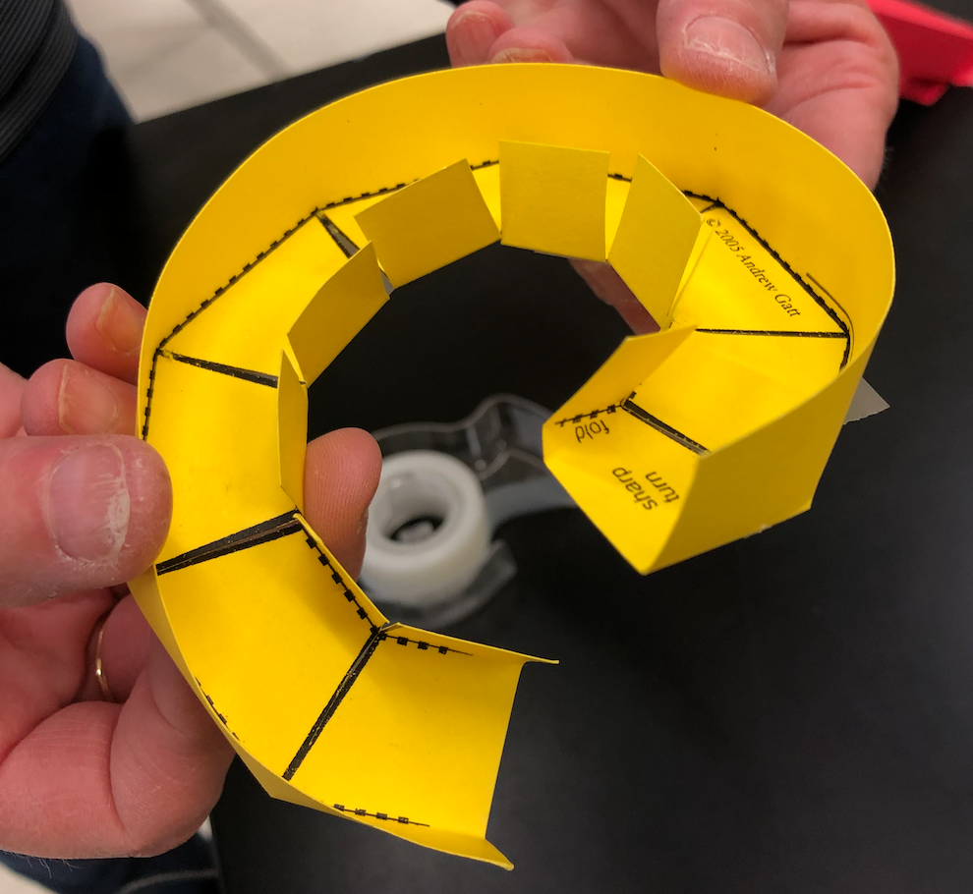
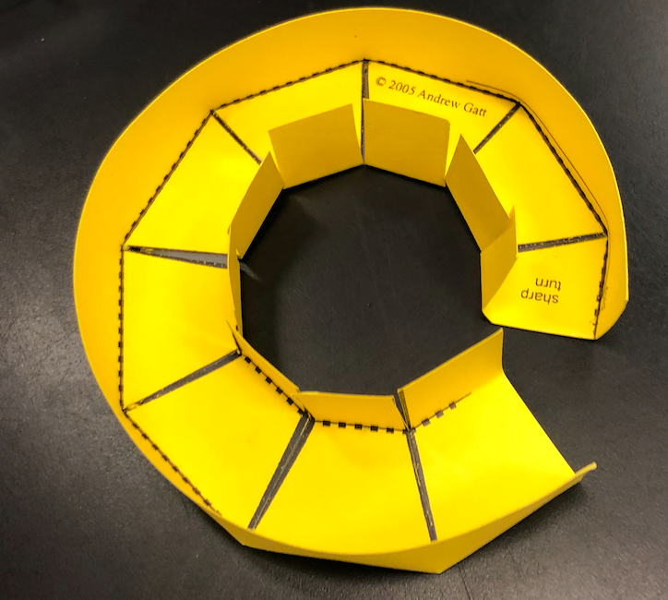
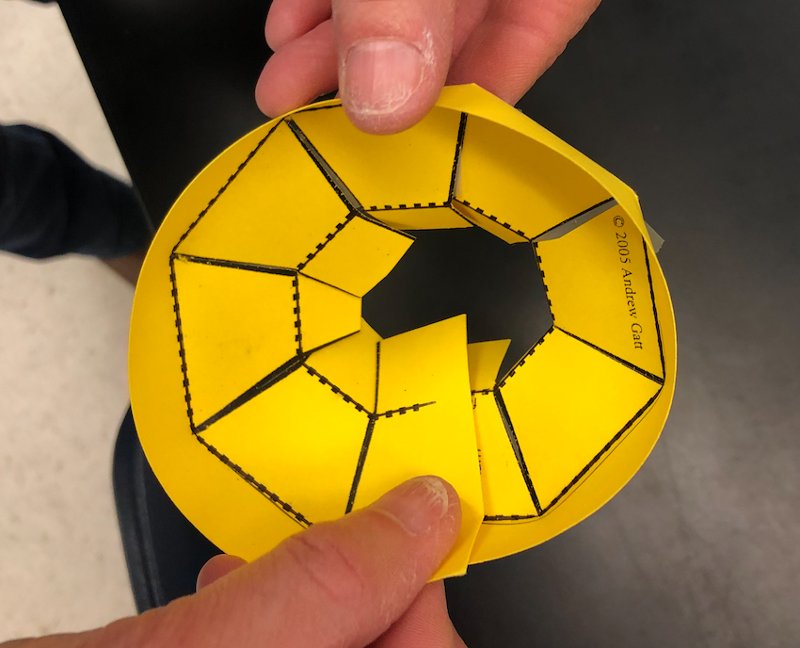
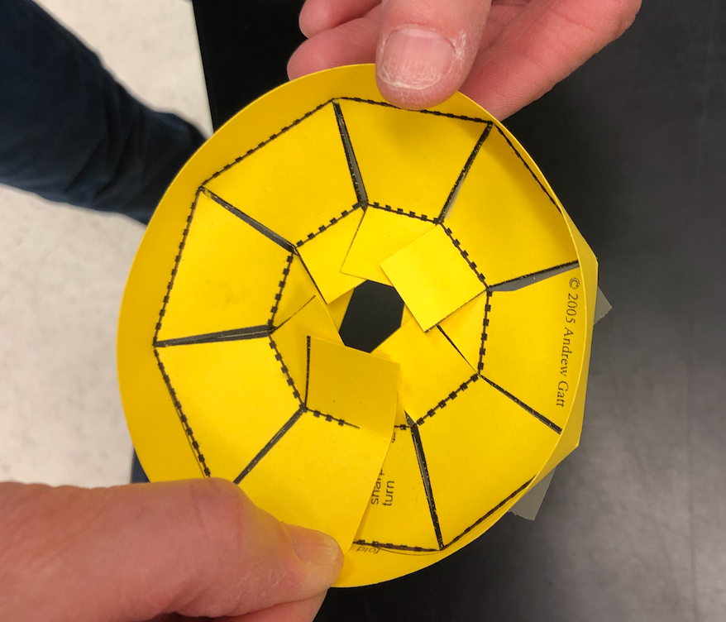
Curves/Funnels
Notes:
Teacher notes:
Show students these examples to help them visualize their roller coaster

Slide 84
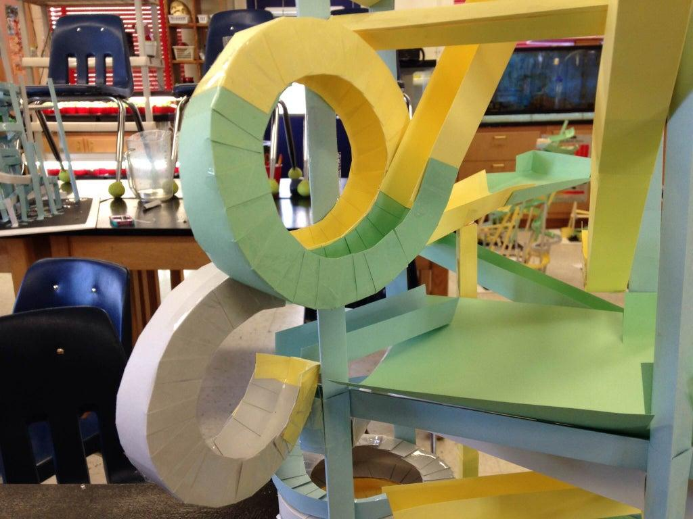
Loops
Notes:
Teacher notes:
Show students these examples to help them visualize their roller coaster

Slide 85
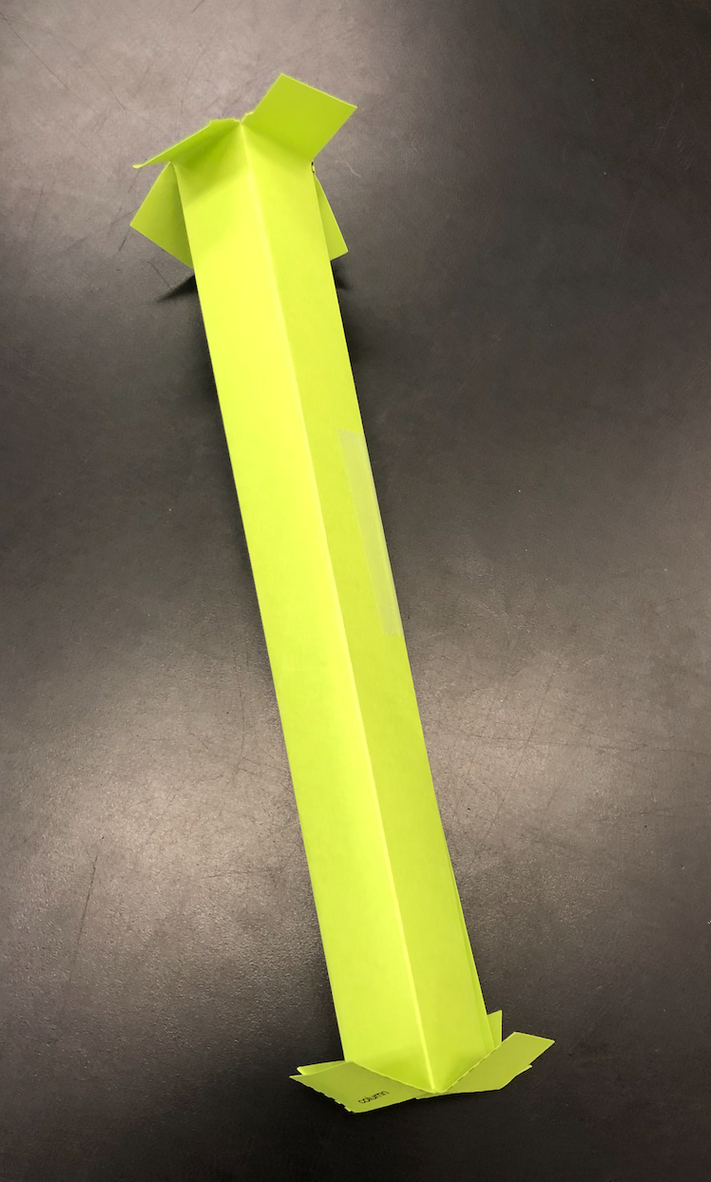
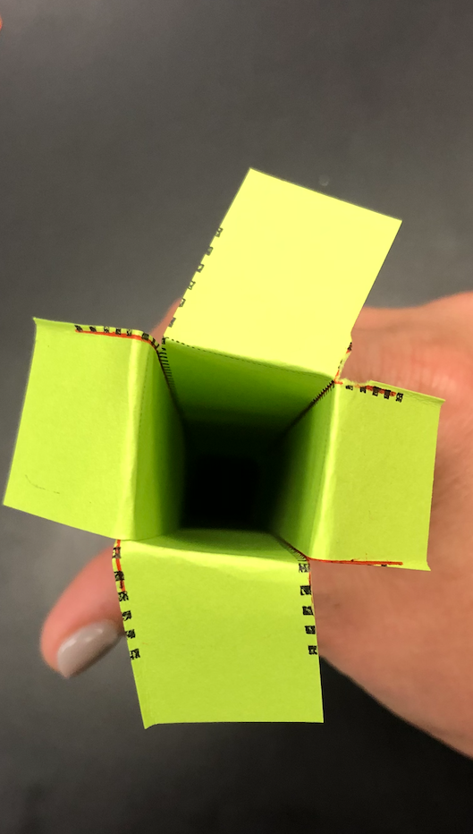
Columns
Notes:
Teacher notes:
Show students these examples to help them visualize their roller coaster

Slide 86
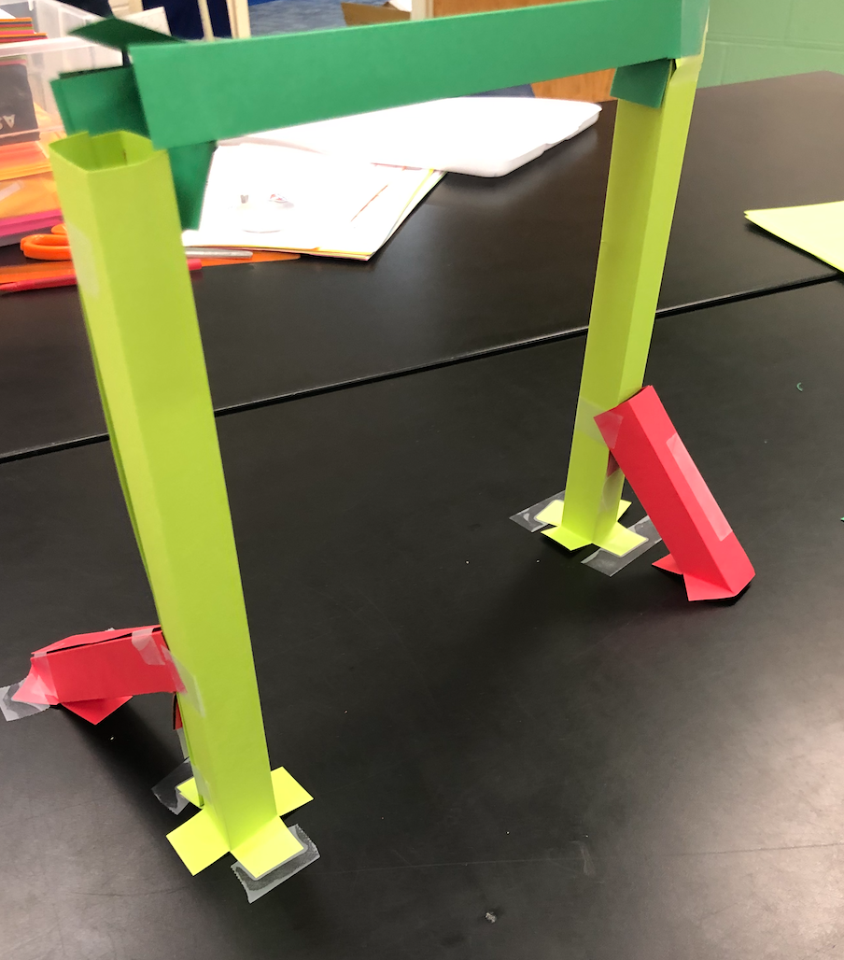
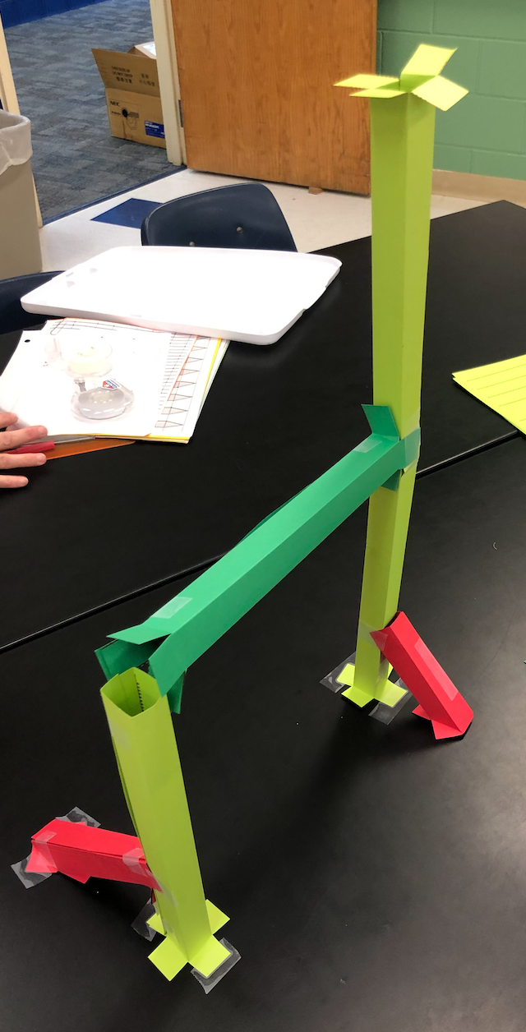
Beams
Notes:
Teacher notes:
Show students these examples to help them visualize their roller coaster

Slide 87
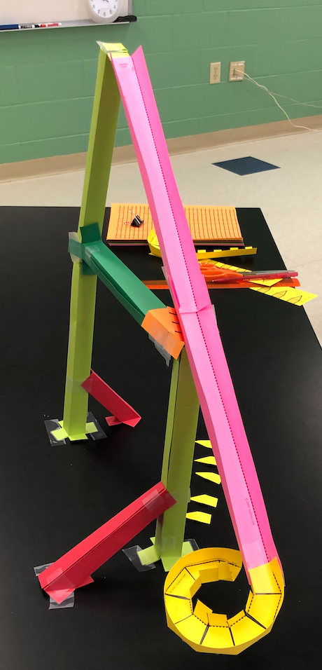
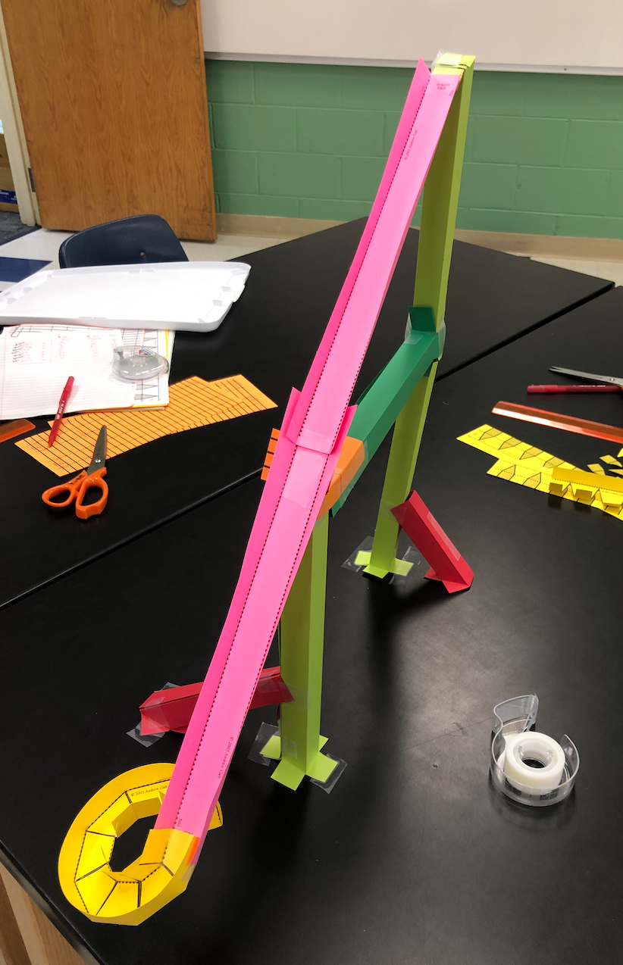
Simple Examples
Notes:
Teacher notes:
Show students these examples to help them visualize their roller coaster

Slide 88
Roller Coasters - Examples
Watch these videos again and see if you notice the different sections of the roller coasters:
Notes:
Teacher notes:
students will watch these two videos for lots of examples of paper roller coasters

Slide 89
EXIT TICKET
Don’t forget to complete your daily learning log!!
Question
Submit your roller coaster to the BreakFree contest!
Notes:
Teacher notes:
Submit your student’s roller coaster to the BreakFree contest.
Remind students to complete Daily Learning Log

Slide 90
UNLEASHED

