Slide 1



UNEXPLORED

Slide 2

Day 1
Bone Density

Slide 3
DO NOW
Question:
What is life like in Space?
Notes:
Teacher notes:
Have students write down their answers and/or share out as a class

Slide 4
OBJECTIVES
Students will be able to:
explore slope and the effects of a change of slope
recognize slope and y-intercept from key words
identify the y-intercept and interpret its meaning in a real world situation
write linear equations in slope-intercept form
calculate values using percents and proportional relationships
solve linear equations
create tables from words
Notes:
Teacher notes:
Review the objectives for the day, so students know what is expected of their learning

Slide 5
AGENDA
Discuss the Do Now
Mini-lesson: Review slope y-intercept
Mini-lesson: Bone Density in Space
Activity: Exploring Space through Math
Exit ticket
Notes:
Teacher notes:
Review the agenda for the day

Slide 6
Introduction
Through Unexplored, students will delve into the math behind NASA and space travel. Students will explore slope and y-intercept and solve linear equations while investigating the risk of bone density loss and oxygen limitations for astronauts. The initiative will culminate with students designing key elements to a successful spacesuit.
Don’t forget, there’s a competition too!
Notes:
Explain to students that by the end of this unit, they will be asked to create a space suit helmet from cardboard. Anytime something sparks their imagination, they should make a note of it. Explain BreakFree’s monthly contest and pass out the Note to Students.

Slide 7


LESSON: Slope & Y-Intercept
Before we soar into our study of space, let’s remember how to find the slope y-intercept of an equation!
Slope is a number that measures the steepness and direction of the line. It's the ratio of the vertical change of the graph to the horizontal change. We often refer to slope as "rise over run." For example, if the slope of a line is 1/2, that means it goes up 1 unit for every 2 units that it goes over.
Vertical Change
Horizontal Change
Rise
Run
Slope =
=
Notes:
Teacher notes
Read the information on the slide to learn more about slope y-intercept.
Content source

Slide 8
LESSON: Slope & Y-Intercept
The slope of a line also tells us the direction of the line. We can tell if the line goes up to the right, down to the right, or if it's horizontal or vertical.
Types of Slope
Positive
Negative
Zero
Undefined
Notes:
Teacher notes
Read the information on the slide to learn more about slope y-intercept.
Content source

Slide 9
LESSON: Slope & Y-Intercept
What’s an intercept?
There are two axes on the coordinate plane: the x-axis and the y-axis. When a line crosses one of these axes, the point where it crosses is called an intercept. In slope-intercept form, the equation of the line uses the y-intercept. This is where the line crosses the y-axis. Remember, the y-axis is the vertical axis that goes up and down. The y-intercept is the point where the line and y-axis meet.
y-axis
y-intercept
x-axis
Notes:
Teacher notes
Read the information on the slide to learn more about slope y-intercept.
Content source

Slide 10
LESSON: Slope & Y-Intercept
There are a few different ways to write the equation of a line. One of the most common ways is called "slope-intercept" form. It's called this because it clearly identifies the slope and the y-intercept in the equation. The slope is the number written before the x. The y-intercept is the constant written at the end.
Slope-Intercept Form
y = mx + b
slope
y-intercept
Notes:
Teacher notes
Read the information on the slide to learn more about slope y-intercept.
Content source

Slide 11
LESSON: Slope & Y-Intercept
When an equation of a line is written in slope-intercept form, the number in front of the x represents the slope. In this equation, there is a 3 in front of the x. This means the slope of the line is 3. The constant written at the end represents the y-intercept.There is a positive 2 at the end.This means the y-intercept is 2. If you're asked to write the y-intercept as an ordered pair, it would be the point (0,2). Remember, the y-intercept is where the graph crosses the y-axis. The x-coordinate of every point on the y-axis is always 0 so the y-intercept is always (0,b).
y = 3x + 2
slope
y-intercept
Notes:
Teacher notes
Read the information on the slide to learn more about slope y-intercept.
Content source

Slide 12
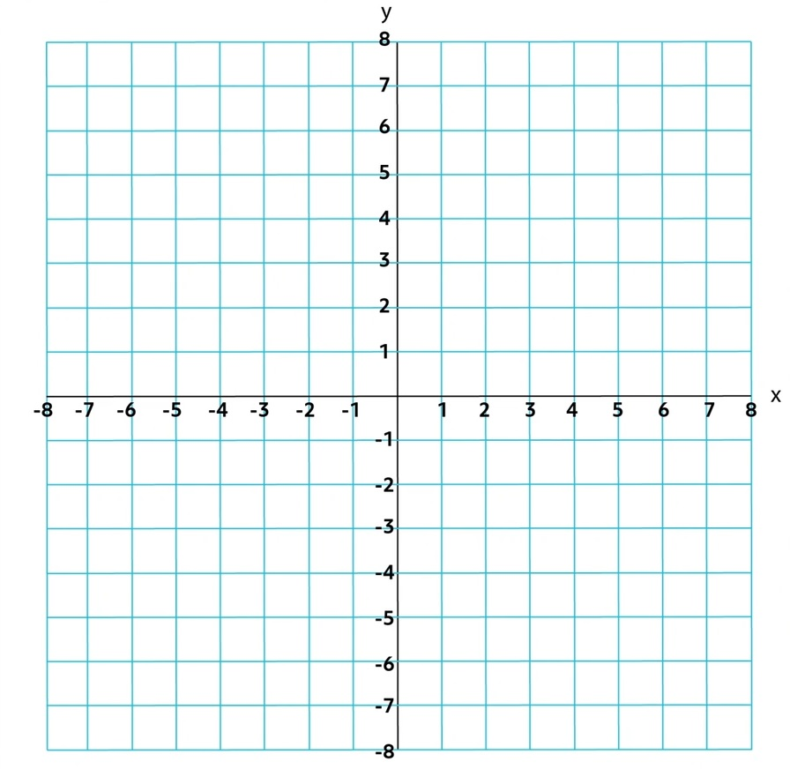
LESSON: Slope & Y-Intercept
Let's also look at the graph of this line. The y-intercept is 2. This means it crosses the y-axis 2 units up from the origin. We also know the slope is positive 3. Whenever the slope is positive, the line will go up to the right. 3 is the same as 3/1 so this means it goes up 3 units and over to the right 1 unit (remember, slope is rise/run).
Graph of y = 3x + 2
3
Slope = 3 =
1
Y-intercept = 2
Notes:
Teacher notes
Read the information on the slide to learn more about slope y-intercept.
Content source

Slide 13
LESSON: Slope & Y-Intercept
When an equation is in slope-intercept form, the slope is the number in front of the x. This means the slope is 1/4. A line with a slope of 1/4 will go up 1 and over to the right 4. The y-intercept is the constant at the end. Pay close attention to the sign of the y-intercept. This equation has a minus sign, so the y-intercept is -1. This means the line crosses the y-axis at the point (0,-1).
1
y = x - 1
4
slope
y-intercept
Notes:
Teacher notes
Read the information on the slide to learn more about slope y-intercept.
Content source

Slide 14
LESSON: Slope & Y-Intercept
1
It's pretty straightforward to graph this line. The y-intercept is -1, so it crosses one unit down from the origin. The slope is a positive 1/4, so it will go up 1 unit and over 4 units to the right.
Graph of y = x -1
4
1
Slope =
4
Y-intercept = -1
Notes:
Teacher notes
Read the information on the slide to learn more about slope y-intercept.
Content source

Slide 15

LESSON: Slope & Y-Intercept
Watch this video to learn more about finding the slope and y-intercept of an equation.
Notes:
Teacher notes
Watch the video on the slide to learn more about the ISS. You can access more (optional) information by clicking here.

Slide 16

LESSON: Bone Density
Watch this video to learn more about what life is like living in space.
Did You Know? There are currently seven crew members from different countries living on the International Space Station (ISS)?
Notes:
Teacher notes
Watch the video on the slide to learn more about the ISS. You can access more (optional) information by clicking here.

Slide 17
LESSON: Bone Density
The Space Shuttle Mission Control Center and the International Space Station (ISS) Control Center use some of the most sophisticated technology and communication equipment in the world. Teams of highly qualified engineers, scientists, doctors, and technicians, known as flight controllers, monitor the systems and activities aboard the space shuttle and the ISS. They work together as a powerful team, spending many hours performing critical simulations as they prepare to support each mission and crew during normal operations and any unexpected events.
One of the flight control positions is the flight surgeon, whose call sign is SURGEON. The flight surgeon is a medical doctor who monitors and maintains the astronauts’ health during all phases of a particular mission, including spacewalks. The flight surgeon also monitors the astronauts’ scheduled activities, coordinates the medical operations team, provides crew health consultations during the mission, and advises the Flight Director of the crew’s health.
Notes:
Teacher notes
Read the information on the slide to learn more about the ISS.

Slide 18
LESSON: Bone Density
Because spaceflight is physically challenging, the flight surgeon will assess the astronaut’s health before a flight, also known as preflight, to determine if the crew member is healthy. During the preflight phase of a mission, the flight surgeon will perform a physical examination of the astronaut. He or she will use pre-existing data to determine the astronaut’s preflight condition and to predict how the astronaut’s body will react in a reduced gravity environment.
One specific area of concern is bone density, which is a measure of how strong the bone is.
Notes:
Teacher notes
Read the information on the slide to learn more about bone density.

Slide 19
LESSON: Bone Density
On Earth, you experience the force of gravity. It is what keeps you from floating off into Earth’s atmosphere. Have you ever seen pictures or videos of astronauts floating around in their spacecrafts? This is called weightlessness. Astronauts float because the force of gravity is not very strong in space. This small amount of gravity is called microgravity. This is what damages astronauts’ bones.
Why does this happen? To understand, let’s look at how bones are formed and maintained in your body.
Did You Know? The term space is short for outer space. You already live in space!
Notes:
Teacher notes
Read the information on the slide to learn more about bone density.
Content source

Slide 20
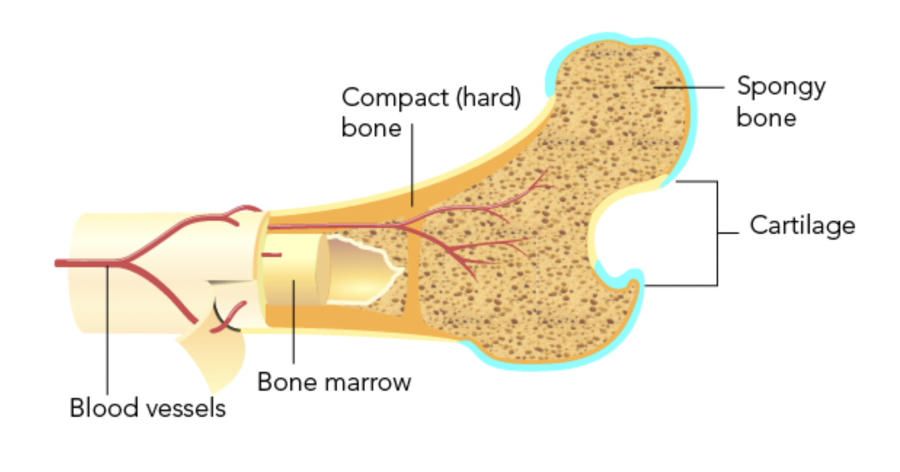
LESSON: Bone Density
Bones are a type of connective tissue that helps hold the parts of your body together. Bones are made up of bone tissue. Your bone tissue is very similar to your hair. One difference is that bone tissue also has minerals like calcium. Minerals give your bone tissue strength.
Notes:
Teacher notes
Read the information on the slide to learn more about bone density.
image by Pbroks13 [CC BY 3.0] via Wikimedia Commons)
Content source

Slide 21
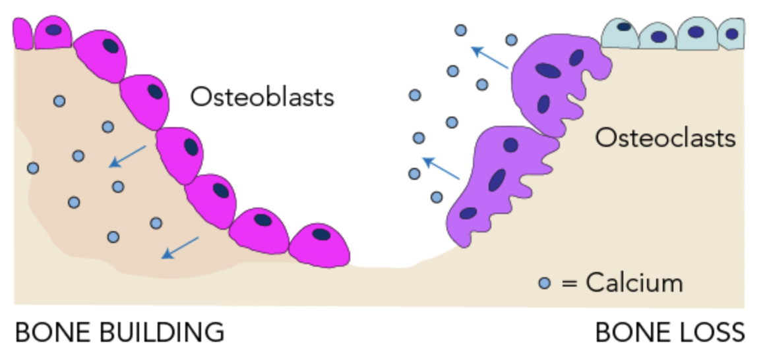
LESSON: Bone Density
As you grow, your bones are constantly being broken down and rebuilt. This process is called remodelling. There are two main types of cells that are important for bone structure and maintenance. They have fancy names and do opposite things.
Osteoblasts (os-tee-oh-blasts) build bones using the same kinds of cells that build fat, muscle, and cartilage.
Osteoclasts (os-tee-oh-clasts) break up bones. They use the same cells as the immune system. These cells help osteoclasts dissolve the minerals on the outside the bone tissue. This releases calcium into the body in a process called resorption.
Notes:
Teacher notes
Read the information on the slide to learn more about bone density.
image by Shandristhe azylean [CC BY-SA 3.0] via Wikimedia Commons
Content source

Slide 22
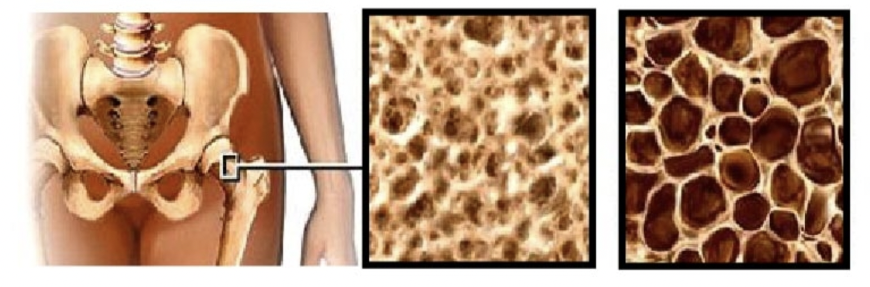
LESSON: Bone Density
What happens to bones in space?
Problems with remodelling can lead to bone diseases like osteoporosis. Remember how your bones are always being broken and built? People with osteoporosis have more bone loss than bone building. This causes the bones to weaken, which can make break easily.
Astronauts experience spaceflight osteopenia when they are in space. This condition can cause astronauts to lose bone mass in their legs, hips, and spines. Once the astronauts return to Earth, it can take three or four years for those bones to recover!
Notes:
Teacher notes
Read the information on the slide to learn more about bone density.
Source: cropped image by Partynia [CC BY-SA 4.0] via Wikimedia Commons)
Content source

Slide 23
LESSON: Bone Density
Scientists have learned that spending time in microgravity decreases bone building. This results in bone loss similar to osteoporosis. Remember, astronauts experience microgravity when they are in space. In microgravity, there is not as much stress on astronauts’ bones. That is mostly because they do not have to walk around. By having less stress on their bones, astronauts’ bones can become weaker.
Scientists know that exercise is important for your bones. Exercise helps keep a healthy balance of bone building and bone loss. The best exercise for your bones on Earth is called load-bearing exercise. Walking, running, and playing sports like basketball are examples. Microgravity makes it hard to exercise in space. Astronauts must strap themselves down to treadmills in order to walk or run!
Notes:
Teacher notes
Read the information on the slide to learn more about bone density.
Content source

Slide 24
LESSON: Bone Density
Bone density is measured by the amount of mineral in a skeletal area, and this measurement is called Bone Mineral Density (BMD). BMD is measured with an instrument called a Dual-energy X-ray Absorptiometry densitometer (DXA), which uses x-rays to transmit photons through the body. DXA detects the different energies of the photons as they are absorbed differently by hard vs. soft tissue. These energy levels are used to determine the BMD of hard bone tissue. Different groups of people lose BMD more rapidly than others. On Earth the rate of bone loss for elderly men and women ranges from 1% to 1.5% per year, whereas the rate of bone loss for an early postmenopausal woman could be 2-3% per year. A person may also lose BMD more rapidly at one site, e.g. the spine, than at another site in the body.
Notes:
Teacher notes
Read the information on the slide to learn more about bone density.

Slide 25
LESSON: Bone Density
Bone loss increases when the human body is in a reduced gravity environment. Astronauts on the ISS, or on a future long-duration mission, may lose an average of 1% BMD per month while in space. An astronaut’s bones may weaken in a way similar to osteoporosis. Osteoporosis is a condition in which bones have lost minerals, especially calcium, making them weaker, more brittle, and susceptible to fractures. The risk of fracture for an astronaut may increase after the astronaut returns to Earth’s gravitational pull of 1g. The flight surgeon must continue to monitor the astronauts once back on Earth to make sure their BMD is regained through proper diet and exercise.
Notes:
Teacher notes
Read the information on the slide to learn more about bone density.

Slide 26
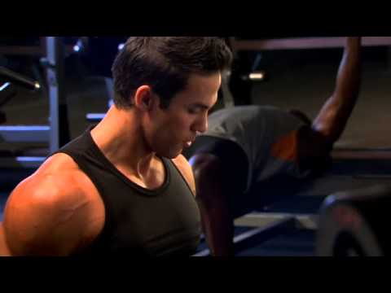
LESSON: Bone Density
Watch this video to learn more about bone density.
Notes:
Teacher notes
Watch the video on the slide to learn more about bone density.

Slide 27
CHECK for UNDERSTANDING
Name possible side effects on astronauts while in the reduced gravity of a long mission?
What is the name of the treadmill on the ISS, and what type of exercise does it provide?
What is essential for astronauts on long-duration missions in space to maintain healthy bones, muscles, and heart?
What type of exercise involves lifting or moving a mass?
Compare the time it could take for a 50 year old woman to lose 2% of bone mass in her hip with the time it could take an astronaut in space to lose the same amount.
What device on the ISS simulates weight-bearing exercise?
What types of activities help keep the astronaut’s heart and circulatory system healthy?
What type of exercise in space can help the astronaut avoid bone loss?
Notes:
Teacher notes
Discuss the questions on the slide from the previous video to ensure students understand the lesson on bone density (answers are below).
Answers:
Name some possible negative effects on astronauts while in the reduced gravity of a long duration mission?
Bone loss, loss of muscle mass and strength, radiation, stress.
What is essential for astronauts on long-duration missions in space to maintain healthy bones, muscles, and heart?
Exercise.
Compare the time it could take for a 50 year old woman to lose 2% of bone mass in her hip with the time it could take an astronaut in space to lose the same amount.
The woman on Earth could lose 2% in one year, while the astronaut in space could lose 2% in one month.
What types of activities help keep the astronaut’s heart and circulatory system healthy?
Running and cycling.
What is the name of the treadmill on the ISS, and what type of exercise does it provide?
COLBERT (treadmill), aerobic exercise.
What type of exercise involves lifting or moving a mass?
Resistive exercise.
What device on the ISS simulates weight-bearing exercise?
Advanced Resistive Exercise Device (ARED).
What type of exercise in space can help the astronaut avoid bone loss?
Resistive or weight- bearing exercise.

Slide 28
ACTIVITY: Exploring Space through Math
Put your knowledge into practice using the worksheet!
In the reduced gravity environment of the International Space Station (ISS), the average Bone Mineral Density (BMD) loss is approximately 1% per month compared to the average loss of approximately 1% per year on Earth. Researchers would treat this loss of BMD as a constant loss per month. The BMD would be measured preflight and then again at the end of 6 months. The difference between the two measures would be divided by 6 to get the average amount of bone loss per month. To get an average rate of loss, divide the amount of bone loss in a month by the initial BMD. This ratio may be expressed as a fraction, decimal, or percent. This number as a percent is the average percentage of loss each month. The unit of measure that is used for BMD is mg/cm2.
Notes:
Teacher notes
Print and pass out this worksheet for students to complete in small groups or individually.
Access the answer sheet for the problems by clicking here.

Slide 29
EXIT TICKET
Don’t forget to complete your daily learning log!!
Would you live in space?
Notes:
Teacher notes:
Have students answer this question on paper or discuss as a class.
Remind students to complete Daily Learning Log.

Slide 30
Day 2
Exercising in Space

Slide 31
DO NOW
Question:
Can Astronauts run in space?
Notes:
Teacher notes:
Have students write down their answers and/or share out as a class

Slide 32
OBJECTIVES
Students will be able to:
identify direct variation from ordered pairs by calculating the constant of variation
calculate slope from two points using the slope formula
determine independent and dependent variables
solve linear equations
create tables
Notes:
Teacher notes:
Review the objectives for the day, so students know what is expected of their learning

Slide 33
AGENDA
Discuss the Do Now
Mini-lesson: Exercising in Space
Activity: Exploring Space through Math
Exit ticket
Notes:
Teacher notes:
Review the agenda for the day

Slide 34
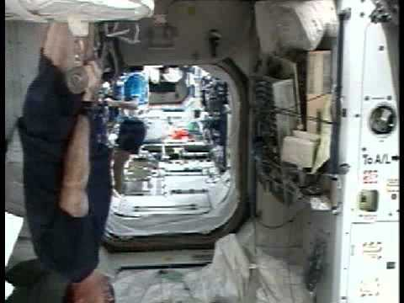
LESSON: Exercising in Space
Watch this video to learn more about what exercising in space is like.
Notes:
Teacher notes
Watch the video on the slide to learn more about exercising in space.

Slide 35
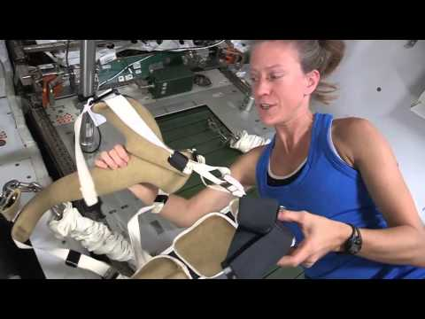
LESSON: Exercising in Space
But, can you run in space?
Did You Know? Sunita Williams ran the Boston Marathon in while in space!
Notes:
Teacher notes
Watch the video on the slide to learn more about exercising in space.

Slide 36
LESSON: Exercising in Space
The Space Shuttle Mission Control Center (MCC) and the International Space Station (ISS) Control Center use some of the most sophisticated technology and communication equipment in the world. Teams of highly qualified engineers, scientists, doctors, and technicians, known as flight controllers, monitor the systems and activities aboard the space shuttle and the ISS. They work together as a powerful team, spending many hours performing critical simulations as they prepare to support each mission and crew during normal operations and any unexpected events.
The Biomedical Engineer (BME) flight controller is part of the medical operations team in the MCC. The BME supports the Flight Surgeon and is the medical hardware expert. On the ISS that hardware includes the Crew Health Care System and its subsystems: the Health Maintenance System, the Environmental Health System, and the Countermeasure System.
Notes:
Teacher notes
Read the information on the slide to learn more about exercising in space.

Slide 37
LESSON: Exercising in Space
Astronauts orbiting Earth aboard the space shuttle or the ISS do not feel the effects of gravity as we do on Earth. In this reduced gravity state, it is easier to accomplish routine activities and requires little use of muscles. Since minimal to no exercise would result in muscle deterioration and bone density loss, astronauts are prescribed exercise routines by exercise and rehabilitation specialists and medical doctors. Astronauts are scheduled to exercise approximately 2 hours per day while on the ISS. Exercise is an example of what is called a “countermeasure”. It is used to prevent or counter the physical symptoms that might otherwise occur. Exercise is an essential part of every astronaut’s health maintenance.
Notes:
Teacher notes
Read the information on the slide to learn more about exercising in space.

Slide 38
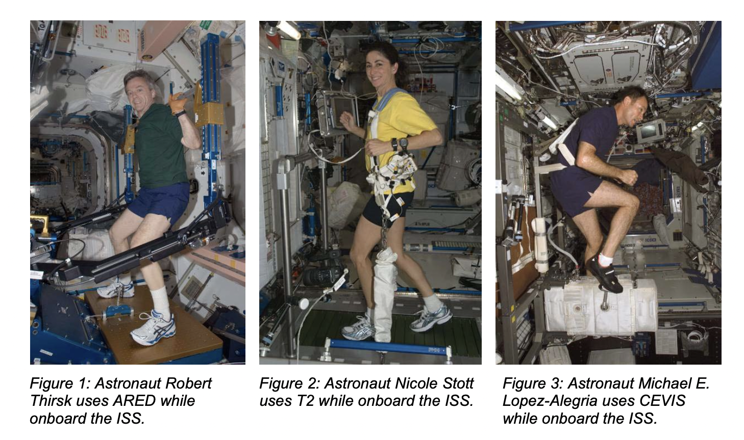
LESSON: Exercising in Space
Numerous types of exercise equipment have been used in reduced gravity to evaluate and maintain astronaut fitness. Currently, astronauts use the Advanced Resistive Exercise Device (ARED) on the ISS to perform resistance exercises (Figure 1). Treadmill 2 (T2), also known as COLBERT, is a second generation treadmill that is used as one of the
countermeasures to help prevent bone loss on long duration missions aboard the ISS (Figure 2). Like its predecessor, Treadmill with Vibration Isolation and Stabilization (TVIS), T2 is suspended and contained within an opening in the floor to minimize the forces of exercise being transferred to the structure of the ISS.
Notes:
Teacher notes
Read the information on the slide to learn more about exercising in space.
Source: NASA

Slide 39
LESSON: Exercising in Space
The Cycle Ergometer with Vibration Isolation Stabilization (CEVIS) is similar to a stationary mechanical bicycle and is connected to the ISS with wire tethers. It also sits on a vibration isolation system which reduces impacts to the structure of the ISS (Figure 3). Astronauts snap their shoes onto the pedals and use a seatbelt to hold them on the bicycle. They can change the workload (the force with which they must push on the pedals) to maximize their workout. The speed is also adjusted to keep the astronaut’s heart rate at a specific target which is tracked with a heart rate monitor.
The BME flight controller provides procedures for activities such as maintenance, repair, and regular use of this equipment. When something does not go as planned or the crew needs clarification regarding the hardware, the BME is available to relay any needed adjustments.
Notes:
Teacher notes
Read the information on the slide to learn more about exercising in space.

Slide 40
ACTIVITY: Exploring Space through Math
Put your knowledge into practice using the worksheet!
Part of the daily routine of a crew member on the ISS is to exercise. CEVIS, the exercise bike, has a control panel with loaded protocols to increase and decrease the loads, but if it fails, astronauts control the settings with a less sophisticated back-up display. Astronauts have reference cards that show the settings for adjusting the controls according to the prescriptions given to them by the medical doctor.
Notes:
Teacher notes
Print and pass out this worksheet for students to complete in small groups or individually.
Access the answer sheet for the problems by clicking here.

Slide 41
EXIT TICKET
Don’t forget to complete your daily learning log!!
What exercise equipment are the Astronauts missing?
Notes:
Teacher notes:
Have students answer this question on paper or discuss as a class.
Remind students to complete Daily Learning Log.

Slide 42
Day 3
Suit Yourself

Slide 43
DO NOW
Question:
How do Astronauts walk outside the ISS?
Notes:
Teacher notes:
Have students write down their answers and/or share out as a class

Slide 44
OBJECTIVES
Students will be able to:
identify slope and the effects of a change in slope, and determine what slope means in a problem situation
find the x-intercept, y-intercept, and determine what they represent in a problem situation
create linear equations given y-intercept and slope
solve linear equations and systems of linear equations using the substitution method and the graphing calculator
work in cooperative learning groups to communicate mathematical ideas in a team environment.
Notes:
Teacher notes:
Review the objectives for the day, so students know what is expected of their learning

Slide 45
AGENDA
Discuss the Do Now
Mini-lesson: Suit Yourself - Space Suits
Activity: Exploring Space through Math
Exit ticket
Notes:
Teacher notes:
Review the agenda for the day

Slide 46
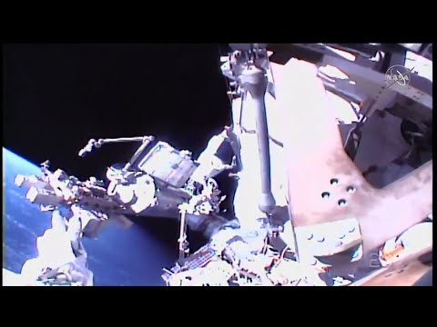
LESSON: Space Suits
Watch this video to see Astronauts working outside the Space Station.
Notes:
Teacher notes
Watch the video on the slide to learn more about walking in space.

Slide 47
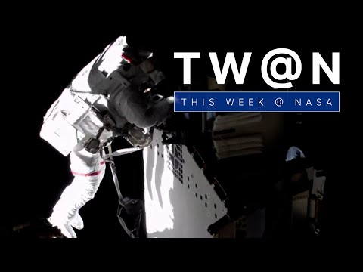
LESSON: Space Suits
Watch this video to see the view of space from a spacewalkers helmet cam!
Notes:
Teacher notes
Watch the video on the slide to learn more about walking in space.

Slide 48
LESSON: Space Suits
The Space Shuttle Mission Control Center (MCC) and the International Space Station (ISS) Control Center use some of the most sophisticated technology and communication equipment in the world. Teams of highly qualified engineers, scientists, doctors, and technicians, known as flight controllers, monitor the systems and activities aboard the space shuttle and the ISS. They work together as a powerful team, spending many hours performing critical simulations as they prepare to support each mission and crew during normal operations and any unexpected events.
Notes:
Teacher notes
Read the information on the slide to learn more about space suits.

Slide 49
LESSON: Space Suits
The Extra-Vehicular Activities (EVA) officer monitors all aspects of the spacewalks performed from the space shuttle and the ISS. The EVA officer monitors the technical operation of the spacesuits and the activities to be carried out prior to a spacewalk. The EVA officer also monitors the space walk from the MCC and evaluates the spacewalk afterward. The spacesuit is officially known as an Extra-vehicular Mobility Unit (EMU). Anytime a crew member has to step outside of a pressurized vehicle, such as the space shuttle or ISS, to work in the vacuum of space, an EMU must be worn.
Notes:
Teacher notes
Read the information on the slide to learn more about space suits.

Slide 50
LESSON: Space Suits
Suppose an astronaut were to leave a pressurized vehicle without wearing an EMU. Because there is no oxygen, the astronaut would lose consciousness within 15 seconds. While in orbit the sun rises and sets every 90 minutes, which means the astronaut experiences sunlight for 45 minutes with temperatures possibly reaching 120o C (248o F) and darkness for 45 minutes with temperatures possibly dropping to -100o C (-148o F). A typical EVA may be up to 7 hours, which means the astronaut would change from hot to cold or cold to hot, about 9 times during the EVA. These extreme temperature changes and the lack of air pressure would cause the body fluids to boil or freeze.The astronaut would also be exposed to radiation and cosmic rays, and could even be hit by space debris, such as micrometeoroids, that move at high rates of speed.
Notes:
Teacher notes
Read the information on the slide to learn more about space suits.

Slide 51
LESSON: Space Suits
The key features of the EMU that keep astronauts alive and comfortable are habitable pressure, breathable air, heating and cooling control, and protection from the harsh space environment. It also provides astronauts the ability to move around with a range of motion for arms and legs, good visibility, and communication with the crew and with the MCC. The EMU is its own controlled environment in which a crew member can perform scheduled activities and planned spacewalks for up to seven hours.
Notes:
Teacher notes
Read the information on the slide to learn more about space suits.

Slide 52
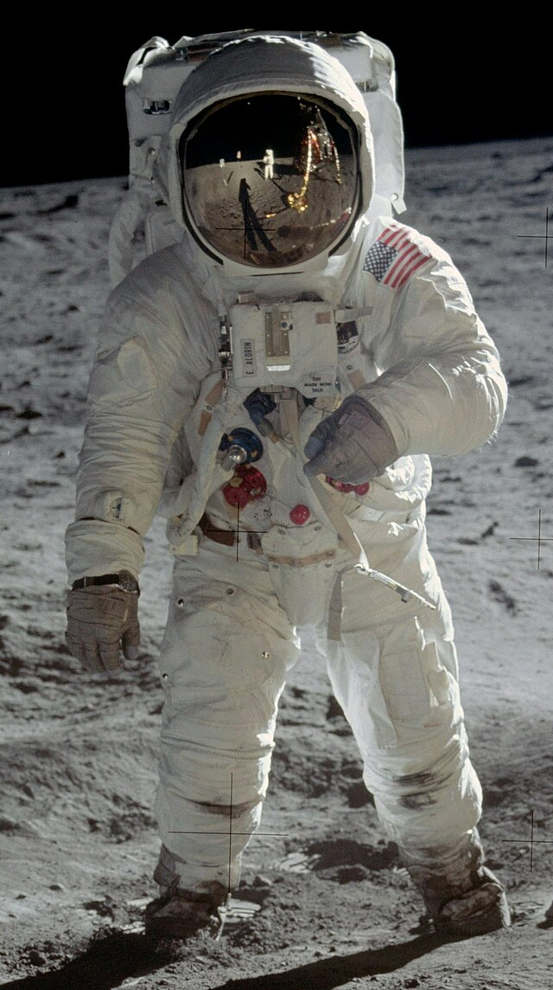
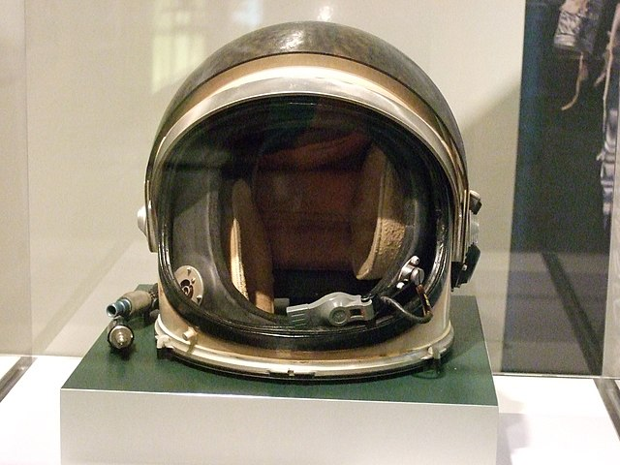
LESSON: Space Suits
Source: Astronaut Edwin E. "Buzz" Aldrin, lunar module pilot, walks on the surface of the moon near the leg of the Lunar Module "Eagle" during the Apollo 11 extravehicular activity. Astronaut Neil A. Armstrong, commander, took this photograph.
Source: Spacesuit helmet from NASA on exhibit at the Chemical Heritage Foundation as part of their "Suited For Space" temporary exhibition, 2014.
Notes:
Teacher notes
Read the information on the slide to learn more about space suits.

Slide 53
ACTIVITY: Exploring Space through Math
Put your knowledge into practice using the worksheet!
Two crew members are preparing for a spacewalk to install solar panels on the International Space Station (ISS). The spacewalk will last about seven hours. As they put on their Extra-vehicular Mobility Units (EMU), a series of system checks are taking place. One system of concern is the primary life support subsystem which supplies oxygen. The oxygen tank pressure is checked to ensure that the starting pressure is suitable to complete the spacewalk and that there are no leaks. The oxygen tank pressure is used to measure oxygen usage throughout the spacewalk and is measured in pounds per square inch (psi).
Notes:
Teacher notes
Print and pass out this worksheet for students to complete in small groups or individually. Note: if you do not have access to graphing calculates, skip questions 11-15.
Access the answer sheet for the problems by clicking here.

Slide 54
EXIT TICKET
Don’t forget to complete your daily learning log!!
What would your space suit look like?
Notes:
Teacher notes:
Have students draw an example of what their space suit might look like!
Remind students to complete Daily Learning Log.

Slide 55
Day 4+
Design a Space Suit

Slide 56
DO NOW
Question:
Review your space suit design.
Notes:
Teacher notes:
Have students write down their answers and/or share out as a class

Slide 57
OBJECTIVES
Students will be able to:
Design and build a space suit helmet with cardboard and other allowed materials.
Notes:
Teacher notes:
Review the objectives for the day, so students know what is expected of their learning

Slide 58
AGENDA
Discuss the Do Now
Mini-lesson: Space Suit Challenge
Activity: Design and Build a Space Suit
Exit ticket
Notes:
Teacher notes:
Review the agenda for the day

Slide 59
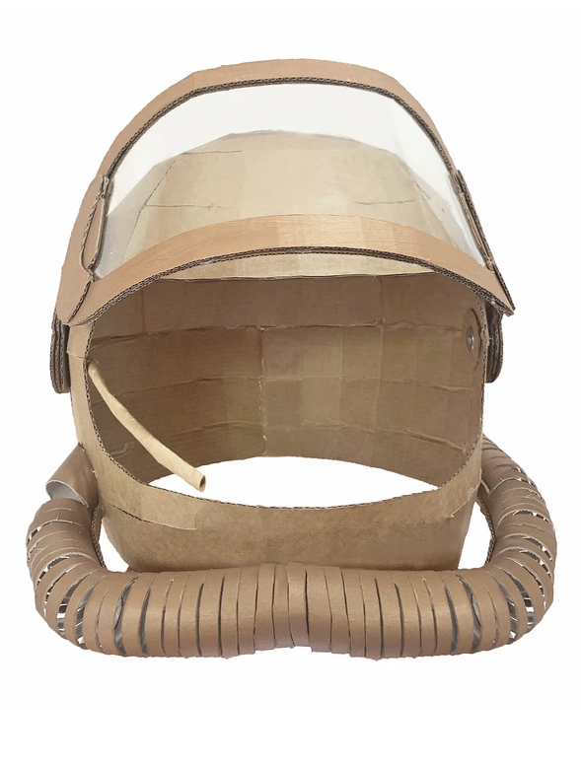
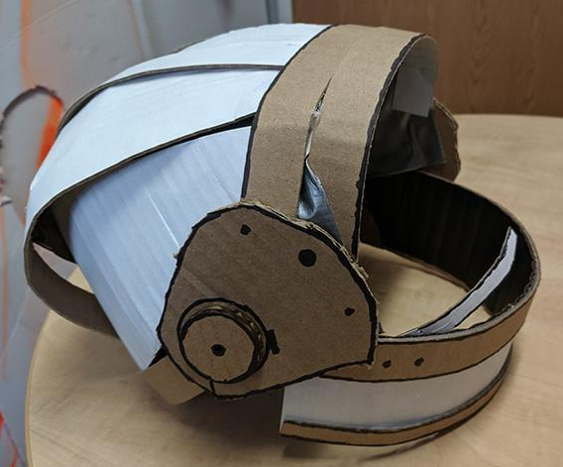
LESSON: Spacesuit Helmet Design
Space is a hostile environment that cannot support human life. To help keep astronauts safe, you are going to design and build a space suit that will protect them while living and working in space!
Your space suit should
include the following a Helmet!
Notes:
Teacher notes
Introduce the challenge to students and begin brainstorming how to create the space suit helmet using facility allowed materials like cardboard, duct tape, paper, boxes, etc. If allowed you can use pipe cleaners, string, yarn, pom poms, and other crafts materials.
Image source
Image source

Slide 60
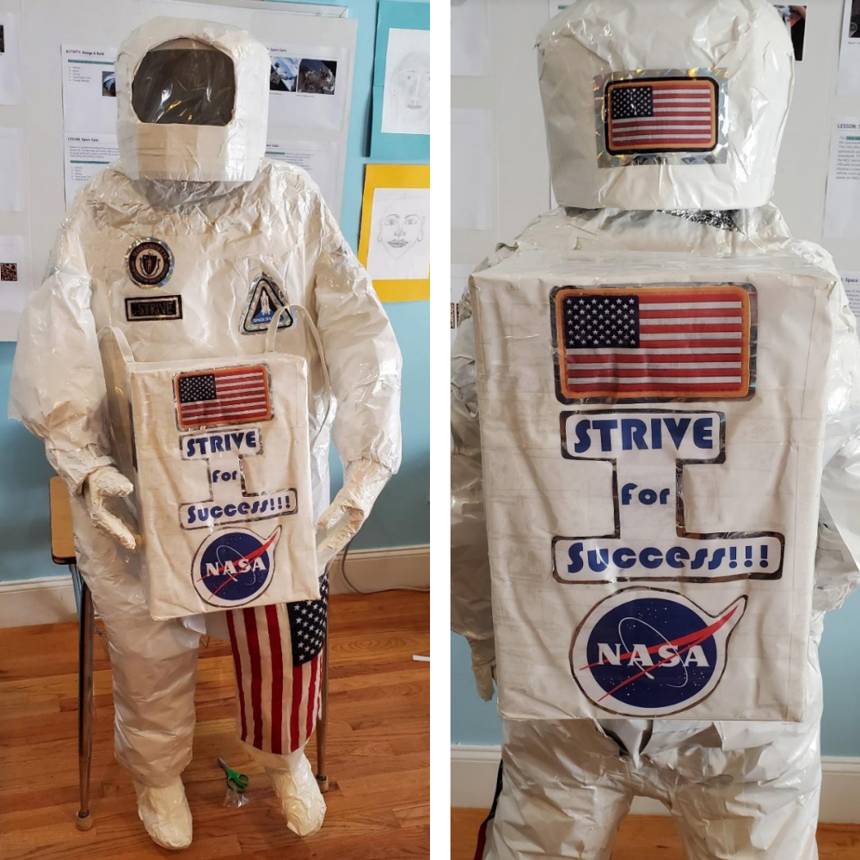
LESSON: Spacesuit Helmet Design
This is the winner of the space suit challenge last year.
ESOG from Strive, MA
Notes:
Teacher notes
The challenge last year was an entire space suit and this was the winner. This year, we narrowed the challenge to a space suit challenge.

Slide 61

NASA ISS Live Stream
Notes:
Teacher notes
While students are building, play this live video feed from the ISS!

Slide 62
EXIT TICKET
Don’t forget to complete your daily learning log!!
Share your spacesuit with your classmates and submit to the BreakFree contest!
Notes:
Teacher notes:
Have students share their space suits with the class.
Remind students to complete Daily Learning Log.

Slide 63
UNEXPLORED

