Slide 1



UNCOVERED

Slide 2


Day 1
What will you uncover?

Slide 3

ESSENTIAL QUESTION
What does it mean to uncover truth?
Notes:
Teacher notes:
Have students answer out loud or on paper

Slide 4
Objectives
Students will
Be able to become detectives by completing the launch activity digitally or on paper
Notes:
Teacher notes:
Review the objectives for the day, so students know what is expected of their learning

Slide 5

AGENDA
Complete the launch activity digitally or on paper
Distribute the Note to Self Journal either digitally on printed
Notes:
Teacher notes: see the lesson plan for exact instructions, links, and helpful videos.

Slide 6


LESSON & ACTIVITY
DIGITAL ACTIVITY
PAPER BASED ACTIVITY
Click the newspapers for access.
Notes:
Teacher notes: see the lesson plan for exact instructions, links, and helpful videos.

Slide 7
EXIT TICKET
Answer these questions in your Note to Self journal!
What did you uncover? | Which clue was your favorite?
Notes:
Teacher notes:
Introduce the “Note to Self Journal” and have students answer these questions in the “Note to Self Journal”

Slide 8
Day 2
Uncovering Climate Change

Slide 9

DO NOW
Question:
What do you know about “climate change”& “global warming”? What are infographics and why are they helpful?
Answer in your Student Journal!
Notes:
Teacher notes:
Have students answer this question in the “Note to Self Student Journal" digital or pdf format.
NOTE: In this initiative, “global warming” and “climate change” will be used interchangeably. Feel free to explain to your students that global warming refers strictly to the globe’s temperature rising, while climate change refers to global warming and the side effects of a warmer globe.

Slide 10
OBJECTIVES
Students will be able to:
Create a working definition of climate change
Describe the causes and potential effects of climate change
Notes:
Teacher notes:
Review the objectives for the day, so students know what is expected of their learning

Slide 11
AGENDA
Discuss the Do Now
Mini-lesson: How to Use Infographics
Activity: Learn About Climate Change Using Infographics
Class Discussion: What did you learn about climate change?
Exit ticket
Notes:
Teacher notes:
Review the agenda for the day

Slide 12
LESSON: What’s an infographic and how do I use it?
Info
graphic
information
visual
data,
descriptions, knowledge
charts,
diagrams,
imagery
Did You Know? An infographic can be defined as a visual image such as a chart of diagram used to represent information or data.
Notes:
Teacher notes
This slide breaks the term “infographic” into its root words to assist students with understanding what an infographic is. The definition is from taken directly from Webster's dictionary.

Slide 13
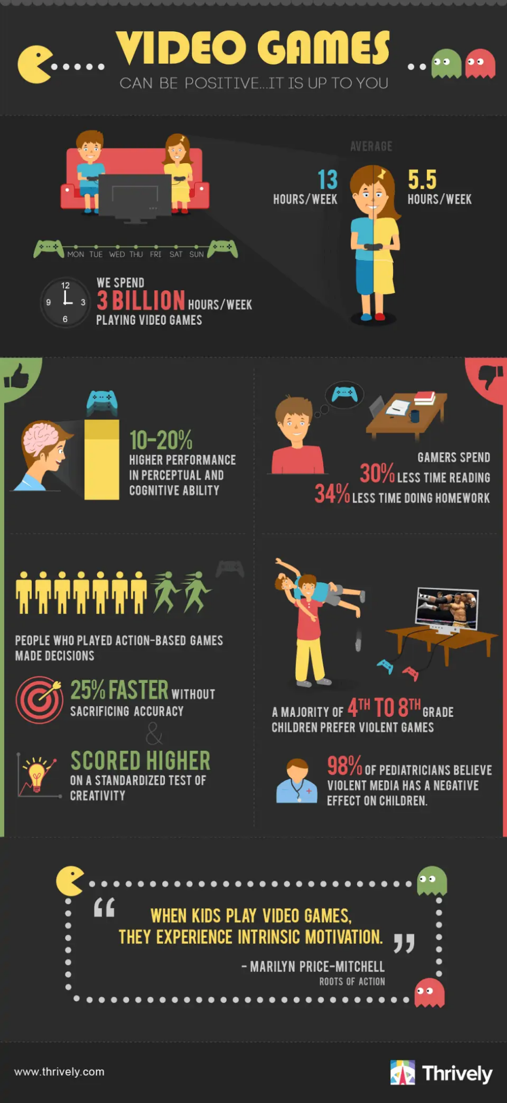
LESSON: What’s an infographic and how do I use it?
This Infographic shows data about video game? What can you learn about video games from this example?
Infographic Source
Notes:
Teacher notes
Student answers may vary.
Possible answers:
Boys spend an average of 13 hours a week playing video games
Girls spend an average of 5.5 hours a week playing video games
“We” spend 3 billion hours per week playing video - discuss who “we” is - Americans, teenagers - the infographic does not confirm who the “we” is
“Video Games can be positive...it’s up to you” alludes to the fact that “we” play video games for too many hours a week making it a negative.
Infographic Source

Slide 14
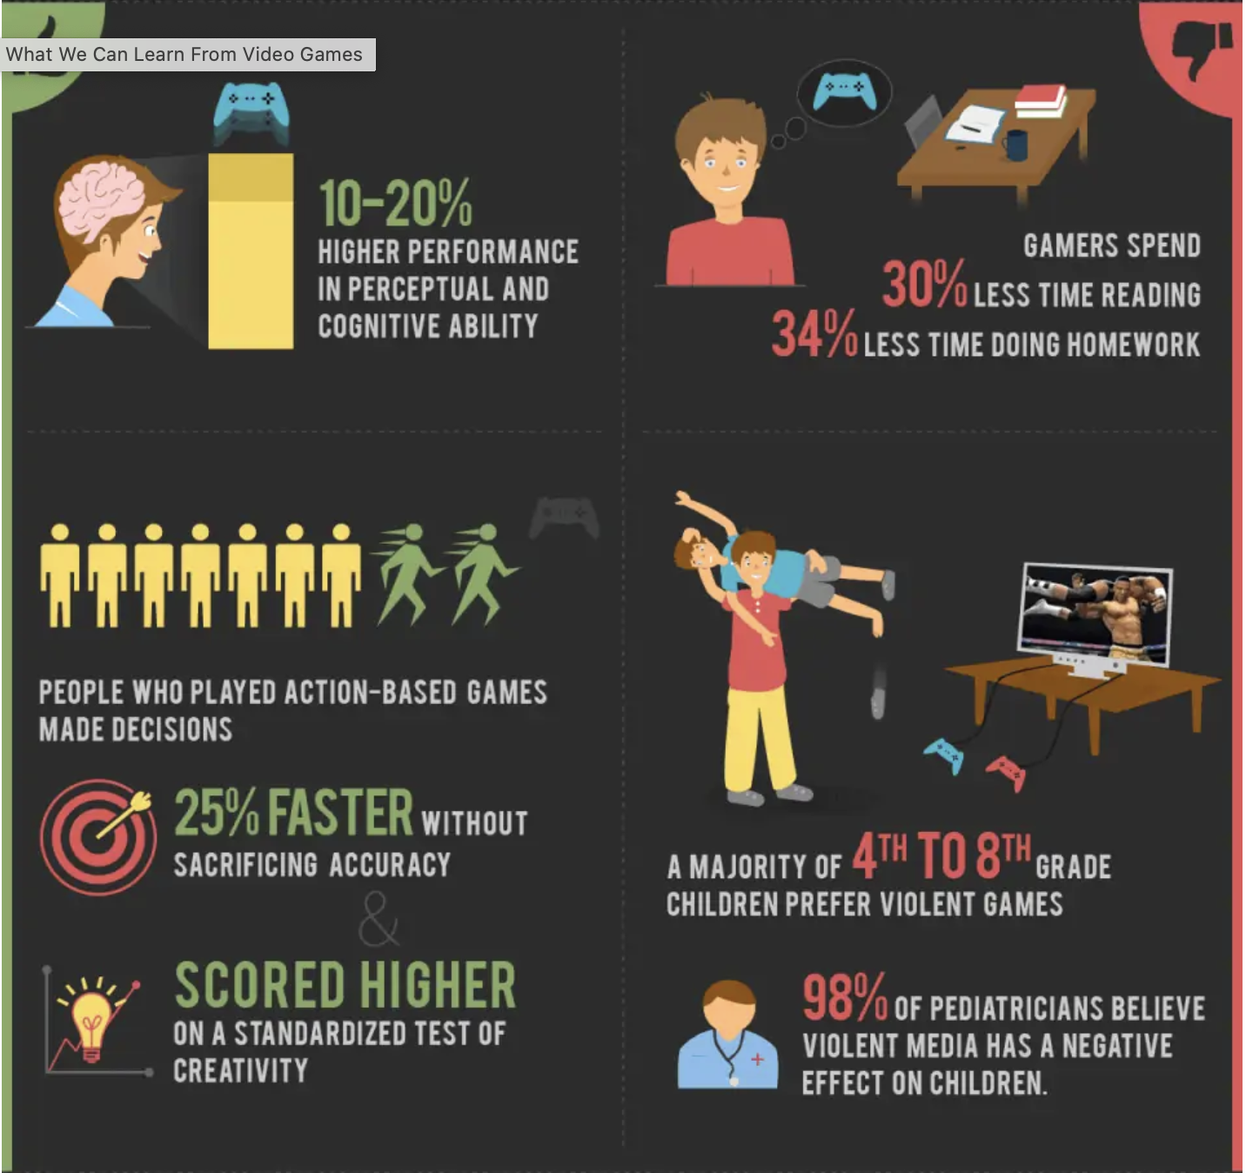
LESSON: What’s an infographic and how do I use it?
With the information presented in this infographic, determine at what point video games can be positive.
Infographic Source
Notes:
Teacher notes
Use this slide to model how to utilize an infographic.
Discuss as a class how (with the information presented in the graphic) can video games be used in a positive way
Infographic Source

Slide 15
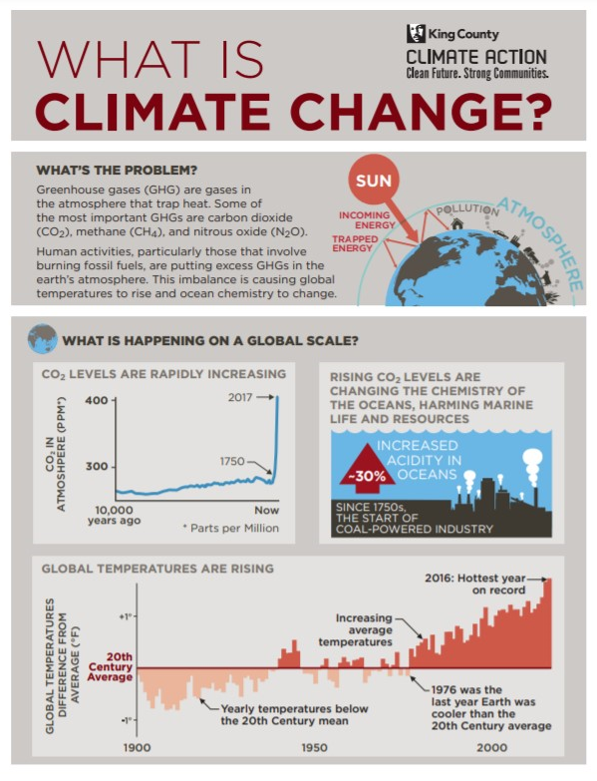
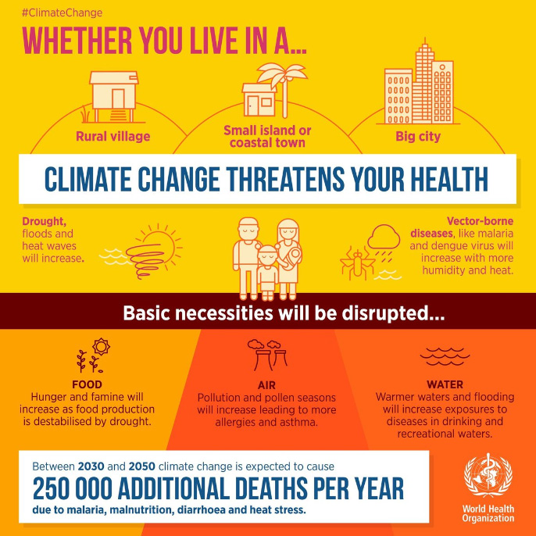
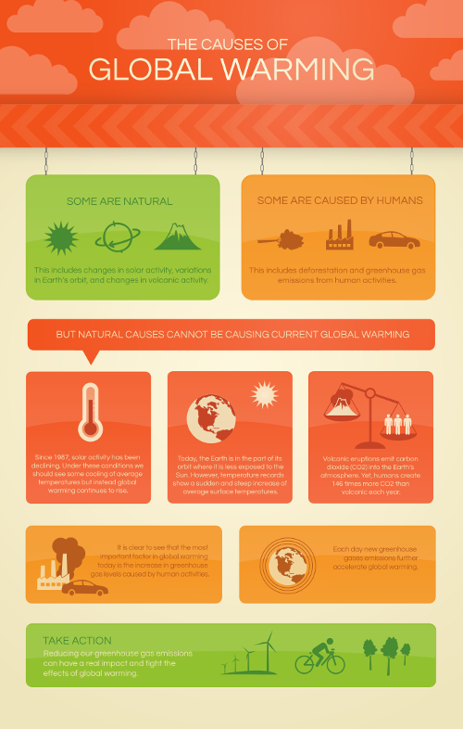
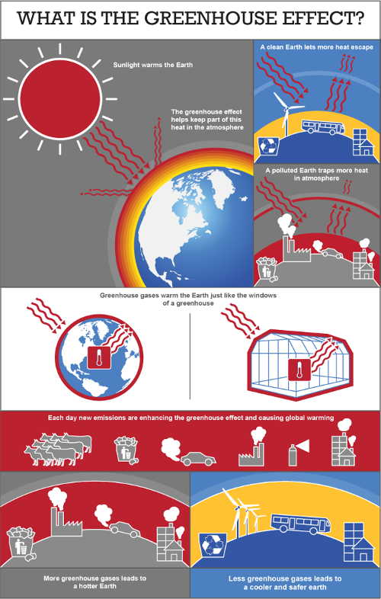
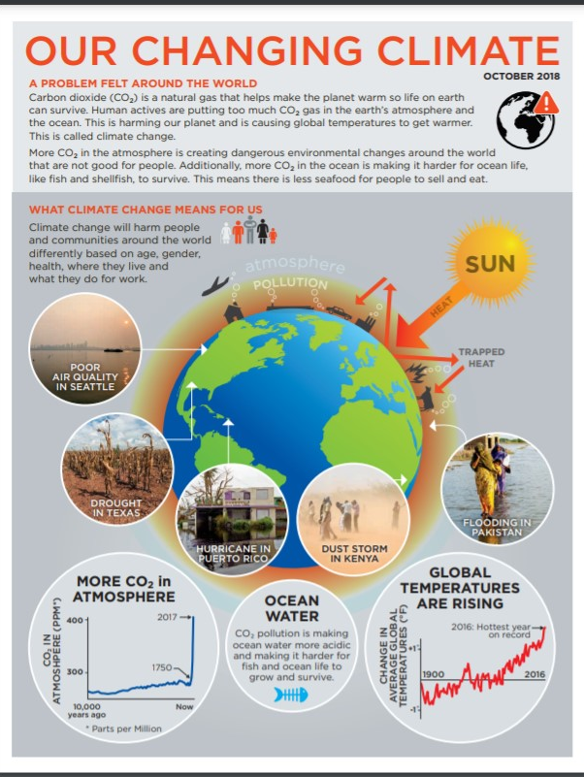
ACTIVITY: Climate Change
Use your newfound knowledge about infographics to learn more about Climate Change. Select an infographic and answer questions in your student journal.
What is climate change?
Health & Climate Change
Causes of global warming
What Climate Change means
The Greenhouse Effect
Choose one of these infographics to study.
Notes:
Teacher notes
Print or access the infographics here
Suggestion: Make sure that students choose different infographics to have a better discussion.
Students will complete the analysis in their student journal.

Slide 16
ACTIVITY
THINK-PAIR-SHARE
Rotate through groups discussing what you learned about Climate Change.
(1) COUNT AWAY
(2) ODDS VERSUS EVENS
1
2
3
4
(3) NUMBERS UNITES
EXAMPLES
Notes:
Teacher notes:
assign a number to students 1, 2, 3, and 4.
(THINK) students begin by completing their analysis of their chosen infographic
(PAIR) Students will rotate through the groups shown on this slide (and explained below) sharing what they found in their infographics about Climate Change. Students can spend any length of time in each group. The teacher should rotate through the groups to ensure students are on topic. If you do not have enough students for four groups, you can split students into any number of groups that works best. The goal is to have students discussing what they found several times with different students.
Count Away (each group has a 1, 2, 3, and 4 represented)
Odds versus Evens: odds & evens together (one group has two 1s and two 3s, another group has two 2s and two 4s, etc)
Numbers Unite: All same numbers together (all 1s, all 2s, all 3s, all 4s)
(SHARE) Students will share out with the class as a whole group discussion what they found in their infographics about Climate Change. You can use the questions on the next slide as a guide for the whole class discussion.

Slide 17
ACTIVITY: Class Discussion
Questions to consider...
What is climate change? | What caused global warming?
What does climate change mean for your health?
Explain the greenhouse effect | What are the potential effects of climate change?
Notes:
Teacher notes
(SHARE) Students will share out with the class as a whole group discussion what they found in their infographics about Climate Change. You can use the questions on the next slide as a guide for the whole class discussion.

Slide 18
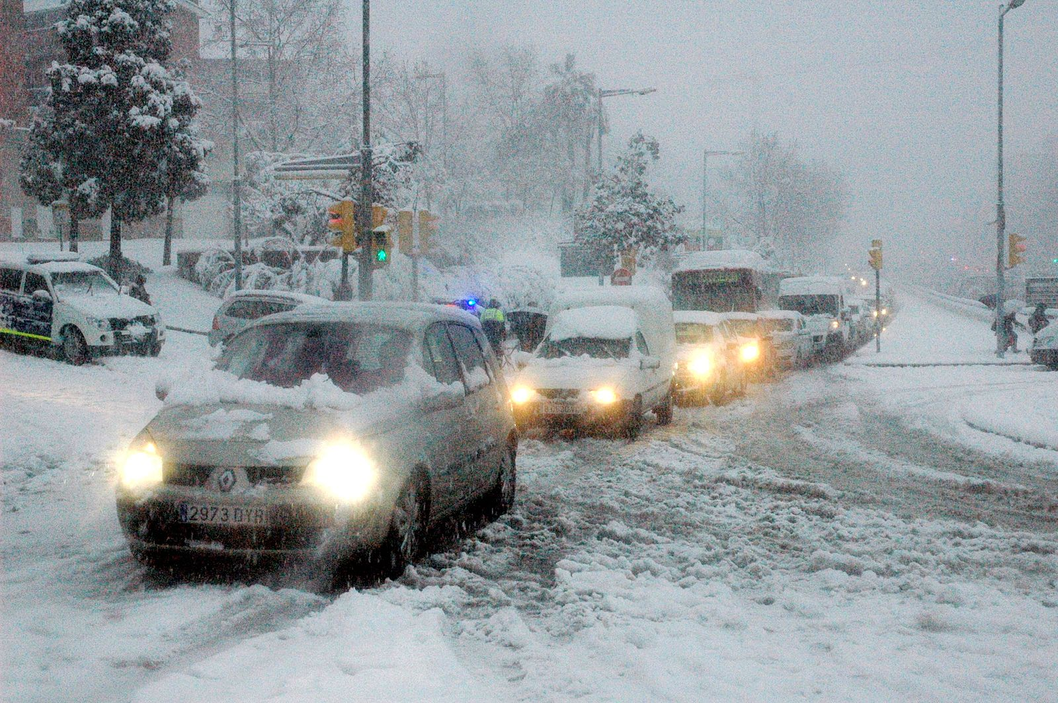
EXIT TICKET
Look at this image, is this what climate change looks like? Explain your answer in your student journal.
Image source
Notes:
Teacher notes:
Have students answer this question in the “Note to Self Student Journal" digital or pdf format.
Image source

Slide 19
Day 3
The Big Picture

Slide 20
DO NOW
Question:
What are the top three causes of climate change.
Answer in your Student Journal!
Notes:
Teacher notes:
Have students answer this question in the “Note to Self Student Journal" digital or pdf format.

Slide 21
OBJECTIVES
Students will be able to:
Examine what climate change looks like
Evaluate the main causes of climate change
Notes:
Teacher notes:
Review the objectives for the day, so students know what is expected of their learning

Slide 22
AGENDA
Do Now
Mini-lesson: Explore Climate Change
Activity: Rank climate change effects
Exit Ticket
Notes:
Teacher notes:
Review the agenda for the day

Slide 23
LESSON: Explore Climate Change
Explore the following slides. What do you notice about the photos? Try to identify what you are seeing through a lens of Climate Change. What potentially caused these changes?
Notes:
Teacher notes
Images are as impactful as facts. In this lesson, students will better understand how climate change impacts human activity by examining what climate change looks like. Students will evaluate images that show how the planet is changing in order to prepare them to decide for themselves why climate change is newsworthy. As you go through the images on the following slides, read the teacher notes to students to explain the photo.

Slide 24
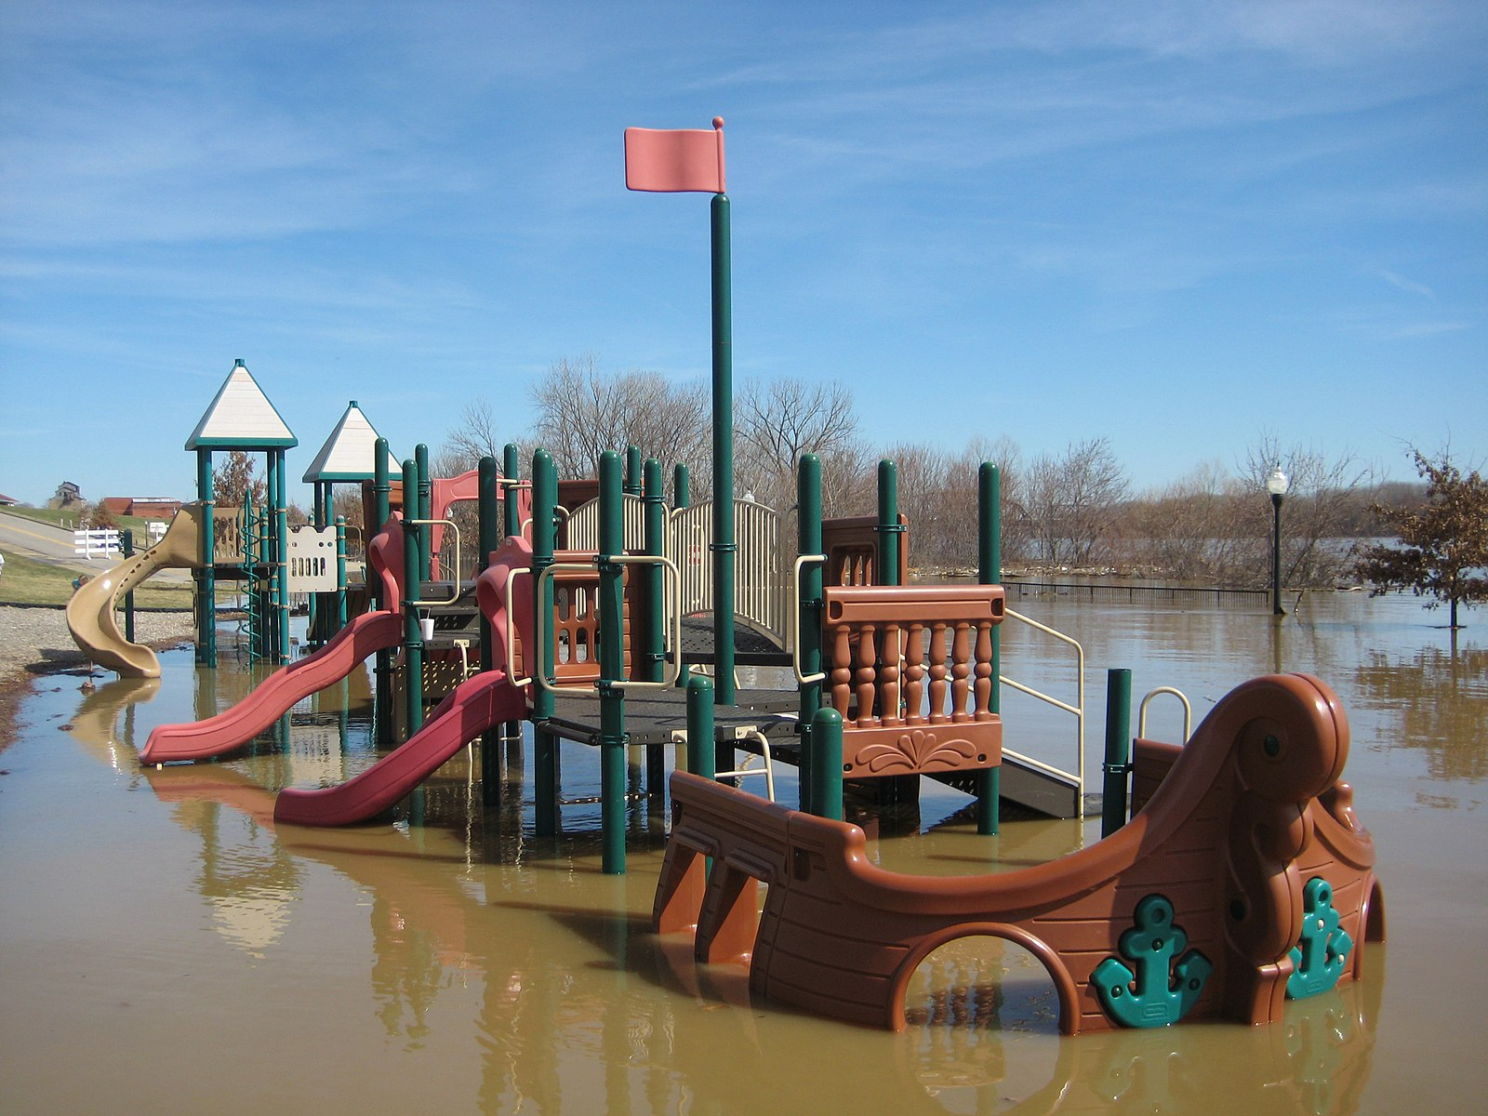
LESSON: Climate Change in Pictures
Source
Notes:
Teacher notes
FLOODING. Environmental experts have linked an increasing number of floods to climate change.
The big picture: While floods are one of the most natural disasters, data is showing that flooding is being exacerbated by climate change. A warmer globe results in heavier rain and more frequent hurricanes. A warmer globe also means that the world’s glaciers are melting, which causes the ocean and sea levels to rise. These higher waters result in more water surge and areas flooded. Here is an (optional) informative article on flooding and climate change.
Photo description:
Tewkesbury Abbey and a children's playground at the confluence of the Rivers Severn and Avon is surrounded by flood waters on February 27, 2020, in Tewskesbury, England.

Slide 25
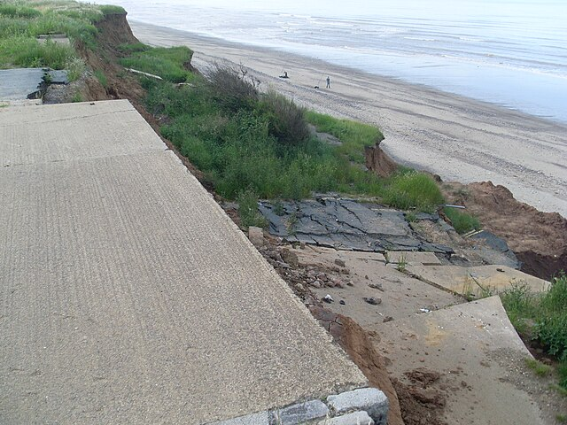
LESSON: Climate Change in Pictures
Notes:
Teacher notes
Beach Erosion. Rising temperatures cause both a reduction in sea ice and a thawing of permafrost along the coast, threatening the shoreline. Scientists are concerned that 50% of the globe’s beaches are at risk of “disappearing” due to erosion. The higher sea levels increase the amount of battering that the shoreline suffers during storms and extreme weather events. Click here for an optional article.
Photo description:
A home destroyed by beach erosion tips over in the the Alaskan village of Shishmaref.
https://commons.wikimedia.org/wiki/File:Coastal_Erosion_at_Seaside_Road_end,_Aldbrough_-_geograph.org.uk_-_4022408.jpg

Slide 26
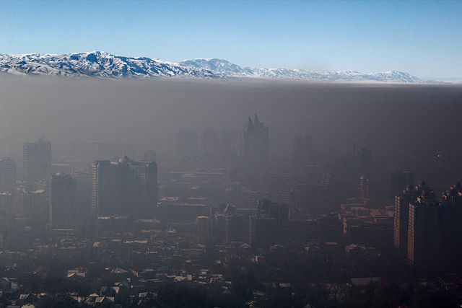
LESSON: Climate Change in Pictures
Notes:
Teacher notes
Air Pollution higher temperatures and drier conditions "can speed up the reaction rate of air pollutants that form in the atmosphere, causes high rates of air pollution. You can stree how air pollution impacts our health as it decreases the quality of the air we breathe. Breathing polluted air already to more than 5.5 million premature deaths a year, and researchers predict that by 2030, air pollution-related deaths could rise by 60,000 a year due to the effects of climate change. Click here for an optional article.
Photo description:
Beijing is shrouded in air pollution on a winter morning.
Picture Source

Slide 27
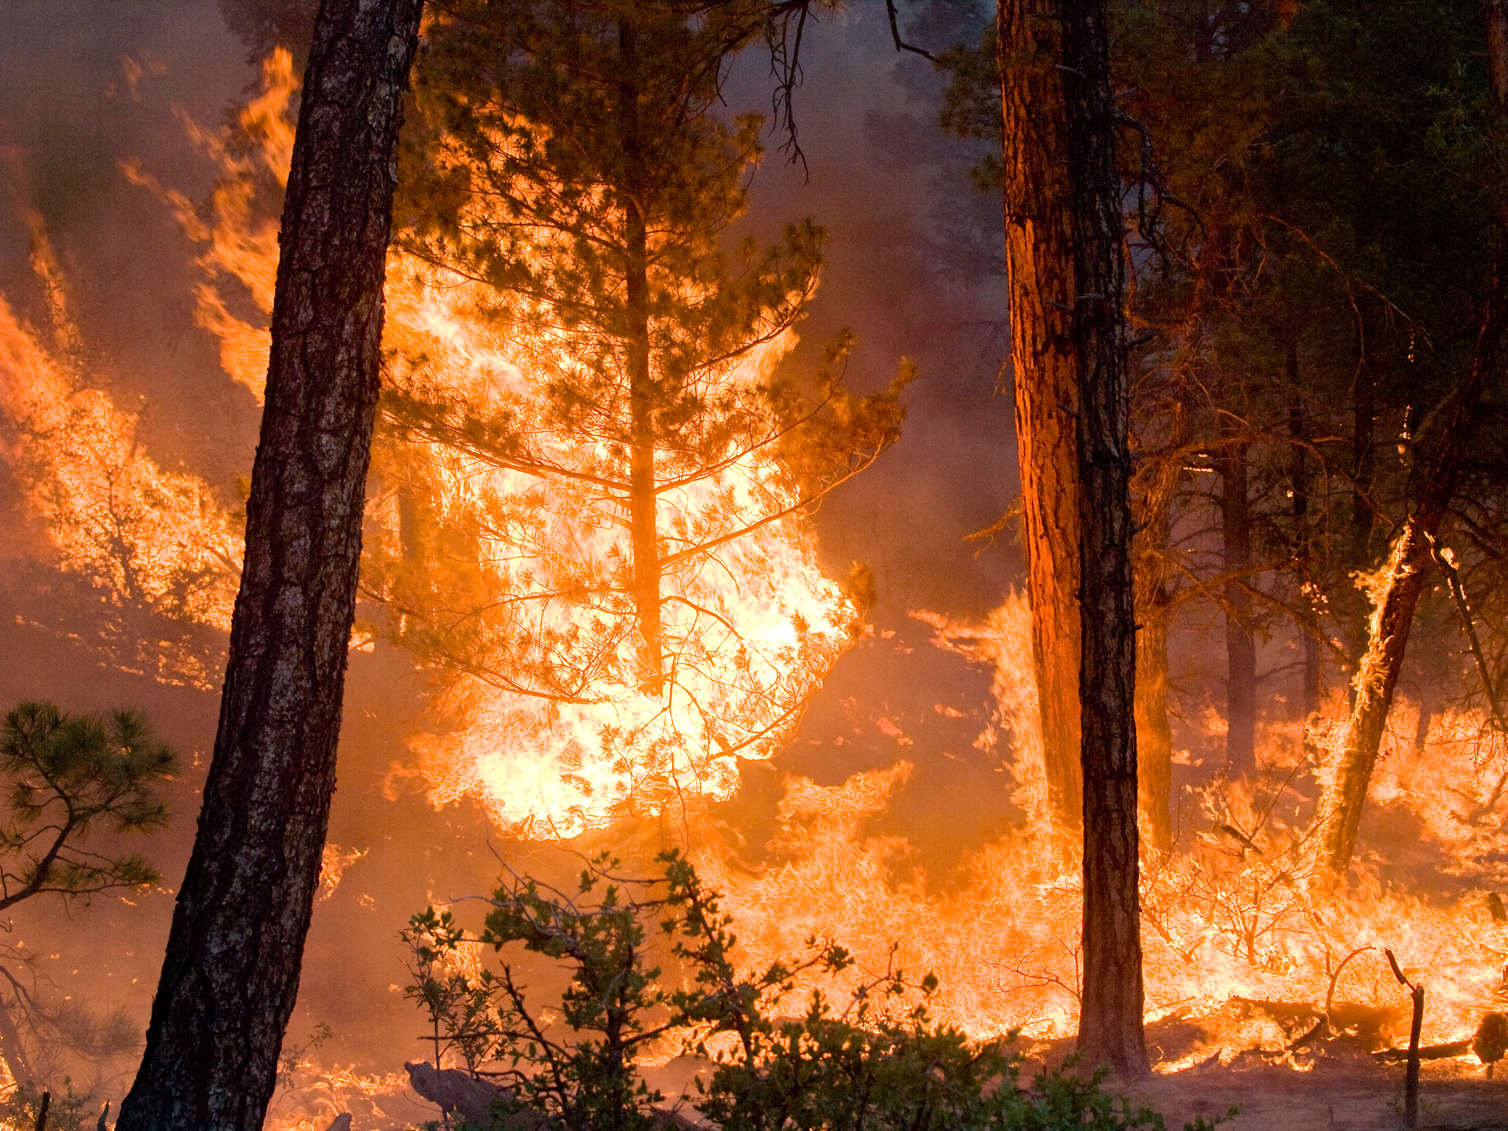
LESSON: Climate Change in Pictures
Notes:
Teacher notes
Wildfires. Scientists believe that, without a dramatic reduction in greenhouses gases in the atmosphere, West Coast wildfires will continue to increase in frequency and intensity. Climate change enhances the factors that lead to wildfires. The warmer, drier conditions that result from climate change increase the likelihood of wildfires. Click here for an optional article.
Photo description
Yuccas catch fire as hot and dry conditions fuel a 19,500-acre wildfire in California in this photo from 2013.
Picture Source

Slide 28
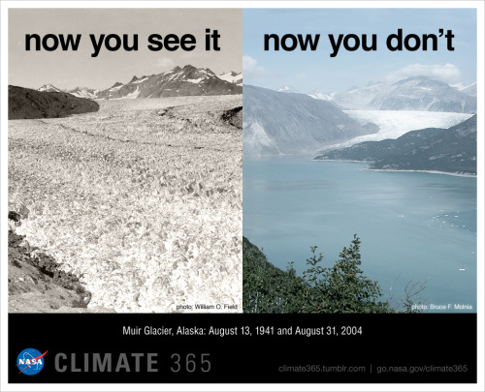
LESSON: Climate Change in Pictures
Notes:
Teacher notes
Disappearing Ice Caps. A NASA study published in the Journal of Climate shows that the oldest and thickest Arctic sea ice is disappearing at a faster rate than the younger, thinner ice at the edges of the Arctic Ocean's floating ice cap. When ice caps melt, the sea levels rise and result in flooding and beach erosion. Other effects include wildlife losing their polar homes and extreme weather caused by the warmer water. Here is an optional article.
Photo description:
This pair of historical images posted to the NASA Climate 365 Project's Tumblr page show just how dramatically Alaska's Muir Glacier has retreated and thinned over the second half of the 20th century. In just 60 years, the front of the glacier moved back about seven miles and its overall thickness decreased by more than 2,625 feet, according to the National Snow and Ice Data Center.
Picture Source

Slide 29
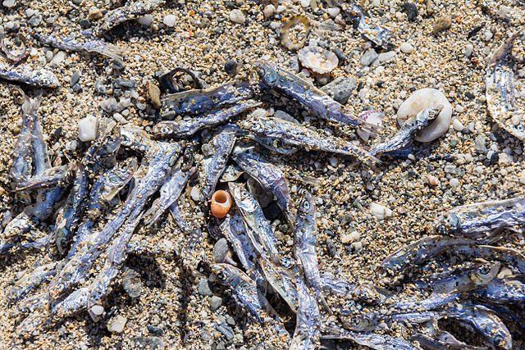
LESSON: Climate Change in Pictures
Notes:
Teacher notes
Massive Fish Death. A prolonged heat wave lowered this lagoon's oxygen levels, provoking the death of several tons of fish. Click here to view more images from climate change.
Picture Source

Slide 30
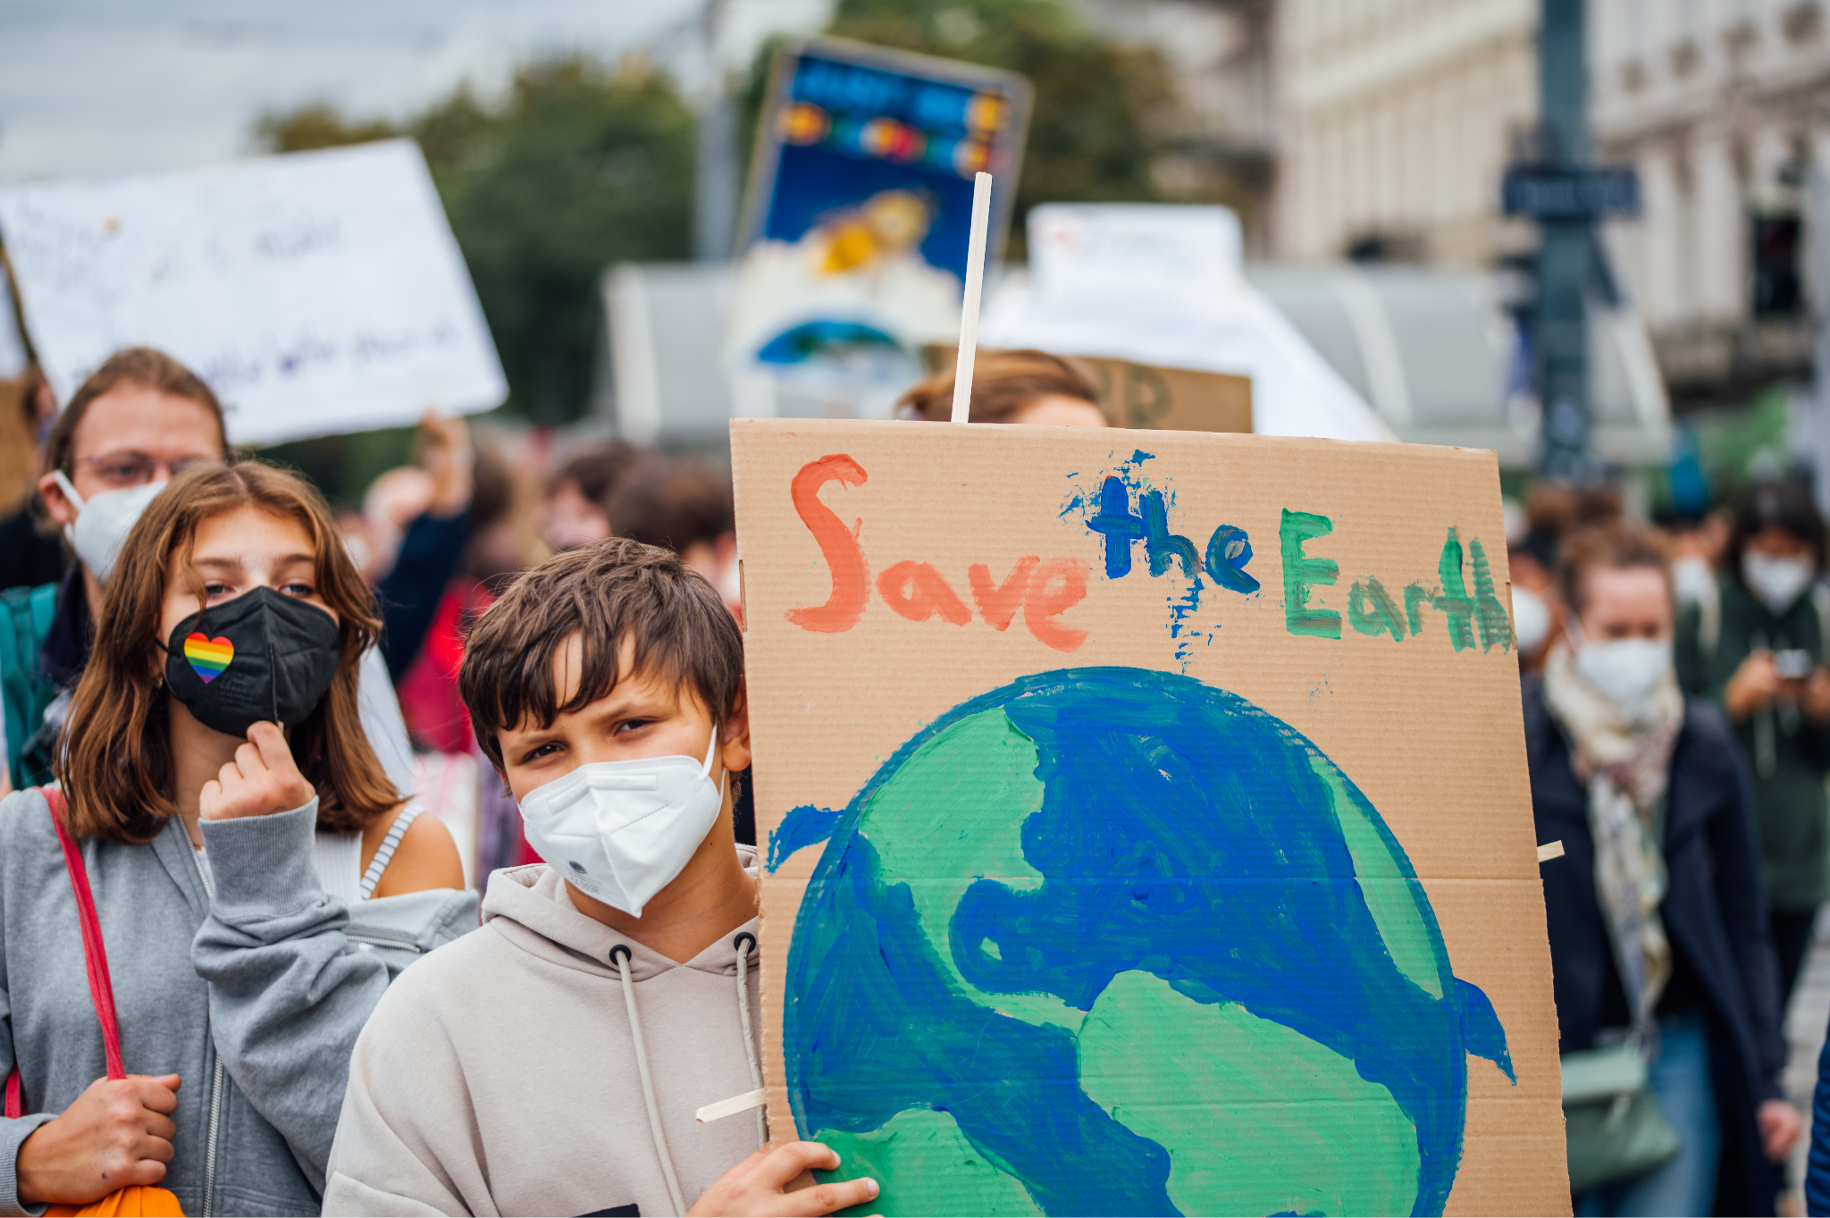
LESSON: Climate Change NOW
Notes:
Teacher notes
Optional: Click here to read the article titled A climate change emergency about President Biden’s reaction to climate change issues.
Image source

Slide 31
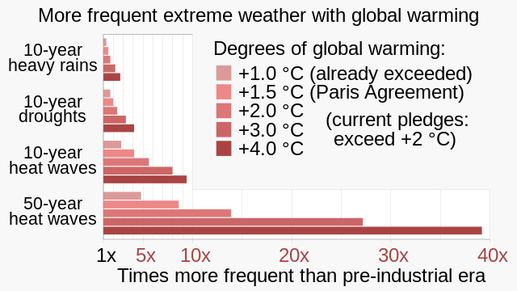
LESSON: Climate Change NOW
Notes:
Teacher notes
Optional: to dive deeper into climate change, click here to read an article titled “Extreme Heat Continues Its March Across Europe”.
The IPCC Sixth Assessment Report (2021) projected multiplicative increases in the frequency of extreme events compared to the pre-industrial era for heat waves, droughts and heavy precipitation events, for various global warming scenarios.
Image source

Slide 32
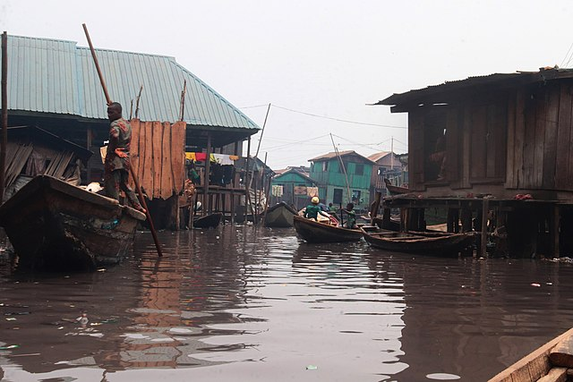
LESSON: Climate Change in Pictures
Notes:
Teacher notes
Optional: to dive deeper into climate change, click here to read an article titled “Visualizing the Climate Crisis Through the Lens of Indegienous Photographers”.
The Makoko Community is a slum located across the 3rd Mainland Bridge on the coast of mainland Lagos. The History of Makoko goes as far back as 1909 where the ancestors of the inhabitants migrated to the area from Ipokia, Badagary and the Republic of Benin through fishing before deciding to make settlements there. Today the community survives on NGOs and charity organizations. Being an informal settlement ,it receives no support from the government. The Makoko Community has 75% its community built on stilts along the lagoon and the rest is on the land. To oversee affairs in the community, local chiefs ( Baale) are appointed, some for the land and the others for the lagoon.Present day occupations includes fishing, carpentry, boat making etc
Source: https://commons.wikimedia.org/wiki/File:Makoko_1.jpg

Slide 33
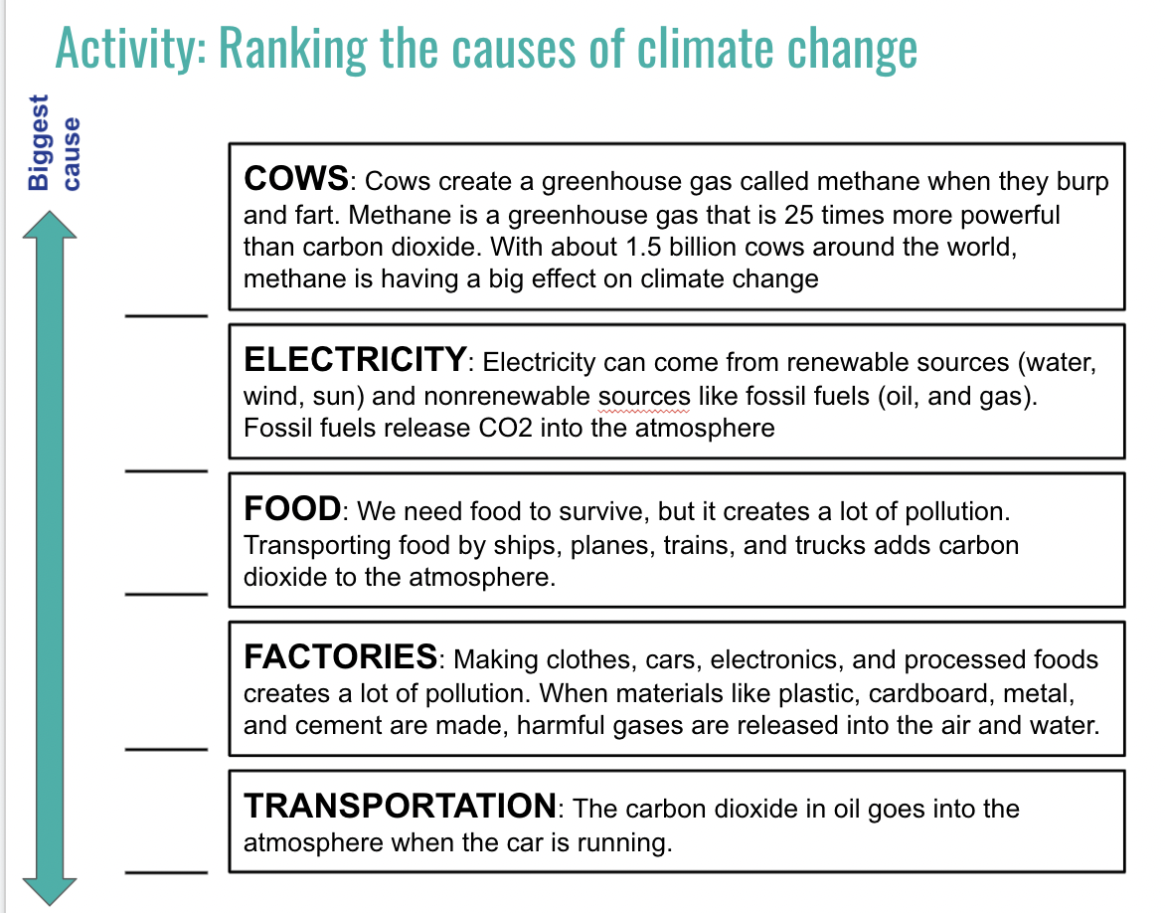
ACTIVITY: Ranking Climate Change Effects
Notes:
Teacher notes
Access this activity in the“Note to Self Student Journal" digital or pdf format.
For digital based, students can drag (manipulate) the boxes to place them in the order they desire or type in their number (1-5) on the lines
For paper-based, students can write the number ranking next to each box in the line provided
When students have completed their ranking, have them share with a classmate and explain why they choose to rank in that order. Hint: there is no right or wrong answer here just make sure students can justify their choices.

Slide 34
ACTIVITY: Wrap-up
Share your rankings
Notes:
Teacher notes
To wrap-up the ranking activity, facilitate discussion on climate change. Have students share their rankings then compare student answers as a class. Students should begin to take ownership of their understanding of the causes and effects of climate change.
Answer key: there is no one right answer for the ranking activity. This activity is designed to create conversations amongst students. Answers may vary based on whether students are considering these climate change causes on a local, national, or global scale.

Slide 35
Exit Ticket
As a young person, how concerned are you about climate change? Why or why not?
Notes:
Teacher notes:
Have students answer this question in the “Note to Self Journal”
One of the essential principles of teaching climate change to students is the message that it has consequences for the earth and human lives. Read more from an optional article on educating students on climate change by clicking here.

Slide 36
Day 4
Choosing a Story

Slide 37
DO NOW
Question:
In your opinion, is Climate Change newsworthy? Explain why or why not.
Answer in your Student Journal!
Notes:
Teacher notes:
Have students answer this question in the “Note to Self Student Journal" digital or pdf format.

Slide 38
OBJECTIVES
Students will be able to:
Identify what makes a story newsworthy
Tell the difference between news and information
Identify potential topics for their documentary
Notes:
Teacher notes:
Review the objectives for the day, so students know what is expected of their learning

Slide 39
AGENDA
Do Now
Mini-lesson: What makes something Newsworthy
Activity: Choose your documentary topic
Exit Ticket
Notes:
Teacher notes:
Review the agenda for the day

Slide 40
LESSON
What news stories are
important in your life?
Notes:
Teacher notes:
1. Ask students “What news stories are important in your life?” and write their answers on the board or on a digital whiteboard
2. After a list of 10 (or so) news stories ask the class to rank which news stories are the most “newsworthy”. Your result should be that you have identified the most and the least newsworthy stories.
3. Next, ask the class to reflect on their rankings and identify criteria they used to pick the most and least newsworthy stories. What did the top three stories have that the bottom three didn’t?
4. Ask the class if they think there is a difference between information and news? What about news makes it different from plain old information? Have class brainstorm as many differences as they can and write their criteria on the board. Then go back to their list and label each story on the board as either an “I” for information or an “N” for news.
source

Slide 41
LESSON
When journalists talk about what’s newsworthy, they rely on these values:
TIMELINESS Immediate, current information and events are newsworthy because they have just recently occured. It’s news because it is “new”.
PROXIMITY Local information and events are newsworthy because they affect the people in a community and region. You can also include global events that are “close to home” because they happen to a people group with a personal connection.
CONFLICT & CONTROVERSY When violence strikes or when people argue about actions, events, ideas, or policies, journalists care. Conflict and controversy attract our attention by highlighting problems or differences within the community.
HUMAN INTEREST People are interested in other people. Everyone has something to celebrate and something to complain about. Journalists like unusual stories of people who accomplish amazing feats or handle a life crisis because we can identify with them.
RELEVANCE People are attracted to information that helps them make good decisions. If you like to cook, you find recipes relevant. If you’re looking for a job, the business news is relevant. We depend on relevant information that helps us make decisions.
source
Notes:
Teacher notes
Review the five values journalists rely on before writing and publishing a story

Slide 42
ACTIVITY: What will your documentary topic be?
PROXIMITY
TIMELINESS
CONFLICT & CONTROVERSY
YOUR STORY
RELEVANCE
HUMAN INTEREST
Notes:
Teacher notes
Teacher notes: Provide the handout (digitally or on paper) for students to complete the what is your story activity. Encourage students to list topics of Climate Change in the ‘love it’, ‘world needs it’, ‘it matters’ categories of the activity and then to select something that is or could be in all three categories (meaning it is something students are passionate about). Then have students look at the topic through the five values listed on this slide. Click here to access the digital handout and click here to access the printable one. Students should also list their items in the “Choosing a story” section of their student journal.
Once students choose a topic, have them look through the five values listed on this slide for what makes a story newsworthy. If their topic fits with several categories the that is the topic they should choose for their documentary. Have students write their documentary topic in their student journal.
Have students share their documentary topic with the class.

Slide 43
EXIT TICKET
Six Word Memoir - Write this in your journal!
In order to tell your story in a succinct way, let’s practice choosing specific words that are meaningful and still get your point across.
______________________________________________
Ernest Hemingway was challenged to write a story in only six words. His response was “Baby shoes. For sale. Never worn”.
Create your own six word memoir about your chosen topic.
source
Notes:
Teacher notes:
Explain the six word memoir as described on the page. Talk about what the story might mean. Click here to show more examples of other six word memoirs. Students should create their own six word memoir and submit it to you either digitally or on paper.
Students will also add their six word memoir to their Note to Self journal.

Slide 44
Day 5
Sources Matter

Slide 45
DO NOW
Question:
What is “fake news”? How can you find great sources online without being fooled by fake news?
Notes:
Teacher notes:
Have students answer this question in the “Note to Self Student Journal" digital or pdf format.

Slide 46
OBJECTIVES
Students will be able to:
Define and describe fake news
Identify the main tests used by fact checkers
Notes:
Teacher notes:
Review the objectives for the day, so students know what is expected of their learning

Slide 47
AGENDA
Watch the viral Pig Hero video and discuss with question prompts.
Watch the Creation of the Pig Hero video and discuss with question prompts.
Complete the Sources Matter Activity.
Discuss Fake News and complete Become a Fact Checker activity.
Notes:
Teacher notes:
Review the agenda for the day

Slide 48
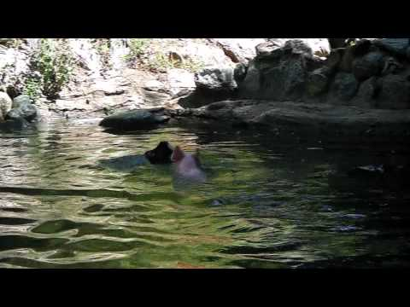
LESSON
Notes:
Teacher notes: Play the video after asking students if they have seen this video that went viral last year.

Slide 49
LESSON
Answer these questions in your Note to Self journal!
How does this video make you feel happy? | What makes this video good?
Notes:
Teacher notes: Discuss - prompt students to discuss the video with the questions above. The video should make students feel happy because the stranded goat (victim) was rescued by an unlikely hero (the pig). The video plays to our emotions because we celebrate when something great happens.

Slide 50
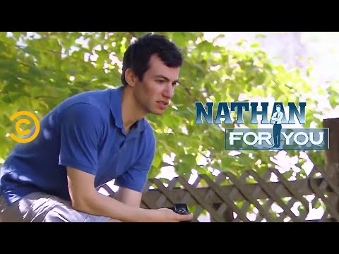
LESSON
Notes:
Teacher notes: before playing the video, tell students that fake news is created to purposely distract us from truth and facts and always has a real purpose.

Slide 51
LESSON
Answer these questions in your Note to Self journal!
How did this video make you feel? | What was the purpose of creating a fake video?
Notes:
Teacher notes: Discuss - prompt students to discuss the second video. Students might feel angry or disappointed that the video was intentionally made to be fake news. Students might also think the dupe is funny. Direct the conversation so that students understand intentionally spreading false news is not ethical or moral. In order to be a great journalist, we must adhere to set standards of journalism and constantly check facts to make sure we are spreading news that is true.

Slide 52
ACTIVITY
Answer these questions in your Note to Self journal!
Who is your intended audience? | What is the overall message you are trying to share?
What are the main points? | What evidence have you gathered to prove the main points?
Search for evidence to add!
Notes:
Teacher notes: Sources matter in journalism but before you can begin to find sources, students need to have a general idea of what they are up against when it comes to climate change. Have students add the above information to their Note to Self journal using the provided article or allow students to search for evidence for their chosen topics.

Slide 53
ACTIVITY
Use the CRAAP test and find at least two sources to use in your article.
Currency: the timeliness of information When was the information published? Has the information been updated? Does your topic require current sources or will older sources work?
Relevance: the importance of the information for your needs Does the information relate to your topic? Does the intended audience match your intended audience (age, grade, gender, etc)? Have you looked at a variety of sources?
Authority: the source of the information Who is the author? What are the author's credentials or organizational affiliations? Is the author qualified to write on the topic?
Accuracy: the reliability, truthfulness, and correctness of the content Where does the information come from? Is the information supported by evidence? Does the language or tone remain unbiased and free from emotions?
Purpose: the reason information exists What is the purpose? Is it to inform, teacher, sell, entertain, or persuade? Does the author make the purpose clear? Is the information fact, opinion, or propaganda?
C
R
A
A
P
source
Notes:
Teacher notes: Discuss - fact checking is the most important job a journalist has because it ensures that they are creating articles based on truth and are not spreading fake news. Fact Checkers do this by using the CRAAP test. Discuss the CRAAP test and have students use the CRAAP test on the previous activity.

Slide 54
EXIT TICKET
Answer these questions in your Note to Self journal!
How can you determine if news is fake or factual? | What is the main point of your documentary?
Notes:
Teacher notes:
Have students answer this question in the “Note to Self Journal”

Slide 55
Day 6
Climate Justice:
All Voices Matter

Slide 56
Do Now
Question:
Who is most affected by climate change?
Notes:
Teacher notes:
Have students answer this question in the “Note to Self Student Journal" digital or pdf format.

Slide 57
OBJECTIVES
Students will be able to:
Explain what climate justice is and how climate change impacts minorities
Evaluate the relevance of climate change stories and select stories for their documentary.
Notes:
Teacher notes:
Review the objectives for the day, so students know what is expected of their learning

Slide 58
AGENDA
Do Now
Lesson: Why Voices Matter in Climate Justice
Activity: Voices Matter
Exit Ticket
Notes:
Teacher notes:
Review the agenda for the day

Slide 59
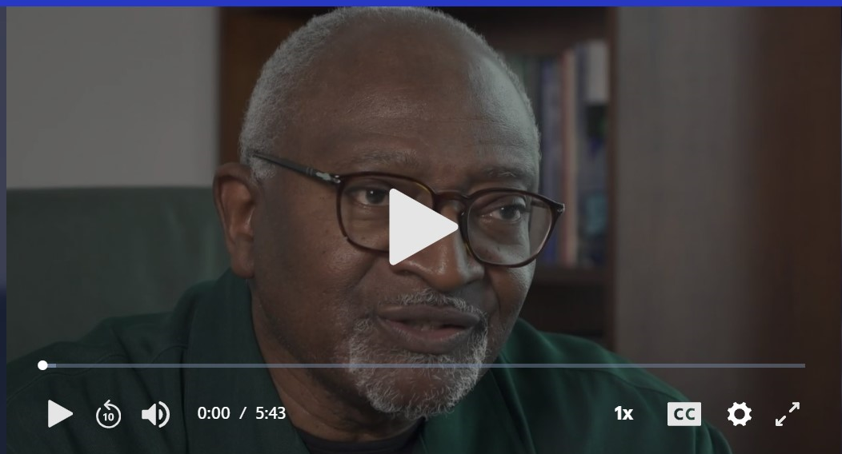
LESSON
Climate change is real & affects us all.
Watch this video explaining why climate justice is important.
“This is only one example of environmental racism that low-income communities of color face. For residents in the area, they are not just fighting climate change, they're fighting for their ‘Freedom to Breathe’." (source)
Notes:
Teacher notes
Watch the video - click on the image to be redirected to the video or the video link is here
After the watching the video, have students to share their reactions outloud & in their student journals

Slide 60
ACTIVITY
Read stories from real people about how Climate Change has affected their lives!
Larry Gibson, West Virginia | Roman Abramovich, Russia | Wangari Maathai, Kenya | Enele Sopoaga, Tuvalu | Matthew Gilbert, Alaska/Canada
Chris Loken, New York | James Hansen, NASA/ New York City | Stephanie Tunmore, Greenpeace | Yolanda del Carmen Marin, El Salvador | Rafael Hernandez, Desert Angels
Richard Anderson, Georgia | Trisha Kehaulani Watson, Hawaii | Mustafa Abdul Hamid, Syria | Steve Tritch, Westinghouse Electric | Nancy Tanaka, Oregon
Moi Enomenga, Ecuador | Anisur Rahman, Bangladesh | Robert Lovelace, Canada | Wangchuk, India | Elizabeth Easton, California
Tom Conway, Florida | Paulette Richards, Florida
Answer questions in your Student Journal!
Notes:
Teacher notes
Encourage students to read 4-5 stories included from real people about how climate change has affected their lives.
For digital based, you can post the link to the stories. For paper based, you can print a class set for students to use.
Have students answer the questions in their student journal.

Slide 61
EXIT TICKET
Answer the question in your Note to Self journal!
Which story impacted you the most? Why was their story so powerful?
Notes:
Teacher notes:
Have students answer this question in the “Note to Self Journal”

Slide 62
Days 7
Design the Documentary

Slide 63
DO NOW
Question:
Have you ever watched a documentary? If so, what was it about? If not, write down the last thing you watched that was based on real life events.
Notes:
Teacher notes:
Have students answer this question in the “Note to Self Student Journal" digital or pdf format.

Slide 64
OBJECTIVES
Students will be able to:
Identify the types of documentaries and select the type they plan to create
Begin to write their documentary scripts
Notes:
Teacher notes:
Review the objectives for the day, so students know what is expected of their learning

Slide 65
AGENDA
Do Now
Mini-lesson: What is a documentary?
Activity: Get started, filmmaker!
Exit Ticket
Notes:
Teacher notes:
Review the agenda for the day

Slide 66
LESSON
Documentaries are nonfiction movies that explore and investigate real stories!
Documentaries should:
be informative
bring attention to real stories
raise awareness and understanding of the events currently taking place
Did You Know? Nonfiction means a movie that is based on facts, real events, and real people - like a biography or historical event.
Notes:
Teacher notes
Read the definition of documentaries to students. Ask them if they have ever seen a documentary?

Slide 67
LESSON
What is a documentary?
Documentaries usually are created to INFORM the viewer about something they might not already know or they also want to PERSUADE the viewer.
Let’s watch a few examples of 60 second documentaries.
Notes:
Teacher notes
Click on the video squares to launch the videos. There are a ton of examples located on the 60 second docs youtube channel so feel free to play as many as you can!

Slide 68
ACTIVITY
Your turn:
Filmmaker, write your script!
Notes:
Teacher notes
Walk students through the script writing activity located in the student journal including creating an outline and script for their documentary. Feel free to make a duplicate of slide 14 in the student journal if students needs more room for their script. Students will be submitting their script & video file for the contest. Click here for a longer version of the script as a Google doc and here as a pdf.

Slide 69
EXIT TICKET
Answer these questions in your Note to Self journal!
Is your documentary informing or persuading your audience?
Notes:
Teacher notes:
Have students answer this question in the outline section of their “Note to Self Journal” day 7

Slide 70
Day 8
Edit the Documentary

Slide 71
ESSENTIAL QUESTION
How can you give excellent feedback to your peers?
Notes:
Teacher notes:
Have students answer this question in the “Note to Self Student Journal" digital or pdf format.

Slide 72
OBJECTIVES
Students will be able to:
Complete peer edit critique
Understand the difference between good & poor feedback
Notes:
Teacher notes:
Review the objectives for the day, so students know what is expected of their learning

Slide 73
AGENDA
Complete the good versus poor feedback lesson
Complete the 4 Corners Critique activity
Notes:
Teacher notes:
Review the agenda for the day

Slide 74
LESSON
Feedback is most helpful when it is honest and offering ways of improvement.
Look at the difference between the examples on the next slide and discuss why some examples are better than others.
Notes:
Teacher notes: Discuss - why honest feedback is important.

Slide 75


LESSON
Ex) “That’s a great idea!” | Ex) “That’s a great idea! You seem to really be passionate about this topic. I wonder if you have read the script out loud? You have a few minor errors that reading out loud will help you find.”
Ex) “I didn’t like your conclusion.” | Ex) “Your conclusion seems to be short. I wonder if you could explain your idea a little more?”
Notes:
Teacher notes:
Discuss - use the examples provided and discuss why the bad examples are not helpful and discuss why the good examples are helpful to the writer

Slide 76




ACTIVITY
Ideas you love
Positive criticisms
Questions you have
Ideas to make
it better
Notes:
Teacher notes:
Use the handout in digital form or on paper and have students complete the activity for 3-4 peers then allow students time to reflect on the feedback and make changes to their script. The heart is for things you liked about the script. The settings/gear wheel is for items that can be improved but worded in a positive way. The question mark is for items that did not make sense or need clarification. The lightning bolt is for suggestions to make the script better. Click here for the digital version and click here for the printable version.

Slide 77
EXIT TICKET
Answer these questions in your Note to Self journal!
What changes did you make to your documentary script based on feedback from your peers?
Notes:
Teacher notes:
Have students answer this question in the “Note to Self Journal”

Slide 78
Day 9
Build the Documentary

Slide 79
ESSENTIAL QUESTION
What are you most excited about showcasing in your one minute documentary?
Notes:
Teacher notes:
Have students answer this question in the “Note to Self Student Journal" digital or pdf format.

Slide 80
OBJECTIVES
Students will be able to:
Create a one minute documentary
Notes:
Teacher notes:
Review the objectives for the day, so students know what is expected of their learning

Slide 81
AGENDA
Create a one minute documentary
Notes:
Teacher notes:
Review the agenda for the day

Slide 82
ACTIVITY
Build your documentary!
Notes:
Teacher notes:
You can create a one minute documentary in any of the following ways. Click here for an overview video for each of the following suggestions.
Use adobe spark
Use WeVideo
Use Google Slides (with images) and record the screen with Loom or include audio files (using online-voice-recorder) for each slide
Use Google Slides to create stop motion videos and record the screen with Loom or include audio files (using online-voice-recorder)
Low tech, no problem? Have students draw images on paper and record over them using their voice as a narration (info and example)

Slide 83
EXIT TICKET
Answer this question in your Note to Self journal!
Submit your one minute documentary to the BreakFree Education contest!
Notes:
Teacher notes:
Have students answer this question in the “Note to Self Journal”

Slide 84
UNCOVERED

