Slide 1
Unveiled

Slide 2
Day 1
The Importance of Women in History

Slide 3
Featured Teacher Fellow
Unveiled is adapted from BreakFree Education’s Teacher Fellow Clarissa Robison’s original content. Clarissa teaches at a juvenile justice facility in Missouri.

Slide 4
Introduction
Through Unveiled, students study the lives of notable women and women's movements throughout history in the areas of art, STEM, and sports. The Unveiled initiative culminates with a living museum through which students showcase their knowledge. Students select a notable woman in history and build an artifact that represents that woman's impact on the world, to be displayed in the living museum.
Don’t forget, there’s a competition too!
Notes:
Explain to students that by the end of this unit, they will be asked to create an artifact for a living museum. Anytime something sparks their imagination, they should make a note of it. Explain BreakFree’s monthly contest and pass out the Note to Students.

Slide 5
DO NOW
Question:
Name a notable woman in history and list three important facts about them.
Notes:
Teacher notes:
discuss as a class and/or have students keep a learning journal throughout this.

Slide 6
OBJECTIVE
Students will
Explain why it is important to include everyone in history
Identify at least two notable women from history
Notes:
Teacher notes:
Review the objectives for the day, so students know what is expected of their learning

Slide 7
AGENDA
Do Now
Mini Lesson: The Importance of Women in History
Activity: Think, Pair, Share
Exit Ticket
Notes:
Teacher notes:
Review the agenda for the day

Slide 8
What are we talking about?
What do you know about Women’s History?
Over the next few days, we will study notable women in history from the following categories:
Women’s Suffrage
Women in STEM
Women in the Arts
Women in Sports
Notes:
Teacher notes:

Slide 9
Why Study Women in History?
The next few slides are from the UN Women’s website and is a moving timeline of women’s activism throughout history.
Notes:
Teacher notes:
Access a moving timeline of women’s activism throughout history at this link: https://interactive.unwomen.org/multimedia/timeline/womenunite/en/index.html#/

Slide 10
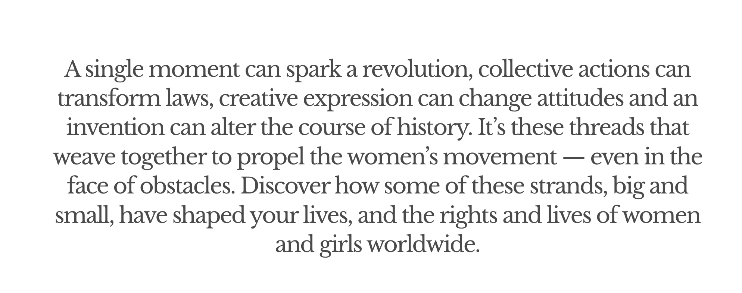
Why Study Women in History?
Source: UN Women
Notes:
Teacher notes:
Source Link: https://interactive.unwomen.org/multimedia/timeline/womenunite/en/index.html#/

Slide 11
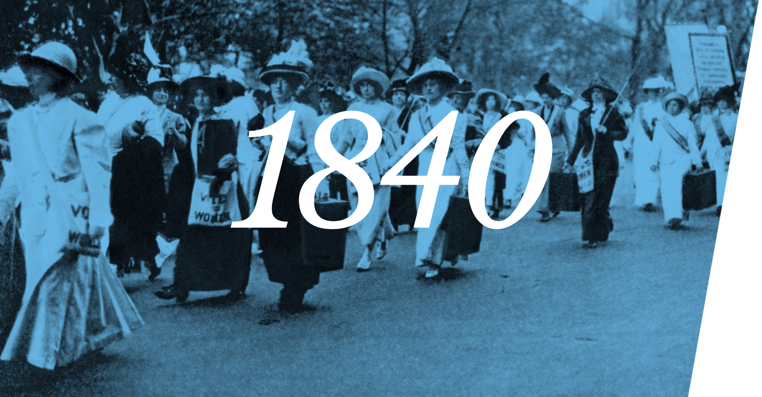
Why Study Women in History?
Source: UN Women
Notes:
Teacher notes:
Source Link: https://interactive.unwomen.org/multimedia/timeline/womenunite/en/index.html#/

Slide 12
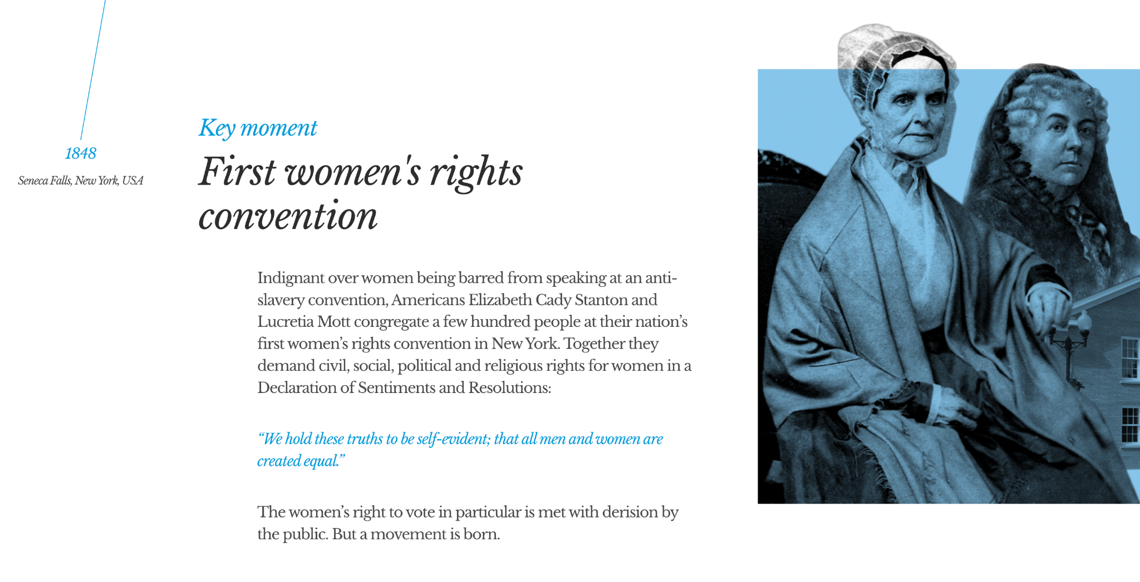
Why Study Women in History?
Source: UN Women
Notes:
Teacher notes:
Source Link: https://interactive.unwomen.org/multimedia/timeline/womenunite/en/index.html#/

Slide 13
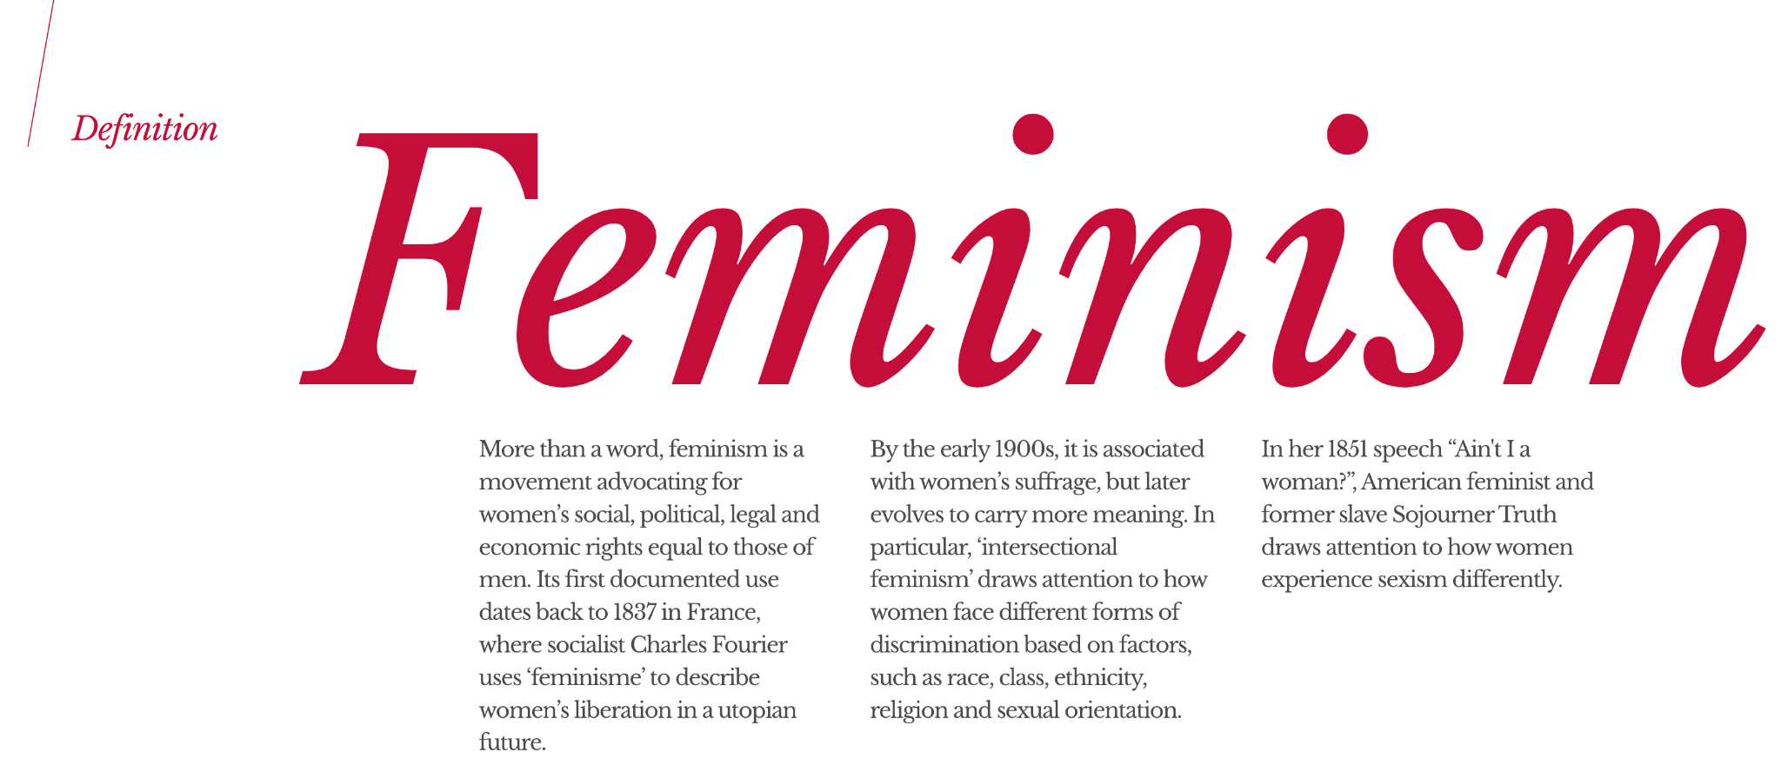
Why Study Women in History?
Source: UN Women
Notes:
Teacher notes:
Read the text on the slide and discuss as a group.

Slide 14
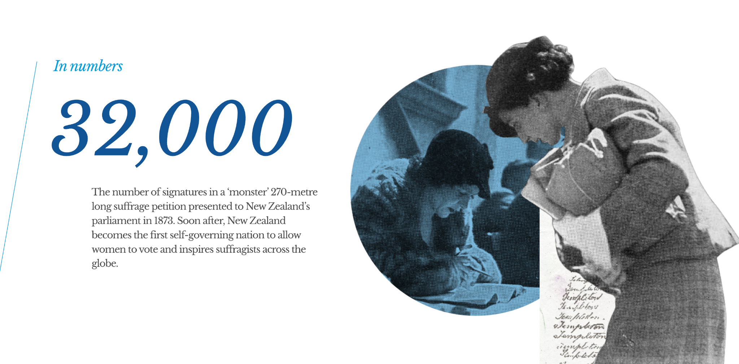
Why Study Women in History?
Source: UN Women
Notes:
Teacher notes:
Source Link: https://interactive.unwomen.org/multimedia/timeline/womenunite/en/index.html#/

Slide 15
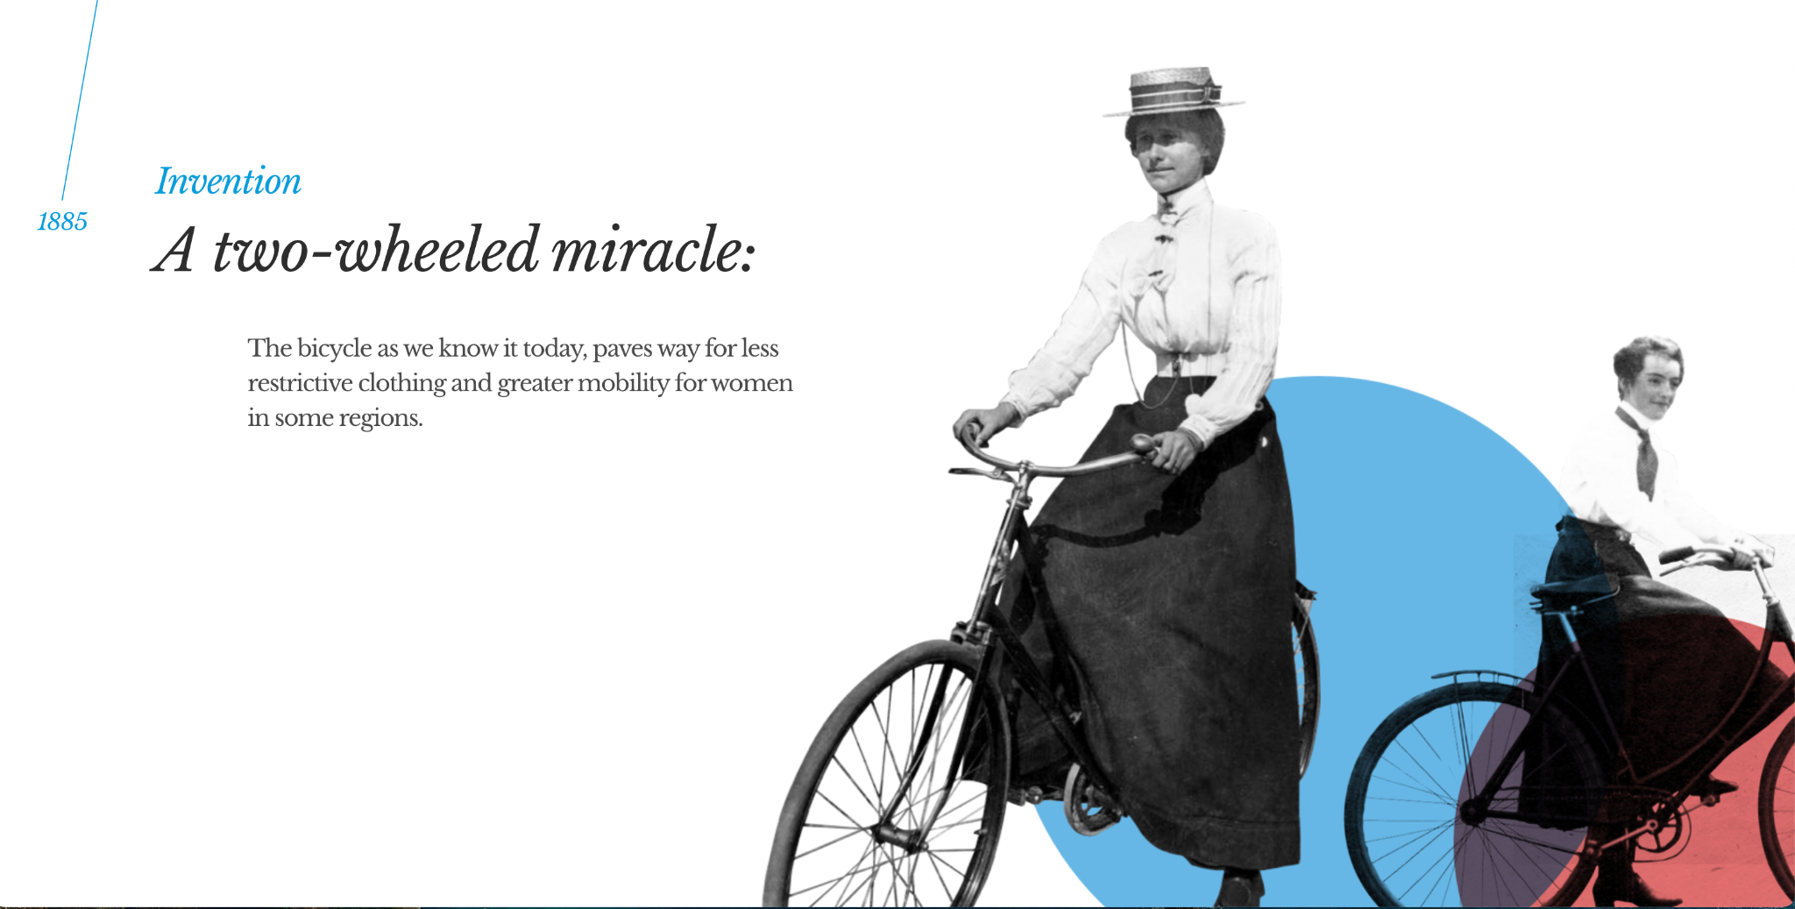
Why Study Women in History?
Source: UN Women
Notes:
Teacher notes:
Source Link: https://interactive.unwomen.org/multimedia/timeline/womenunite/en/index.html#/

Slide 16
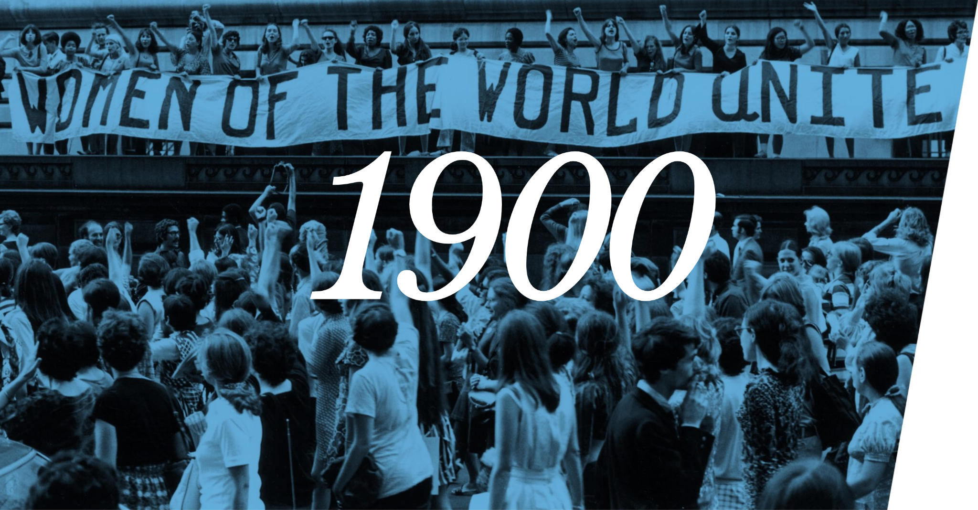
Why Study Women in History?
Source: UN Women
Notes:
Teacher notes:
Source Link: https://interactive.unwomen.org/multimedia/timeline/womenunite/en/index.html#/

Slide 17
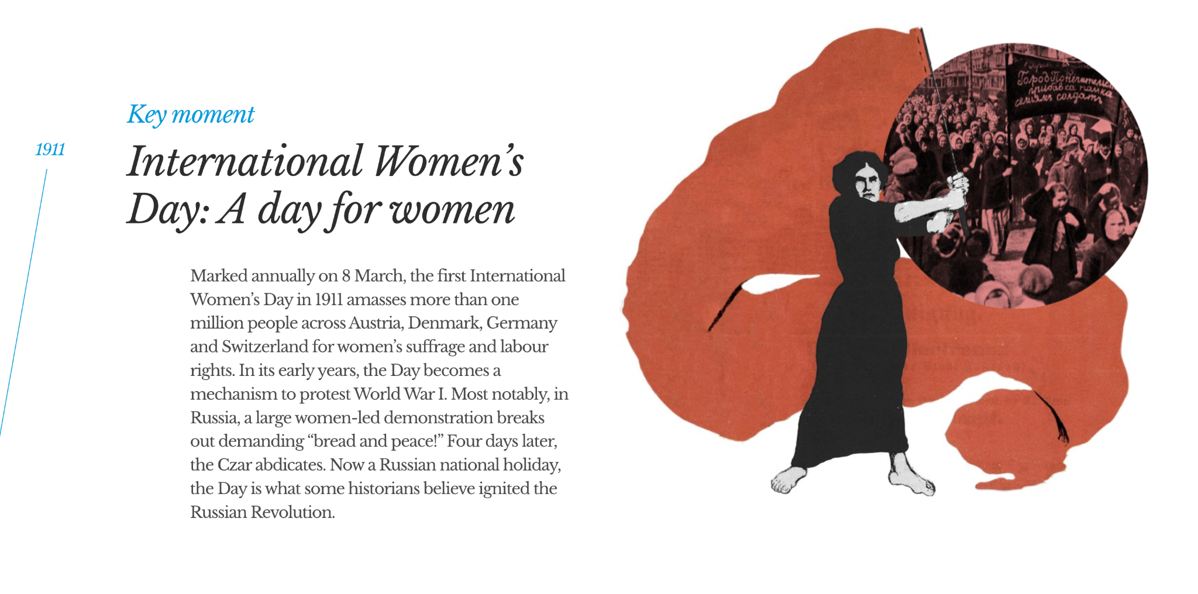
Why Study Women in History?
Source: UN Women
Notes:
Teacher notes:
Source Link: https://interactive.unwomen.org/multimedia/timeline/womenunite/en/index.html#/

Slide 18
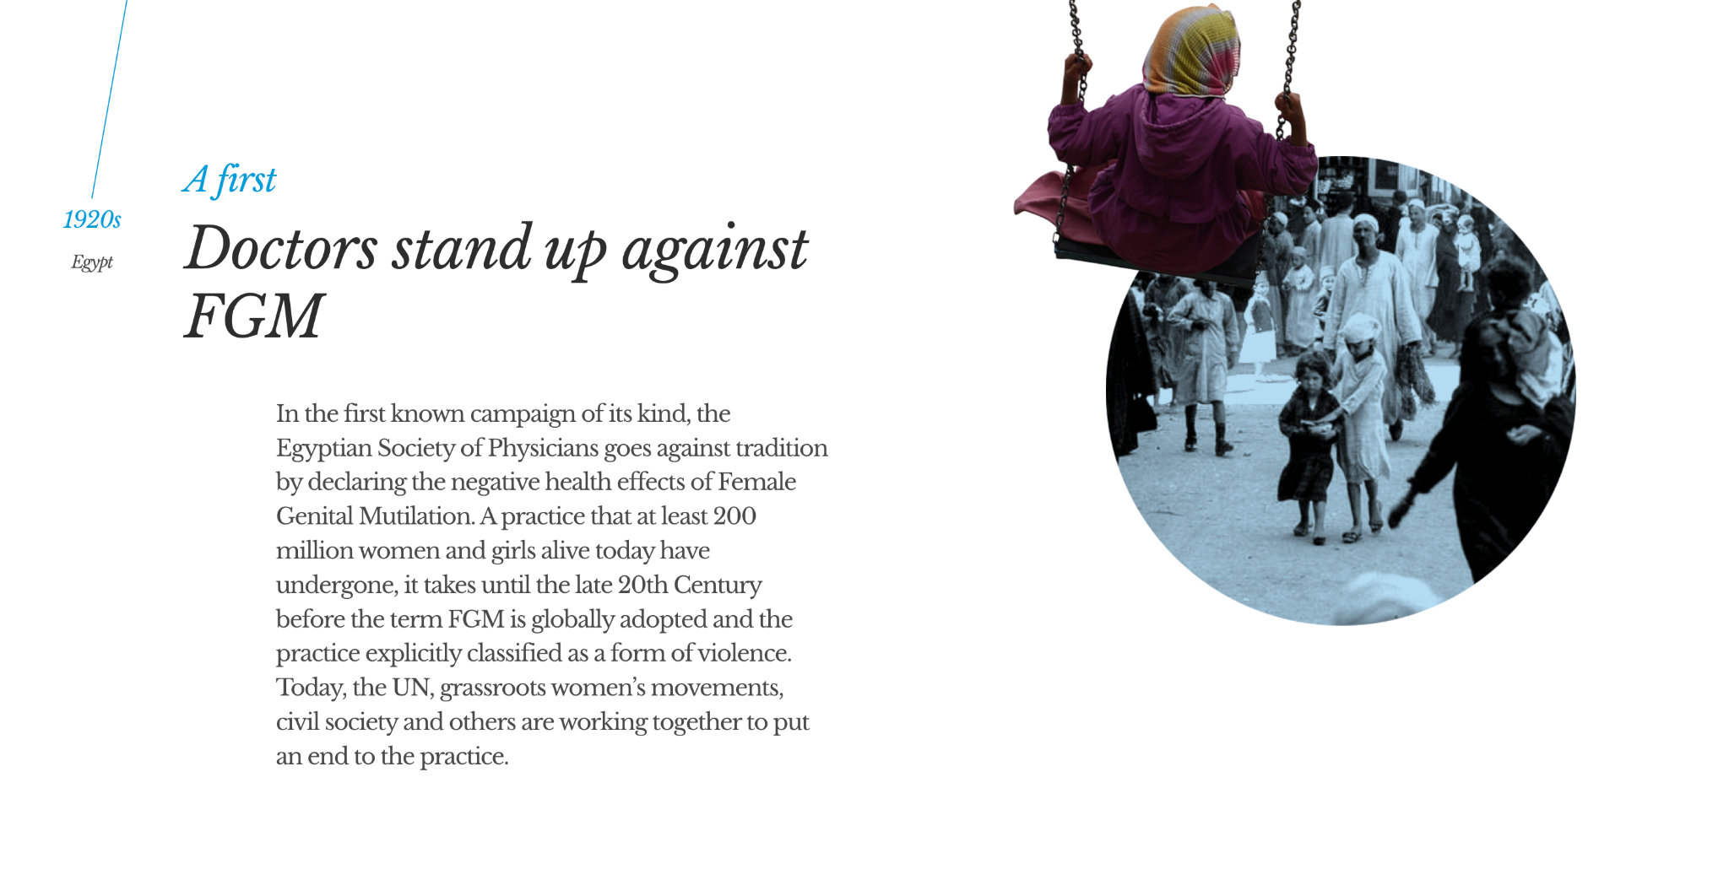
Why Study Women in History?
Source: UN Women
Notes:
Teacher notes:
Source Link: https://interactive.unwomen.org/multimedia/timeline/womenunite/en/index.html#/

Slide 19
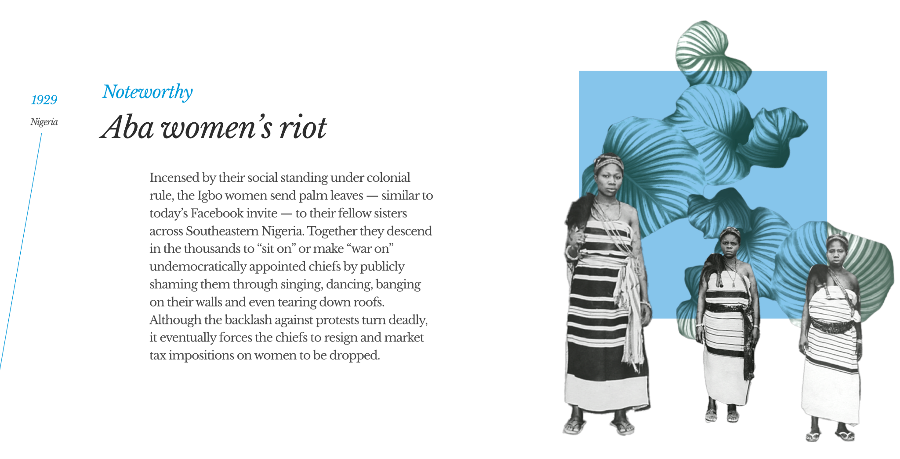
Why Study Women in History?
Source: UN Women
Notes:
Teacher notes:
Source Link: https://interactive.unwomen.org/multimedia/timeline/womenunite/en/index.html#/

Slide 20
Why Study Women in History?
Source: UN Women
Notes:
Teacher notes:
Source Link: https://interactive.unwomen.org/multimedia/timeline/womenunite/en/index.html#/

Slide 21
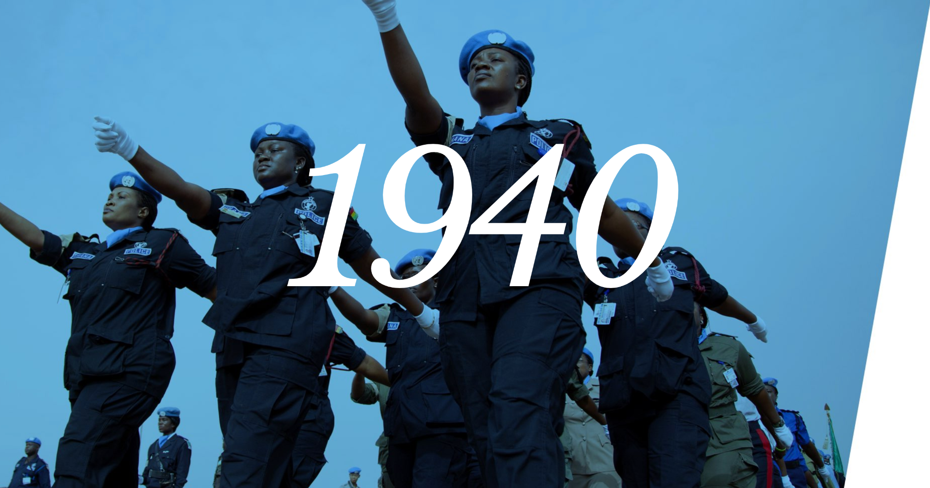
Why Study Women in History?
Source: UN Women
Notes:
Teacher notes:
Source Link: https://interactive.unwomen.org/multimedia/timeline/womenunite/en/index.html#/

Slide 22
Why Study Women in History?
Source: UN Women
Notes:
Teacher notes:
Source Link: https://interactive.unwomen.org/multimedia/timeline/womenunite/en/index.html#/

Slide 23
Why Study Women in History?
Source: UN Women
Notes:
Teacher notes:
Source Link: https://interactive.unwomen.org/multimedia/timeline/womenunite/en/index.html#/

Slide 24
Why Study Women in History?
Source: UN Women
Click here to watch her speech!
Notes:
Teacher notes:
Source Link: https://interactive.unwomen.org/multimedia/timeline/womenunite/en/index.html#/

Slide 25
Why Study Women in History?
Source: UN Women
Notes:
Teacher notes:
Source Link: https://interactive.unwomen.org/multimedia/timeline/womenunite/en/index.html#/

Slide 26
Why Study Women in History?
Source: UN Women
Notes:
Teacher notes:
Source Link: https://interactive.unwomen.org/multimedia/timeline/womenunite/en/index.html#/

Slide 27
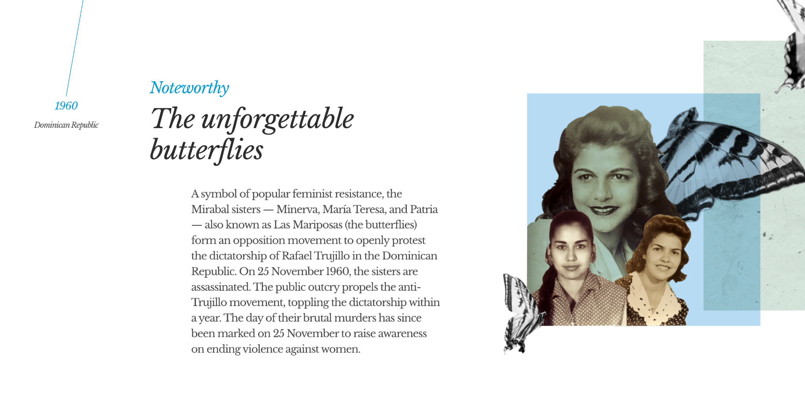
Why Study Women in History?
Source: UN Women
Notes:
Teacher notes:
Source Link: https://interactive.unwomen.org/multimedia/timeline/womenunite/en/index.html#/

Slide 28
Why Study Women in History?
Source: UN Women
Notes:
Teacher notes:
Source Link: https://interactive.unwomen.org/multimedia/timeline/womenunite/en/index.html#/

Slide 29
Why Study Women in History?
Source: UN Women
Notes:
Teacher notes:
Source Link: https://interactive.unwomen.org/multimedia/timeline/womenunite/en/index.html#/

Slide 30
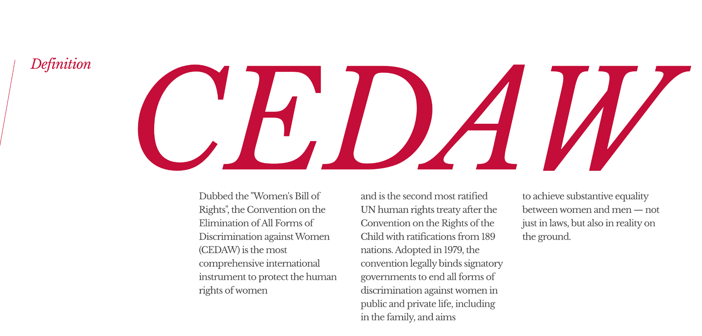
Why Study Women in History?
Source: UN Women
Notes:
Teacher notes:
Source Link: https://interactive.unwomen.org/multimedia/timeline/womenunite/en/index.html#/

Slide 31
Why Study Women in History?
Source: UN Women
Notes:
Teacher notes:
Source Link: https://interactive.unwomen.org/multimedia/timeline/womenunite/en/index.html#/

Slide 32
Why Study Women in History?
Source: UN Women
Notes:
Teacher notes:
Source Link: https://interactive.unwomen.org/multimedia/timeline/womenunite/en/index.html#/

Slide 33
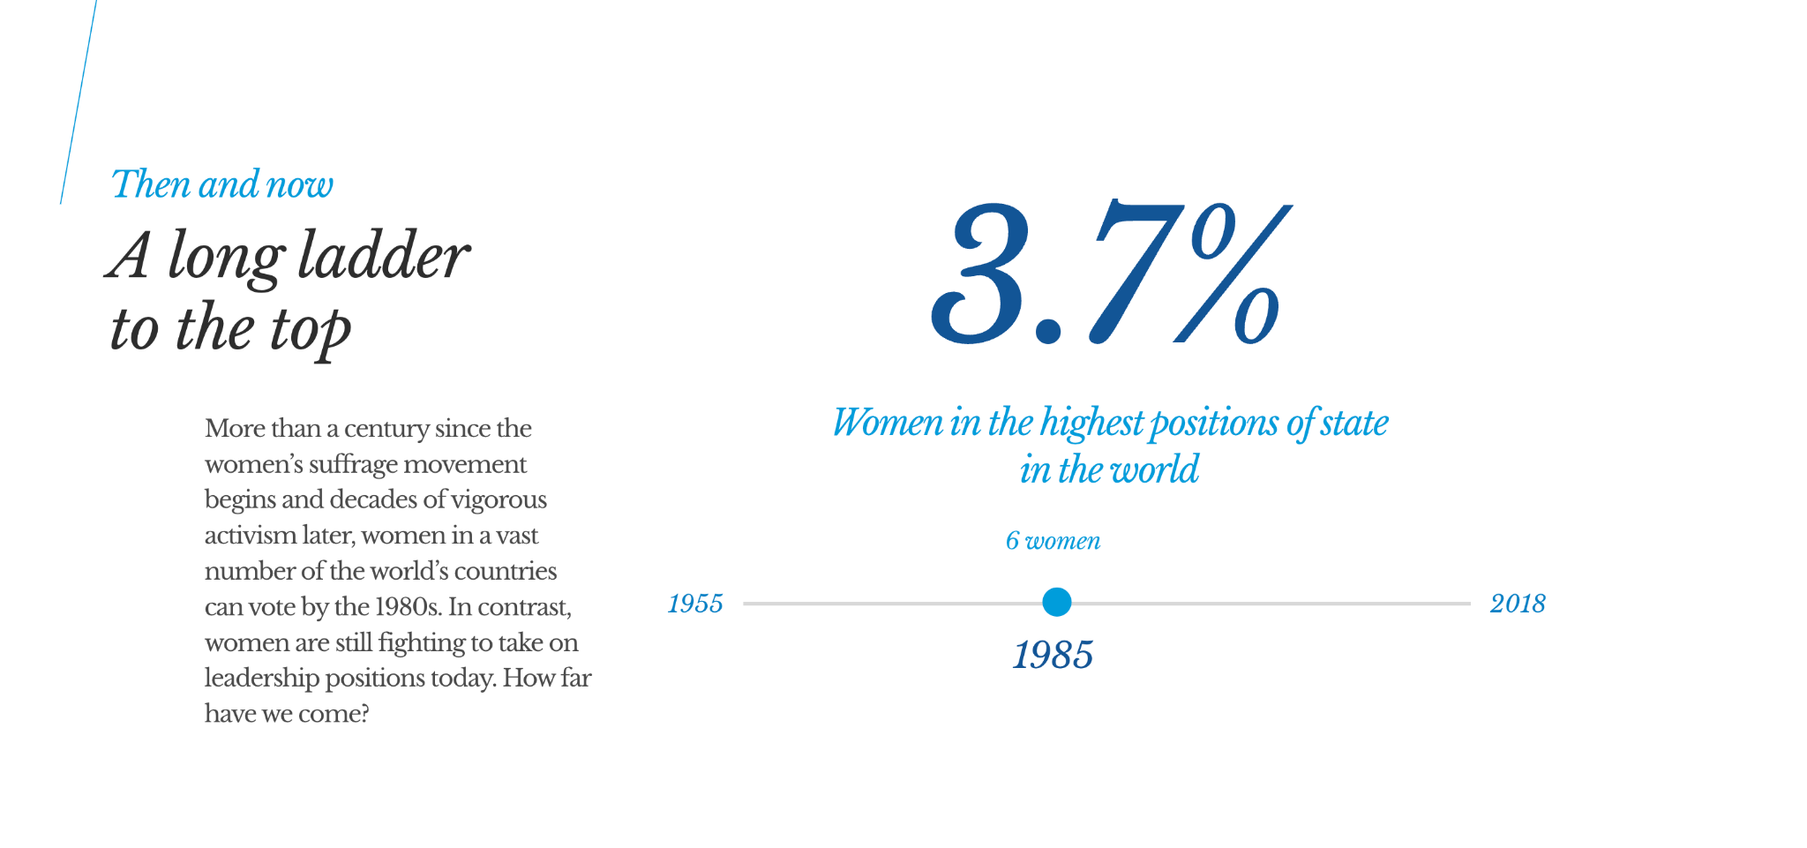
Why Study Women in History?
Source: UN Women
Notes:
Teacher notes:
Source Link: https://interactive.unwomen.org/multimedia/timeline/womenunite/en/index.html#/

Slide 34
Why Study Women in History?
Source: UN Women
Notes:
Teacher notes:
Source Link: https://interactive.unwomen.org/multimedia/timeline/womenunite/en/index.html#/

Slide 35
Why Study Women in History?
Source: UN Women
Notes:
Teacher notes:
Source Link: https://interactive.unwomen.org/multimedia/timeline/womenunite/en/index.html#/

Slide 36
Why Study Women in History?
Source: UN Women
Notes:
Teacher notes:
Source Link: https://interactive.unwomen.org/multimedia/timeline/womenunite/en/index.html#/

Slide 37
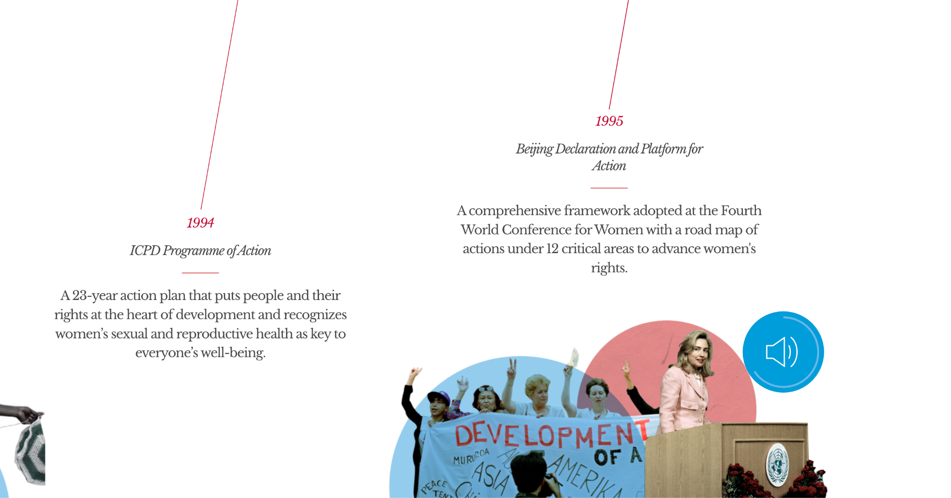
Why Study Women in History?
If there is one message that echoes forth from this conference, let it be that human rights are women's rights and women's rights are human rights, once and for all. - Hillary Clinton
Source: UN Women
Notes:
Teacher notes:
Source Link: https://interactive.unwomen.org/multimedia/timeline/womenunite/en/index.html#/

Slide 38
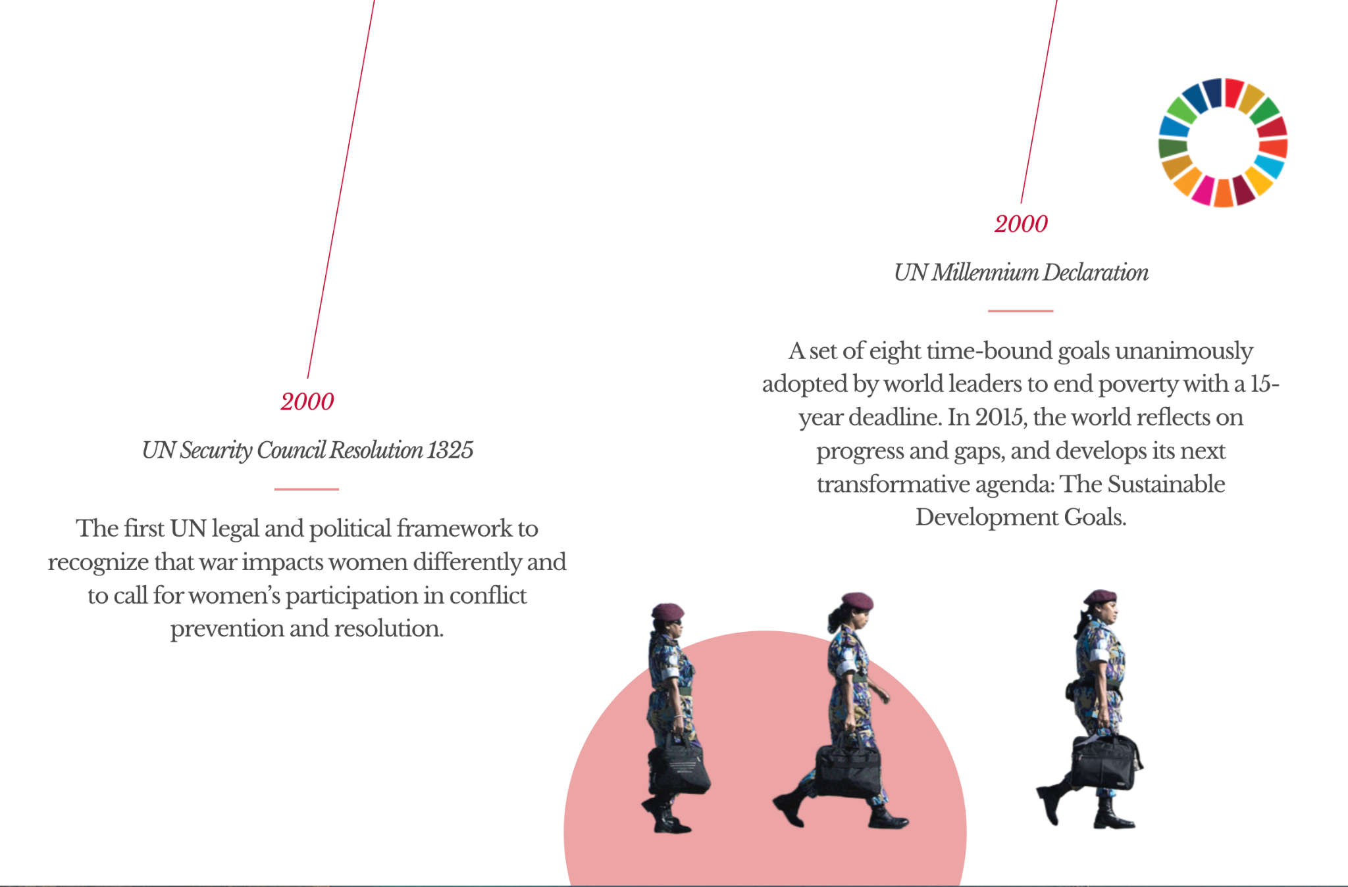
Why Study Women in History?
Source: UN Women
Notes:
Teacher notes:
Source Link: https://interactive.unwomen.org/multimedia/timeline/womenunite/en/index.html#/

Slide 39
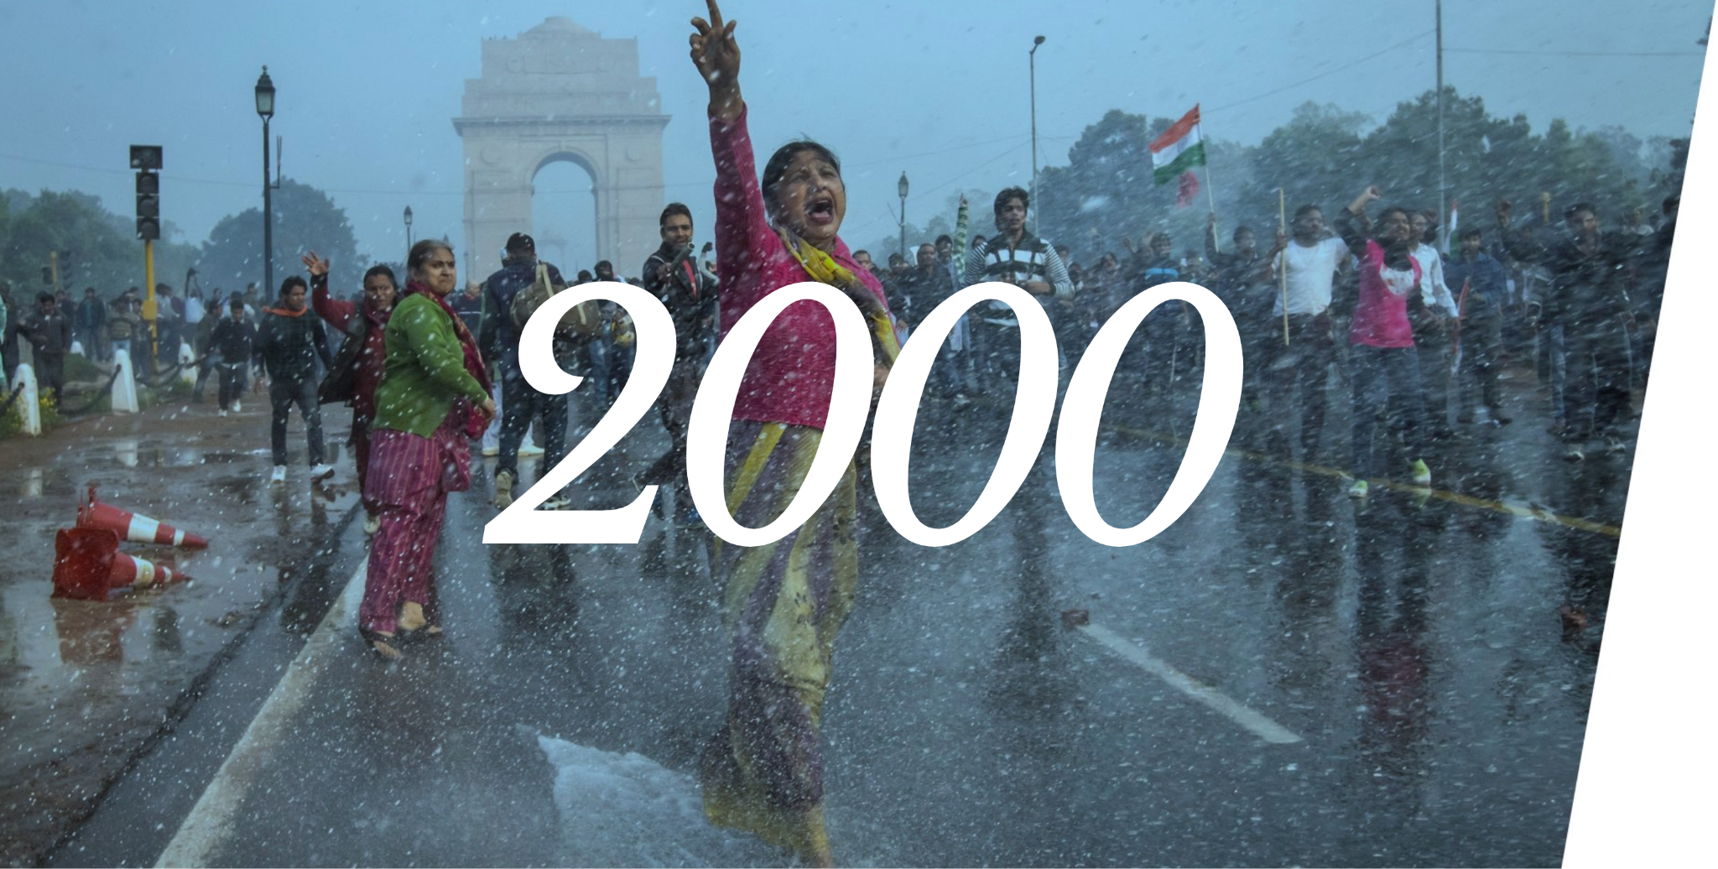
Why Study Women in History?
Source: UN Women
Notes:
Teacher notes:
Source Link: https://interactive.unwomen.org/multimedia/timeline/womenunite/en/index.html#/

Slide 40
Why Study Women in History?
Source: UN Women
Notes:
Teacher notes:
Source Link: https://interactive.unwomen.org/multimedia/timeline/womenunite/en/index.html#/

Slide 41
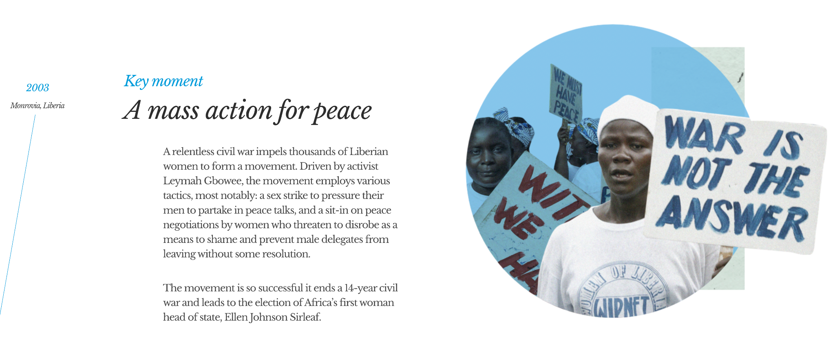
Why Study Women in History?
Source: UN Women
Notes:
Teacher notes:
Source Link: https://interactive.unwomen.org/multimedia/timeline/womenunite/en/index.html#/

Slide 42
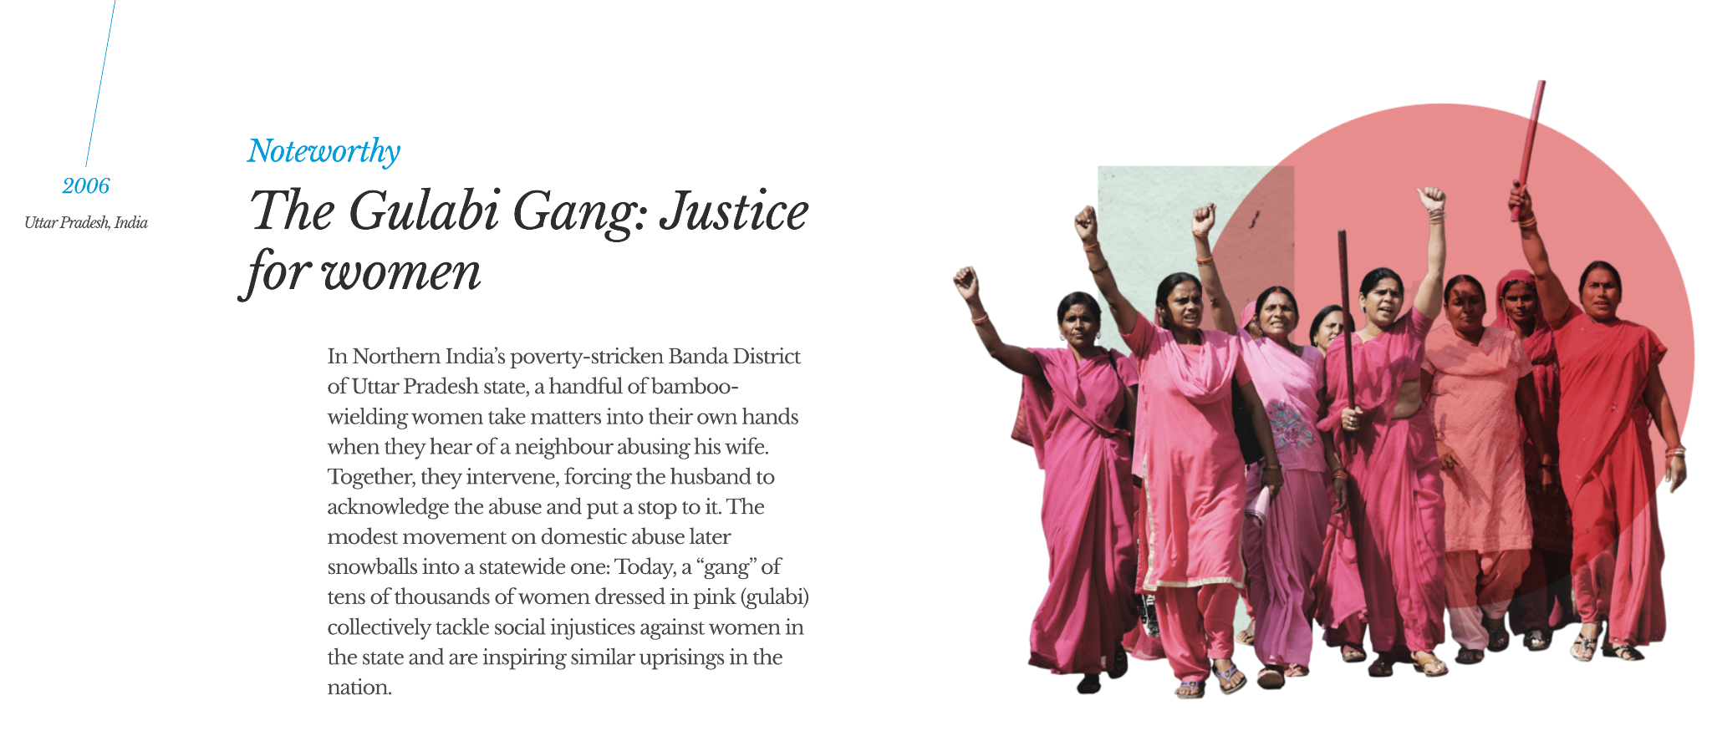
Why Study Women in History?
Source: UN Women
Notes:
Teacher notes:
Source Link: https://interactive.unwomen.org/multimedia/timeline/womenunite/en/index.html#/

Slide 43
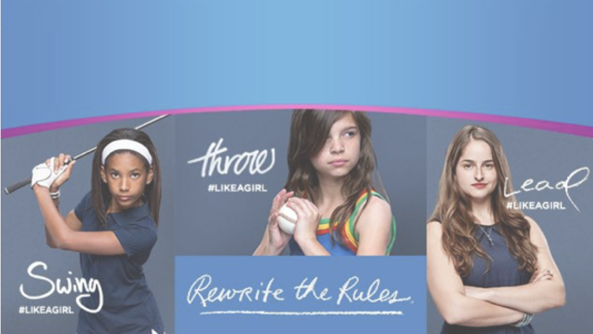
Why Study Women in History?
Source: UN Women
Notes:
Teacher notes:
Source Link: https://interactive.unwomen.org/multimedia/timeline/womenunite/en/index.html#/

Slide 44
Why Study Women in History?
Source: UN Women
Notes:
Teacher notes:
Source Link: https://interactive.unwomen.org/multimedia/timeline/womenunite/en/index.html#/

Slide 45
Why Study Women in History?
Source: UN Women
Click here to watch her speech!
Notes:
Teacher notes:
Source Link: https://interactive.unwomen.org/multimedia/timeline/womenunite/en/index.html#/

Slide 46
Why Study Women in History?
Source: UN Women
Notes:
Teacher notes:
Source Link: https://interactive.unwomen.org/multimedia/timeline/womenunite/en/index.html#/

Slide 47
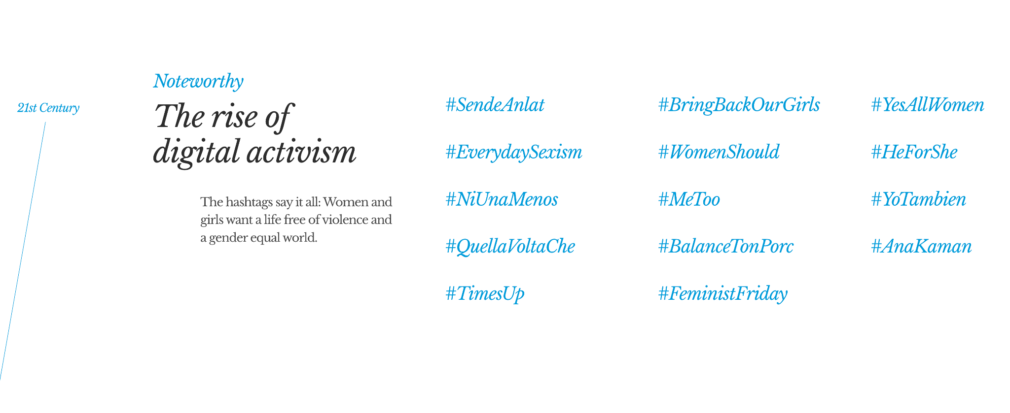
Why Study Women in History?
Source: UN Women
Notes:
Teacher notes:
Source Link: https://interactive.unwomen.org/multimedia/timeline/womenunite/en/index.html#/

Slide 48
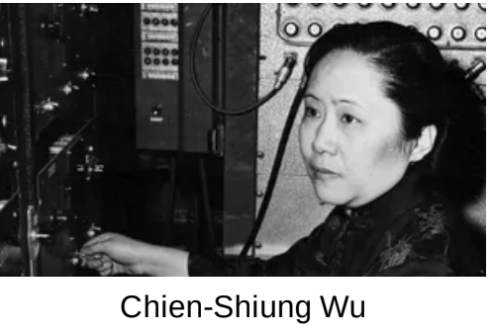
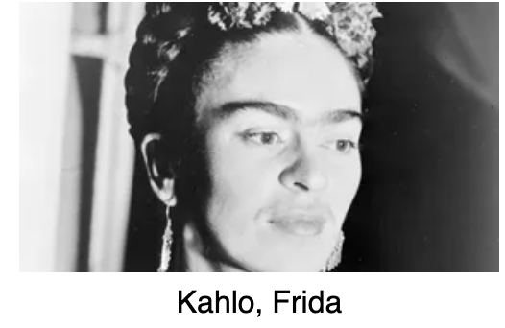
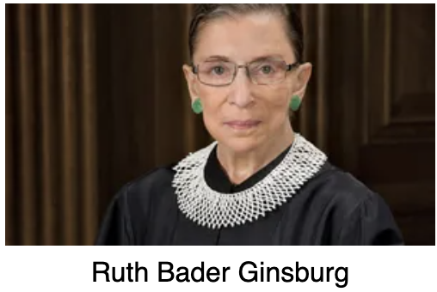
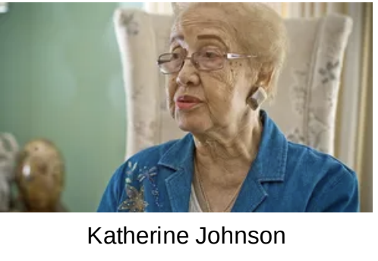
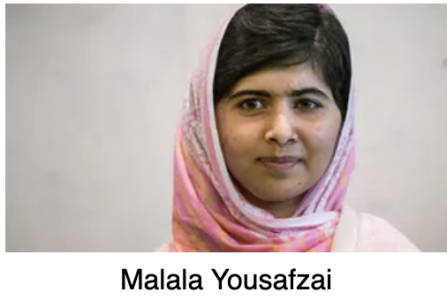
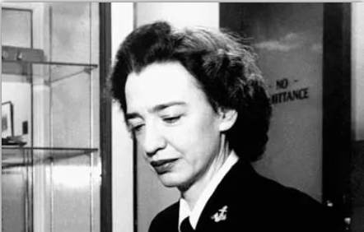
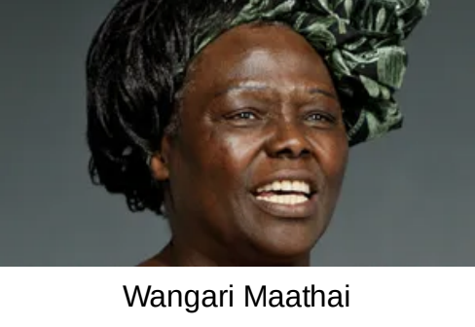
ACTIVITY
Select one of the women below (or choose your own notable women from history).
Read the provided article and answer the question on the next slide.
Grace Hopper
Notes:
Teacher notes:
Provide access to the list of women from the slide. You can access PDFs at this link: https://drive.google.com/drive/folders/1eGW6kvH8ppR7XDde0clFSkhwdCbY1b1t?usp=sharing
If allowed, you can have students research their own notable women from history or feel free to provide more than just these names.
NOTE: there is information available on more women than pictured on this slide in the linked folder

Slide 49
ACTIVITY
THINK
What are three things you learned from your selected woman in history?
Notes:
Teacher notes:
students will

Slide 50
ACTIVITY
PAIR
Rotate through groups discussing what you learned about your selected notable women in history.
(1) COUNT AWAY
(2) ODDS VERSUS EVENS
1
2
3
4
(3) NUMBERS UNITES
EXAMPLES
Notes:
Teacher notes:
Assign a number to students 1, 2, 3, and 4.
Students will rotate through the groups sharing what they learned from their notable women in history in the following order:
Count Away (each group has a 1, 2, 3, and 4 represented)
Odds versus Evens: odds & evens together (one group has two 1s and two 3s, another group has two 2s and two 4s, etc)
Numbers Unite: All same numbers together (all 1s, all 2s, all 3s, all 4s)
Students can spend any length of time in each group. The teacher should rotate through the groups to ensure students are on topic. If you do not have enough students for four groups, you can split students into any number of groups that works best. The goal is to have students discussing what they found several times with different students.

Slide 51
ACTIVITY
SHARE
Let’s hear what you learned?
Present your information to the class.
Notes:
Teacher notes:
students will

Slide 52
EXIT TICKET
Don’t forget to complete your daily learning log!!
Question
Why is learning about our history essential to our future?
Notes:
Teacher notes:
discuss as a class and/or have students keep a learning journal throughout this initiative
Remind students to complete Daily Learning Log.

Slide 53
Day 2
Women’s Suffrage

Slide 54
DO NOW
Question
What do you currently know about the Suffrage movement?
Notes:
Teacher notes:
Discuss as a class and/or have students keep a learning journal throughout this initiative

Slide 55
OBJECTIVE
Students will
Understand the Women’s Suffrage movement
Create a poster for a protest march
Notes:
Teacher notes:
Review the objectives for the day, so students know what is expected of their learning

Slide 56
AGENDA
Do Now
Mini Lesson: The Suffrage Movement
Activity: Marching Protest Poster
Exit Ticket
Notes:
Teacher notes:
Review the agenda for the day

Slide 57
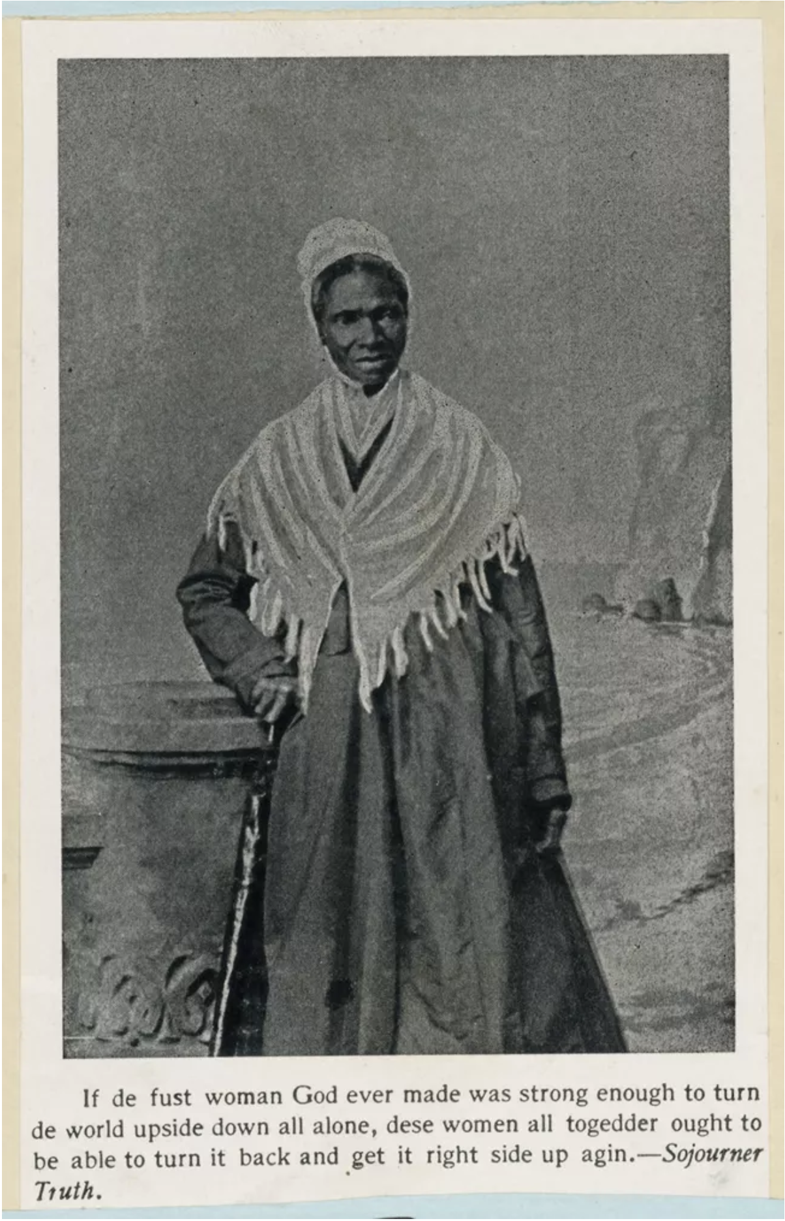
Sojournor Truth
Sojourner Truth was born enslaved with the name Isabella Baumfree in 1797. Her parents spoke Dutch, the language of the family's enslavers. When she was 9 years old, Isabella was sold away from her parents and brother to English-speakers. She had to work and learn a new language through her enslavement in several different households in New York. She was often beaten and treated cruelly. She won her freedom in 1826 when she was 29 years old. Then in 1843, Isabella changed her name to Sojourner Truth, because she believed that the Holy Spirit was calling her to travel around (or sojourn) and tell the truth. In May 1851, Sojourner Truth gave a speech at the Ohio Women's Rights Convention that became known as the "Ain't I A Woman" speech. Sojourner Truth was not able to read or write, and since sound recording and film had not yet been invented, we know about what she said that day because other people wrote down what they remembered.
Notes:
Teacher notes:
Read the content on the slide and Discuss as a class
Source: https://www.nps.gov/articles/000/aint-i-a-woman-lesson-plan.htm

Slide 58
Sojournor Truth
Read:
“Ain’t I a Woman?” by Sojournor Truth
Notes:
Teacher notes:
Discuss as a class and/or have students keep a learning journal throughout this initiative
Print for each student, or project for class: https://drive.google.com/file/d/1cQJyfZccEtwyvAAS4QBIaGVeyPAacNUU/view?usp=sharing

Slide 59
Sojournor Truth
Answer the following questions:
Why do you think Sojourner Truth says that "white men will be in a fix pretty soon"? Find something in the speech that addresses the issue of slavery. Why do you think Sojourner Truth talked about her experiences as a slave at a women's rights convention? Did Sojourner Truth believe that men and women are equal? Find a sentence that supports your answer. Explain the main idea of Sojourner Truth's speech in your own words.
Notes:
Teacher notes:
Discuss as a class and/or have students keep a learning journal throughout this initiative

Slide 60
Women’s Suffrage
What is the Suffrage Movement?
The women’s suffrage movement was a decades-long fight to win the right to vote for women in the United States. It took activists and reformers nearly 100 years to win that right, and the campaign was not easy: Disagreements over strategy threatened to cripple the movement more than once. But on August 18, 1920, the 19th Amendment to the Constitution was finally ratified, enfranchising all American women and declaring for the first time that they, like men, deserve all the rights and responsibilities of citizenship.
Notes:
Teacher notes:
Read the content on the slide and discuss as a class
As an extension activity, you can click on this link to dive into the connection between Civil Rights and Women’s Rights (link: https://www.history.com/topics/womens-history/the-fight-for-womens-suffrage)
Source: https://www.history.com/topics/womens-history/the-fight-for-womens-suffrage

Slide 61
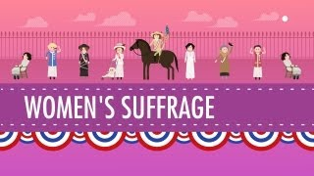
Women’s Suffrage
Notes:
Teacher notes:
Video: Women's Suffrage Crash Course US History
https://youtu.be/HGEMscZE5dY
Note: this video is set to play at 9:03 to discuss the women’s suffrage movement

Slide 62
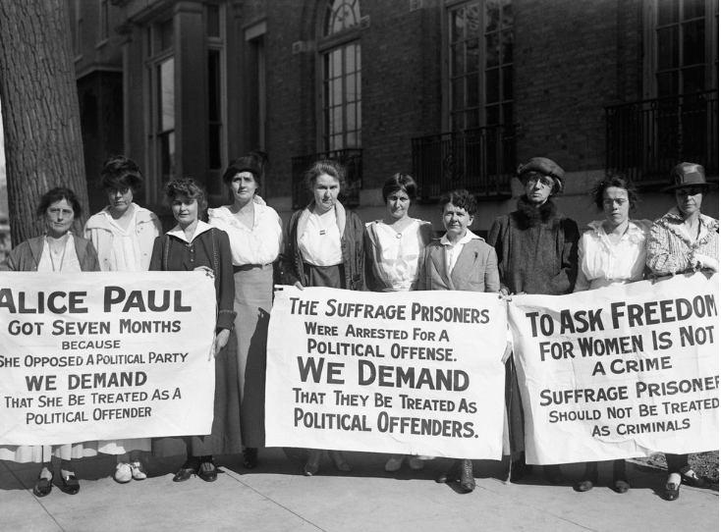
ACTIVITY
What do you SEE in this image?
What do you THINK is happening in this image?
What do you WONDER about this image?
Notes:
Photo:
https://www.smithsonianmag.com/history/radical-protests-propelled-suffrage-movement-heres-how-new-museum-captures-history-180976114/

Slide 63
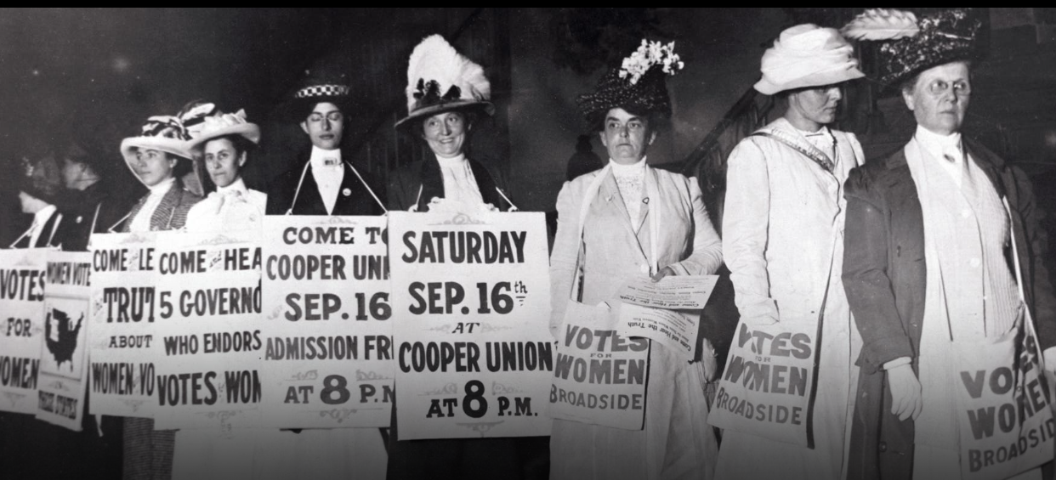
ACTIVITY
What do you SEE in this image?
What do you THINK is happening in this image?
What do you WONDER about this image?
Notes:
Photo:
https://www.history.com/topics/womens-history/the-fight-for-womens-suffrage

Slide 64
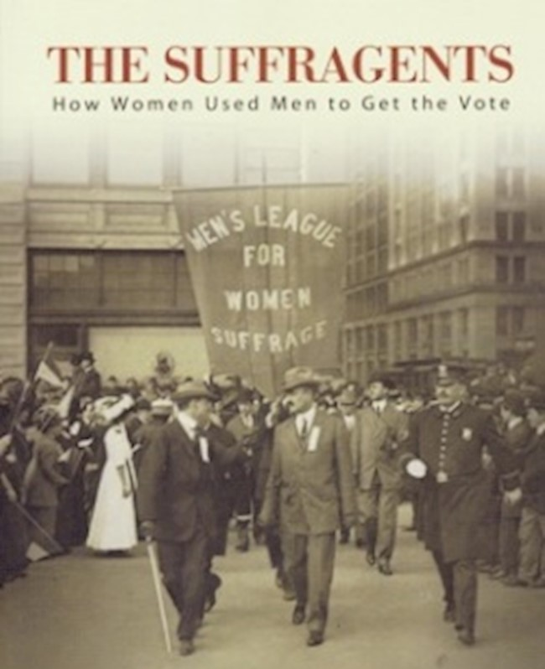
Men’s Role in the Suffrage Movement
Surprising to some, many of the suffragists’ strongest supporters were their husbands, fathers, brothers, uncles, and other men. There were men throughout the country who were themselves suffragists and who lent their support to advancing the women’s cause. Showing family influence, many young female suffragists were inspired to take action in the political arena because their fathers were politically active. It is a testimony to their democratic values that a large number of American men consistently supported women’s cause. There were more than 50 electoral campaigns and in every one, a large number of men — often above 40% — voted in favor of equal suffrage. A majority of male voters in New York, California, and eleven other states actually approved it.” - National Women’s History Alliance
Click here to learn more about the Suffragents!
Notes:
Teacher notes:
Read the text on the slide and click to access more information about the suffragents role.
Ask students what they would do is the suffrage movement was taking place today.
Note: image source is a book cover by Brooke Kroeger

Slide 65
ACTIVITY
Create and Share
Let’s see what you learned?
Create a poster or banner that you would have used if you had taken part in the Women’s March for Suffrage Movement.
Click here to see examples!
Notes:
Teacher notes:
Distribute allowed materials: paper & pencil, markers, etc and have students create their own sign if they were marching in the suffrage movement.
2. Image source: <a href="https://storyset.com/people">People illustrations by Storyset</a>

Slide 66
EXIT TICKET
Don’t forget to complete your daily learning log!!
Question:
What is one question you have about Women’s History?
Notes:
Teacher notes:
discuss as a class and/or have students keep a learning journal throughout this initiative
Remind students to complete Daily Learning Log.

Slide 67
Day 3
Women in STEM

Slide 68
DO NOW
Question
What is STEM?
Notes:
Teacher notes:
discuss as a class and/or have students keep a learning journal throughout this initiative

Slide 69
OBJECTIVE
Students will
Understand the role of Women in STEM
Learn about important inventions and inventors
Design their own invention
Notes:
Teacher notes:
Review the objectives for the day, so students know what is expected of their learning

Slide 70
AGENDA
Do Now
Mini Lesson: Women in STEM
Activity: Design an Invention
Exit Ticket
Notes:
Teacher notes:
Review the agenda for the day

Slide 71
STEM
What is STEM??
STEM consists of
SCIENCE
TECHNOLOGY
ENGINEERING
MATH
Notes:
Teacher notes:

Slide 72
Question
What do these things have in common?
WiFI
Windshield Wipers
Fax Machine
Security Systems
Aquariums
Dishwashers
Computer Code
Coffee Filters
Notes:
Teacher notes:
discuss as a class
Answer: ALL were designed and made by women
Icons from Noun Project

Slide 73
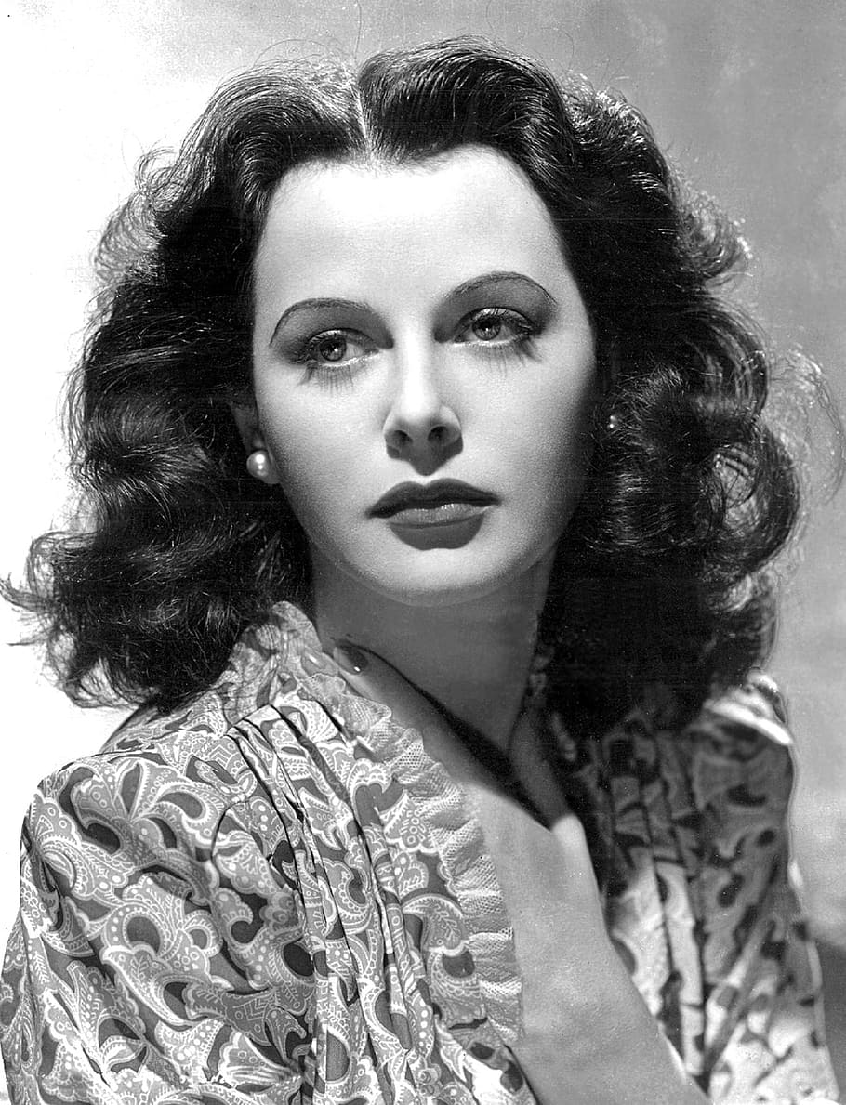
Hedy Lamarr
A lot of people only knew Hedy Lamarr as a film actress (one so beautiful that she allegedly inspired the character of Snow White....nbd). But she was also a longtime inventor who loved to tinker and innovate. When World War II came around, Lamarr wanted to help however she could, so she and a partner developed “frequency hopping” technology to guide missiles. It paved the way for wireless communication technology like WiFi, GPS, and Bluetooth.
INVENTED: WiFi, GPS, and Bluetooth
Notes:
Teacher notes:
Read the description of the female inventor. Anything underlined is a link to more information. Feel free to explore.
Ask students what they think the world would be like without these inventions.
SOURCE: linked here

Slide 74
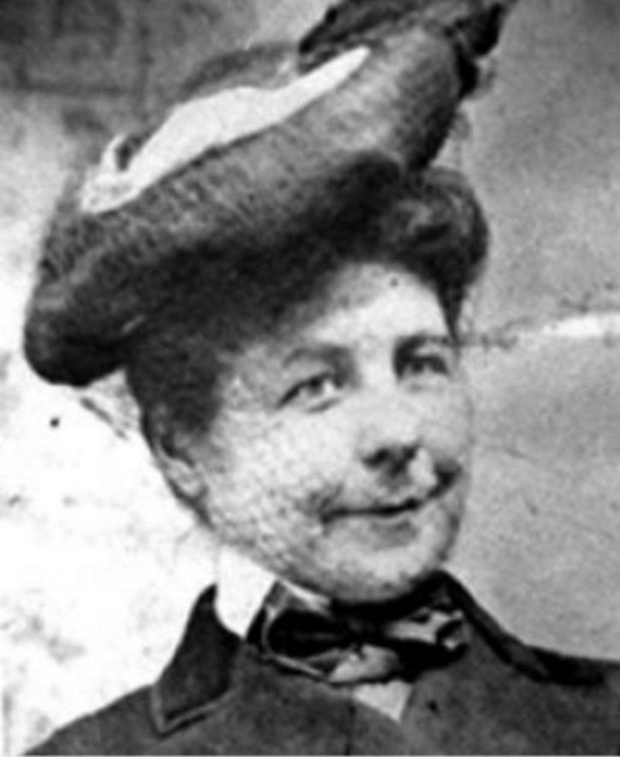
Mary Anderson
The idea for this invention came to Mary Anderson while stuck in traffic, which is more productive than what we usually do while stuck in traffic (listen to podcasts and suffer). She was visiting New York City in 1902, and there were delays each time her streetcar driver had to get out and manually clear the snow on the windshield. Anderson sketched out the design of an automated windshield wiper and earned a patent for it a year later.
INVENTED: Windshield Wipers
Notes:
Teacher notes:
Read the description of the female inventor. Anything underlined is a link to more information. Feel free to explore.
Ask students what they think the world would be like without these inventions.
SOURCE: linked here

Slide 75
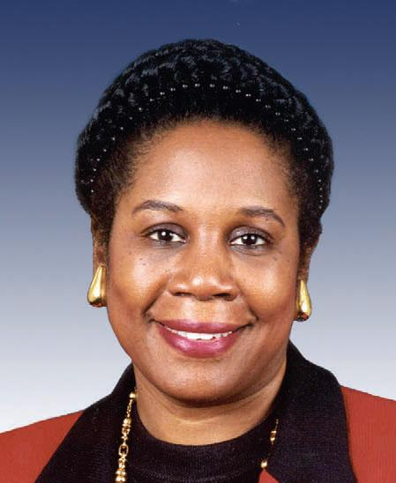
Shirley Ann Jackson
Shirley Ann Jackson was the first Black woman to earn a doctorate from MIT, and her research in the 1970s made breakthroughs in telecommunications. Because of Jackson’s discoveries, inventions like caller ID, fiber optic cables, and portable fax became possible.
INVENTED: Caller ID, Fiber Optic cables, and Portable Fax
Notes:
Teacher notes:
Read the description of the female inventor. Anything underlined is a link to more information. Feel free to explore.
Ask students what they think the world would be like without these inventions.
SOURCE: linked here

Slide 76
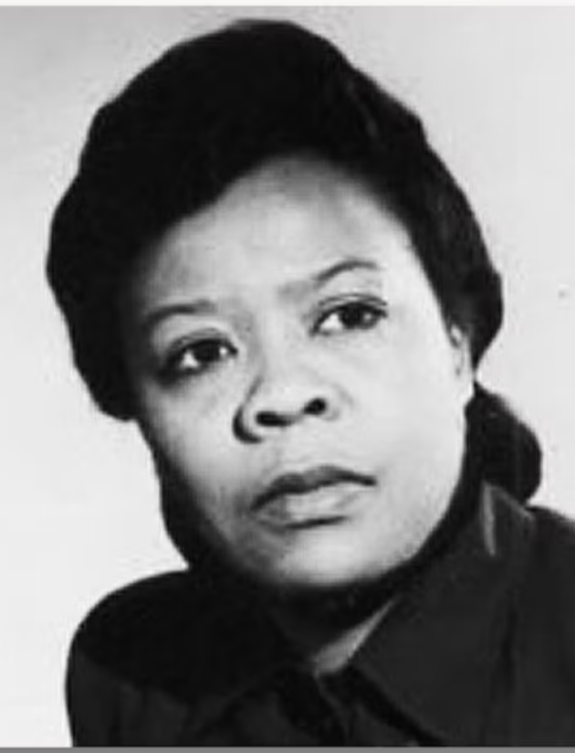
Marie Van Brittan
Frustrated with the high crime rate and slow police response in her Queens neighborhood, Marie Van Brittan Brown took home security into her own hands. In 1966, she invented a video and audio security system, with the ability to unlock doors, speak through a microphone, and call for help remotely. It laid the foundation for systems we still use today, so, in a way, we have her to thank for those cute video-doorbell clips of kids and dogs.
INVENTED: Security Systems
Notes:
Teacher notes:
Read the description of the female inventor. Anything underlined is a link to more information. Feel free to explore.
Ask students what they think the world would be like without these inventions.
SOURCE: linked here

Slide 77
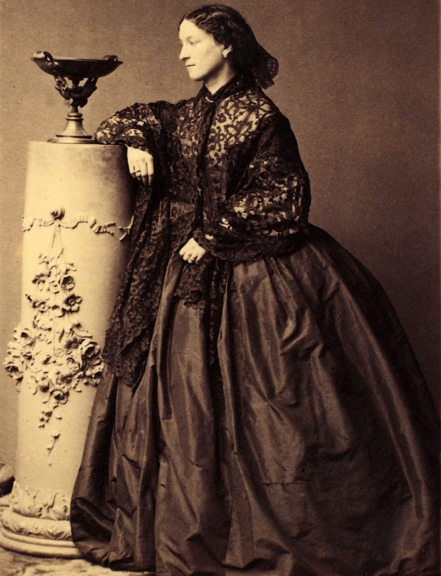
Jeanne Villepreux-Power
At the time of Jeanne Villepreux-Power’s research, the hot topic in marine biology was about where paper nautiluses got their shells. To get to the bottom of it, Villepreux-Power created the first glass aquarium in 1832 so she could study them in a controlled environment (for those wondering, it turns out nautiluses grow their own shells!). Her invention earned her the title of "the mother of aquariophily," but we wonder if she anticipated that this is what it would one day be used for.
INVENTED: Aquariums
Notes:
Teacher notes:
Read the description of the female inventor. Anything underlined is a link to more information. Feel free to explore.
Ask students what they think the world would be like without these inventions.
SOURCE: linked here

Slide 78
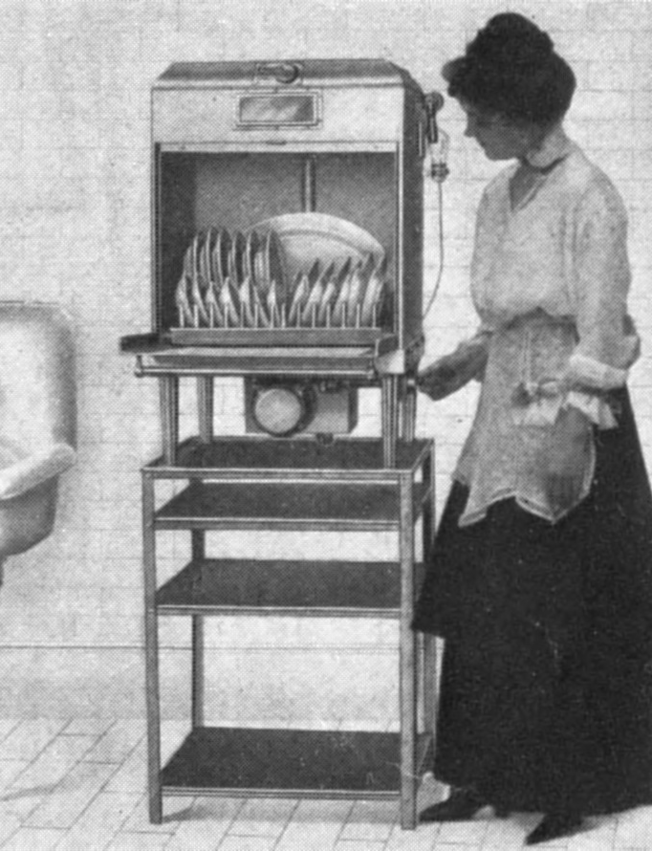
Josephine Cochrane
Technically, two patents for dishwashers existed before Josephine Cochrane’s in 1886, but both were hand-turned and not actually very good at washing dishes. She substituted scrubbers for water pressure and invented the first automatic dishwasher, as we know it today. She went on to open a production factory that later became KitchenAid, and on behalf of everyone who has ever had to touch a wet piece of food on a dirty dish, we thank her.
INVENTED: Automatic Dishwasher
Notes:
Teacher notes:
Read the description of the female inventor. Anything underlined is a link to more information. Feel free to explore.
Ask students what they think the world would be like without these inventions.
SOURCE: linked here

Slide 79
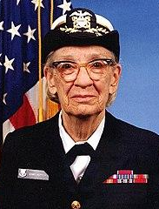
Grace Hopper
Known as “Amazing Grace” by her colleagues, Rear Admiral Grace Hopper was a pioneering computer operator for the US Navy. She worked on the Mark I, one of the earliest computers, programming and repairing it. Hopper went on to develop the world’s first compiler, which translated code and made it possible to program for multiple computers. This eventually evolved into one of the first programming languages.
INVENTED: Computer Language
Notes:
Teacher notes:
Read the description of the female inventor. Anything underlined is a link to more information. Feel free to explore.
Ask students what they think the world would be like without these inventions.
SOURCE: linked here

Slide 80
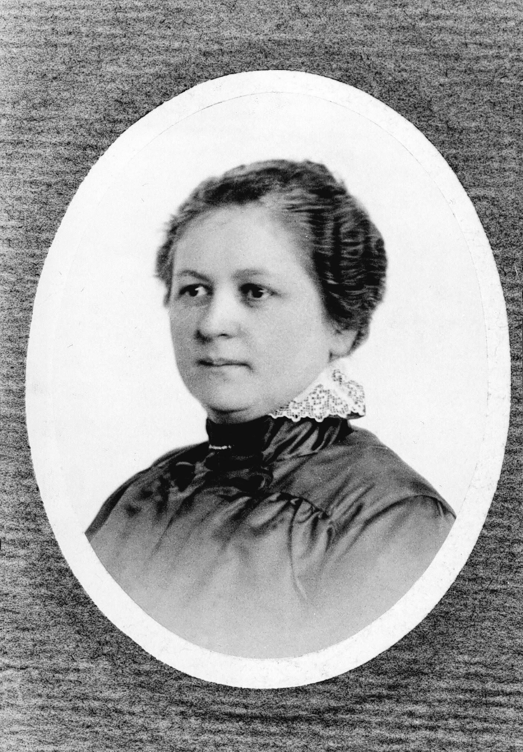
Melitta Bentz
This invention was developed in the pursuit of a perfect cup of coffee, and we really can’t blame her for it. Melitta Benz was tired of coffee grounds getting into her cup each morning, so she took some blotting paper from her son’s notebook and used it as the first coffee filter. She got a patent for it in 1908 and revolutionized the way we drink our coffee.
INVENTED: Coffee Filters
Notes:
Teacher notes:
Read the description of the female inventor. Anything underlined is a link to more information. Feel free to explore.
Ask students what they think the world would be like without these inventions.
SOURCE: linked here

Slide 81
Women in STEM
Notes:
Teacher notes:
Click the image on the slide or click here to access audio recordings about different women in history. Choose three to play to the class.
Source: https://obamawhitehouse.archives.gov/women-in-stem

Slide 82
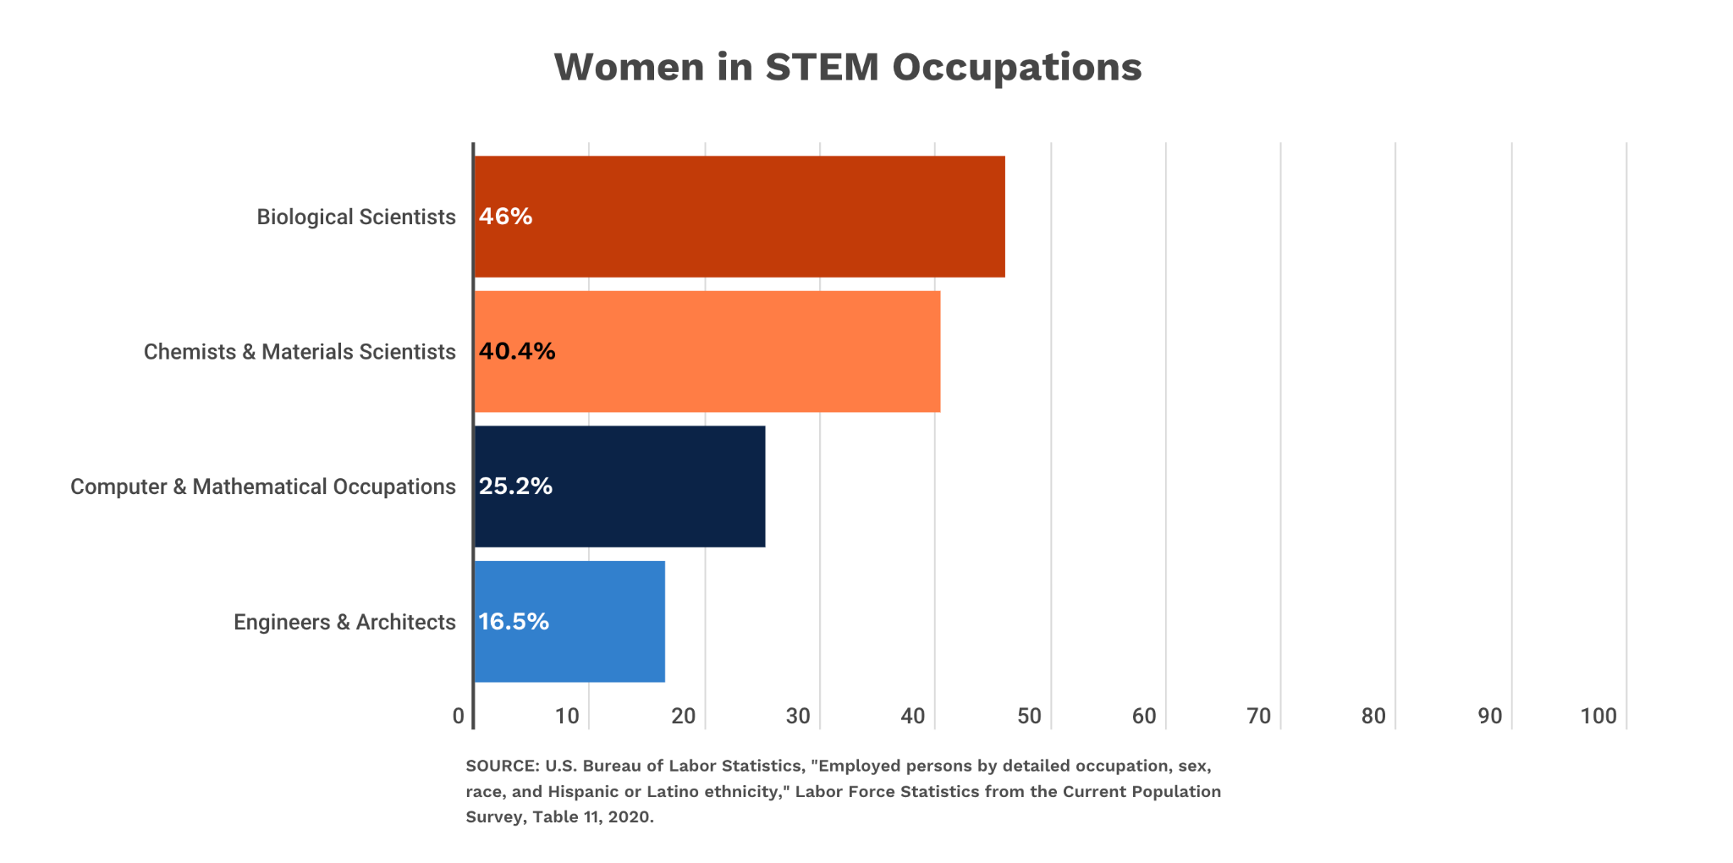
Current Women in STEM
Notes:
Teacher notes:
Discuss the graph and ask students if they are surprised by the data on the slide.
Chart source: https://www.aauw.org/resources/research/the-stem-gap/

Slide 83
ACTIVITY
Brainstorm
Design an invention to solve a current problem!
Design an invention! Create something new to solve a problem, draw it on paper, give it a name, and present it to the class!
Notes:
Teacher notes:
Have students Design an invention! They need to (1) create something new to solve a problem, (2) draw it on paper, (3) give it a name, and (4) present it to the class!
A printable PDF is available here to direct student’s in this activity.

Slide 84
EXIT TICKET
Don’t forget to complete your daily learning log!!
How would our current world be different without the inventions by women?
Notes:
Teacher notes:
discuss as a class and/or have students keep a learning journal throughout this initiative
Remind students to complete Daily Learning Log.

Slide 85
Day 4
Women in the Arts

Slide 86
DO NOW
Read
What does it mean to be phenomenal?
Notes:
Teacher notes:
discuss as a class and/or have students keep a learning journal throughout this initiative

Slide 87
OBJECTIVE
Students will
Understand the role of Women in the Arts
Learn about important female artists
Design their own artwork
Notes:
Teacher notes:
Review the objectives for the day, so students know what is expected of their learning

Slide 88
AGENDA
Do Now
Mini Lesson: Women in Arts
Activity: Become an Artist
Exit Ticket
Notes:
Teacher notes:
Review the agenda for the day

Slide 89
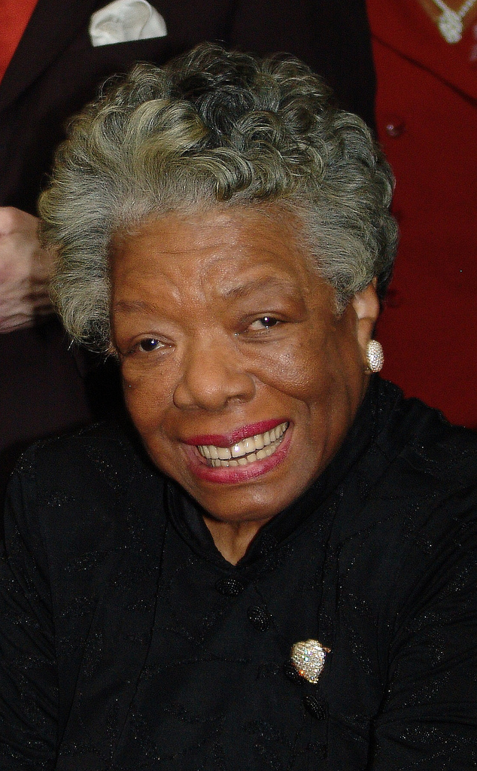
Maya Angelou
An acclaimed American poet, storyteller, activist, and autobiographer, Maya Angelou was born Marguerite Johnson in St. Louis, Missouri. Angelou had a broad career as a singer, dancer, actress, composer, and Hollywood’s first female black director, but became most famous as a writer, editor, essayist, playwright, and poet. As a civil rights activist, Angelou worked for Dr. Martin Luther King Jr. and Malcolm X. She was also an educator and served as the Reynolds professor of American Studies at Wake Forest University. By 1975, wrote Carol E. Neubauer in Southern Women Writers: The New Generation, Angelou was recognized “as a spokesperson for… all people who are committed to raising the moral standards of living in the United States.” In 2000, Angelou was awarded the National Medal of Arts by President Bill Clinton. In 2010, she was awarded the Presidential Medal of Freedom, the highest civilian honor in the U.S., by President Barack Obama. Angelou was awarded over 50 honorary degrees before her death.
Notes:
Teacher notes:
Read the content on the slide and Discuss as a class
Source: https://www.poetryfoundation.org/poets/maya-angelou

Slide 90
Maya Angelou
Read:
“Phenomenal Woman” by Maya Angelou
Notes:
Teacher notes:
Discuss as a class and/or have students keep a learning journal throughout this initiative
Print for each student, or project for class: https://drive.google.com/file/d/1ftys1nhznlo2AC2GzCQDG8H855SrGl7z/view?usp=sharing

Slide 91
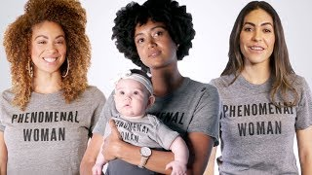
Phenomenal Woman
Notes:
Video: Maya Angelou’s “Phenomenal Women” Read by Phenomenal Women
https://youtu.be/P7c6i-R6gFY
Teacher notes:
Ask students. Did hearing it read aloud along with the visual change your perspective? Discuss.

Slide 92
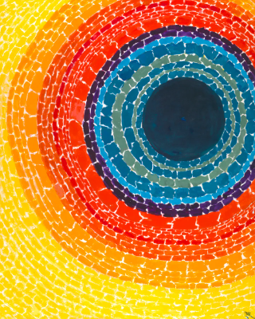
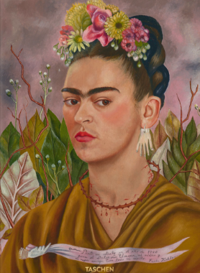
Does Art Communicate Differently?
Whether we are talking about Art, Poetry, or Music women have shaped how centuries of women see themselves.
Notes:
Teacher notes:
Discuss how art of all forms have changed people’s perspectives on women through the years.

Slide 93
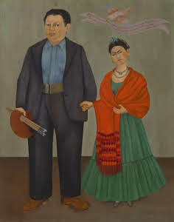
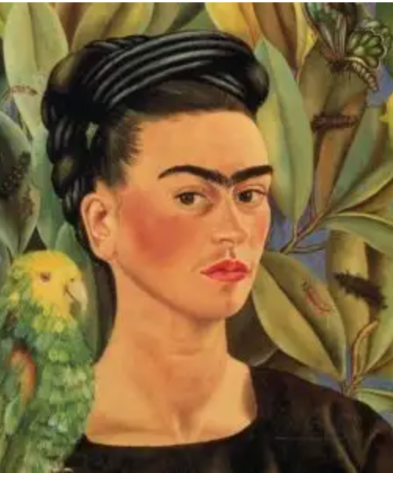
Frida Kahlo
One of the most famous Mexican artists of all time, Frida Kahlo captured people’s imaginations with her surrealistic paintings. She often did self-portraits that portrayed some of the most painful experiences of her life.
In 1946, she received the National Prize of Arts and Sciences from the Mexican Ministry of Public Education.
Notes:
Teacher notes:
Read the description of the female artist.
Ask students what they think about the art on the slide.
SOURCE: linked here - explore for more female artists
Art image is hyperlinked.

Slide 94
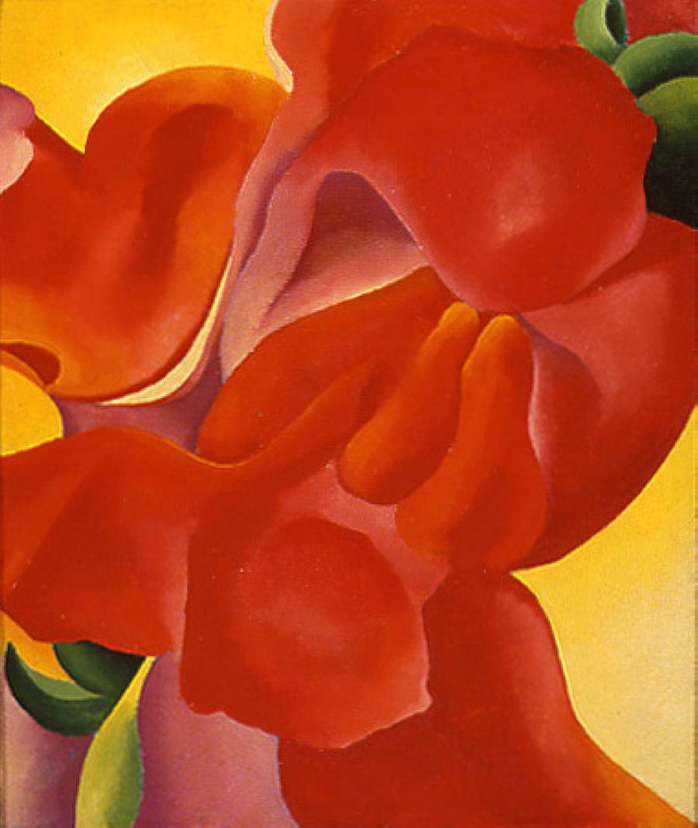
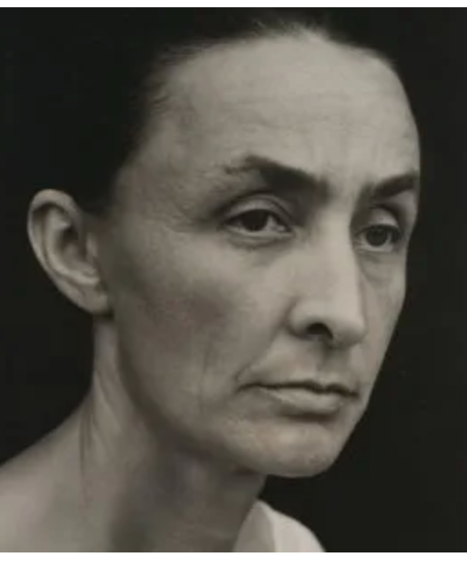
Georgia O’Keeffe
Known as the mother of American modernism, Georgia O’Keeffe challenged conventional styles by experimenting with abstract art. By the 1920s, she became famous for painting skyscrapers and oversized flowers.
In 1977, she received the Presidential Medal of Freedom for her revolutionary artwork.
Notes:
Teacher notes:
Read the description of the female artist.
Ask students what they think about the art on the slide.
SOURCE: linked here - explore for more female artists
Art image is hyperlinked.

Slide 95
Yayoi Kusama
One of Japan’s most famous contemporary artists, Yayoi Kusama is living proof of art’s healing power. Living in New York, Kusama painted the polka dot patterns she saw in her hallucinations.
These Infinity Net paintings, as she called them, pioneered the minimalist art movement.
Notes:
Teacher notes:
Read the description of the female artist.
Ask students what they think about the art on the slide.
SOURCE: linked here - explore for more female artists
Art image is hyperlinked.

Slide 96
Focus Artist: Alma Thomas
Thomas was born in Columbus, Georgia, the oldest of four girls.
In 1907, her family moved to Washington, D.C., seeking relief from the racial violence in the South.
Though segregated, the nation’s capital still offered more opportunities for African Americans than most cities in those years.
Notes:
Teacher notes:
Read the description of the female artist.
SOURCE: linked here
Image hyperlinked

Slide 97
Alma Thomas
As a girl, Thomas dreamed of being an architect and building bridges, but there were few women architects a century ago.
Instead, she attended Howard University, (HBCU) becoming its first fine arts graduate in 1924.
In 1924, Thomas began a 35 year career teaching art at a D.C. junior high school.
Apollo 12 ‘Splash Down
Notes:
Teacher notes:
Read the description of the female artist.
Ask students what they think about the art on the slide.
SOURCE: linked here
Image hyperlinked

Slide 98
Alma Thomas
Though Alma’s earlier art was realistic, it wasn’t until she retired from teaching that she was able to concentrate on art full time and develop her signature style
She debuted her abstract work in an exhibition at Howard 1966, at the age of 75.
Thomas’ abstractions have been compared with Byzantine mosaics
Wind Dancing with Spring Flowers
Notes:
Teacher notes:
Read the description of the female artist.
Ask students what they think about the art on the slide.
SOURCE: linked here

Slide 99
Alma Thomas
Thomas became an important role model for women, African Americans, and older artists.
She was the first African American woman to have a solo exhibition at New York’s Whitney Museum of American Art, and she exhibited her paintings at the White House three times.”
Breeze Rustling Through Fall Flowers, 1968
Notes:
Teacher notes:
Read the description of the female artist.
Ask students what they think about the art on the slide.
SOURCE: linked here

Slide 100
ACTIVITY
It’s your turn to become an artist! Choose between an abstract shape or draw a landscape, animal, etc Whichever you choose you must: Use bright, bold colors Use Alma Thomas’ signature style of dots/dashes with space in between Cover the entire paper
Notes:
Teacher notes:
Give students an overview of the activity.
Show this video to students if they need direction with how to use the style of Alma Thomas: https://youtu.be/7MUWLKUS4lc

Slide 101
EXIT TICKET
Don’t forget to complete your daily learning log!!
Question
How does your artwork represent you?
Notes:
Teacher notes:
Discuss as a class and/or have students keep a learning journal throughout this initiative
Remind students to complete Daily Learning Log.

Slide 102
Day 5
Women in Sports

Slide 103
DO NOW
Question
What is your favorite sport?
Notes:
Teacher notes:
discuss as a class and/or have students keep a learning journal throughout this initiative

Slide 104
OBJECTIVE
Students will
Understand the role of Women in Sports
Learn about important female sports figures
Create your own sport
Notes:
Teacher notes:
Review the objectives for the day, so students know what is expected of their learning

Slide 105
AGENDA
Do Now
Mini Lesson: Women in Sports
Activity: Create a New Sport
Exit Ticket
Notes:
Teacher notes:
Review the agenda for the day

Slide 106
LESSON - Dream Crazy
Notes:
Teacher notes:
Show the video to students and lead a discussion about Women in Sports.
Video: https://www.youtube.com/watch?v=zWfX5jeF6k4

Slide 107
Althea Gibson
Born in Silver, South Carolina but grew up in Harlem, New York. She was a professional tennis player and golfer. When she was 14 she was a ward of New York City’s Welfare Department. In Late 1958 after winning 56 national and international singles and doubles she retired. First African American tennis player to compete at the U.S. National Championships in 1950 and then the first African American player to compete at Wimbledon in 1951.
Notes:
Teacher notes:
Read the description of the female athlete.
Discuss the sport and/or athlete.
SOURCE: linked here

Slide 108
Babe Didrikson Zaharias
The first woman to play in a PGA event, Zaharias competed in the 1938 Los Angeles Open. Only four other women have appeared in PGA events since. She was also accomplished in basketball, track, tennis, baseball, and swimming, and was selected the best female athlete of the first half of the 20th century by the AP. Asked if there was anything she didn't play, Babe responded: "Yeah, dolls."
Notes:
Teacher notes:
Read the description of the female athlete.
Discuss the sport and/or athlete.
SOURCE: linked here

Slide 109
Toni Stone
Stone is considered the "female Jackie Robinson," as she was the first woman to play big-league professional baseball. She was signed by the Indianapolis Clowns of the Negro American League in 1953 to play second base. Their previous second baseman? Future Hall of Famer Hank Aaron.
Notes:
Teacher notes:
Read the description of the female athlete.
Discuss the sport and/or athlete.
SOURCE: linked here

Slide 110
Billie Jean King
King defeated Bobby Riggs on Mother's Day in the first of two 1973 matches dubbed Battle of the Sexes, landmark moments where a female athlete bested a male head-to-head on a nationwide broadcast. She had staying power too -- 10 years later at Wimbledon, she became the oldest Grand Slam semi finalist at 39 years, 7 months and 9 days old.
Notes:
Teacher notes:
Read the description of the female athlete.
Discuss the sport and/or athlete.
SOURCE: linked here

Slide 111
Victoria Roche
Roche, originally from Korea and adopted by British parents living in Brussels, was the first girl to play in the Little League World Series in 1984. Little League began allowing girls to play in the late 1970s, and the first to reach the World Series was Roche. She was an outfielder on the Belgium squad, which also included her brother Jeremy. Other girls have followed in her footsteps.
Notes:
Teacher notes:
Read the description of the female athlete.
Discuss the sport and/or athlete.
SOURCE: linked here

Slide 112
Nancy Lieberman
Lieberman has been a pioneer since she was 17 and made the U.S. Olympic team for the 1976 Montreal Games. She became the first woman in a men's pro league in 1986 with the Springfield Fame of the United States Basketball League. When the WNBA started, she returned as a player, and played one last game in 2008, at age 50.
Notes:
Teacher notes:
Read the description of the female athlete.
Discuss the sport and/or athlete.
SOURCE: linked here

Slide 113
Manon Rheaume
A scout sent videotape of Rheaume to the Tampa Bay Lightning, she was invited to camp, and made her debut against the Blues in 1992. It was the first appearance by a woman in an NHL preseason game. "This changed my life basically and took my life in a different direction than I was planning to go," said Rheaume, who won silver for Canada in the 1998 Winter Olympics.
Notes:
Teacher notes:
Read the description of the female athlete.
Discuss the sport and/or athlete.
SOURCE: linked here

Slide 114
Mia Hamm
After suiting up for the US national team at age 15 and winning four NCAA titles at North Carolina, Hamm kept making history during her distinguished international career. She was part of the 1999 World Cup team, the first and only women's team to win it all on home soil, and in 2013 became the first woman inducted into the World Football Hall of Fame.
Notes:
Teacher notes:
Read the description of the female athlete.
Discuss the sport and/or athlete.
SOURCE: linked here

Slide 115
Sarah Attar
Attar ran the 800 meters in 2 minutes, 44.95 seconds at the 2012 Summer Olympics in London, but the time didn't matter. It made her the first woman from Saudi Arabia to compete in track and field at the Olympics. "For women in Saudi Arabia, I think this can really spark something to get more involved in sports, to become more athletic," she said.
Notes:
Teacher notes:
Read the description of the female athlete.
Discuss the sport and/or athlete.
SOURCE: linked here

Slide 116
Ronda Rousey
Rousey left an indelible mark on UFC, right from the start in 2013. She submitted Liz Carmouche in the first round via her signature armbar at UFC 157, in the first women's fight in UFC history. She would make six consecutive defenses of the women's bantamweight title, which remains the record for that division, and was the first woman inducted into the UFC Hall of Fame in 2018.
Notes:
Teacher notes:
Read the description of the female athlete.
Discuss the sport and/or athlete.
SOURCE: linked here

Slide 117
Danica Patrick
With a lap at 196.434 mph, Patrick locked down the pole for the 2013 Daytona 500 and became the first female driver to do so. She would finish her career with seven top-10 Nascar finishes and a win on the IndyCar circuit. "I was brought up to be the fastest driver, not the fastest girl," Patrick said.
Notes:
Teacher notes:
Read the description of the female athlete.
Discuss the sport and/or athlete.
SOURCE: linked here

Slide 118
Serena Williams
After besting her sister Venus at the 2017 Australian Open, Serena eclipsed Steffi Graf's Open era record with her 23rd career Grand Slam singles title. With her next major title, Serena will tie the all-time record held by Margaret Court. Also notable: she would become the fourth mother in the Open era to win a major, joining Court, Evonne Goolagong and Kim Clijsters.
Notes:
Teacher notes:
Read the description of the female athlete.
Discuss the sport and/or athlete.
SOURCE: linked here

Slide 119
ACTIVITY
Design your own sport! Design something new, create rules, give it a name, and present it to the class!
Notes:
Teacher notes:
Students will design their own sport! They need to (1) design something new, (2) create rules, (3) give it a name, (4) and present it to the class.
If possible, choose one to play in class.
A printable PDF is available here to direct student’s in this activity.

Slide 120
EXIT TICKET
Don’t forget to complete your daily learning log!!
Question
Why is gender equality in sports important?
Notes:
Teacher notes:
discuss as a class and/or have students keep a learning journal throughout this initiative
Remind students to complete Daily Learning Log.

Slide 121
Day 6+
Living Museum

Slide 122
DO NOW
Question
What is the most interesting fact that you have learned about Women in history?
Notes:
Teacher notes:
discuss as a class and/or have students keep a learning journal throughout this initiative

Slide 123
OBJECTIVE
Students will
Review information learned about notable women in history
Create an artifact for a living museum
Participate in peer reviews
Notes:
Teacher notes:
Review the objectives for the day, so students know what is expected of their learning

Slide 124
AGENDA
Do Now
Mini Lesson: Living Museum
Activity: Create an artifact from cardboard
Exit Ticket
Notes:
Teacher notes:
Review the agenda for the day

Slide 125
Review
So far, you have learned about...
Women’s Suffrage
Women in STEM
Women in the Arts
Women in Sports
Notes:
Teacher notes:
Introduce the activity to students and show examples on the next few slides.

Slide 126
ACTIVITY - Overview
A living museum is a way to represent specific cultures and time periods by focusing on artifacts of notable people throughout history. Complete the following steps to participate in the living museum contest.
Select a notable woman from history Choose an artifact to represent her history Select at least three important facts about her history Create your artifact using cardboard Participate in at least two peer reviews
Notes:
Teacher notes
Help students complete the steps on this slide. Example artifacts are on the next slide.

Slide 127
ACTIVITY - Examples of Artifacts
Notes:
Teacher notes: Show students these examples

Slide 128
ACTIVITY - Planning Doc
Use the provided planning doc brainstorm what your artifact will contain.
Which notable woman from history did you choose?
List three important facts about your selected notable woman from history.
1.
2.
3.
Draw a picture representing what you will build out of cardboard.
Notes:
Teacher notes
Use this printable planning doc for students to design their product before building.

Slide 129
ACTIVITY - Peer Review
Feedback is most helpful when it is honest and offers ways of improvement. Look at the difference between the examples and discuss why some examples are better than others.
Ex) “That’s really good!” | Ex) “That’s a great idea! You seem to really be interested in this topic. I wonder what your artifact would look like if you used a different method of folding?
Ex) “I didn’t like your facts.” | Ex) “Your important facts are a little short. I wonder if you could explain them a little more?”
Notes:
Teacher notes
Use the examples on this slide to discuss the importance of honest feedback.

Slide 130
ACTIVITY - Peer Review
Ideas you love
Positive criticisms
Questions you have
Ideas to make
it better
Notes:
Teacher notes
Use this printable activity to have students provide feedback or 2-3 peers then allow students time to reflect on the feedback and make changes to their design. The heart is for things you liked about the design. The settings/gear wheel is for items that can be improved but worded in a positive way. The question mark is for items that did not make sense or need clarification. The lightning bolt is for suggestions to make the script better.
Once students design their artifact and receive peer feedback, they can begin building their artifact out of cardboard.

Slide 131
EXIT TICKET
Don’t forget to submit your work to the BreakFree Education national contest!
How has participating in this initiative changed your perspective on women?
Notes:
Teacher notes:
discuss as a class and/or have students keep a learning journal throughout this initiative
Submit student work to the BreakFree Education contest.
Remind students to complete Daily Learning Log.

Slide 132
Unveiled

