Slide 1
UNCONSTRUCT

Slide 2
Day 1
People

Slide 3
OBJECTIVE
Students will be able to
Define empathy
Apply the steps of the design thinking process
Demonstrate empathy in the design process by understanding the user’s needs
Analyze the impact of pedestrian safety and associated policies in America
Notes:
Teacher notes:
Review the objectives for the day, so students know what is expected of their learning

Slide 4
AGENDA
Introduction of Design Thinking Challenge
Activity: Empathy Map
Exit Ticket
Notes:
Teacher notes:
Review the agenda for the day

Slide 5
Introduction
Through Unconstruct, students will uncover a problem and use the design thinking process to create a solution to that problem. Students will identify a user and learn to empathize with them, define a problem, ideate possible solutions, build prototypes of their solutions, and then test their prototypes to perfect them.
Don’t forget, there’s a competition too!
Notes:
Explain to students that by the end of this unit, they will be asked to create a prototype for a solution to a real world problem. Anytime something sparks their imagination, they should make a note of it. Explain BreakFree’s monthly contest and pass out the Note to Students.

Slide 6
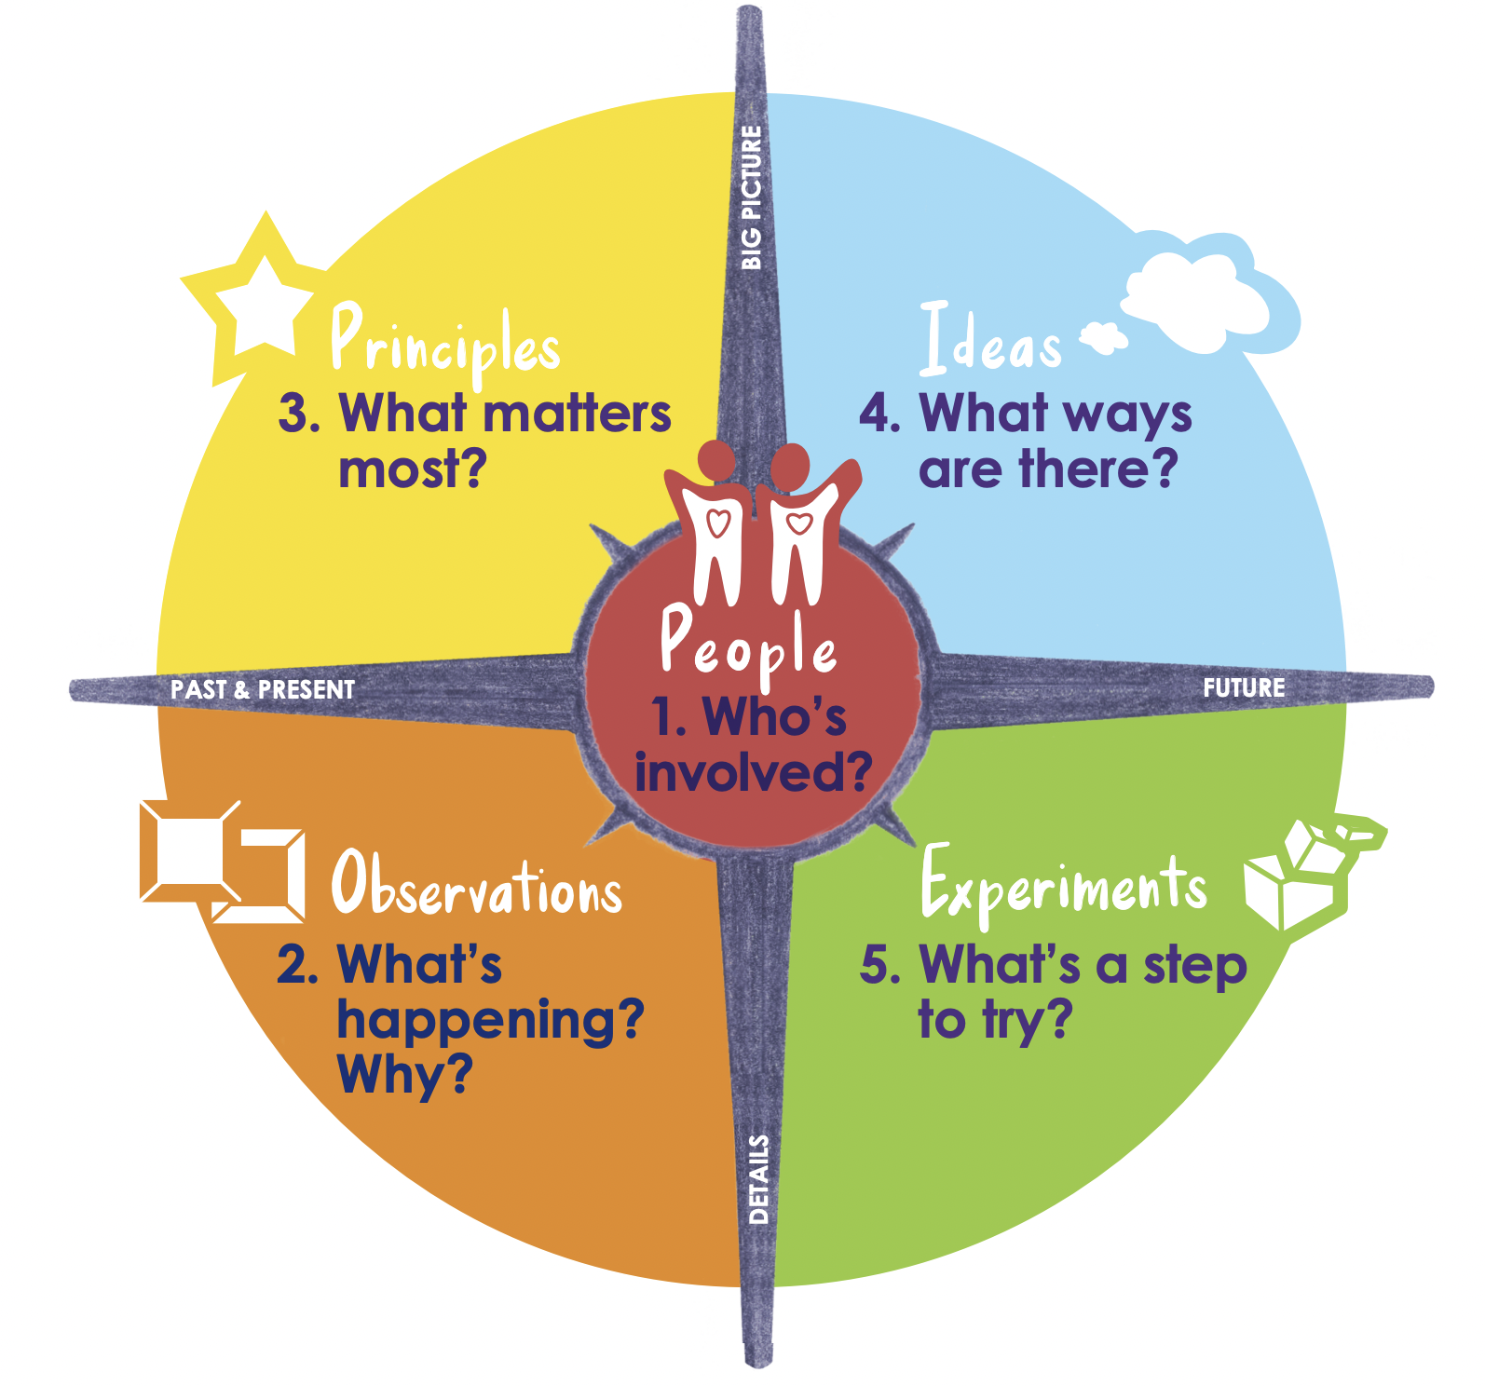
What is Design Thinking?
DESIGN THINKING is a process for creative problem solving centered around humans. For this initiative, we are using the process of Innovators Compass.
Watch this video to learn more about Design Thinking and the Unconstruct challenge!
Notes:
Teacher notes:
Explain the definition of design thinking and play the video to learn more about the design thinking process.
The Innovators Compass was created by Ela Ben-Ur. You can learn more at innovatorscompass.org.

Slide 7
What is Design Thinking?
Notice the 5 steps in the Compass!
People
Observations
Principles
Ideas
Experiments
Notes:
Teacher notes:
Show students the compass discussed in the previous video.

Slide 8
What is our challenge?
Pedestrian safety is a huge problem in the United States. “In 2020, 6,516 pedestrians were killed and an estimated 55,000 pedestrians were injured nationwide” (NHTSA).
DID YOU KNOW: The average pedestrian, if struck by a car moving at forty miles per hour, has about a fifty-percent chance of survival. If the car is going twenty miles per hour, the pedestrian has more than a ninety-per-cent chance.
Notes:
Teacher notes:
Source from NHTSA.

Slide 9
ESSENTIAL QUESTION
Who’s involved in the challenge?
Notes:
Teacher notes:
discuss as a class and/or have students keep a learning journal throughout this initiative
This question acts as an overarching goal for this lesson.

Slide 10
What are pedestrians?
Pedestrians include people of all abilities and ages, sitting, walking, pausing, and resting within urban streets. Designing for pedestrians means making streets accessible to the most vulnerable users. Design safe spaces with continuous, unobstructed sidewalks. Include visual variety, engage building frontages, design for human scale, and incorporate protection from extreme weather to ensure an enjoyable street experience” (Global Street Design).
Notes:
Teacher notes:
Optional: read the article provided here (as pdf or via the website here). Note: the article is long and the interactive are available in day 2.
Watch the video on the next slide to hear from families about pedestrian safety.
Source

Slide 11
Pedestrian Safety
Notes:
Teacher notes:
Watch the video to hear several stories of families who have lost family members due to traffic violence - located here.

Slide 12
What is empathy?
Empathy is defined as:
the ability to understand and share the feelings of another.
Notes:
Teacher notes:
Discuss the definition of empathy before moving on to the activity

Slide 13
Who are you designing for?
Families on a walk
Children going to school
People walking dogs
Homeless people living on the street
People delivering food
People eating at an outdoor cafe
People running or cycling
People running errands or walking to the grocery store
People walking to work
Musicians playing on the street corner
Notes:
Teacher notes:
Discuss the different types of pedestrians
Remind students that within the pedestrian population, there are many different types of people, some with additional needs.
Tell students that as they learn more about the pedestrian population, they should be thinking about specific subcategories of pedestrians for whom they want to design for.
For example, a student may want to focus on someone who delivers food as a job
Or children who walk to and from school each day

Slide 14
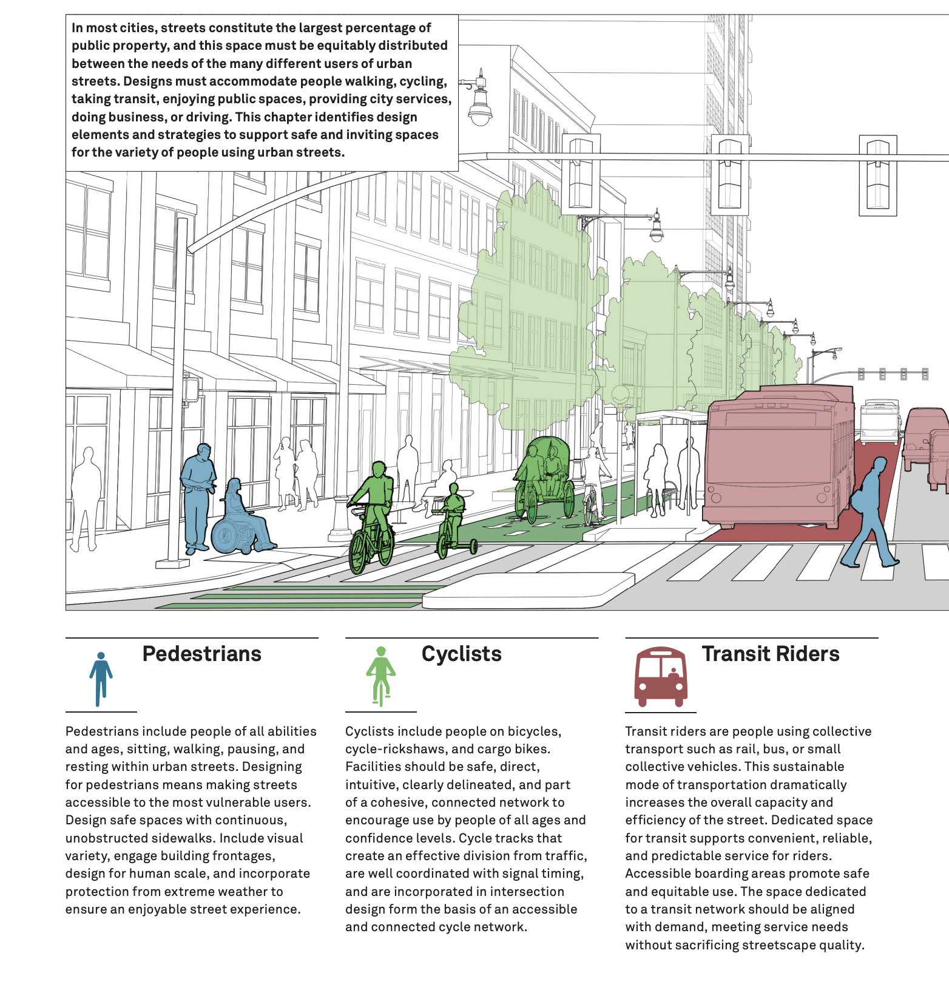
Who are you designing for?
Notes:
Teacher notes:
The images & information on this slide are Global Street Design - located here.

Slide 15
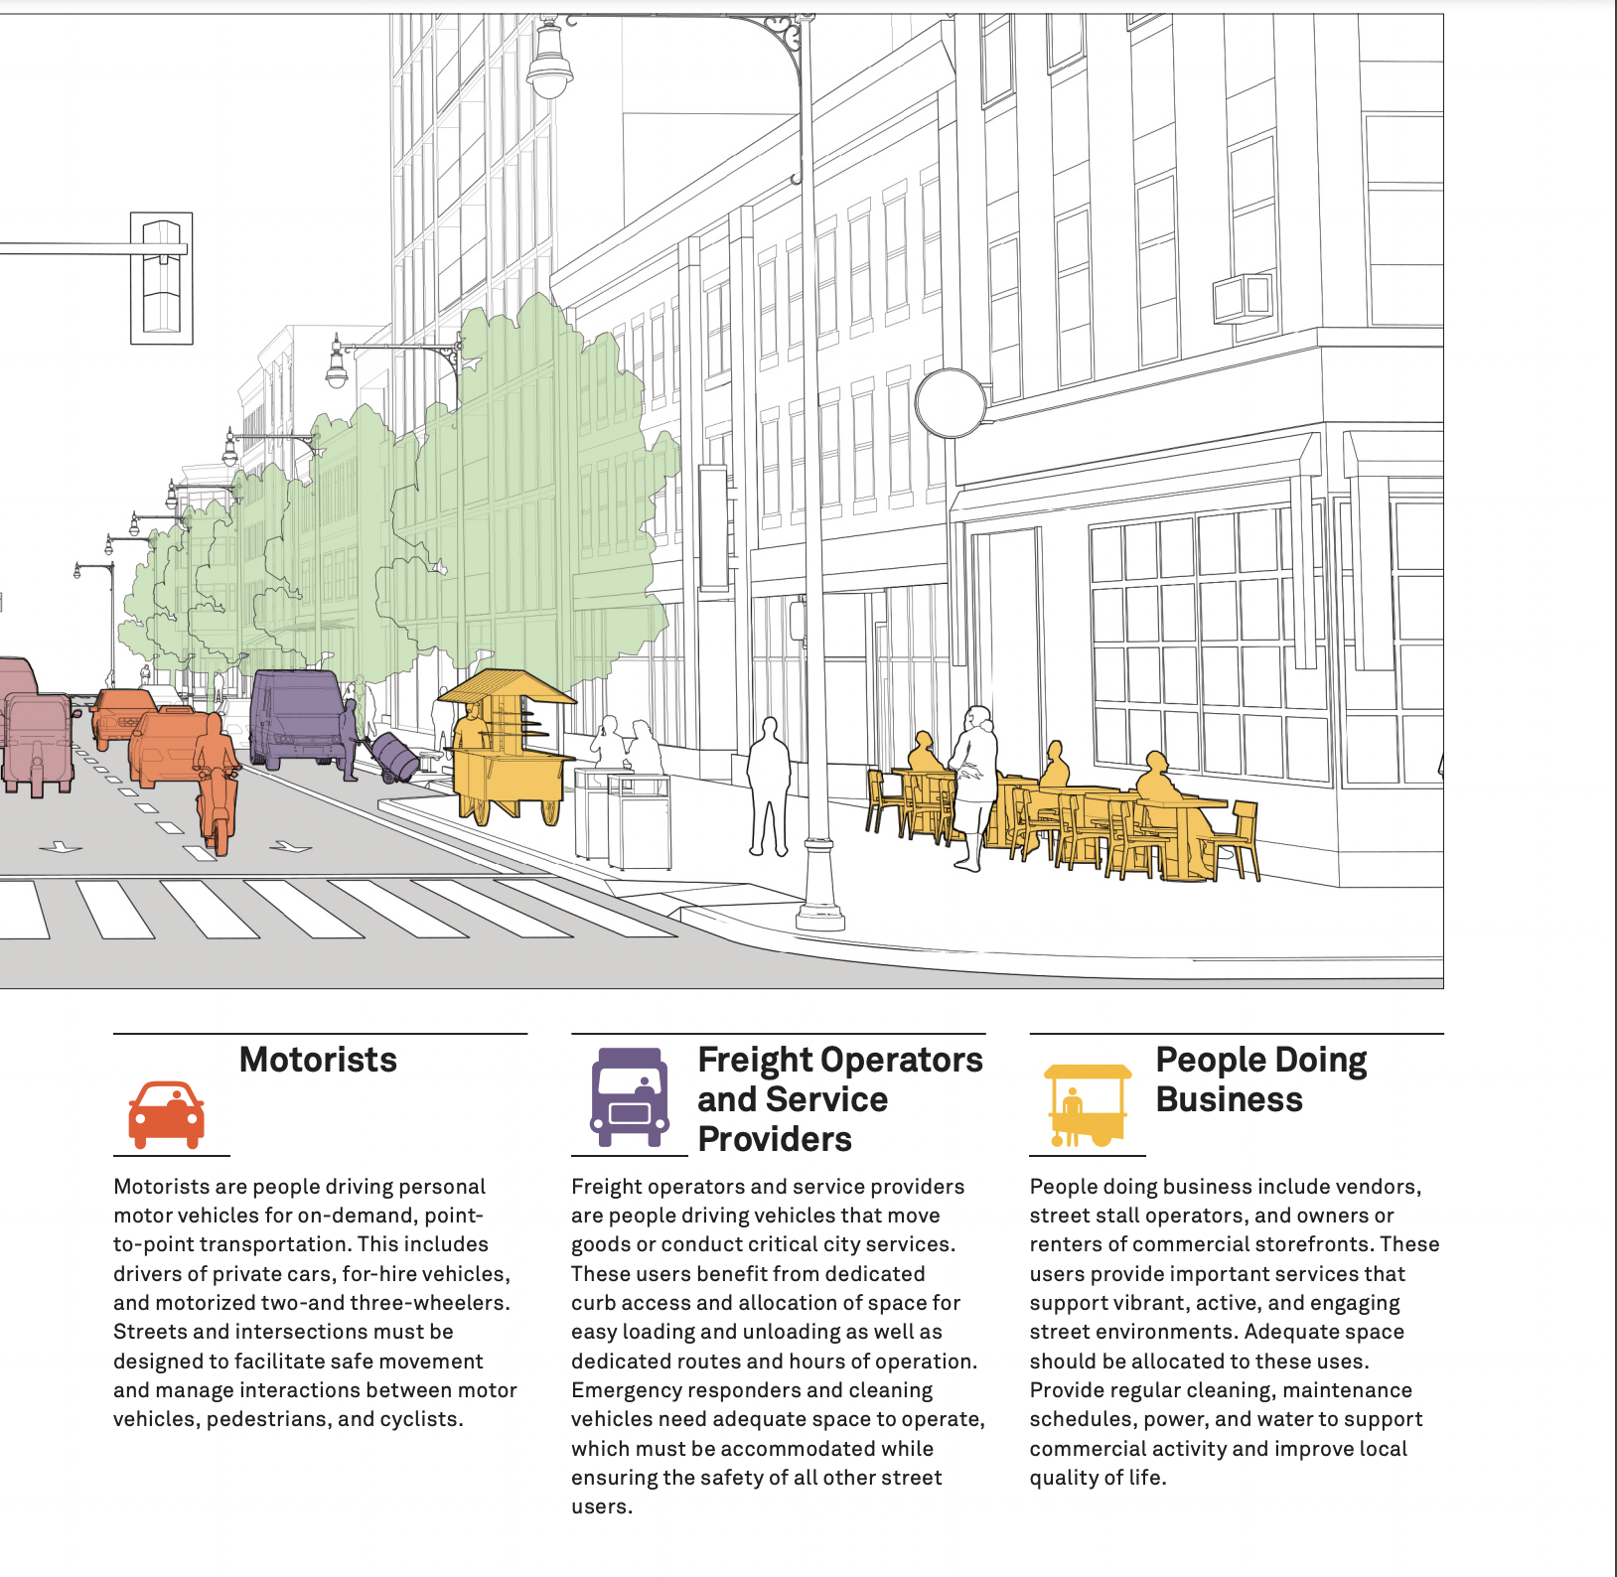
Who are you designing for?
Notes:
Teacher notes:
The images & information on this slide are Global Street Design - located here.

Slide 16
What is empathy?
Why do you think Empathy is important to the design process?
Notes:
Teacher notes:
Discuss the definition of empathy before moving on to the activity

Slide 17
ACTIVITY
Create an Empathy Map that focuses on the thoughts, needs, motivations, feelings, attitudes, beliefs, and issues of pedestrians. The next few slides will walk you through creating an empathy map. You can use the digital or physical hangout for this activity.
Notes:
Teacher notes:
Assign students to complete the top of their empathy map
Maps can be printed at this link:
https://drive.google.com/file/d/19-Rn4BTpJ4hXCCC5tQktdHIWKHKNnYDi/view?usp=sharing
A copy of a google draw version of the map is available at the following link if students are working from computers:
https://docs.google.com/drawings/d/1t9gFb43lF6BSmlqXJzroOY-Ni6UBu2-lWSTv8ujmZxg/copy

Slide 18
ACTIVITY
Choose a person. Remember, when we empathize with someone we place ourselves in their “shoes”. Select a person and describe them in the center circle of the handout.
Notes:
Teacher notes:

Slide 19
ACTIVITY
What does your person THINK & FEEL about this challenge?
Notes:
Teacher notes:

Slide 20
ACTIVITY
What does your person SAY & DO about this challenge?
Notes:
Teacher notes:

Slide 21
ACTIVITY
What does your person SEE about this challenge?
Notes:
Teacher notes:

Slide 22
ACTIVITY
What does your person HEAR about this challenge?
Notes:
Teacher notes:

Slide 23
ACTIVITY
What are the PAINS about this challenge?
Notes:
Teacher notes:

Slide 24
ACTIVITY
What are the GAINS about this challenge?
Notes:
Teacher notes:

Slide 25
Think & Feel?
Overwhelmed
Waking up for school isn’t fun
Tired
Hates walking in the rain
Bicycles
Cars honking
Other people just like him
Meet Jack
Hear?
People talking
Jack is 18 and walks to college and to his job at the coffee shop every day
See?
Birds
The Future
Say & Do?
Homework is hard
Go to class five days a week
Takes his school stuff with him everywhere he goes.
Works six days a week
Pain
Gain
Access to healthcare through college
Walking everyday is exhausting
I don’t have the money for a car
Learning new things
I need quiet to study
Physically fit
Notes:
Show students this example empathy map and discuss each of the options

Slide 26
EXIT TICKET
Don’t forget to complete your daily learning log!!
Who’s involved in this challenge? Draw an image of your selected person in the People section of the Innovators Compass handout!
Notes:
Teacher notes:
discuss as a class and/or have students keep a learning journal throughout this initiative
Ask students: who is involved in this challenge? Design thinking is best when people are at the center. Who are the people at the center of this challenge?
Hae students complete this section of the Innovators Compass handout
Remind students to complete Daily Learning Log.

Slide 27
Day 2
Observations

Slide 28
OBJECTIVE
Students will be able to
Discuss what’s happening with our challenge
Apply the steps of the design thinking process
Collaborate with peers on a 5 whys activity
Create a how might we statement to narrow the direction of the challenge
Notes:
Teacher notes:
Review the objectives for the day, so students know what is expected of their learning

Slide 29
AGENDA
Introduction of our Challenge
Activity: 5 Whys
Activity: How Might We
Exit Ticket
Notes:
Teacher notes:
Review the agenda for the day

Slide 30
ESSENTIAL QUESTION
What’s happening?
Notes:
Teacher notes:
discuss as a class and/or have students keep a learning journal throughout this initiative
This question acts as an overarching goal for this lesson.

Slide 31
Pedestrian Safety
Pedestrian safety is our focus challenge. Let’s dive into the issues behind pedestrian safety. Use the next few slides to learn more about pedestrian safety in New York City.
Notes:
Teacher notes:
Optional: read the article provided here (as pdf or via the website here) and discuss the information on the following slides. The website has interactive slides that have been reproduced on the following slides.

Slide 32
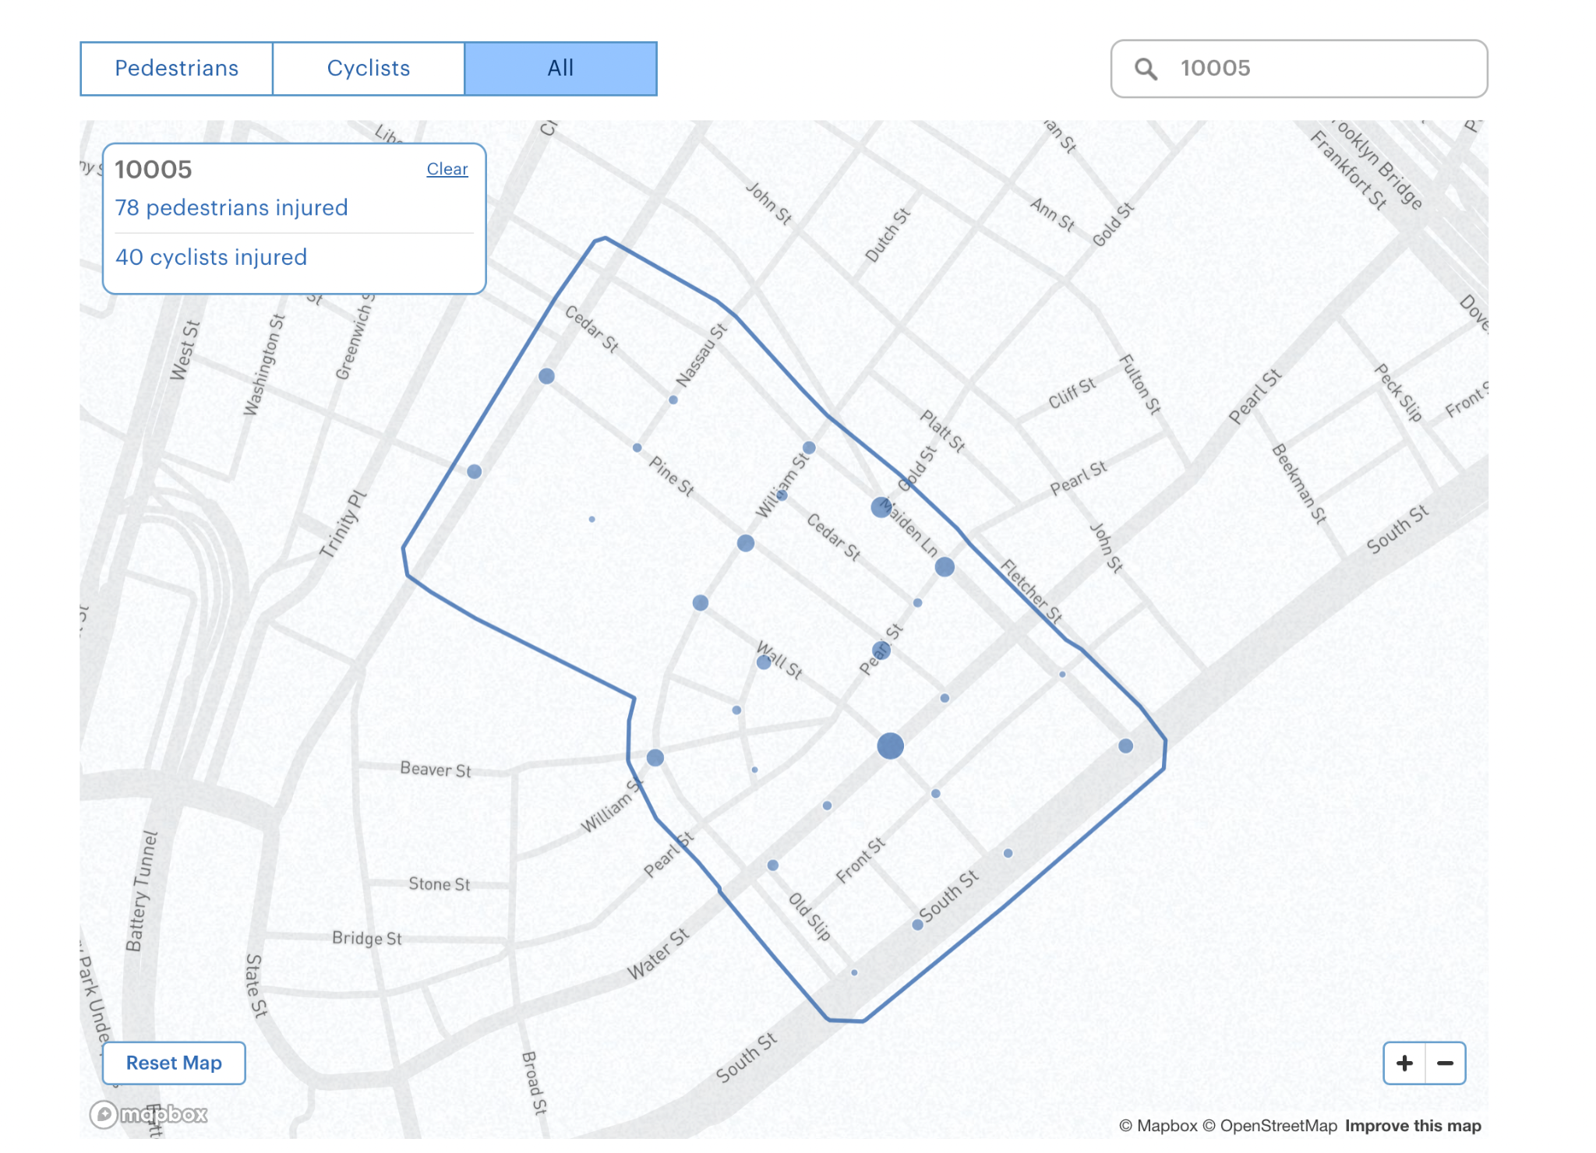
Pedestrian Safety
DID YOU KNOW: Use the map linked above to see how many pedestrians have been injured in New York City from 2013-2021.
Notes:
Teacher notes:
Access the website from the pdf linked on the previous slide to use an interactive map of New York located here.

Slide 33
Pedestrian Safety
“Every trip begins and ends with walking, and therefore everyone is a pedestrian on a city’s street at some point. Providing continuous and unobstructed clear paths ensures walkable neighborhoods for everyone. Each sidewalk’s clear path should be complemented with active street edges and accessible facilities to make the journey comfortable and engaging. Cities are places for people, and they use streets for not only walking, but also resting, sitting, playing, and waiting. This requires making people the highest priority in street design, with careful consideration for the most vulnerable users: the young, the elderly” (Global Street Design).
Notes:
Teacher notes:
Share the quote on this slides and talk about the different types of pedestrians. Source

Slide 34
Pedestrian Safety
Notes:
Teacher notes:
Share this information about the image on this slide:
Sidewalks play a vital role in city life. As a conduit for pedestrian movement and access, they enhance connectivity and promote walking. As public spaces, sidewalks serve as the front steps to the city, activating streets socially and economically. Safe, accessible, and well-maintained sidewalks are a fundamental and necessary investment for cities, and have been shown to enhance general public health and maximize social capital.
Just as roadway expansions and improvements have historically enhanced travel for motorists, superior sidewalk design can encourage walking by making it more attractive. Curb cuts for vehicle access should be limited in areas with high pedestrian volumes, and when unavoidable, they must maintain accessible levels, slopes, and clear path minimums.
The images & information on this slide are Global Street Design - located here.

Slide 35
Pedestrian Safety
Notes:
Teacher notes:
The images on this slide are Global Street Design - located here.

Slide 36
Pedestrian Safety
Notes:
Teacher notes:
The images on this slide are Global Street Design - located here.

Slide 37
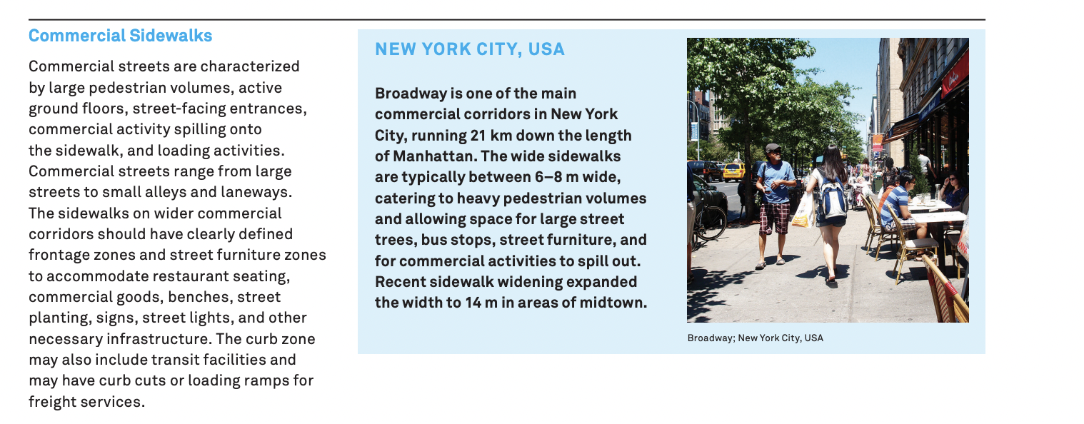
Pedestrian Safety
Notes:
Teacher notes:
The images on this slide are Global Street Design - located here.

Slide 38
Pedestrian Safety
Notes:
Teacher notes:
The images on this slide are Global Street Design - located here.

Slide 39
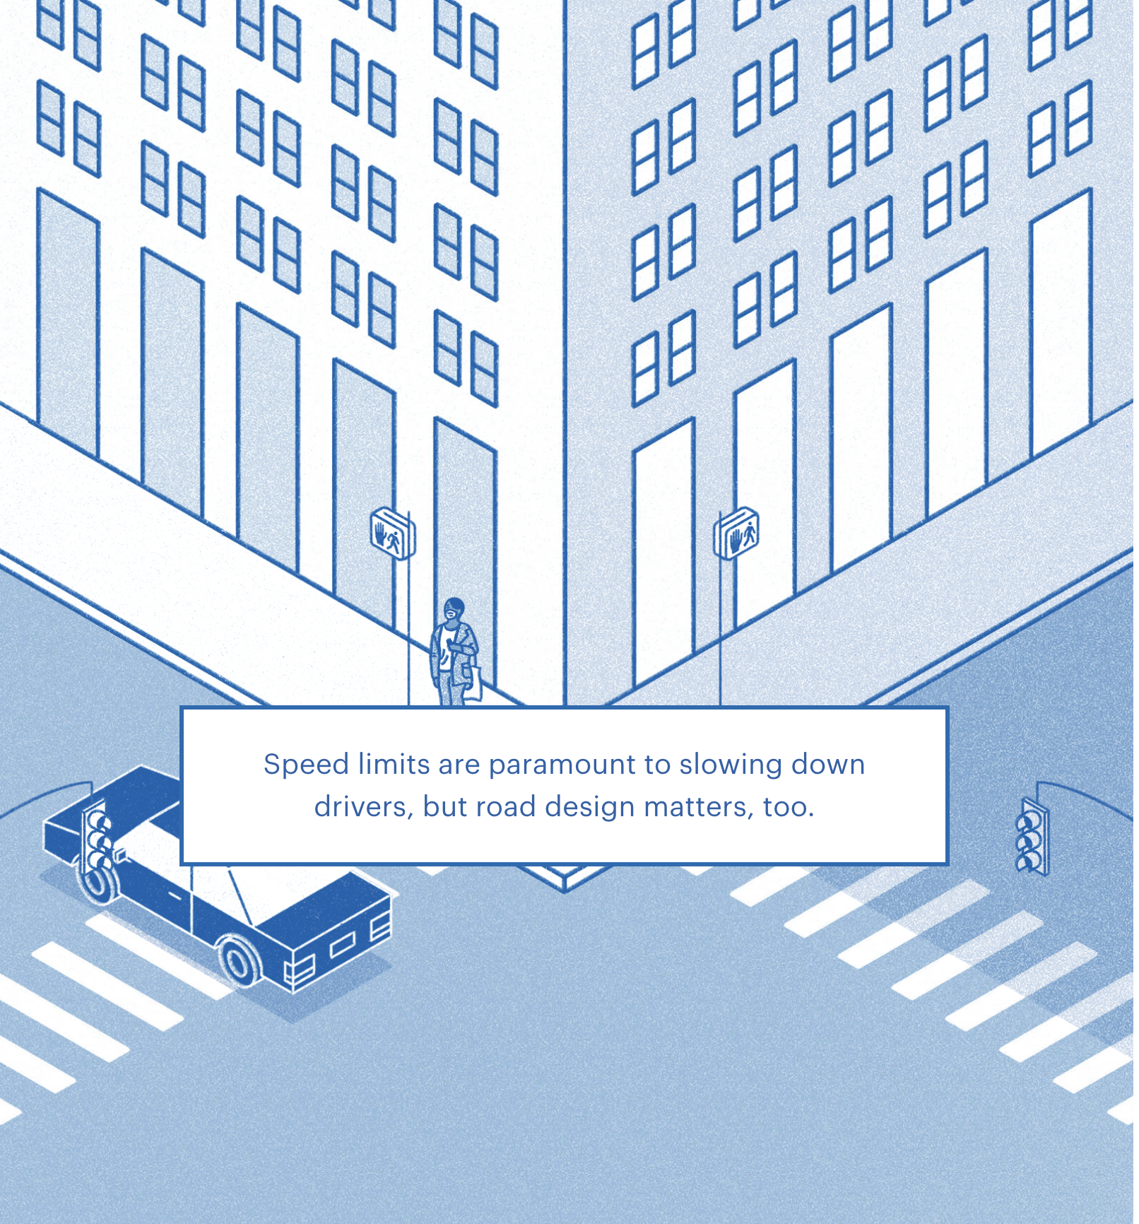
Pedestrian Safety
Notes:
Teacher notes:
The images on this slide are taken from the interactive section of the website article - located here.

Slide 40
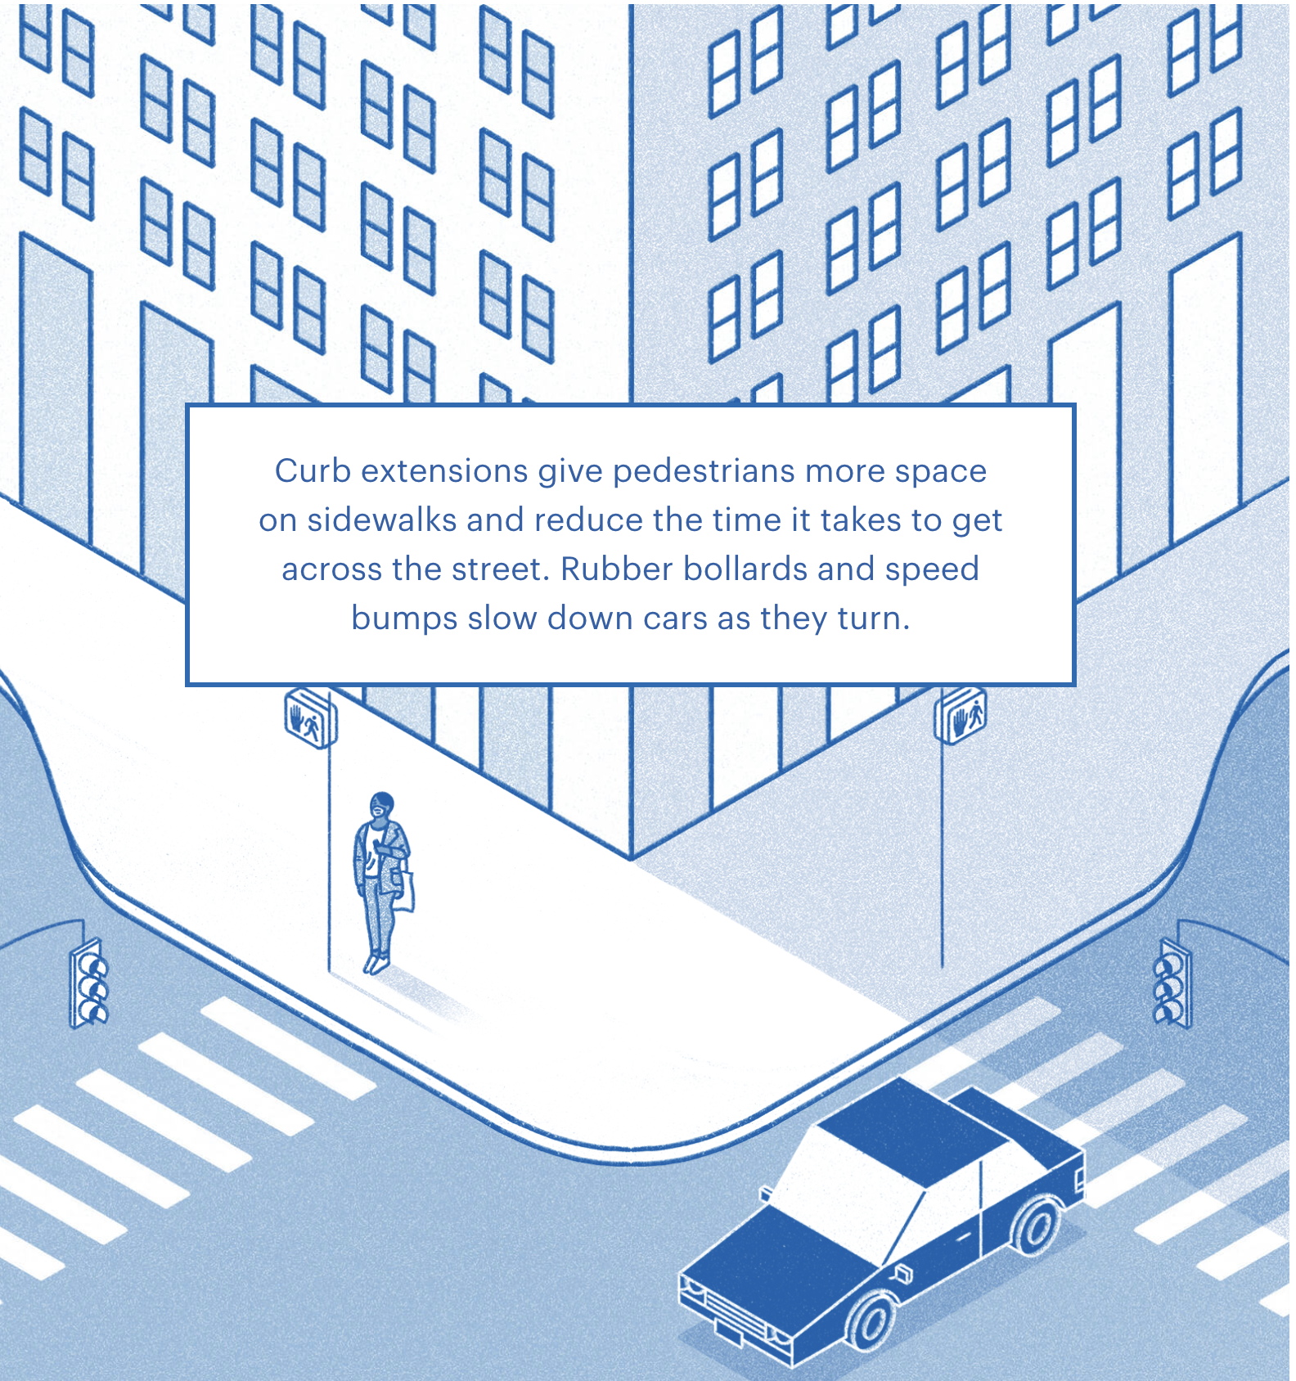
Pedestrian Safety
Notes:
Teacher notes:
The images on this slide are taken from the interactive section of the website article - located here.

Slide 41
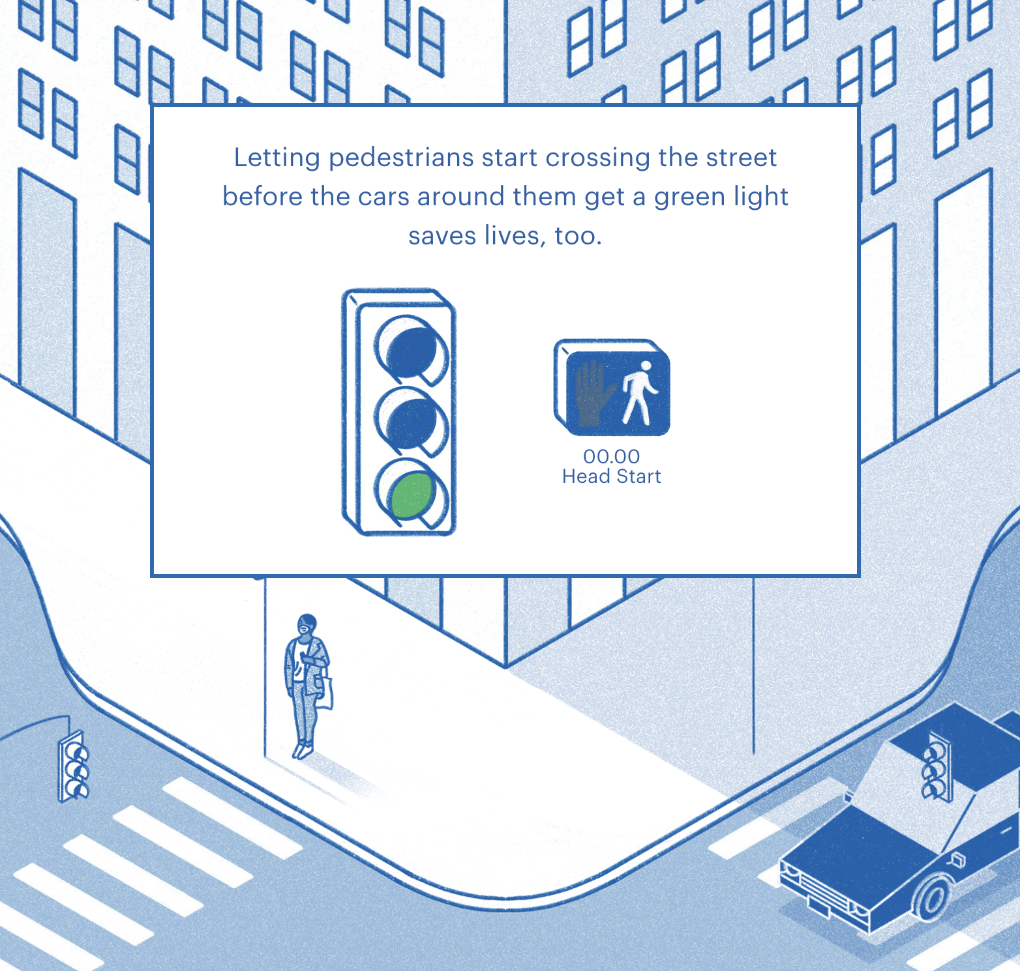
Pedestrian Safety
Notes:
Teacher notes:
The images on this slide are taken from the interactive section of the website article - located here.

Slide 42
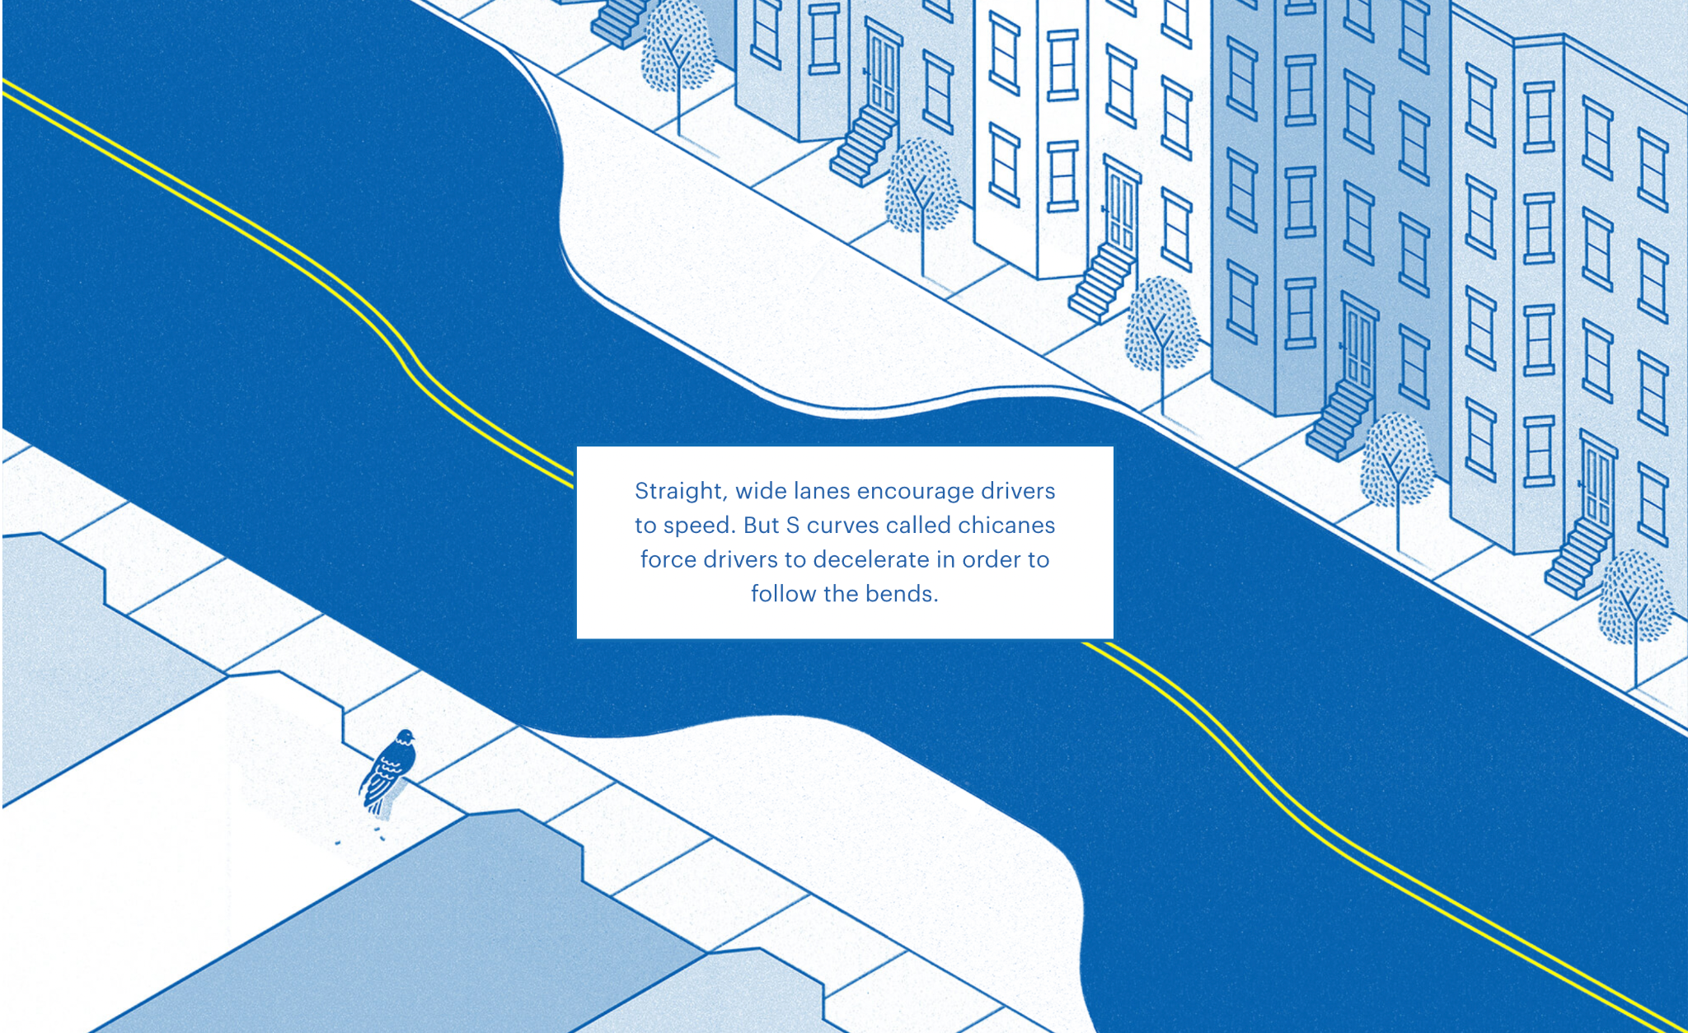
Pedestrian Safety
Notes:
Teacher notes:
The images on this slide are taken from the interactive section of the website article - located here.

Slide 43
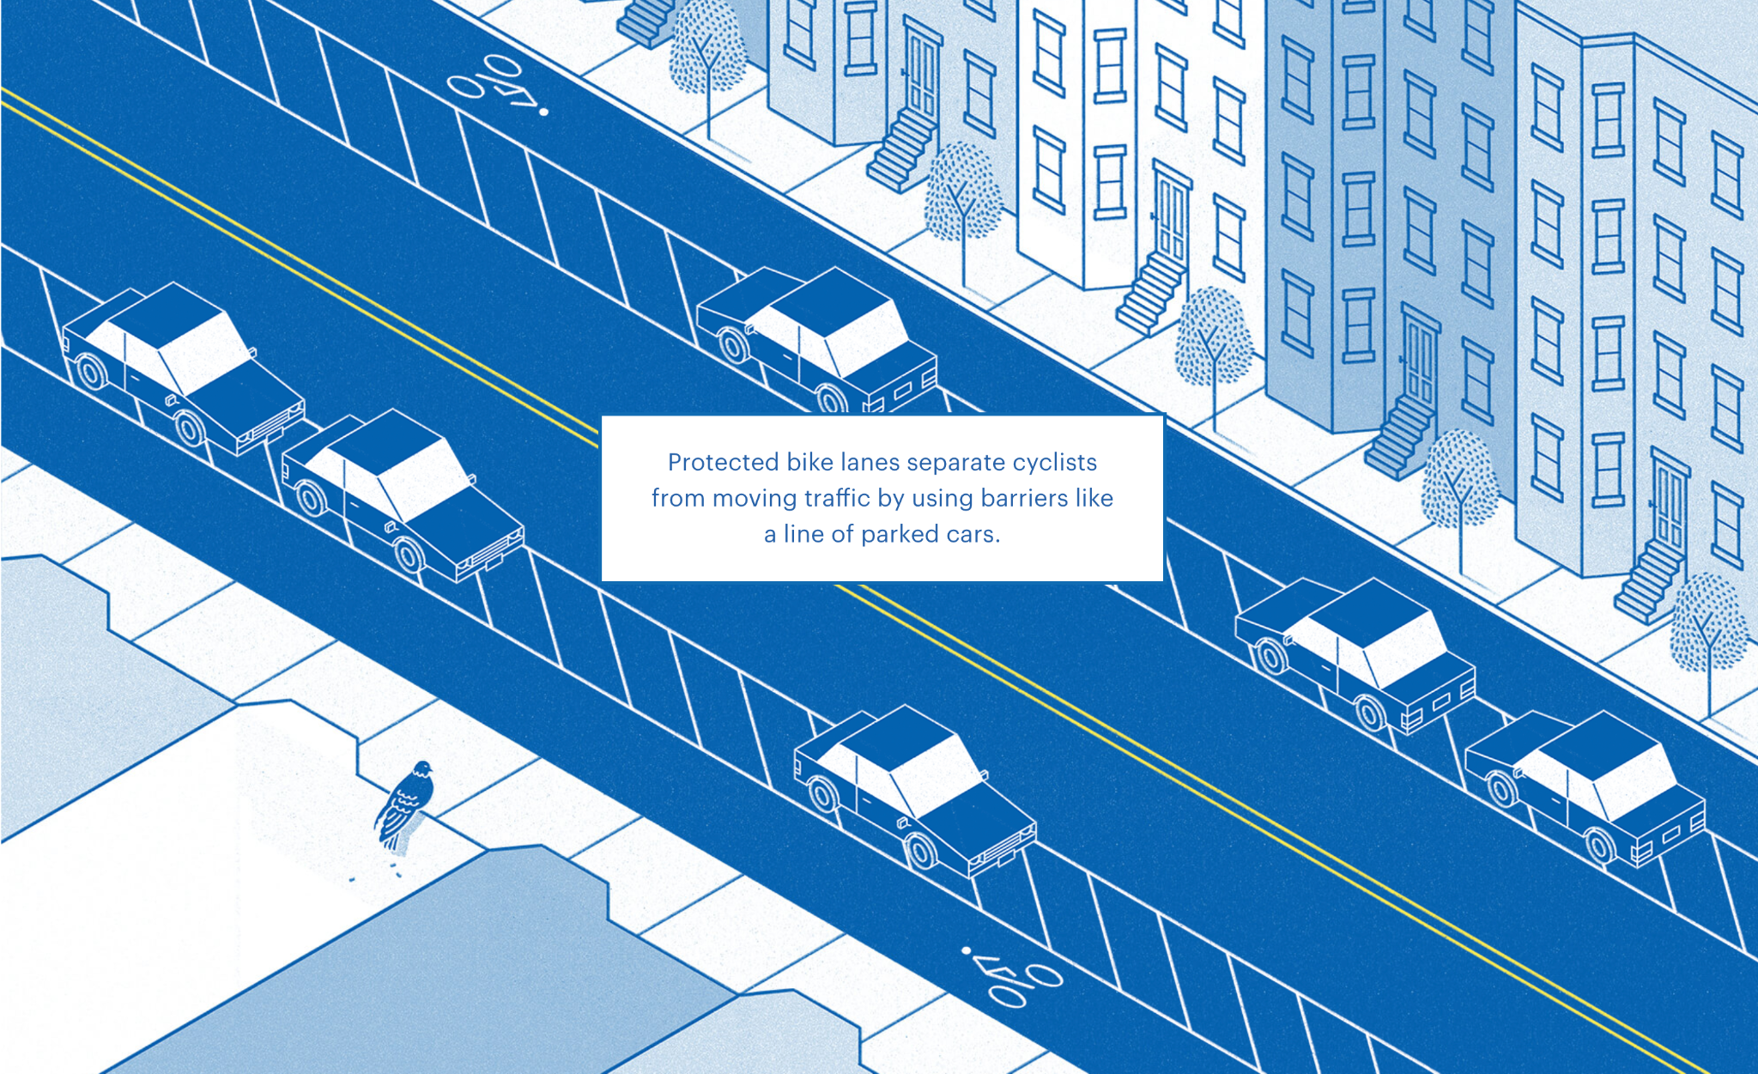
Pedestrian Safety
Notes:
Teacher notes:
The images on this slide are taken from the interactive section of the website article - located here.

Slide 44
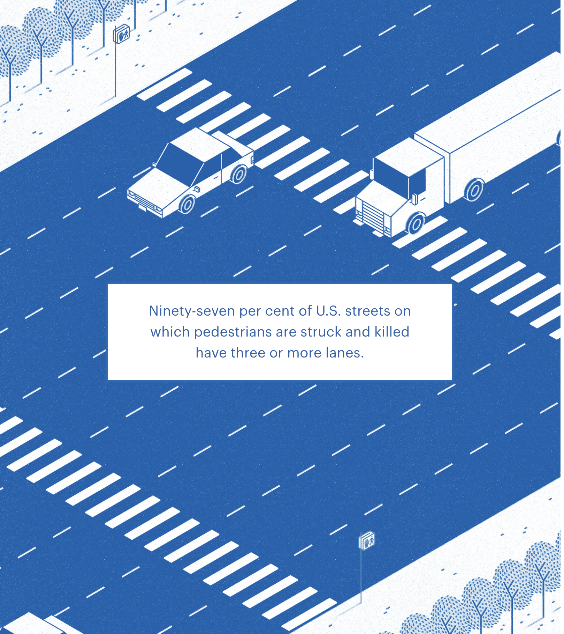
Pedestrian Safety
Notes:
Teacher notes:
The images on this slide are taken from the interactive section of the website article - located here.

Slide 45
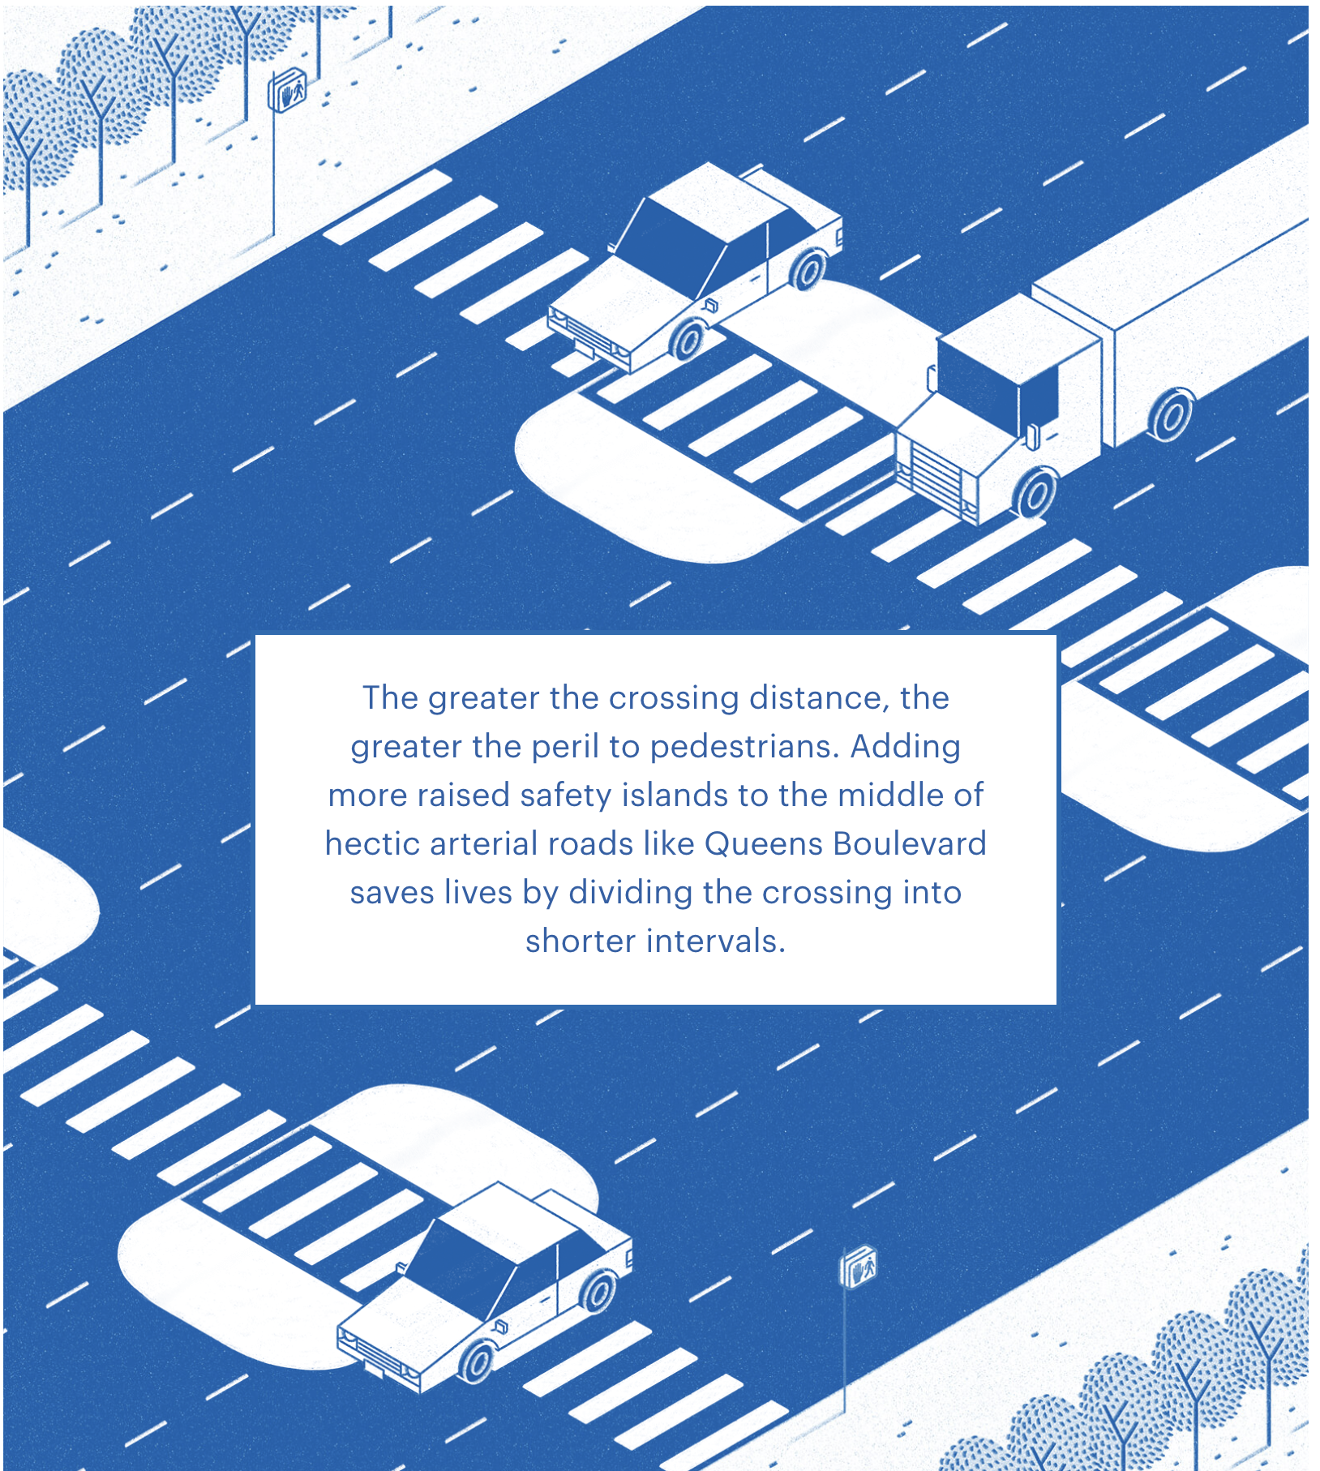
Pedestrian Safety
Notes:
Teacher notes:
The images on this slide are taken from the interactive section of the website article - located here.

Slide 46
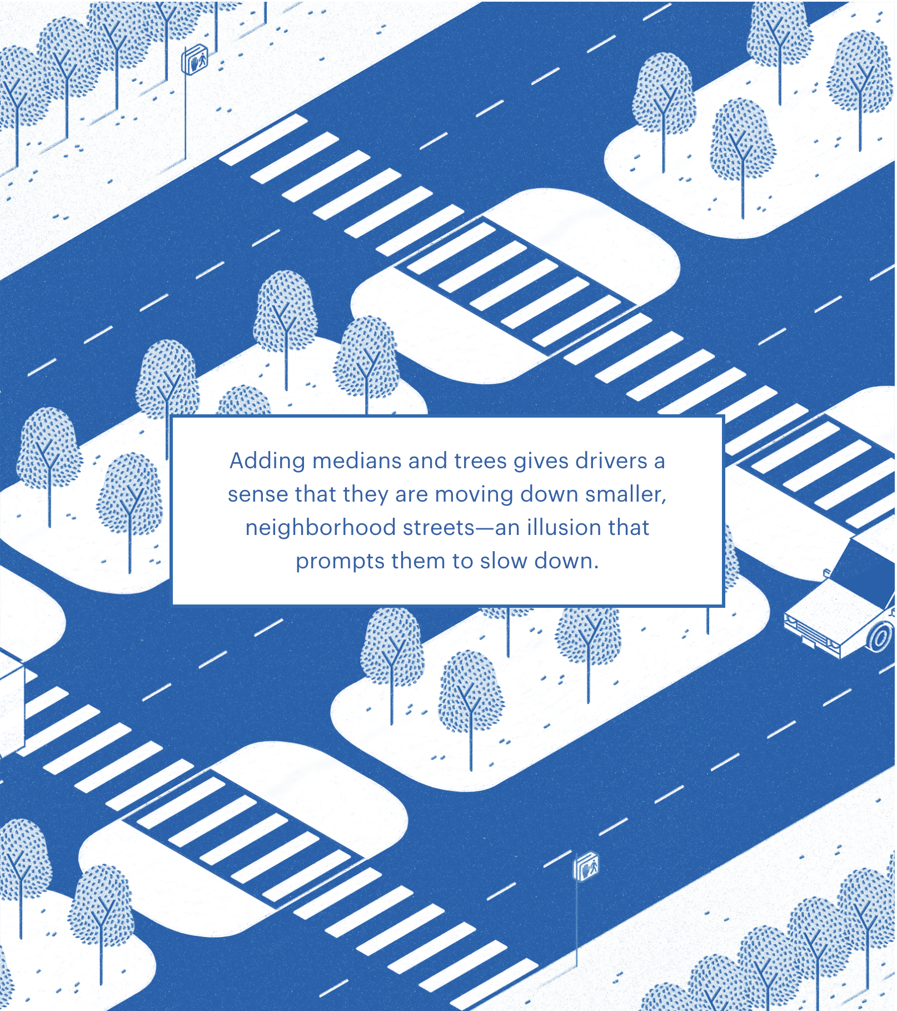
Pedestrian Safety
Notes:
Teacher notes:
The images on this slide are taken from the interactive section of the website article - located here.

Slide 47
Pedestrian Safety
Access more information about pedestrian safety at the websites below.
Families for Safe Streets
National Safety Council
National Highway Safety Traffic Administration
Global Street Design Guide
Notes:
Teacher notes:
OPTIONAL: Access more information at the websites listed on this slide.

Slide 48
ACTIVITY
How Might We...
A How Might We statement turns your problem into an opportunity for design!
Notes:
Teacher notes:

Slide 49
ACTIVITY
Example How Might We (HMW) Statements
HMW
reduce traffic speed for children in order to help them walk to school safely.
HMW
create an accessible path for Martha in order to meet the needs of her disability .
Notes:
Teacher notes:
Show students the example how might we statements

Slide 50
ACTIVITY
How Might We statements
Take Action
Use strong verbs to take action with your problem.
Examples
No Action
How Might We create a way for Jack to walk to school & work.
Action Packed
How Might We remodel Jack’s community to make room for a safe pedestrian route.
ACTION WORDS: Control, Display, Produce, Test, Navigate, Identify, Remodel, Upgrade
Notes:
Teacher notes:

Slide 51
ACTIVITY
How Might We…?
Here’s the framework to develop your How Might We statement.
How might we __________________
________________ for ___________
in order to ____________________ ?
(Action)
(What)
(Client)
(What changes?)
EXAMPLE: How Might We remodel the community for Jack in order to create a safe pedestrian route.
Notes:
Teacher notes:
Show students this madlib approach to drafting a HMW statement
Use the How Might We handout for students to create their own how might we statement for the challenge

Slide 52
ACTIVITY
THINK - PAIR - SHARE
THINK: think about your own how might we statement.
PAIR: Rotate through groups (as shown) discussing your how might we statement and make any changes needed
SHARE: share what you learned with the class
(1) COUNT AWAY
(2) ODDS VERSUS EVENS
1
2
3
4
(3) NUMBERS UNITES
EXAMPLES
Notes:
Teacher notes:
assign a number to students 1, 2, 3, and 4.
Students will rotate through the groups sharing what they learned about motion in the following order:
Count Away (each group has a 1, 2, 3, and 4 represented)
Odds versus Evens: odds & evens together (one group has two 1s and two 3s, another group has two 2s and two 4s, etc)
Numbers Unite: All same numbers together (all 1s, all 2s, all 3s, all 4s)
Students can spend any length of time in each group. The teacher should rotate through the groups to ensure students are on topic. If you do not have enough students for four groups, you can split students into any number of groups that works best. The goal is to have students discussing what they found several times with different students.

Slide 53
EXIT TICKET
Don’t forget to complete your daily learning log!!
What’s happening in this challenge? Complete the Observations section of the Innovators Compass handout!
Notes:
Teacher notes:
discuss as a class and/or have students keep a learning journal throughout this initiative
Ask students: what is happening in this challenge? What are the key issues of this challenge?
Hae students complete this section of the Innovators Compass handout
Remind students to complete Daily Learning Log.

Slide 54
Day 3
Principles

Slide 55
OBJECTIVE
Students will be able to
Discuss what matters most in the challenge
Apply the steps of the design process
Participate in a design sprint and goal jam to find appropriate solutions
Notes:
Teacher notes:
Review the objectives for the day, so students know what is expected of their learning

Slide 56
AGENDA
Introduction of the activity
Activity: Crazy 8s
Activity: Goal Jam
Exit Ticket
Notes:
Teacher notes:
Review the agenda for the day

Slide 57
ESSENTIAL QUESTION
What matters most in the challenge?
Notes:
Teacher notes:
discuss as a class and/or have students keep a learning journal throughout this initiative
This question acts as an overarching goal for this lesson.

Slide 58
Lesson
Design Sprint: Crazy 8’s
Crazy 8’s is a fast sketching exercise that asks you to sketch eight distinct ideas in eight minutes.
The goal is to push beyond your first idea, which is frequently the least innovative, and to generate a wide variety of solutions.
Notes:
Teacher notes:
Introduce the activity for this lesson: Crazy 8 design sprint
Pass out a piece of paper that students can divide into 8 sections

Slide 59
Lesson
Design Sprint: Crazy 8’s
STEP ONE
STEP TWO
STEP THREE
Divide your paper into 8 sections. Grab a pencil or pen to sketch, draw, and write potential solutions.
You will have one minute for each of the eight boxes to design a solution. Make sure to do a different solution for each block.
Complete all 8 squares over the next eight minutes.
Notes:
Teacher notes:
Before explaining the instructions to students, reinforce the concepts of show don’t tell and explain that they need to keep this in mind for the activity

Slide 60
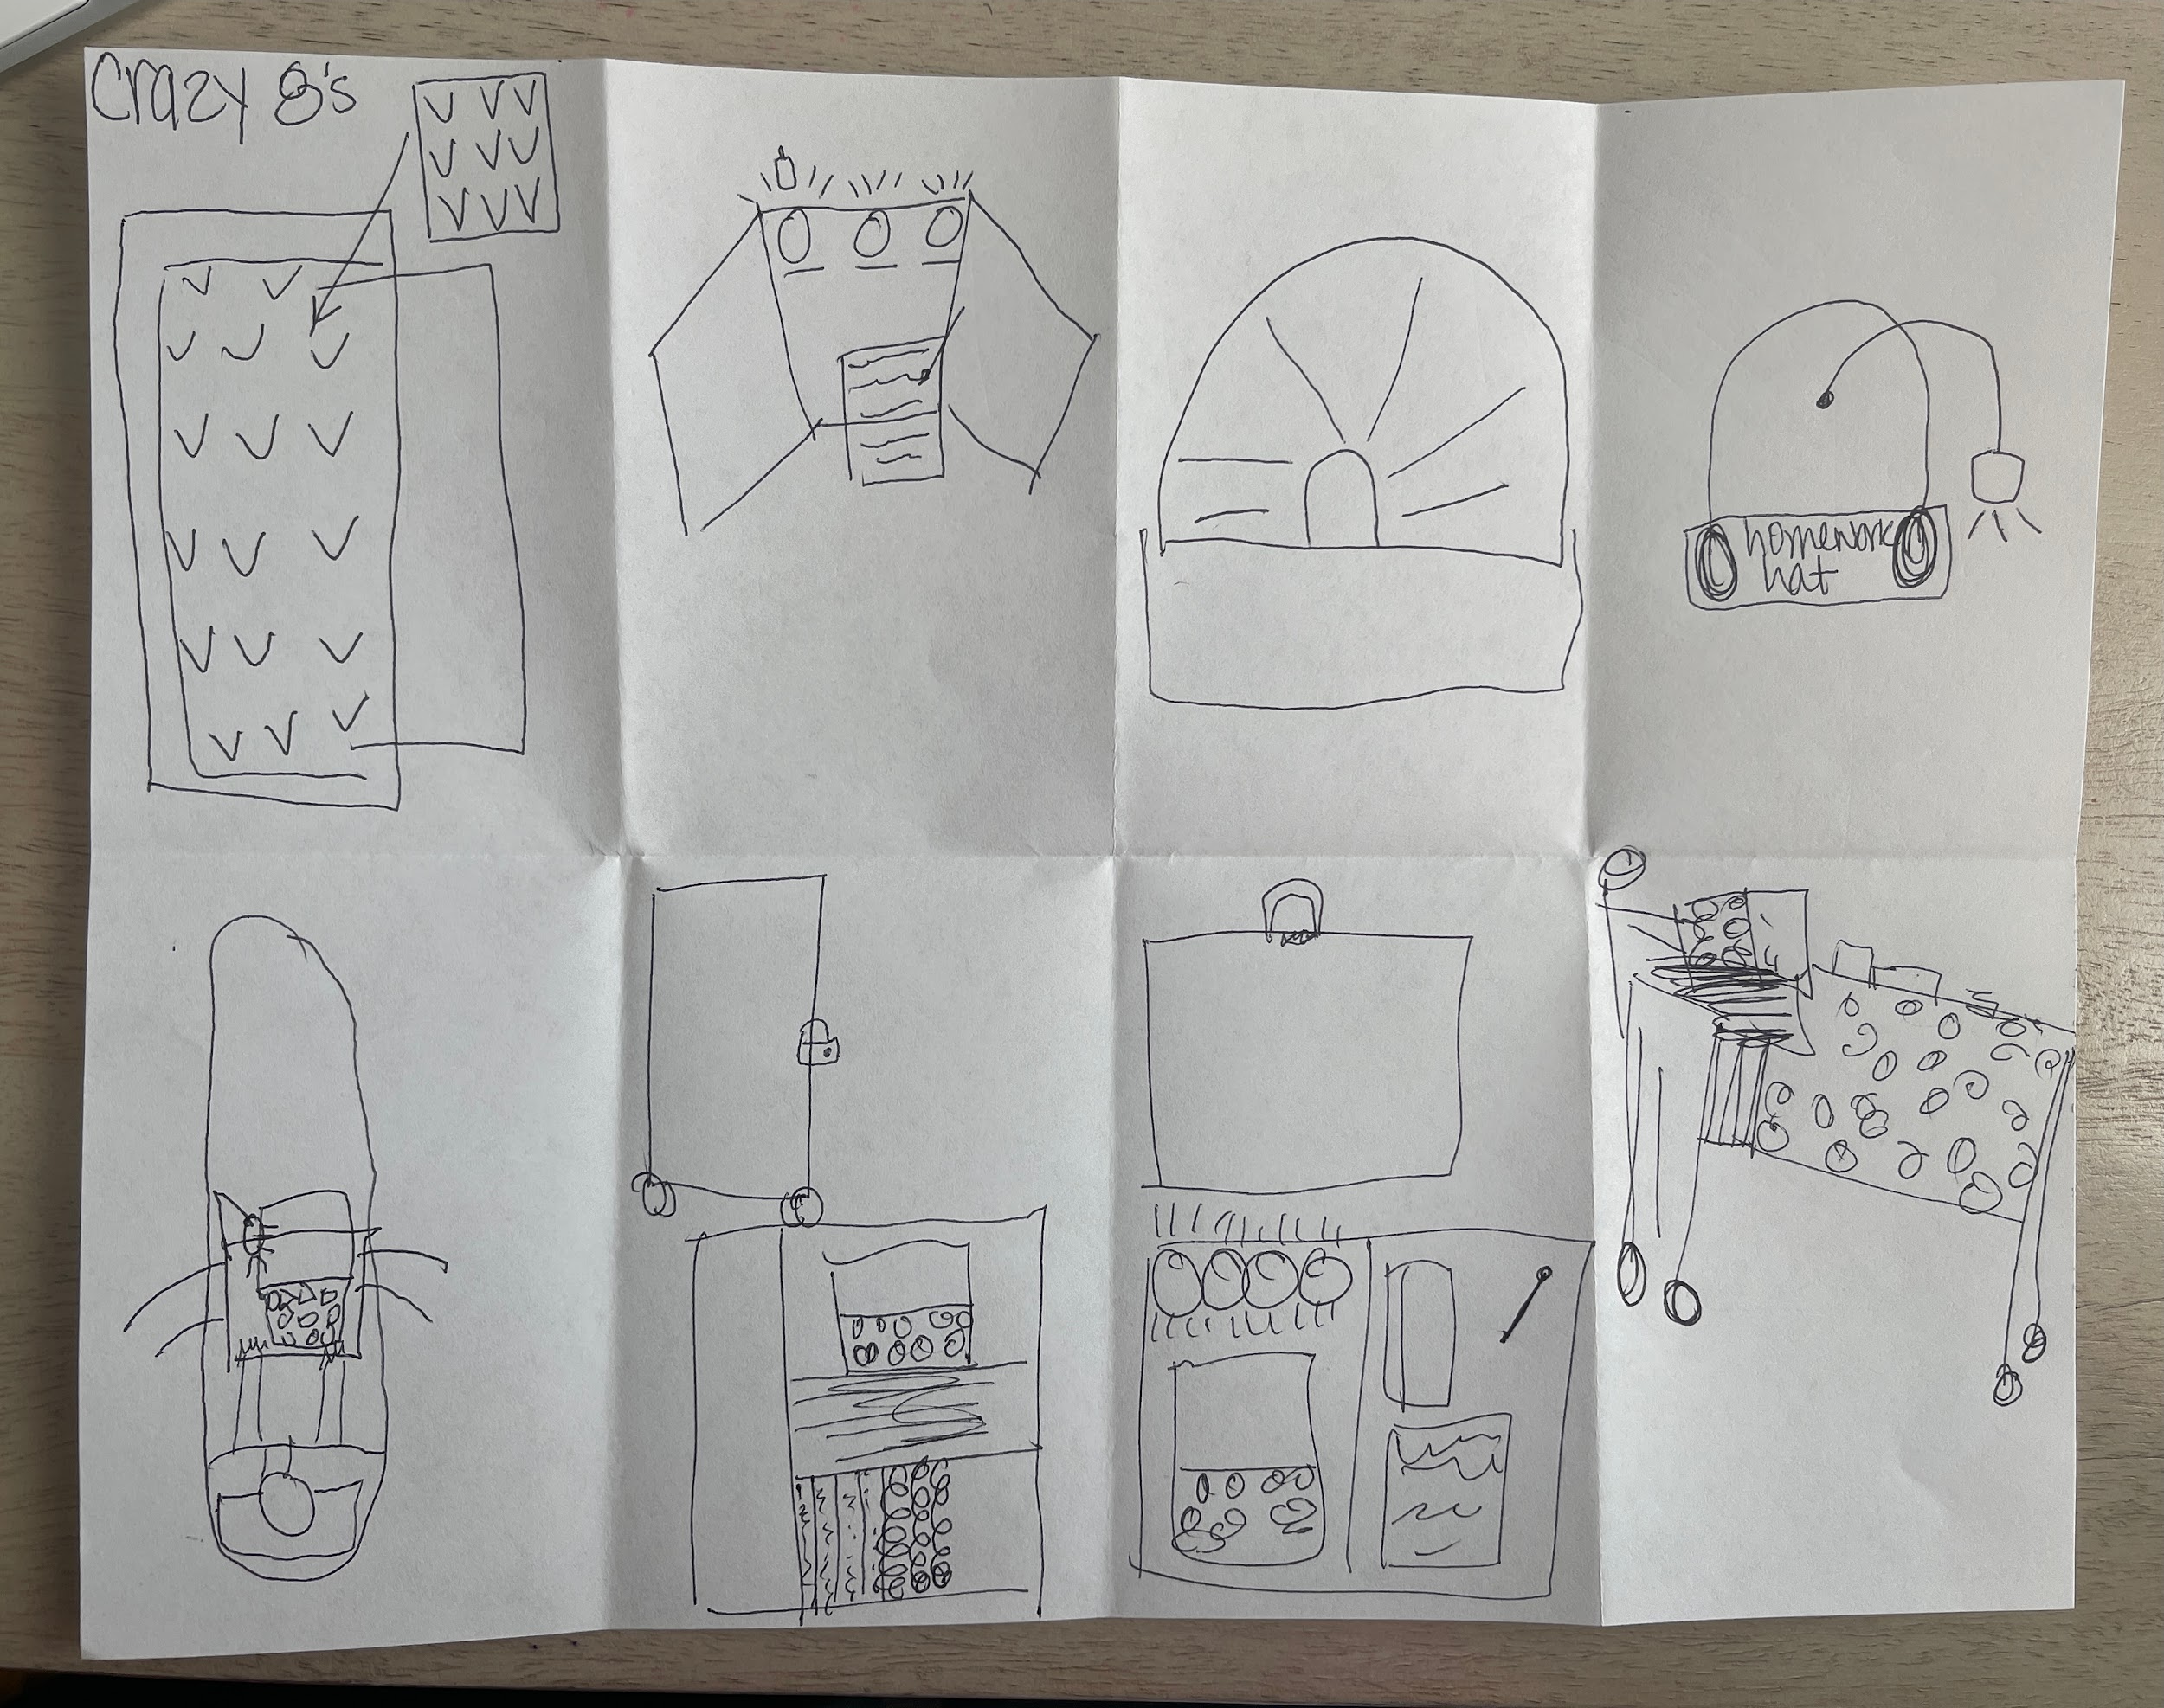
Lesson
Design Sprint: Crazy 8’s Example
Notes:
Teacher notes:

Slide 61
ACTIVITY
Goal Jam
Place each solution from your Crazy 8 exercise onto its own sticky note.
Follow the directions on the next few slides to select the solutions that are most appropriate for your challenge!
Notes:
Teacher notes:
Give students post-it sticky notes to complete the Goal Jam activity
Have students place each crazy 8 solution on it’s own sticky note

Slide 62
ACTIVITY - Goal Jam
More possible
Less possible
Notes:
Teacher notes:
Have students line the sticky notes in a horizontal line based on how possible the solution is
Note: this is a personal preference so there is right or wrong order for the sticky notes

Slide 63
ACTIVITY - Goal Jam
More people affected
Less people affected
More possible
Less possible
Notes:
Teacher notes:
Have students keep the sticky notes in the horizontal line but move them vertically based on how many people are affected by the solution

Slide 64
ACTIVITY - Goal Jam
More people affected
Less people affected
More possible
Less possible
Notes:
Teacher notes:
Have students put a star on the sticky notes they particularly like or think will work best

Slide 65
ACTIVITY - Goal Jam
Focus here to start
More people affected
Less people affected
More possible
Less possible
Notes:
Teacher notes:
This process should have created a focus place for students to begin. The upper left quadrant will be solutions that students likes, will be more possible, and affect the most people.

Slide 66
EXIT TICKET
Don’t forget to complete your daily learning log!!
What matters most in this challenge? Complete the Principles section of the Innovators Compass handout!
Notes:
Teacher notes:
discuss as a class and/or have students keep a learning journal throughout this initiative
Ask students: what matters most in this challenge? What are the most important factors of this challenge?
Hae students complete this section of the Innovators Compass handout
Students can list their top solutions in the Principles section of their Innovator Compass handout
Remind students to complete Daily Learning Log.

Slide 67
Day 4
Ideas

Slide 68
OBJECTIVE
Students will be able to
Discuss what ideas are there for the challenge
Apply the steps of the design process
Design a solution for the challenge
Prototype the solution
Notes:
Teacher notes:
Review the objectives for the day, so students know what is expected of their learning

Slide 69
AGENDA
Introduction of Prototypes
Activity: Design a solution to the challenge
Exit Ticket
Notes:
Teacher notes:
Review the agenda for the day

Slide 70
ESSENTIAL QUESTION
What ways are there to solve the challenge?
Notes:
Teacher notes:
discuss as a class and/or have students keep a learning journal throughout this initiative
This question acts as an overarching goal for this lesson.

Slide 71
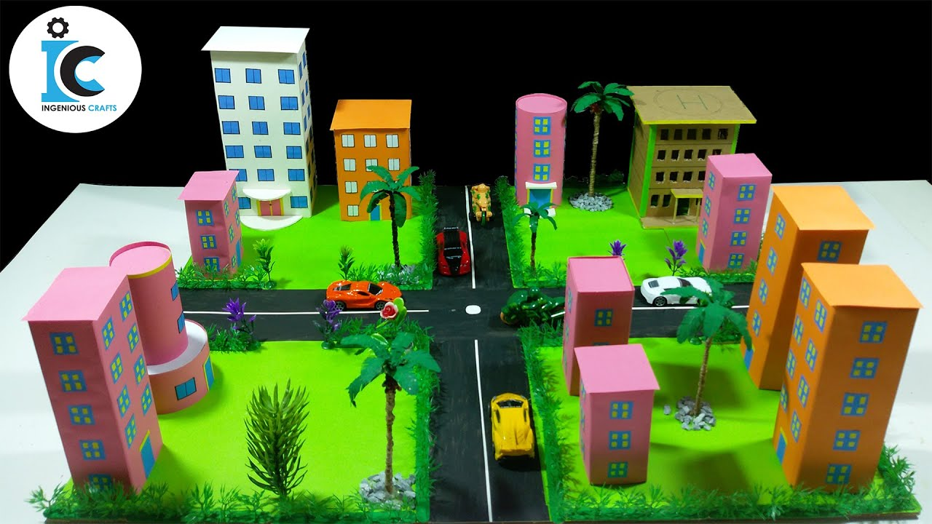
Lesson
What is a Prototype?
The prototype Early-stage conceptualizing, cost effective, and easy to build.
Fail fast, Fail frequently, Fail forward The prototyping mantra.
Iterate A good prototype is measured by all the different drafts!
Notes:
Teacher notes:
Take a moment to review the prototype step in the design thinking process
Image source

Slide 72
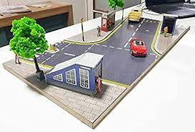
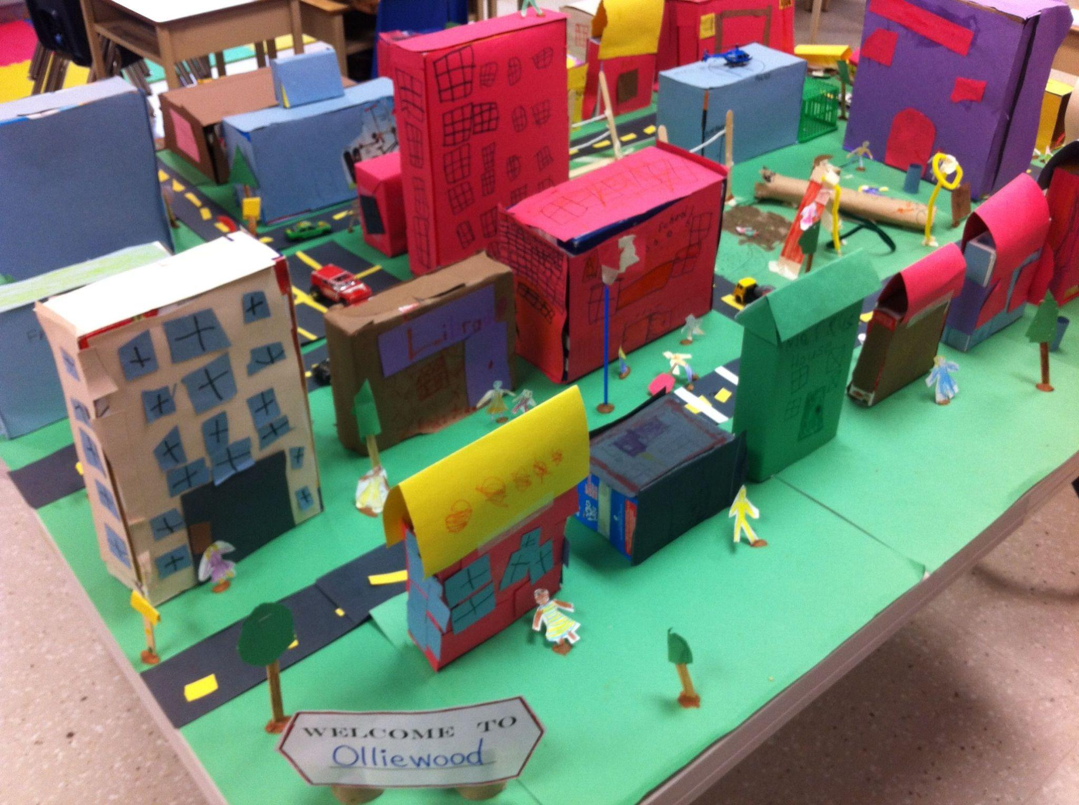
Lesson
The Power of Prototyping
“If a picture is worth a thousand words, then a prototype is worth a thousand meetings.”
Notes:
Teacher notes:
Ask students to consider the importance of prototyping
By practicing to build designs, you can learn a lot more than simply talking about a design!
Image source
Image source

Slide 73
Lesson
Why is
failing forward
an important part of prototyping?
F. A. I. L.
First. Attempt. In. Learning.
Notes:
Teacher notes:
Facilitate a brief discussion about why failing is important in prototyping
By failing you learn what doesn’t work so that the end product is something that WILL work and is the best product possible

Slide 74
ACTIVITY
Time to Prototype!
Spend time now designing your prototype.
You can design it on paper or begin with your cardboard. Remember, to keep people at the center of your solution and use your compass to reiterate the most important areas of your solution!
Notes:
Teacher notes:
Allow students ample time to build prototypes of their designs using cardboard. This can be done over the course of several days!
Students can use the toolkit provided by the Global Street Design to add to their prototype (click here to access the pdf).

Slide 75
ACTIVITY
Prototype a solution for the challenge
The challenge is pedestrian safety! Using your how might we statement, choose one of your possible solutions and build it out of cardboard!
Notes:
Teacher notes:
Review the challenge on the slide. Students can create their own solutions or work in small groups up to three students to create a solution.

Slide 76
EXIT TICKET
Don’t forget to complete your daily learning log!!
What ways are there to solve this challenge? Complete the Ideas section of the Innovators Compass handout!
Notes:
Teacher notes:
discuss as a class and/or have students keep a learning journal throughout this initiative
Ask students: what ways are there in this challenge? What are a few ways we can solve this challenge? Challenges don’t have only one solution but many so highlight a few solutions you have created.
Hae students complete this section of the Innovators Compass handout
Remind students to complete Daily Learning Log.

Slide 77
Day 5
Experiments

Slide 78
OBJECTIVE
Students will be able to
Discuss what’s a step to try in solving the challenge
Apply the steps of the design process
Build a prototype solution for the challenge
Use feedback protocols to iterate their design
Notes:
Teacher notes:
Review the objectives for the day, so students know what is expected of their learning

Slide 79
AGENDA
Introduction of the Challenge
Activity: Build a solution out of cardboard
Activity: Feedback Gallery Walk
Exit Ticket
Notes:
Teacher notes:
Review the agenda for the day

Slide 80
ESSENTIAL QUESTION
What’s a step to try in solving the challenge?
Notes:
Teacher notes:
discuss as a class and/or have students keep a learning journal throughout this initiative
This question acts as an overarching goal for this lesson.

Slide 81
CHALLENGE
Build a solution for the challenge
The challenge is pedestrian safety! Using your how might we statement, choose one of your possible solutions and build it out of cardboard!
Notes:
Teacher notes:
Review the challenge on the slide. Students can create their own solutions or work in small groups up to three students to create a solution. The design process might take several days!

Slide 82
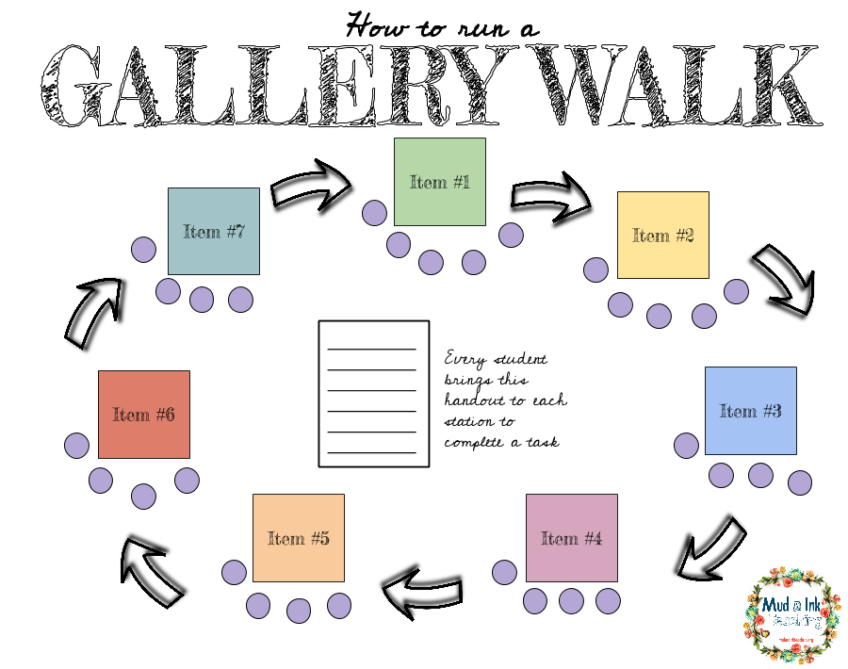
ACTIVITY
Gallery Walk
Setup your cardboard products and walk around to interact with them.
Notes:
Teacher notes:
Introduce the gallery walk activity to students
They will place their prototype on a display and other students will consider it during the gallery walk. Some prototypes will need to be picked up and looked at, so remind students to be careful with their classmates’ work!
You will review feedback protocol in the next slides
*Note: You can use jamboard or padlet to complete a virtual gallery walk.

Slide 83
ACTIVITY
Feedback Protocol
Use these sentence starters for your feedback!
I wish...
I wonder...
I like...
Notes:
Teacher notes:
Introduce the feedback protocol for the gallery walk.
Students will use three different sentence starters to give feedback. When you give feedback you will fill in the rest of the sentence.
Example: I like the way that you spaced out all the buttons in your prototype. I wish I could read what all the labels say. I wonder if you could combine some of those buttons to offer fewer options.
Have a piece of paper next to each prototype in the gallery walk so that students can write down their feedback for each prototype.

Slide 84
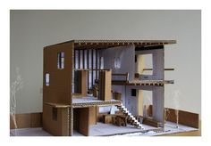
ACTIVITY
Feedback Example
I like the multiple levels you designed in your house.
I wish the ceilings connected in some parts of the house.
I wonder how the outside of the structure could be more unique.
Notes:
Teacher notes:
Show students the example for feedback

Slide 85
ACTIVITY
Gallery Walk
Time!
Notes:
Teacher notes:
Have students participate in the gallery walk!
Can you include other teachers and/or support staff, secure care, etc??

Slide 86
ACTIVITY
Make Changes
Are there any changes you need to make to your design based on the feedback you received??
Notes:
Teacher notes:
Show students the example for feedback

Slide 87
EXIT TICKET
Don’t forget to complete your daily learning log!!
What is a step to try in this challenge? Complete the Experiments section of the Innovators Compass handout!
Submit your design to the BreakFree contest!
Notes:
Teacher notes:
discuss as a class and/or have students keep a learning journal throughout this initiative
Ask students: what is a step to try in this challenge? Once we create a solution, what’s a step to try it out? Your step is to design a prototype of the solution out of cardboard! What might another step be?
Have students complete this section of the Innovators Compass handout
Submit the innovators compass handout & pictures of the completed design to BreakFree for the student contest, Access the submission guidelines here.
Remind students to complete Daily Learning Log.

Slide 88
UNCONSTRUCT

